Slide 1
Machine Learning
Department of CSE
Chaithanya Bharathi Institute Of Engineering Technology(A)
Gandipet Hyderabad 500075
Sources /References : Giuseppe Bonaccorso, Machine Learning Algorithms, 2017, Packt Publishing.

Slide 2
UNIT-III PART –I

Slide 3
Bayes Theorem
Let's consider two probabilistic events, A and B.

Slide 4
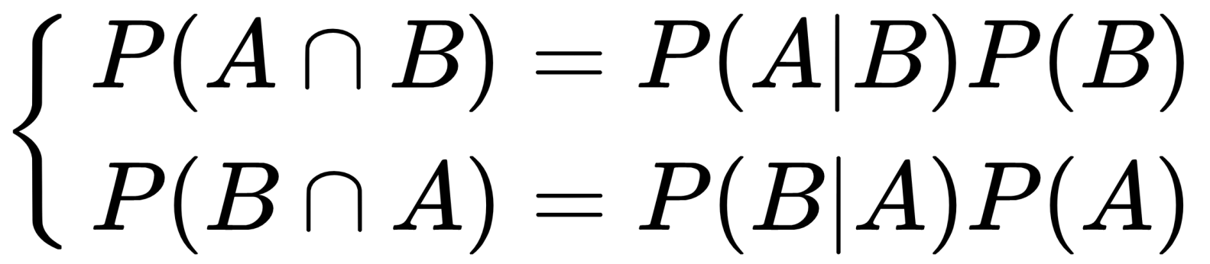
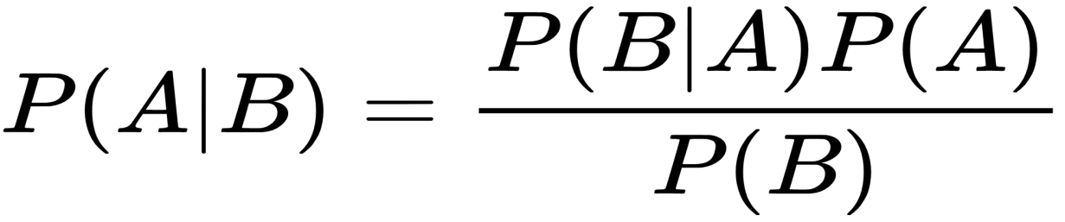
We can correlate the marginal probabilities P(A) and P(B) with the conditional probabilities P(A|B) and P(B|A), using the product rule:
Considering that the intersection is commutative, the first members are equal, so we can derive Bayes' theorem:

Slide 5
Consider the marginal probability, P(A) : It is a value that determines how probable a target event is, such as P(Spam) or P(Rain). As there are no other elements, this kind of probability is called Apriori, because it's often determined by mathematical or contextual considerations.
Example, imagine we want to implement a very simple spam filter and we've collected 100 emails. We know that 30 are spam and that 70 are regular. So, we can say that P(Spam) = 0.3.

Slide 6
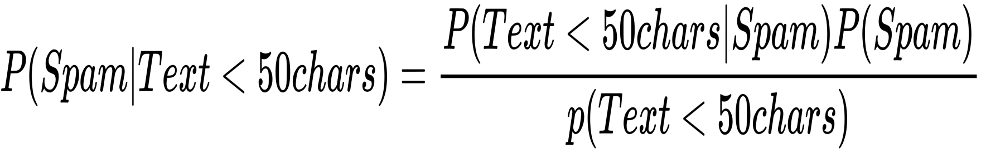
However, we'd like to evaluate using some criteria (for simplicity, let's consider a single one)—for example, email text is shorter than 50 characters. Therefore, our query becomes the following:
The first term is similar to P(Spam) because it's the probability of spam given a certain condition. For this reason, it's called A Posteriori (in other words, it's a probability that we can estimate after knowing some additional elements).

Slide 7
Another thing, we need to calculate the missing values, but it's simple.
Let's suppose that 35 emails have text shorter than 50 characters, so P(Text < 50 chars) = 0.35. Looking only into our spam folder, we discover that only 25 spam emails have short text, so that P(Text < 50 chars|Spam) = 25/30 = 0.83. The result is this:
A likelihood which is a weight between the Apriori probability and the A Posteriori one:

Slide 8
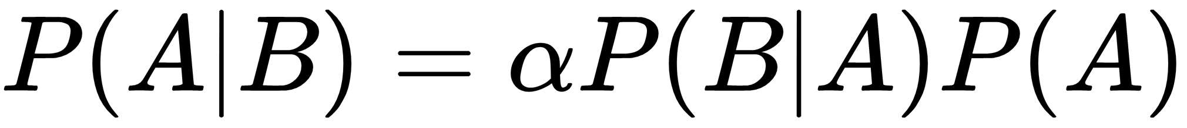
The normalization factor is often represented using the letter α, so the original formula becomes this:
The last step is considering the case when there are more concurrent conditions (this is more realistic in real-life problems):

Slide 9
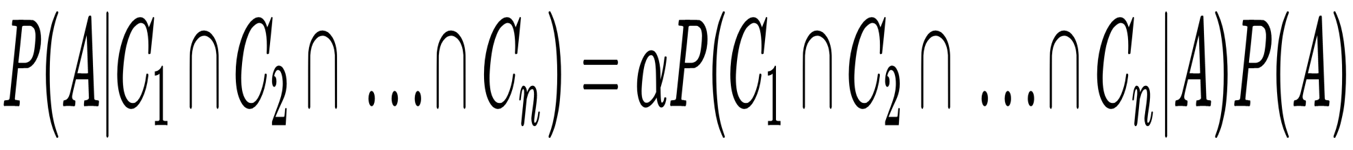
In general, this problem can become extremely complex when considering the joint prior probability. In fact, it's easy to consider the impact of single factors, but the problem can become intractable when it is expressed in the following way
Hence, a common assumption is to consider the causes independent of one another when they are involved in causing the same effect. Formally, this assumption is called conditional independence and it allows employing a simplified expression:

Slide 10
Obviously, it's easier to compute the singles P(C_{i} | A) and multiply them instead of considering the joint probability. For example, considering the spam-detection problem, we could imagine a joint probability in this form:
Even if the problem is very simple, we need to consider the intersection of all email messages whose text length is shorter than 50 characters and contains the word shop.
In more complex scenarios, determining this probability is difficult because of the cross-influences among factors.

Slide 11
Naive Bayes classifiers
A Naive Bayes classifier is so called because it's based on a naive condition, which implies the conditional independence of the causes.
This can seem very difficult to accept in many contexts where the probability of a particular feature is strictly correlated to another one.

Slide 12
Example, in spam filtering, a text shorter than 50 characters can increase the probability of the presence of an image, or if the domain has been already blacklisted for sending the same spam emails to million users, it's likely to find particular keywords.
In other words, the presence of a cause isn't normally independent from the presence of other ones.
However, in The Optimality of Naive Bayes, AAAI 1, no. 2 (2004): 3, Zhang H., the author proved that, under particular conditions (not so rare to happen), different dependencies clear one another, and a Naive Bayes classifier succeeds in achieving very high performances even if the conditional independence is not assured.

Slide 13
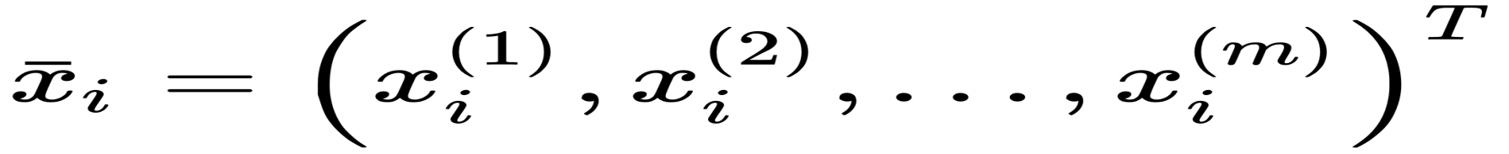
Let's consider a dataset:
Every feature vector, for simplicity, will be represented as follows:
We also need a target dataset (with P possible classes):

Slide 14
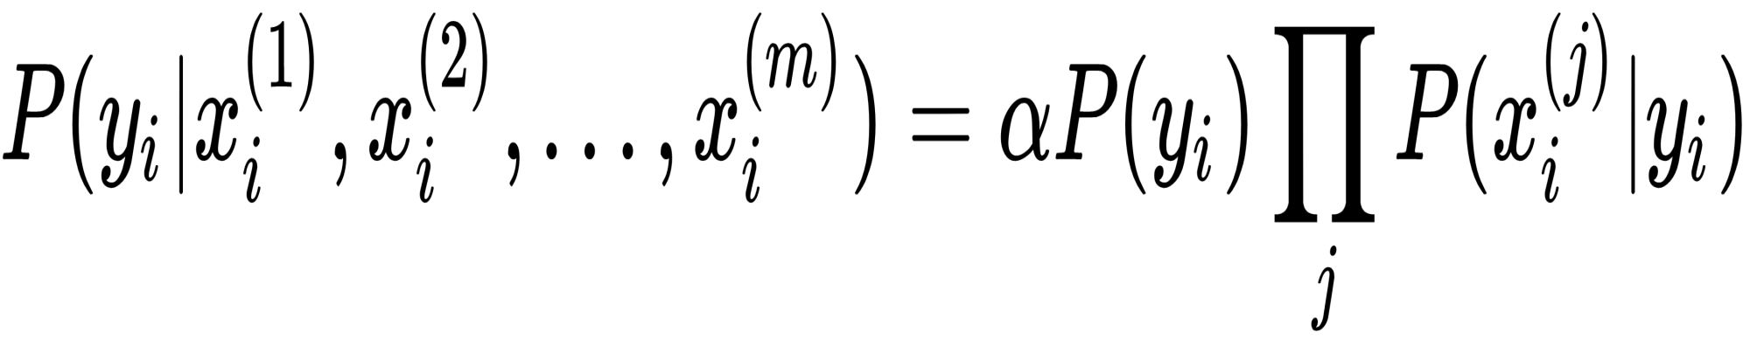
Here, each y can belong to one of the P-1 different classes. Considering Bayes' theorem under conditional independence, we can write the following:

Slide 15
The values of the marginal Apriori probability P(y_{i}) and of the conditional probabilities P(x_{i}^{(j)}|y_{i}) are generally obtained through a frequency count or a maximum likelihood estimation, therefore, given an input vector x, the predicted class is the one for which the A Posteriori probability is maximum.
However, in many implementations (including scikit-learn), it's also possible to specify a prior for each class P(y_{i}), so to focus the training on the optimization of the posterior distribution given the likelihood.

Slide 16
Naive Bayes in scikit-learn
Scikit-learn implements three Naive Bayes variants based on the same number of different probabilistic distributions: Bernoulli, Multinomial, and Gaussian.
The first one is a binary distribution, and is useful when a feature can be present or absent.

Slide 17
The second one is a discrete distribution and is used whenever a feature must be represented by a whole number (for example, in NLP, it can be the frequency of a term), while the third is a continuous distribution characterized by its mean and variance.

Slide 18
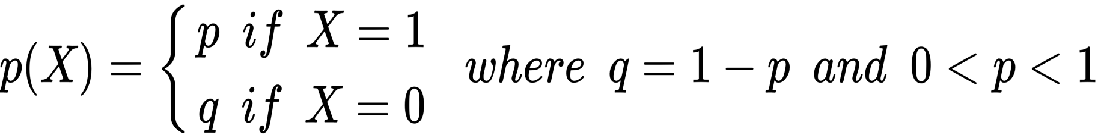
Bernoulli Naive Bayes
If X is a Bernoulli-distributed random variable, it can have only two possible outcomes (for simplicity, let's call them 0 and 1) and their probability is this:

Slide 19
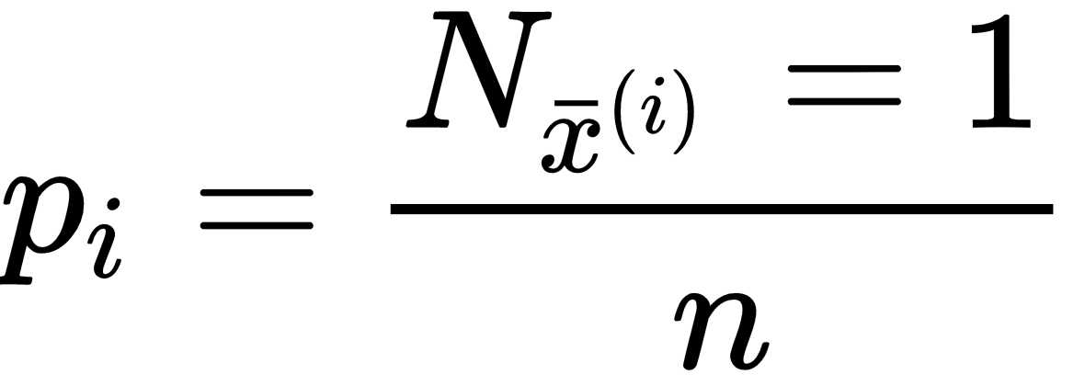
In general, the input vectors x_{i} are assumed to be multivariate Bernoulli distributed and each feature is binary and independent. The parameters of the model are learned according to a frequency count. Hence, if there are n samples with m features, the probability for the i^{th} feature is this (N_{x}^{(i)} counts the number of times the i^{th} = 1):

Slide 20
To test this algorithm with scikit-learn, we're going to generate a dummy dataset. Bernoulli Naive Bayes expects binary feature vectors; however, the BernoulliNB class has a binarize parameter, which allows us to specify a threshold that will be used internally to transform the features:

Slide 21
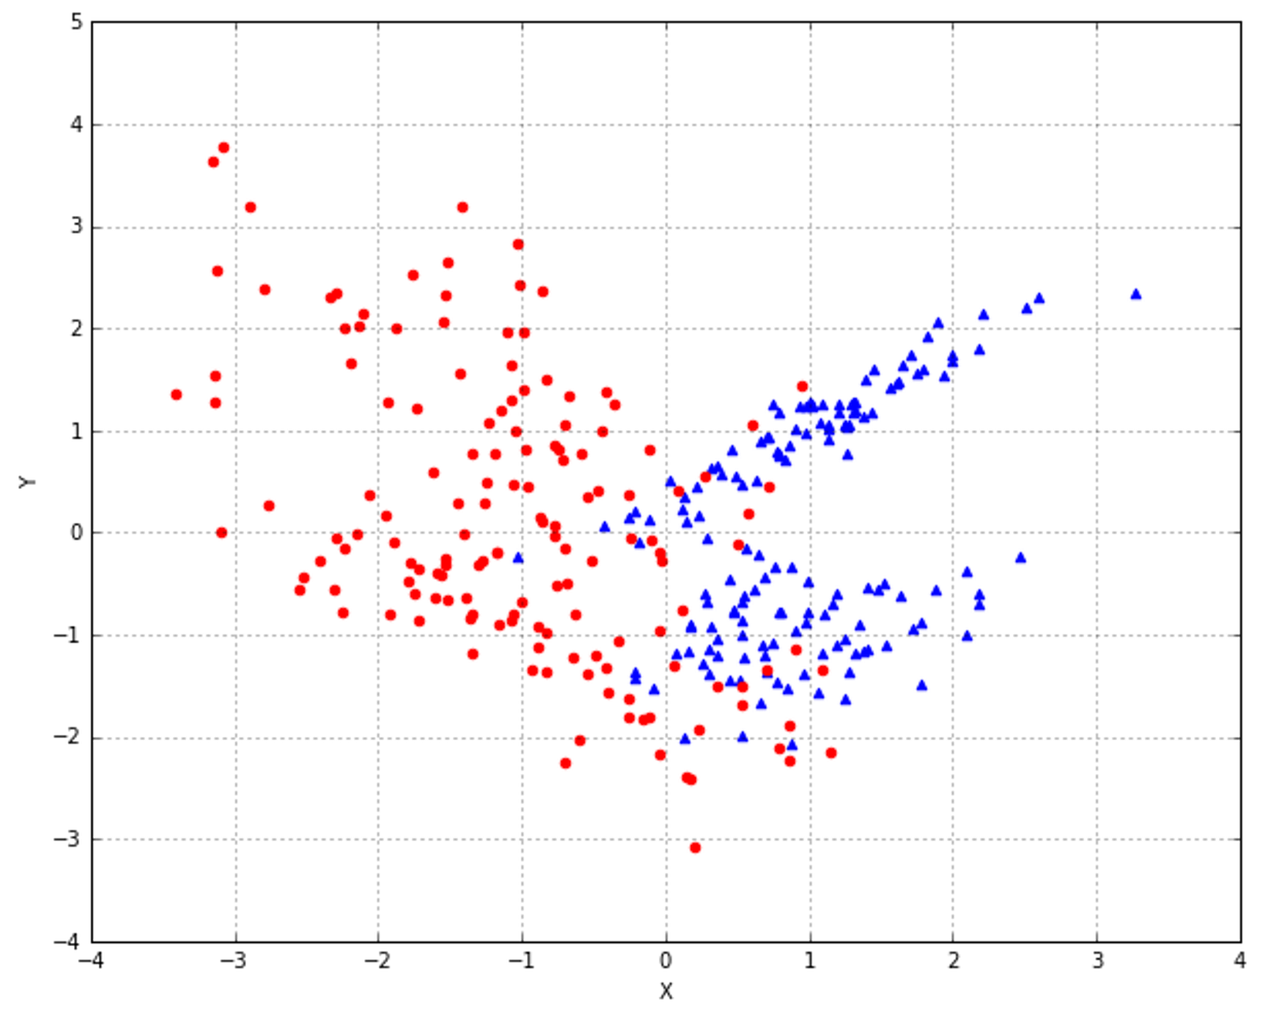

Slide 22
We have decided to use 0.0 as a binary threshold, so each point can be characterized by the quadrant where it's located. Of course, this is a rational choice for our dataset, but Bernoulli Naive Bayes is envisaged for binary feature vectors or continuous values, which can be precisely split with a predefined threshold:

Slide 23
from sklearn.naive_bayes import BernoulliNB from sklearn.model_selection import train_test_split X_train, X_test, Y_train, Y_test = train_test_split(X, Y, test_size=0.25) bnb = BernoulliNB(binarize=0.0) bnb.fit(X_train, Y_train)
print(bnb.score(X_test, Y_test)) 0.85333333333333339

Slide 24
The score is rather good, but if we want to understand how the binary classifier worked, it's useful to see how the data has been internally binarized:

Slide 25
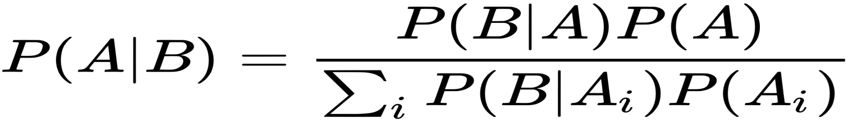
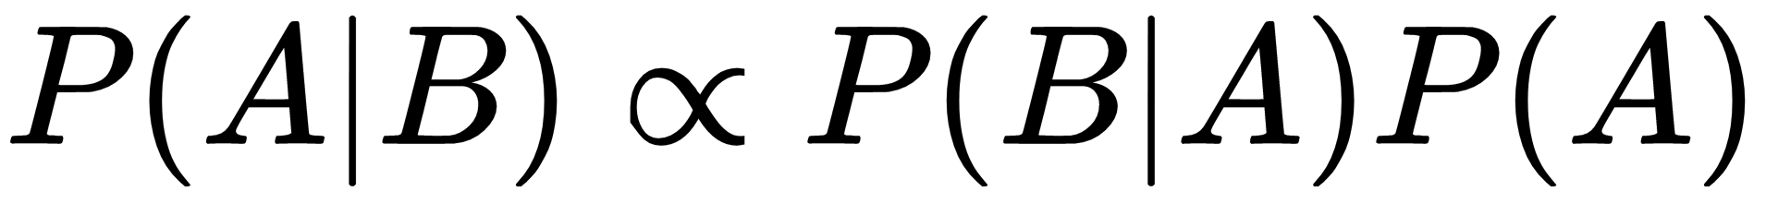
In the general discrete case, the formula can be re-expressed considering all possible outcomes for the random variable A:
As the denominator is a normalization factor, the formula is often expressed as a proportionality relationship

Slide 26
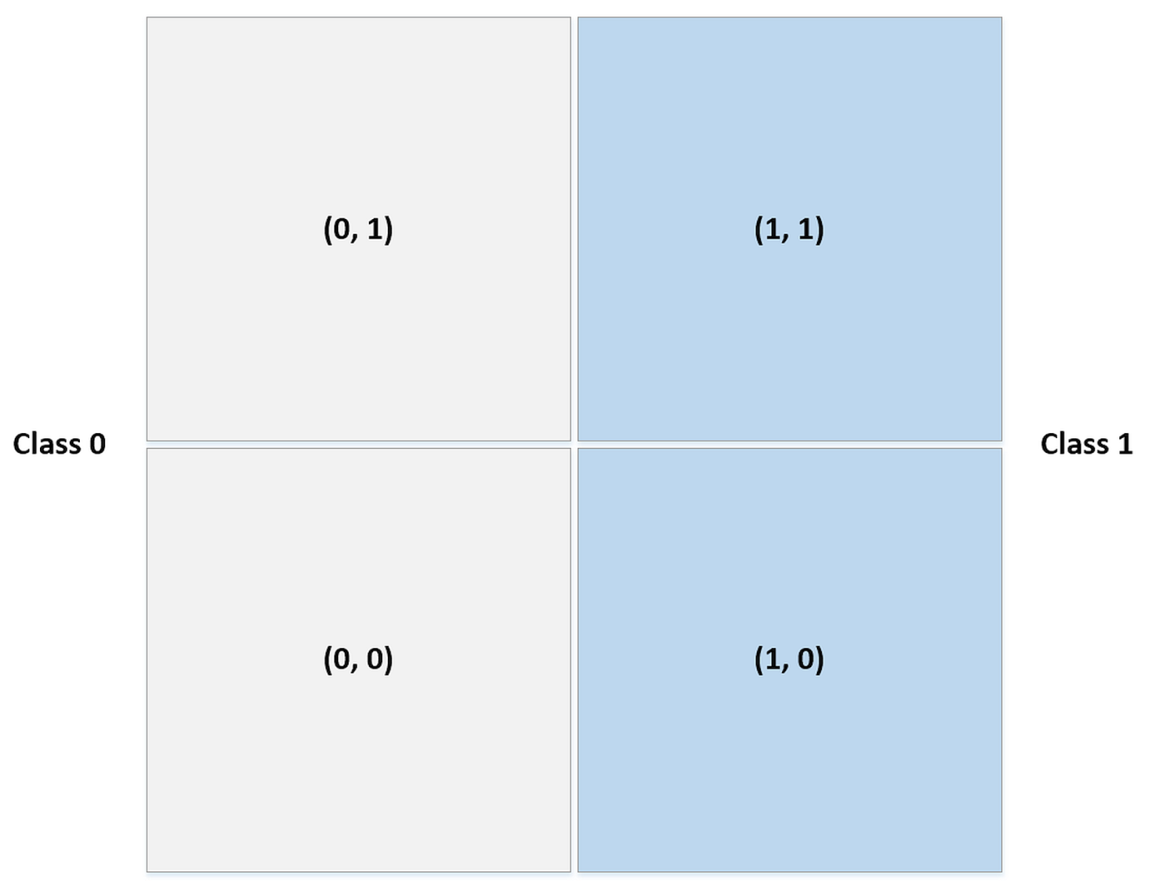

Slide 27
Now, checking the Naive Bayes predictions, we obtain the following:
data = np.array([[0, 0], [0, 1], [1, 0], [1, 1]]) print(bnb.predict(data)) [0, 0, 1, 1]

