Slide 1
A Fun Virtual Cam Design Project Presentation
Sreepathy Jayanand
CED17I038

Slide 2
A Fun Virtual Cam
It is an application to enable a better user experience for video conferencing and video related applications.
It changes the background of the video based on the detecting the sentiments from his / her speech.
It can help change the monotonous nature of conventional video calls.

Slide 3
Working Principle
There are mainly 2 components for this application:
Video processing
Capture video
Get sentiments from audio processing task
Change the background based on the sentiments
Audio processing
Obtain audio
Convert to text
Get sentiments from the text
Give the sentiments to the video processing task

Slide 4
PsuedoCode – Audio Processing Task
while True:
audio = get_audio(index) // Get audio from mic with given index
text = convert_audio_to_text(audio)
sentiment = get_sentiment(text)
if (sentiment == positive)
flag = 1
else
flag = 0

Slide 5
PsuedoCode – Video Processing Task
cam = video_capture(index) // index – Index of the web cam to be captured
while True:
img = cap.read()
if (flag == 1)
bg_image = “positive”
else
bg_image = “negative”
img = change_background(img, bg_image)
show(img)

Slide 6
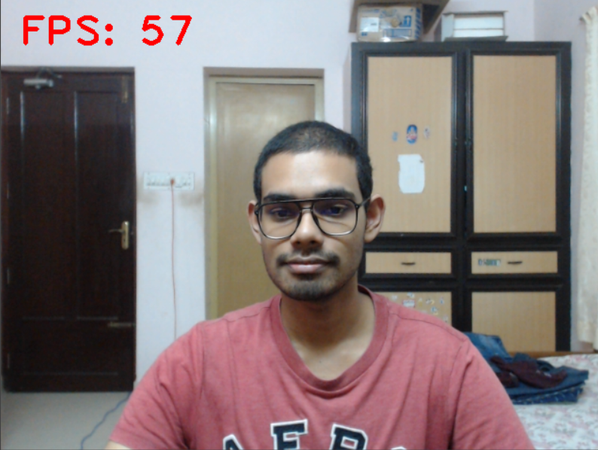
Outputs

Slide 7

Outputs

Slide 8
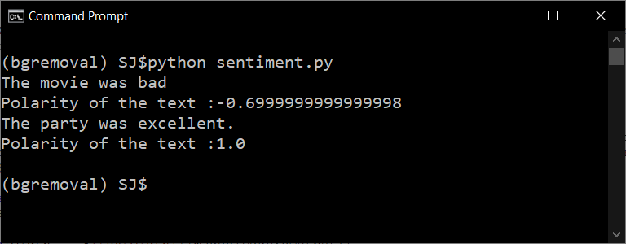
Outputs

Slide 9
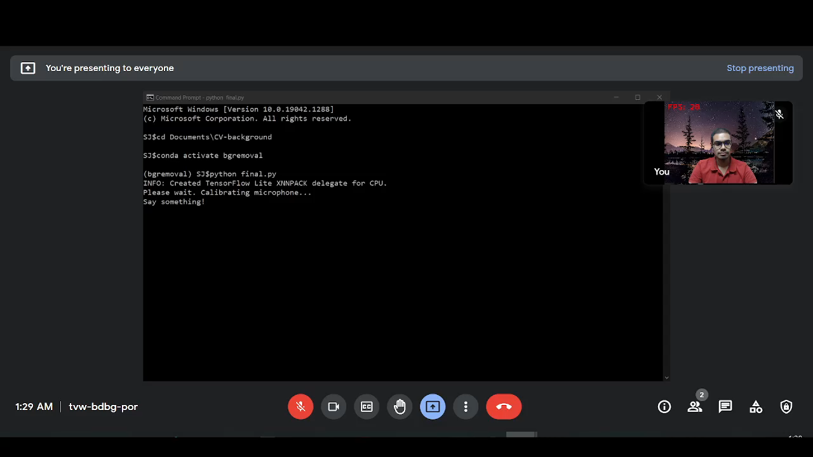
Outputs

Slide 10
THANK YOU

