Slide 1
DevSecOps Internship at AMD Report Presentation
Sreepathy Jayanand
CED17I038

Slide 2
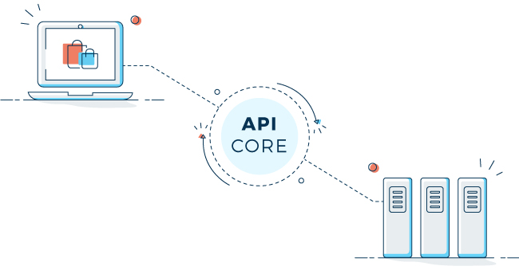
GitHub API Server
What is an API?
An Application Programming Interface or API is a software intermediary that allows for the communication between 2 applications or endpoints.

Slide 3
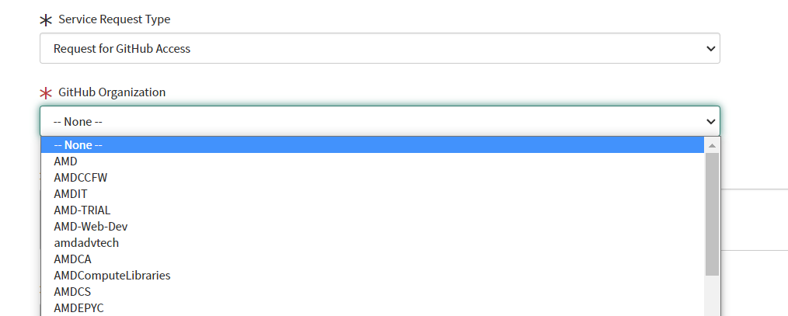
GitHub API Server
Motivation to create an API

Slide 4
GitHub API Server
Objectives
GET information from Github such as list of repos, members, external collaborators etc.
Update / change information in Github such as visibility of repositories, permission of members etc.
Delete repositories, remove collaborators etc.
Get information such as Github login id, given the NTID(Uniquely identifies an employee).
A total of 19 functions.
Ensure proper security in place for the communication to Github’s APIs.

Slide 5
GitHub API Server
Approach
Create a maven build in JAVA for the API using the springboot framework.
For fetching information, use GraphQL capabilities of Github to obtain information one page at a time, merge them together to create the final list. Also use GraphQL for retrieving information regarding mapping of NTIDs to Github login ids.
For updating information, use traditional HTTP Put, Patch, Post methods.
For deleting information, use traditional HTTP Delete method.
For security, use Azure keyvaults to store the PATs necessary for communication with Github APIs.

Slide 6
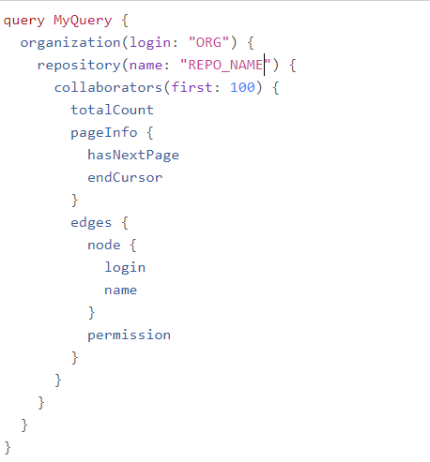
GitHub API Server
A GraphQL query

Slide 7
Output:
{
"data": {
"organization": {
"repository": {
"collaborators": {
"totalCount": 14,
"pageInfo": {
"hasNextPage": true,
"endCursor": "Y3Vyc29yOnYyOpHOAzsyHA=="
},
"edges": [
{
"node": {
"login": "Person 1",
"name": "Name 1",
},
"permission": "ADMIN"
},
{
"node": {
"login": "Person 2",
"name": "Name 2 "
},
"permission": "READ"
}
]
}
}
}
}
}

Slide 8
GitHub API Server
Pseudo Code for the mapping – /SNOW/org/{ORG}/repo/{name}/getadmins
next_page_exists = 1;
while (next_page_exists) {
obj = execute_graph_ql_query(query_object)
list_of_collaborators = (JSONArray) obj3.get("edges");
for (each i in list_of_collaborators) {
if (i.permission == “ADMIN”)
array.add(i.name);
}
next_page_exists = obj.hasNextPage;
}
return array;

Slide 9
GitHub API Server
Pseudo Code for the mapping – /SNOW/org/{ORG}/createrepo/{name}/{admins}
api_url = “https://api.github.com/orgs/” + ORG + “/repos”;
json_form = {“name” : name, “private” : true};
Response = execute_HTTP_POST(api_url, json_form);
if (! response) return 0;
for (i : admins) {
api_url_2 = “https://api.github.com/repos/” + ORG + “/” + name + “/collaborators/” + i;
json_form_2 = {“permission” : admin}
response_2 = execute_HTTP_PUT(api_url_2, json_form_2);
if (! response_2) return 0;
}
return 1;

Slide 10
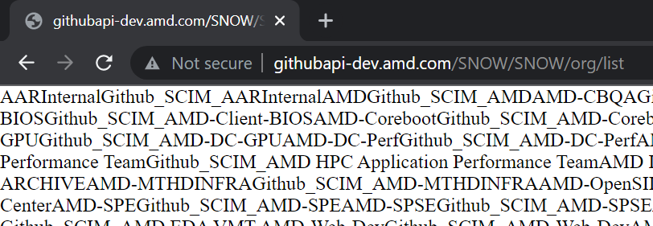
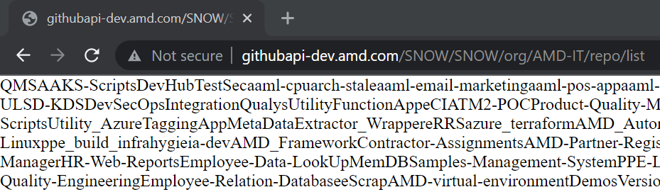
Outputs

Slide 11
GitHub Runner
What is a Runner?
A runner is a virtual machine hosted either by a service provider or on our own machines to help execute various custom work-flows which we desire.
What is a GitHub Runner?
A Github runner is a runner with Github Actions built in. Github actions help to run various jobs such as building images from source code, checking for potential security issues with source code etc.

Slide 12
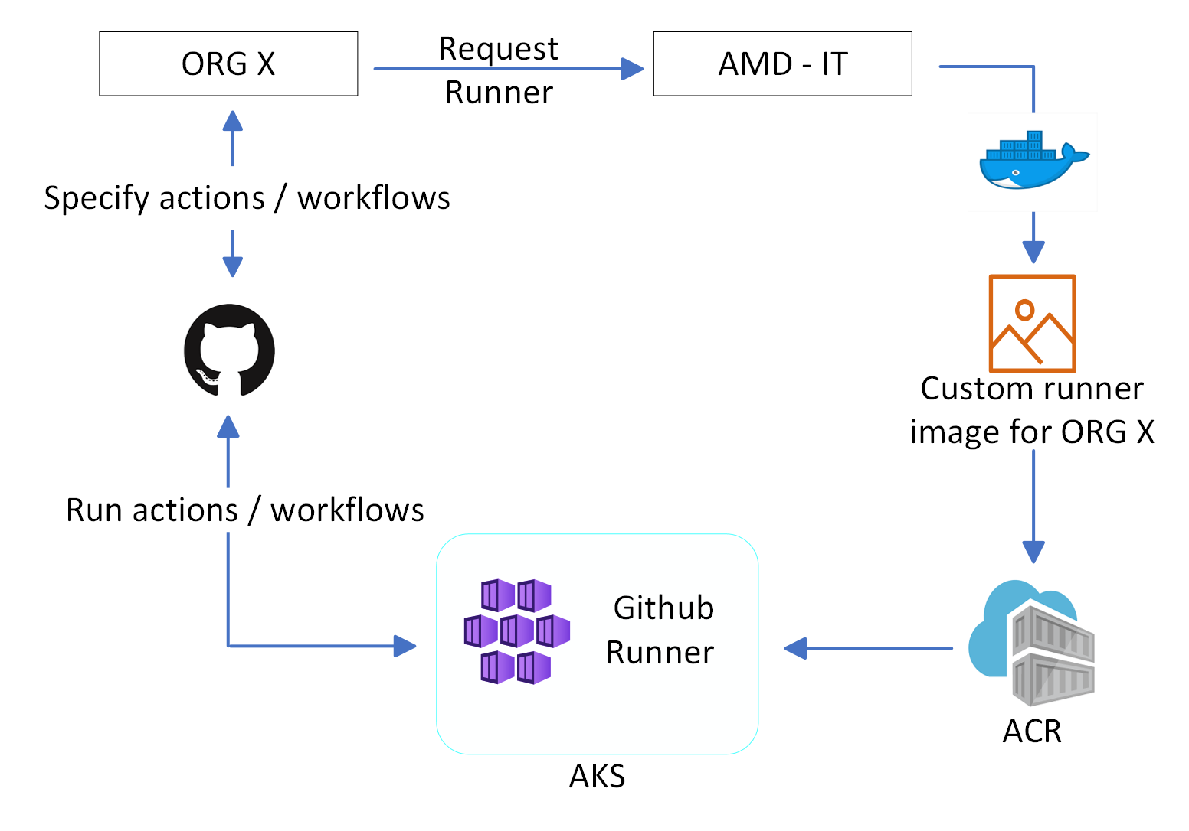
GitHub Runner

Slide 13
GitHub Runner
Steps
Create the Dockerfile, with all the commands to build the Github runner image, including the base OS, installation of packages etc.
Build the Dockerfile to create the image.
Upload the image to Azure container registry, where the image will be stored for future deployments
Deploy the container created from the image pulled from Azure container registry to Azure Kubernetes Services.

Slide 14
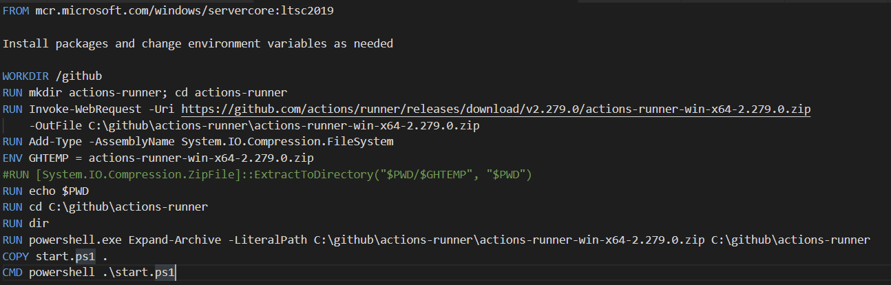
Pseudo Dockerfile

Slide 15
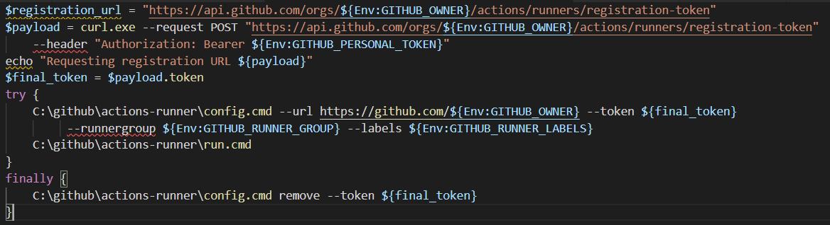
Pseudo start.ps1

Slide 16
GitHub Runner
Pushing to ACR
We specify the ACR location using “docker tag <image-name> <ACR-name/repo>”
We push it to ACR using “docker push <ACR-name/repo>”
Deploying in AKS
We have 2 deployment files. Secrets.yaml and Deployment.yaml.
The secrets.yaml contains the PAT, which is used for obtaining a registration token from github to link the Github runner to an organization.
The deployment.yaml contains the information such as the namespace to where the container has to be deployed, the image, the compute resources of the cluster etc.

Slide 17
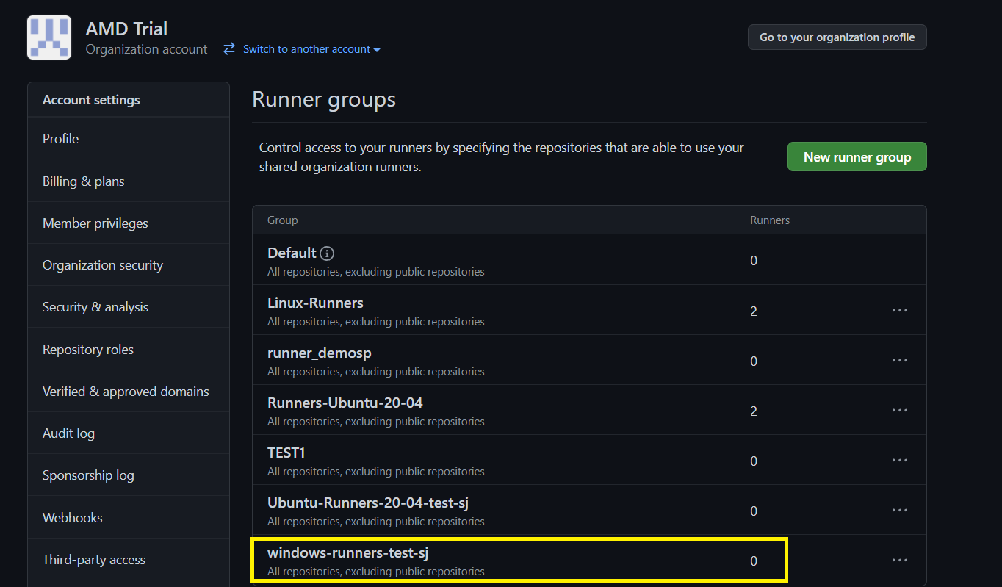
Outputs – Before creating the runner

Slide 18
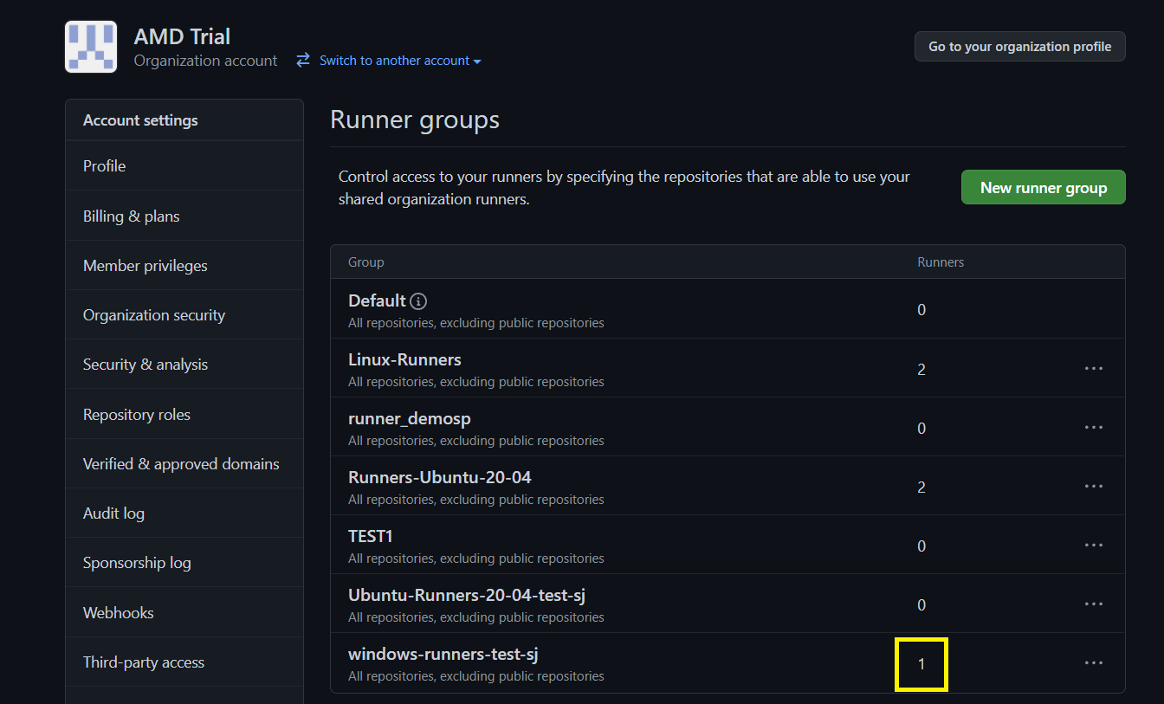
Outputs – After creating the runner

Slide 19
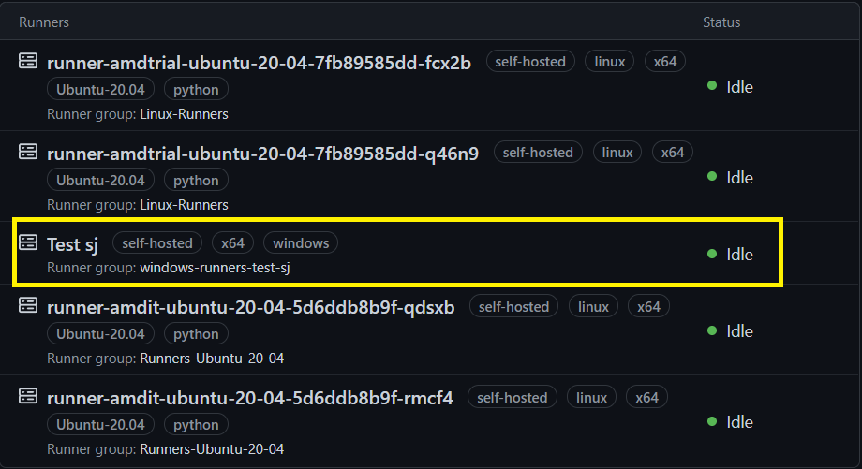
Outputs – After creating the runner

Slide 20
THANK YOU

