Slide 1
An approach for commonsense inference using Macaw encoder Mid-Sem Project Presentation
Guide – Dr B. Sivaselvan
Asst Prof. IIITDM
Sreepathy Jayanand
CED17I038

Slide 2
Problem Statement:
Common-sense inference is a task in natural language processing involving understanding the context and suggesting possible logical extensions from the context.
E.g. :“A young boy was rushed to the hospital emergency room, but the ER doctor saw the boy and refused to operate. ”This boy is my son,” the doctor said. But the doctor wasn’t the boy’s father. How could this be?”
Possible answer: The doctor is boy’s mother.
The problem that we are trying to solve here is – Given a context and a list of possible extensions from the context, select the most probable option.

Slide 3
Literature Review:
Here are the important papers leading to the proposed solution.
Multi angle question answering - MACAW
EncT5: Fine-tuning T5 Encoder for non-autoregressive Tasks

Slide 4
MACAW:
Here are the important papers leading to the proposed solution
T5 is an encoder-decoder generative model that has achieved the state-of-the-art benchmarks in a variety of generation tasks such as language translation, summarization, question answering etc.
Macaw is a generative question answering model that is built on T5, and only has 11billion parameters, as compared to GPT-3, a leading generative model which contains 175billion parameters but still produces similar benchmarks.
Macaw allows different “angles” – For example, Given a question, it can give the answer; Given an answer it can give possible options; Given the option it can give a question etc.

Slide 5
MACAW:
It is fine-tuned on the ARC dataset, which is a school level science-based reasoning dataset with a question with multiple options.
Hence, we can expect it to learnt a good context in general common-sense based questions.
E.g. Q: How would you make a house conduct electricity?
Macaw’s output: Paint it with a metal paint
Another example with Macaw’s syntax:
“$question$ = What is the color of a cloudy sky? ; $answer$ ; $mcoptions$”
Macaw’s output: '$answer$ = gray ; $mcoptions$ = (A) blue (B) white (C) grey (D) white'

Slide 6
EncT5:
T5 is an encoder-decoder generative model.
This paper sheds light on the fact that the encoder of a trained T5 model can be used to obtain embeddings of the input sentence which would have more representational power.
These encoded input vectors would have good representational power of the input sentence and can be used further.

Slide 7
SWAG dataset:
SWAG / Situations With Adversarial Generations dataset contains instances where in a situation is present and a good amount of “common-sense” is required for predicting the next phase of the situation.
E.g. “On stage, a woman takes a seat at the piano. She,
A. sits on a bench as her sister plays with the doll.
B. Smiles with someone as the music plays.
C. is in the crowd, watching the dancers.
D. Nervously sets her fingers on the keys – Correct option

Slide 8
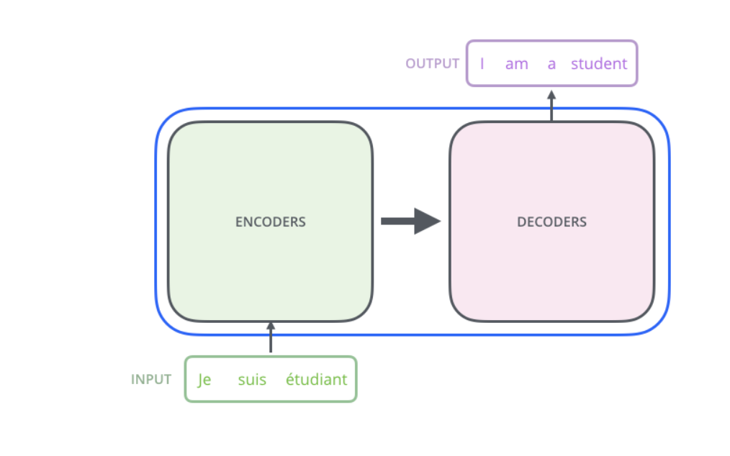
Architecture of Macaw:
T5 is essentially and encoder-decoder architecture, like the transformer.

Slide 9
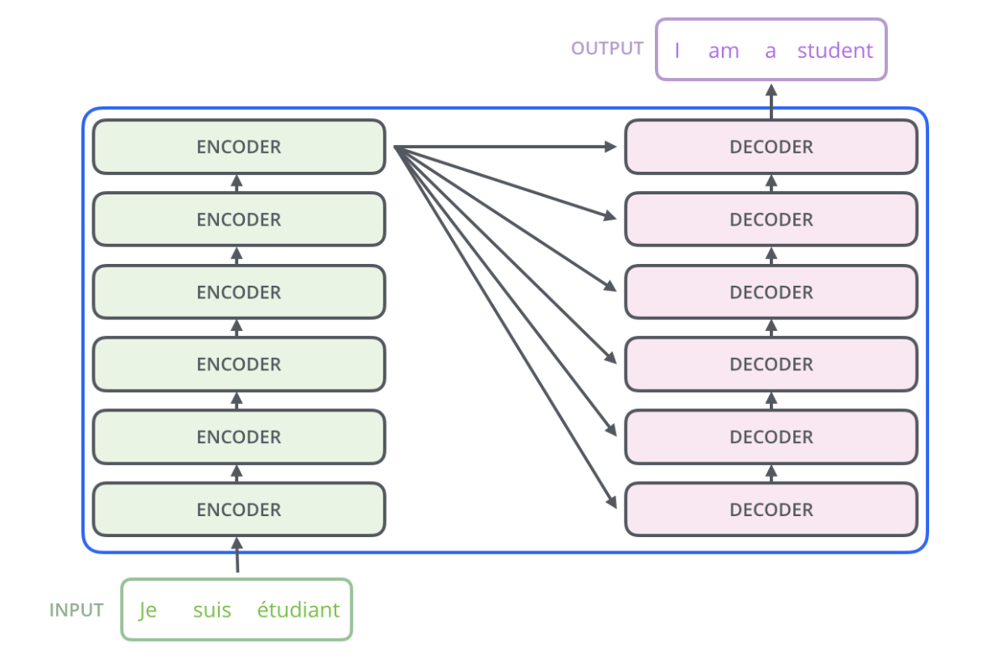
Architecture of Macaw:

Slide 10
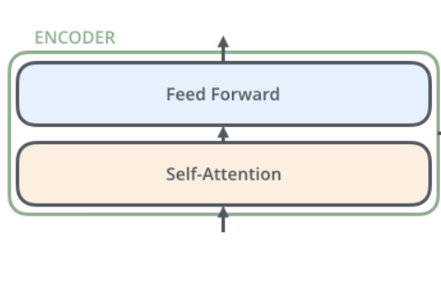
Architecture of Macaw:

Slide 11
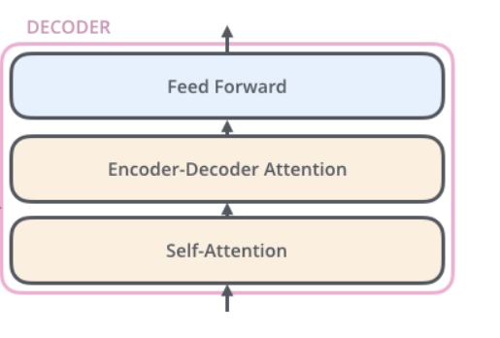
Architecture of Macaw:

Slide 12
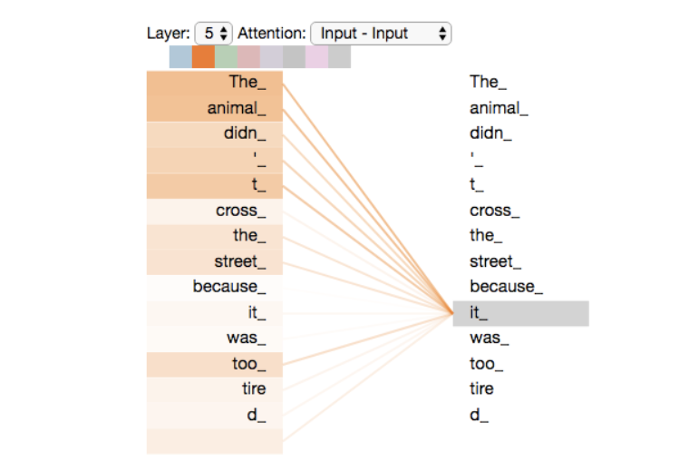
Architecture of Macaw:

Slide 13
Proposed Solution:
Macaw’s encoder
Fully connected layer
Dropout layer
A
B
Context
C
D
Options
Encoded input

Slide 14
THANK YOU

