Slide 1
BLUESTOCK FINTECH
Mutual Fund Analytics Platform
End-to-End Data Engineering, ETL Pipeline & Interactive Dashboard
Data Analyst Intern | July 2026

Slide 2
Problem & Objective
Problems
Solutions
❌ NAV, AUM, SIP data scattered across multiple sources in different formats
✅ Build ETL pipeline consolidating all data into a single SQLite database
❌ No unified platform to compare fund performance on a risk-adjusted basis
✅ Compute risk-return metrics: CAGR, Sharpe, Alpha, Beta, VaR, Max Drawdown
❌ Investors cannot track whether funds outperform their benchmark index
✅ Compare fund returns vs Nifty 50 and Nifty 100 benchmarks
❌ Monthly reports are static PDFs — no interactivity or drill-down capability
✅ Deliver interactive Power BI dashboard with 4 analytical pages

Slide 3
Data Sources & Datasets
40 Schemes
fund_master.csv — AMFI codes, categories, expense ratios
46,000 rows
nav_history.csv — Daily NAV 2022–2026 from mfapi.in
90 rows
aum_by_fund_house.csv — Quarterly AUM per AMC
48 rows
monthly_sip_inflows.csv — Industry SIP trend data
32,778 rows
investor_transactions.csv — SIP/Lumpsum/Redemption records
8,050 rows
benchmark_indices.csv — Nifty 50, 100, BSE SmallCap daily values
322 rows
portfolio_holdings.csv — Top stock holdings per equity fund

Slide 4
System Architecture
EXTRACT
mfapi.in REST API + AMFI CSV datasets
TRANSFORM
Pandas cleaning • Date fixing • Forward-fill • Validation
LOAD
SQLite star schema • dim_fund • fact_nav • fact_transactions
ANALYSE
CAGR • Sharpe • Alpha/Beta • VaR • Cohort Analysis
VISUALISE
Power BI 4-page Dashboard • 9 Matplotlib/Plotly Charts

Slide 5
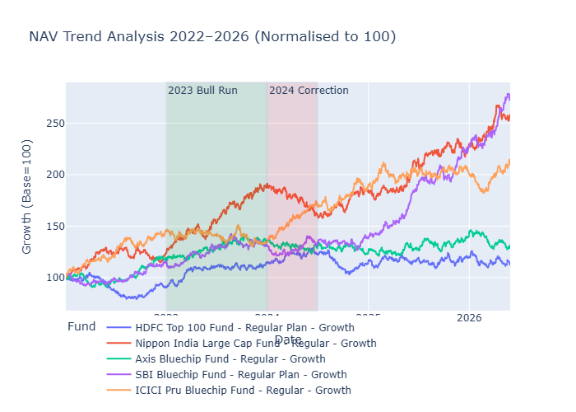
EDA Highlights — Industry Trends
📈 SIP inflows tripled from ₹11,517 Cr (Jan 2022) to ₹31,002 Cr (Dec 2025) — all-time high
🏦 SBI Mutual Fund dominates AUM at ₹12.5L Cr — nearly 2x ICICI Prudential
👥 Industry folios doubled from 13.26 Cr to 26.12 Cr between 2022 and 2025
💧 Liquid funds attract ₹33,000–42,000 Cr monthly — largest category by far
🏙️ T30 cities drive 66.3% of transactions vs 33.7% from B30 cities

Slide 6
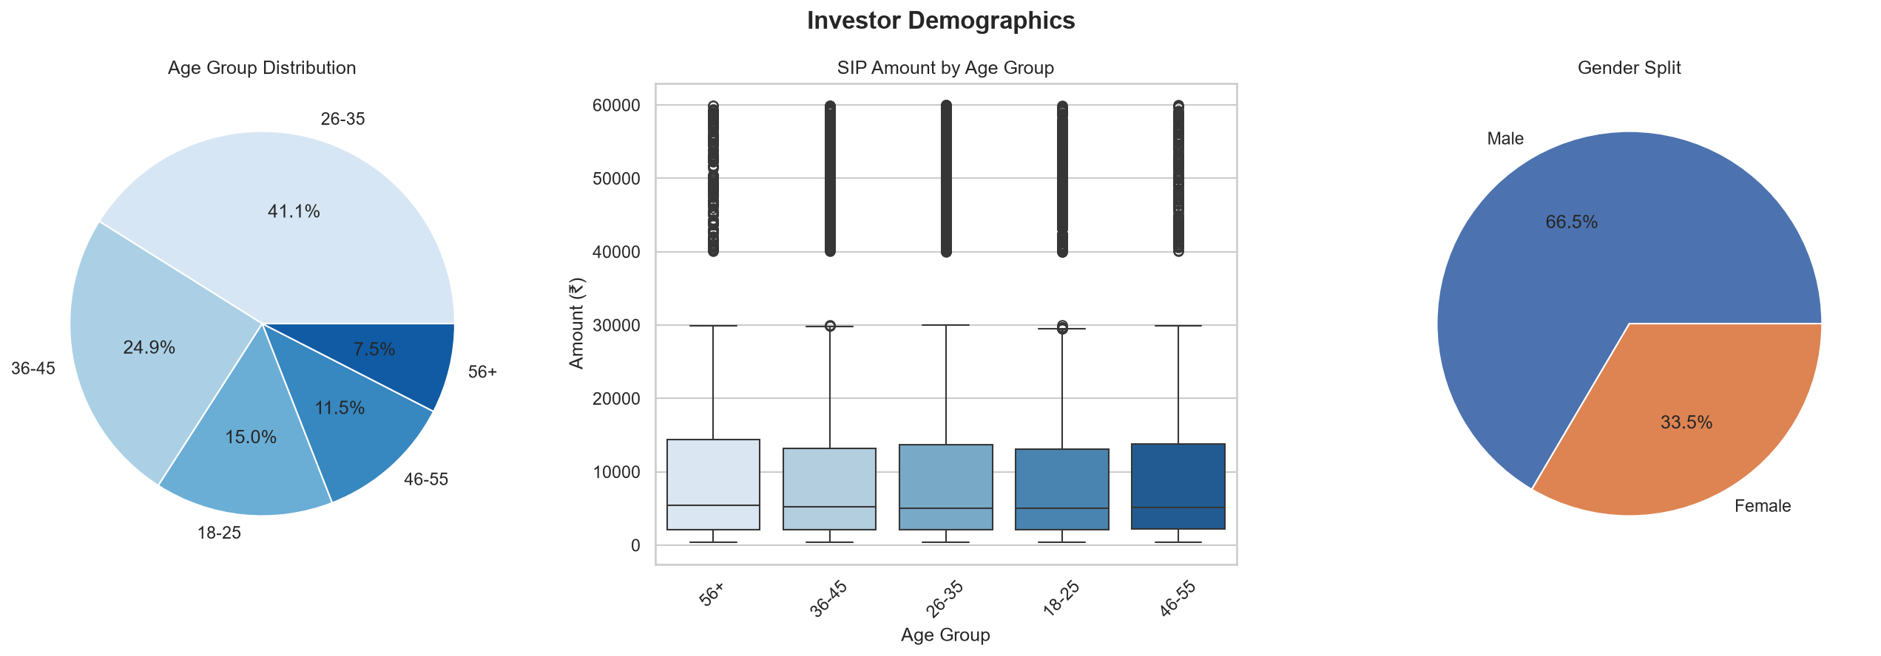
EDA Highlights — Investor Demographics
👶 26-35 age group dominates — 41.1% of all investors
👨 Gender gap persists — 66.5% male vs 33.5% female investors
🏢 Banking (19.2%), IT (13.4%), Pharma (12.0%) = 44.6% of equity portfolios
💰 Average SIP amounts are consistent across age groups (~₹100K)
📊 Small Cap funds delivered highest 1yr returns — DSP Small Cap at 64.88%

Slide 7
Fund Performance Metrics
Fund | Score | 3yr CAGR% | Sharpe
ICICI Pru Midcap Fund - Regular - Growth | 85.1 | 31.22% | 0.883
Axis Midcap Fund - Regular - Growth | 82.0 | 36.21% | 0.731
HDFC Mid-Cap Opportunities Fund - Regular - G | 80.5 | 32.37% | 0.808
Mirae Asset Large Cap Fund - Regular - Growth | 80.0 | 33.95% | 1.068
Kotak Flexicap Fund - Regular - Growth | 78.2 | 29.69% | 0.966
Sharpe Ratio = (Rp - Rf) / σ × √252 | Rf = 6.5% RBI repo rate
CAGR = (NAV_end / NAV_start)^(1/n) - 1
Max Drawdown = min(NAV / running_max - 1)
Fund Score = 30%×CAGR + 25%×Sharpe + 20%×Alpha + 15%×Expense + 10%×MaxDD

Slide 8
Advanced Risk Metrics
VaR (95%)
ABSL Small Cap: -2.39% daily VaR — worst 5% of days exceed this loss
CVaR
Average loss on bad days: -3.03% for Small Cap vs -1.2% for Large Cap
Rolling Sharpe
Sharpe fluctuates -4 to +6 — no fund consistently outperforms
SIP Continuity
97.8% of investors show irregular SIP gaps (avg 64.9 days vs 30 expected)
Sector HHI
Axis Bluechip most concentrated (3000) vs UTI Mid Cap most diversified (1300)

Slide 9
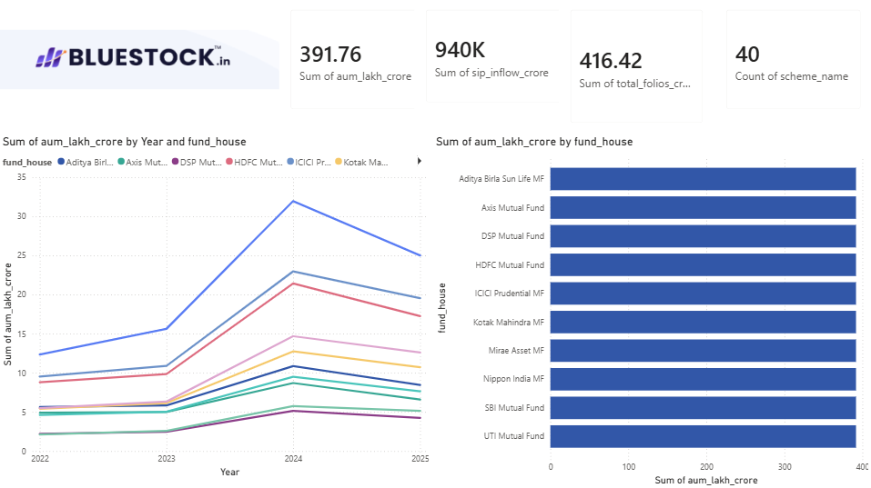
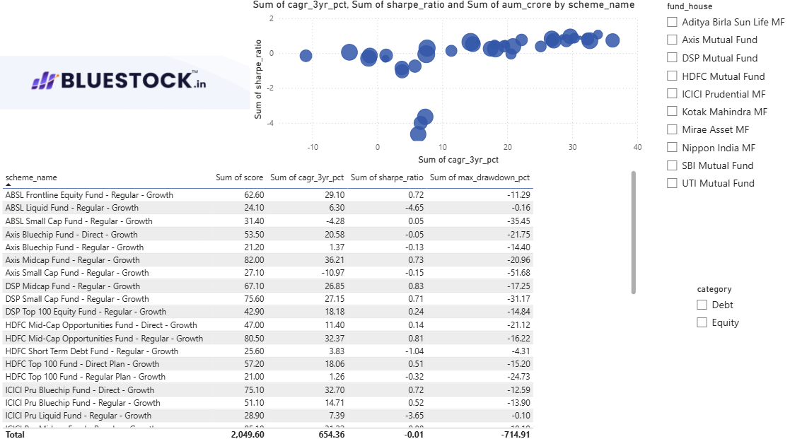
Power BI Dashboard
Page 1 — Industry Overview
Page 2 — Fund Performance

Slide 10
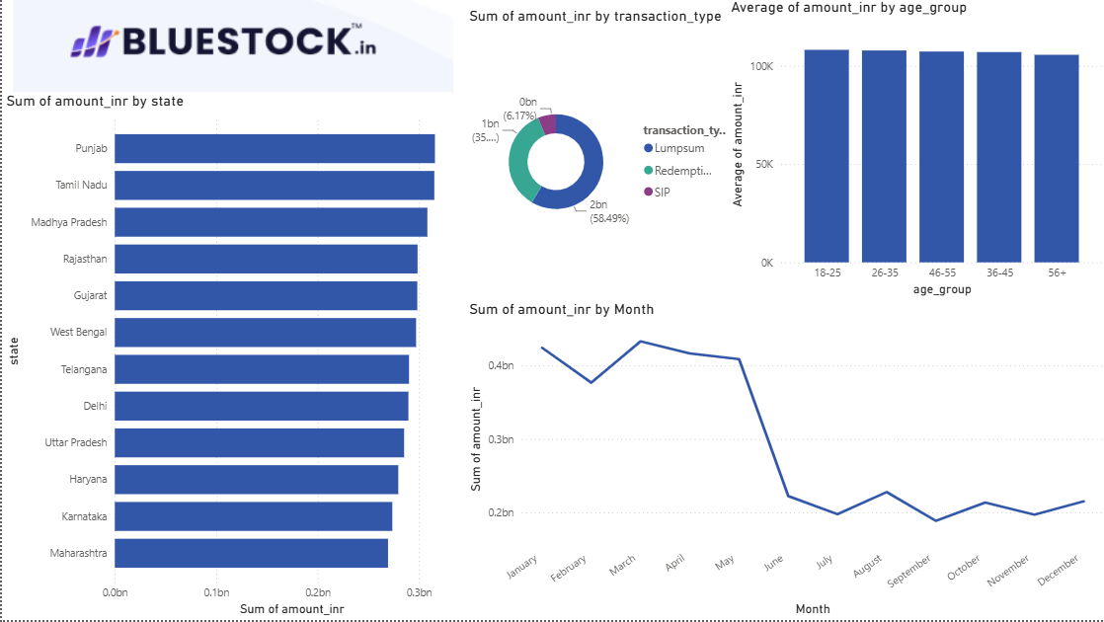
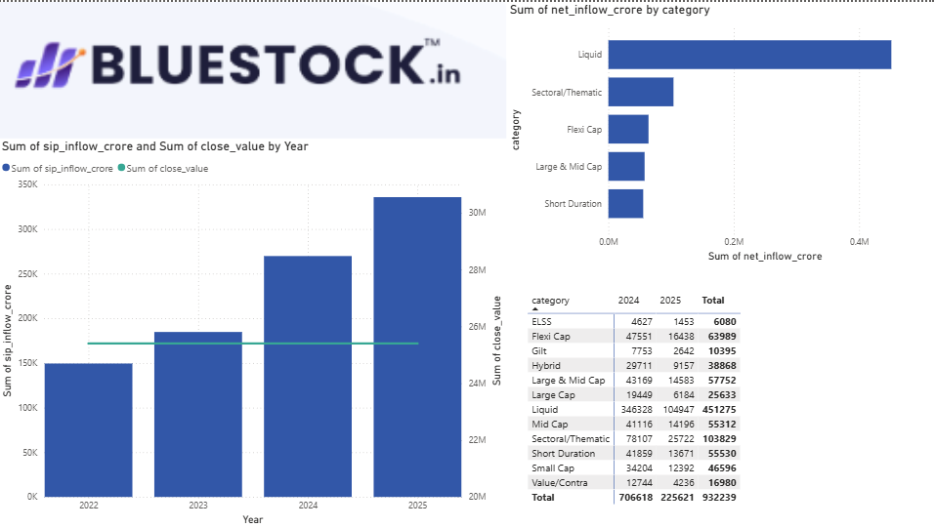
Power BI Dashboard
Page 3 — Investor Analytics
Page 4 — SIP & Market Trends

Slide 11
Key Findings & Recommendations
🏆 ICICI Pru Midcap tops Fund Scorecard at 85.1 — best risk-return balance
📉 Small Cap funds: highest returns (64.88%) but also highest VaR (-2.39%)
💡 Moderate risk investors: Mirae Asset Large Cap offers best Sharpe (1.068)
⚠️ SIP continuity critical — 97.8% investors show irregular payment patterns
🌍 B30 cities at 33.7% — significant untapped growth opportunity
👩 Female investor gap (33.5%) — targeted outreach programs recommended
🏦 Debt funds underperform risk-free rate — negative Sharpe across all debt funds

Slide 12
Thank You
Mutual Fund Analytics Platform — Bluestock Fintech Internship
GitHub Repository | July 2026

