Slide 1

William Stallings, Computer Organization and Architecture, 9th Edition
Chapter 6
External Memory
Notes:
Lecture slides prepared for “Computer Organization and Architecture”, 9/e, by William Stallings, Chapter 6 “External Memory”.
Adapted by Thân Văn Sử

Slide 2
Contents
6.1 Magnetic Disk
6.2 Raid

Slide 3
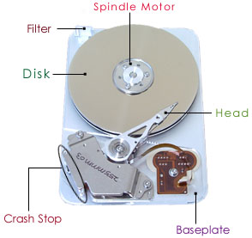
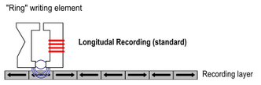

6.1- Magnetic Disk
A disk is a circular platter constructed of nonmagnetic material, called the substrate-chất nền, coated with a magnetizable material
Traditionally the substrate has been an aluminium or aluminium alloy (hợp kim nhôm) material
Recently glass substrates have been introduced
Benefits of the glass substrate:
Improvement in the uniformity of the magnetic film surface to increase disk reliability
A significant reduction in overall surface defects to help reduce read-write errors
Ability to support lower fly heights (cho phép mỏng hơn)
Better stiffness (cứng) to reduce disk dynamics
Greater ability to withstand(anti) shock and damage
(Wiki)
Notes:
A disk is a circular platter constructed of nonmagnetic material, called the substrate,
coated with a magnetizable material. Traditionally, the substrate has been an aluminum
or aluminum alloy material. More recently, glass substrates have been introduced.
The glass substrate has a number of benefits, including the following:
• Improvement in the uniformity of the magnetic film surface to increase disk
reliability
• A significant reduction in overall surface defects to help reduce read-write errors
• Ability to support lower fly heights (described subsequently)
• Better stiffness to reduce disk dynamics
• Greater ability to withstand shock and damage

Slide 4
Magnetic Read and Write Mechanisms
Data are recorded on and later retrieved from the disk via a conducting coil named the head
In many systems there are two heads, a read head and a write head
During a read or write operation the head is stationary while the platter rotates beneath it
The write mechanism exploits the fact that electricity flowing through a coil produces a magnetic field
Electric pulses are sent to the write head and the resulting magnetic patterns are recorded on the surface below, with different patterns for positive and negative currents
The write head itself is made of easily magnetizable material and is in the shape of a rectangular doughnut with a gap along one side and a few turns of conducting wire along the opposite side
An electric current in the wire induces a magnetic field across the gap, which in turn magnetizes a small area of the recording medium
Reversing the direction of the current reverses the direction of the magnetization on the recording medium
Notes:
Data are recorded on and later retrieved from the disk via a conducting coil named
the head; in many systems, there are two heads, a read head and a write head. During
a read or write operation, the head is stationary while the platter rotates beneath it.
The write mechanism exploits the fact that electricity flowing through a coil
produces a magnetic field. Electric pulses are sent to the write head, and the resulting
magnetic patterns are recorded on the surface below, with different patterns for
positive and negative currents. The write head itself is made of easily magnetizable
material and is in the shape of a rectangular doughnut with a gap along one side and
a few turns of conducting wire along the opposite side (Figure 6.1). An electric current
in the wire induces a magnetic field across the gap, which in turn magnetizes a
small area of the recording medium. Reversing the direction of the current reverses
the direction of the magnetization on the recording medium.
The traditional read mechanism exploits the fact that a magnetic field moving
relative to a coil produces an electrical current in the coil. When the surface of the
disk passes under the head, it generates a current of the same polarity as the one
already recorded. The structure of the head for reading is in this case essentially
the same as for writing and therefore the same head can be used for both. Such
single heads are used in floppy disk systems and in older rigid disk systems.
Contemporary rigid disk systems use a different read mechanism, requiring
a separate read head, positioned for convenience close to the write head. The read
head consists of a partially shielded magnetoresistive (MR) sensor. The MR material
has an electrical resistance that depends on the direction of the magnetization of
the medium moving under it. By passing a current through the MR sensor, resistance
changes are detected as voltage signals. The MR design allows higher-frequency
operation, which equates to greater storage densities and operating speeds.

Slide 5
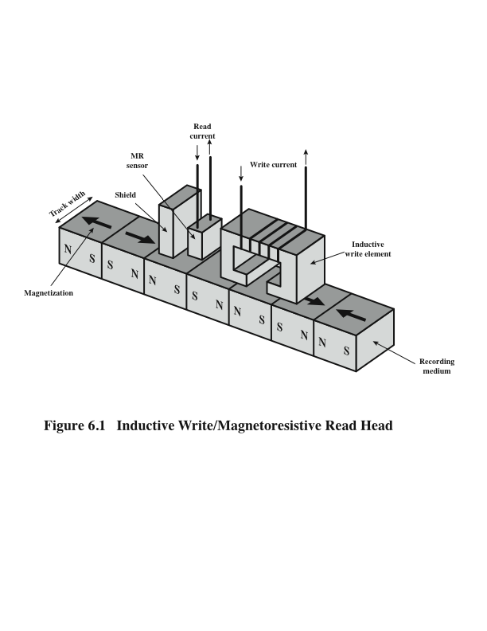
Inductive Write/Magnetoresistive Read Head
Inductive Write: Ghi cảm ứng điện từ
Magneto-resistive Read: đọc từ điện
N: North, S: South
Notes:
Shield che chắn từ trường để chống nhiễu
Figure 6.1. Inductive Write/Magnetoresistive Read Head

Slide 6
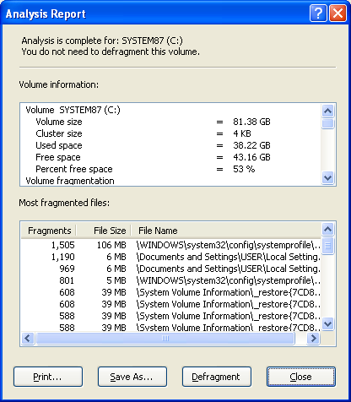
Disk Allocation Unit in Windows: Cluster
Notes:
A bit near the center of a rotating disk travels past a fixed point (such as a read–
write head) slower than a bit on the outside. Therefore, some way must be found
to compensate for the variation in speed so that the head can read all the bits at the
same rate. This can be done by increasing the spacing between bits of information
recorded in segments of the disk. The information can then be scanned at the same
rate by rotating the disk at a fixed speed, known as the constant angular velocity
(CAV). Figure 6.3a shows the layout of a disk using CAV. The disk is divided into
a number of pie-shaped sectors and into a series of concentric tracks. The advantage
of using CAV is that individual blocks of data can be directly addressed by
track and sector. To move the head from its current location to a specific address, it
only takes a short movement of the head to a specific track and a short wait for the
proper sector to spin under the head. The disadvantage of CAV is that the amount
of data that can be stored on the long outer tracks is the only same as what can be
stored on the short inner tracks.
Because the density, in bits per linear inch, increases in moving from the outermost
track to the innermost track, disk storage capacity in a straightforward CAV
system is limited by the maximum recording density that can be achieved on the
innermost track. To increase density, modern hard disk systems use a technique
known as multiple zone recording, in which the surface is divided into a number
of concentric zones (16 is typical). Within a zone, the number of bits per track is
constant. Zones farther from the center contain more bits (more sectors) than zones
closer to the center. This allows for greater overall storage capacity at the expense
of somewhat more complex circuitry. As the disk head moves from one zone to
another, the length (along the track) of individual bits changes, causing a change
in the timing for reads and writes. Figure 6.3b suggests the nature of multiple zone
recording; in this illustration, each zone is only a single track wide.

Slide 7
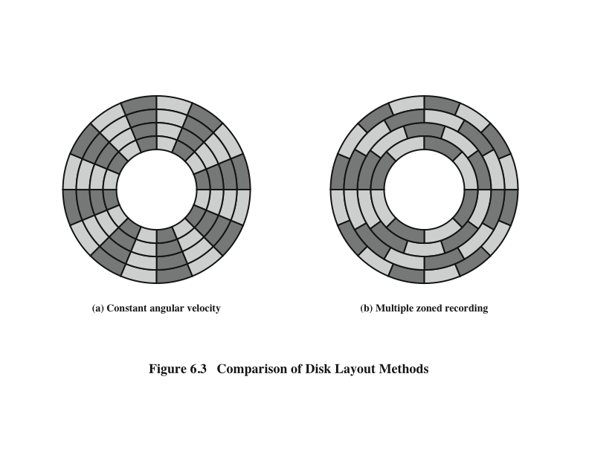
Disk Layout Methods Diagram
Characteristics: Read by yourself
Notes:
A bit near the center of a rotating disk travels past a fixed point (such as a read–
write head) slower than a bit on the outside. Therefore, some way must be found
to compensate for the variation in speed so that the head can read all the bits at the
same rate. This can be done by increasing the spacing between bits of information
recorded in segments of the disk. The information can then be scanned at the same
rate by rotating the disk at a fixed speed, known as the constant angular velocity
(CAV). Figure 6.3a shows the layout of a disk using CAV. The disk is divided into
a number of pie-shaped sectors and into a series of concentric tracks. The advantage
of using CAV is that individual blocks of data can be directly addressed by
track and sector. To move the head from its current location to a specific address, it
only takes a short movement of the head to a specific track and a short wait for the
proper sector to spin under the head. The disadvantage of CAV is that the amount
of data that can be stored on the long outer tracks is the only same as what can be
stored on the short inner tracks.
Because the density, in bits per linear inch, increases in moving from the outermost
track to the innermost track, disk storage capacity in a straightforward CAV
system is limited by the maximum recording density that can be achieved on the
innermost track. To increase density, modern hard disk systems use a technique
known as multiple zone recording, in which the surface is divided into a number
of concentric zones (16 is typical). Within a zone, the number of bits per track is
constant. Zones farther from the center contain more bits (more sectors) than zones
closer to the center. This allows for greater overall storage capacity at the expense
of somewhat more complex circuitry. As the disk head moves from one zone to
another, the length (along the track) of individual bits changes, causing a change
in the timing for reads and writes. Figure 6.3b suggests the nature of multiple zone
recording; in this illustration, each zone is only a single track wide.

Slide 8
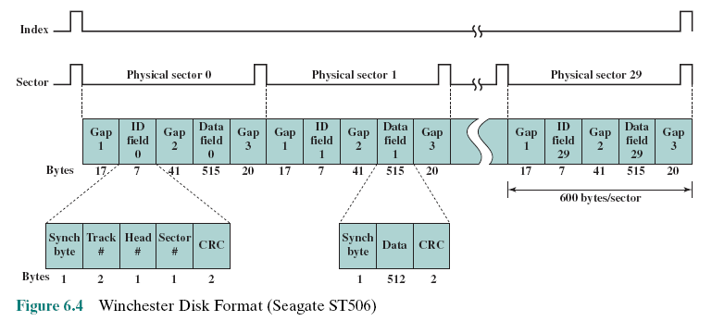
Winchester Disk Format Seagate ST506
CRC- cyclic redundancy check – Data for error checking
Synch. Byte: Byte for identify the beginning of data
Notes:
Some means is needed to locate sector positions within a track. Clearly, there
must be some starting point on the track and a way of identifying the start and end
of each sector. These requirements are handled by means of control data recorded
on the disk. Thus, the disk is formatted with some extra data used only by the disk
drive and not accessible to the user.
An example of disk formatting is shown in Figure 6.4. In this case, each track
contains 30 fixed-length sectors of 600 bytes each. Each sector holds 512 bytes of
data plus control information useful to the disk controller. The ID field is a unique
identifier or address used to locate a particular sector. The SYNCH byte is a special
bit pattern that delimits the beginning of the field. The track number identifies a
track on a surface. The head number identifies a head, because this disk has multiple
surfaces (explained presently). The ID and data fields each contain an error detecting
code.

Slide 9
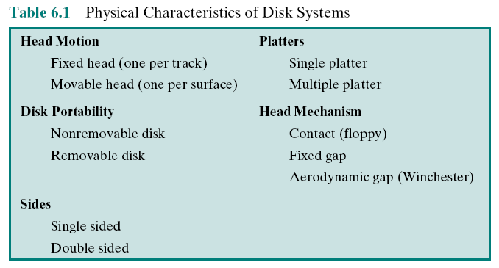
Table 6.1: Physical Characteristics of Disk Systems
Notes:
Table 6.1 lists the major characteristics that differentiate among the various types
of magnetic disks.

Slide 10
Characteristics
Fixed-head disk
One read-write head per track
Heads are mounted on a fixed ridged arm that extends across all tracks
Movable-head disk
One read-write head
Head is mounted on an arm
The arm can be extended or retracted
Removable disk
Can be removed and replaced with another disk
Advantages:
Unlimited amounts of data are available with a limited number of disk systems
A disk may be moved from one computer system to another
Floppy disks and ZIP cartridge disks are examples of removable disks
Non-removable disk
Permanently mounted in the disk drive
The hard disk in a personal computer is a non-removable disk
Double sided disk
Magnetizable coating is applied to both sides of the platter
Notes:
First, the head may either be fixed or movable with respect to
the radial direction of the platter. In a fixed-head disk, there is one read-write
head per track. All of the heads are mounted on a rigid arm that extends across
all tracks; such systems are rare today. In a movable-head disk, there is only one
read-write head. Again, the head is mounted on an arm. Because the head must
be able to be positioned above any track, the arm can be extended or retracted for
this purpose.
The disk itself is mounted in a disk drive, which consists of the arm, a spindle
that rotates the disk, and the electronics needed for input and output of binary data.
A non-removable disk is permanently mounted in the disk drive; the hard disk in
a personal computer is a non-removable disk. A removable disk can be removed
and replaced with another disk. The advantage of the latter type is that unlimited
amounts of data are available with a limited number of disk systems. Furthermore,
such a disk may be moved from one computer system to another. Floppy disks and
ZIP cartridge disks are examples of removable disks.
For most disks, the magnetizable coating is applied to both sides of the platter,
which is then referred to as double sided. Some less expensive disk systems use
single-sided disks.

Slide 11
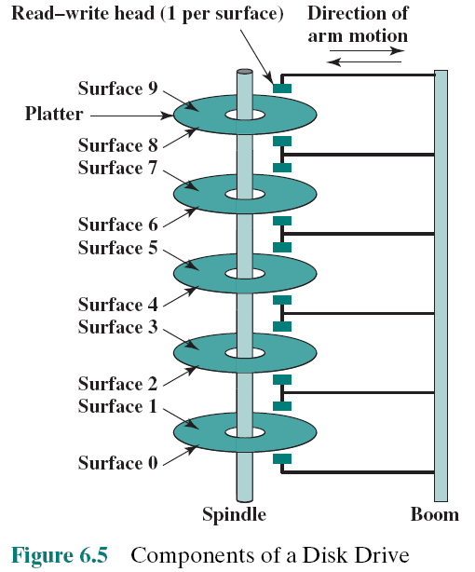
Multiple Platters
Notes:
Some disk drives accommodate multiple platters stacked vertically a fraction
of an inch apart. Multiple arms are provided (Figure 6.5). Multiple–platter disks
employ a movable head, with one read-write head per platter surface. All of the
heads are mechanically fixed so that all are at the same distance from the center of
the disk and move together. Thus, at any time, all of the heads are positioned over
tracks that are of equal distance from the center of the disk.

Slide 12
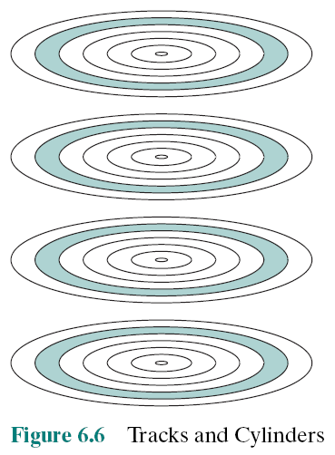
Tracks
Cylinders
Notes:
Cylinder: tập hợp các track trên các mặt đĩa (nhìn từ trên nhìn xuống)
The set of all the tracks
in the same relative position on the platter is referred to as a cylinder.
For example, all of the shaded tracks in Figure 6.6 are part of one cylinder.

Slide 13
Disk Classification
The head mechanism provides a classification of disks into three types
The head must generate or sense an electromagnetic field of sufficient magnitude to write and read properly
The narrower the head, the closer it must be to the platter surface to function
A narrower head means narrower tracks and therefore greater data density
The closer the head is to the disk the greater the risk of error from impurities or imperfections
Winchester Heads
Used in sealed drive assemblies that are almost free of contaminants (chất ô nhiễm)
Designed to operate closer to the disk’s surface than conventional rigid (rời) disk heads, thus allowing greater data density
Is actually an aerodynamic foil (lá) that rests lightly on the platter’s surface when the disk is motionless
The air pressure generated by a spinning disk is enough to make the foil rise above the surface
Notes:
Finally, the head mechanism provides a classification of disks into three types.
Traditionally, the read-write head has been positioned a fixed distance above the
platter, allowing an air gap. At the other extreme is a head mechanism that actually
comes into physical contact with the medium during a read or write operation. This
mechanism is used with the floppy disk, which is a small, flexible platter and the
least expensive type of disk.
To understand the third type of disk, we need to comment on the relationship
between data density and the size of the air gap. The head must generate or sense an
electromagnetic field of sufficient magnitude to write and read properly. The narrower
the head is, the closer it must be to the platter surface to function. A narrower
head means narrower tracks and therefore greater data density, which is desirable.
However, the closer the head is to the disk, the greater the risk of error from impurities
or imperfections. To push the technology further, the Winchester disk was
developed. Winchester heads are used in sealed drive assemblies that are almost
free of contaminants. They are designed to operate closer to the disk’s surface than
conventional rigid disk heads, thus allowing greater data density. The head is actually
an aerodynamic foil that rests lightly on the platter’s surface when the disk is
motionless. The air pressure generated by a spinning disk is enough to make the foil
rise above the surface. The resulting noncontact system can be engineered to use
narrower heads that operate closer to the platter’s surface than conventional rigid
disk heads.

Slide 14
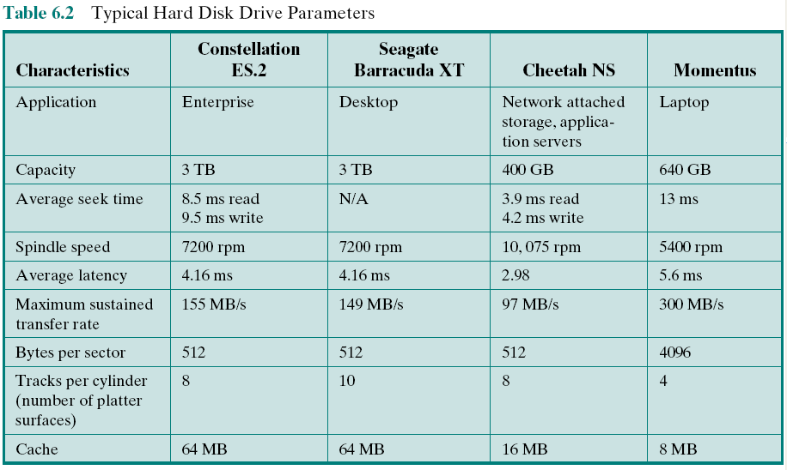
Typical Hard Disk Parameters
Notes:
Table 6.2 gives disk parameters for typical contemporary high-performance
disks.

Slide 15
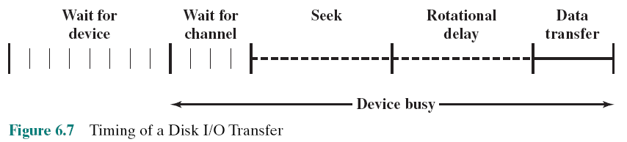
Timing of Disk I/O Transfer
The actual details of disk I/O operation depend on the computer system, the operating
system, and the nature of the I/O channel and disk controller hardware.

Slide 16

Disk Performance Parameters
When the disk drive is operating the disk is rotating at constant speed
To read or write the head must be positioned at the desired track and at the beginning of the desired sector on the track
Track selection involves moving the head in a movable-head system or electronically selecting one head on a fixed-head system
Once the track is selected, the disk controller waits until the appropriate sector rotates to line up with the head
Seek time
On a movable–head system, the time it takes to position the head at the track
Notes:
When the disk drive is operating, the disk is rotating at constant speed. To
read or write, the head must be positioned at the desired track and at the beginning
of the desired sector on that track. Track selection involves moving the head in a
movable-head system or electronically selecting one head on a fixed-head system.
On a movable-head system, the time it takes to position the head at the track is
known as seek time. In either case, once the track is selected, the disk controller
waits until the appropriate sector rotates to line up with the head. The time it takes
for the beginning of the sector to reach the head is known as rotational delay, or
rotational latency. The sum of the seek time, if any, and the rotational delay equals
the access time, which is the time it takes to get into position to read or write. Once
the head is in position, the read or write operation is then performed as the sector
moves under the head; this is the data transfer portion of the operation; the time
required for the transfer is the transfer time.
It is clear that the order in which sectors are read from the disk has a tremendous
effect on I/O performance. In the case of file access in which multiple
sectors are read or written, we have some control over the way in which sectors
of data are deployed. However, even in the case of a file access, in a multiprogramming
environment, there will be I/O requests competing for the same disk.
Thus, it is worthwhile to examine ways in which the performance of disk I/O
can be improved over that achieved with purely random access to the disk. This
leads to a consideration of disk scheduling algorithms, which is the province of
the operating system and beyond the scope of this book (see [STAL12] for a
discussion).

Slide 17
Disk Performance Parameters
Rotational delay (rotational latency)
The time it takes for the beginning of the sector to reach the head
Access time
The sum of the seek time and the rotational delay
The time it takes to get into position to read or write
Transfer time
Once the head is in position, the read or write operation is then performed as the sector moves under the head
This is the data transfer portion of the operation
Notes:
When the disk drive is operating, the disk is rotating at constant speed. To
read or write, the head must be positioned at the desired track and at the beginning
of the desired sector on that track. Track selection involves moving the head in a
movable-head system or electronically selecting one head on a fixed-head system.
On a movable-head system, the time it takes to position the head at the track is
known as seek time. In either case, once the track is selected, the disk controller
waits until the appropriate sector rotates to line up with the head. The time it takes
for the beginning of the sector to reach the head is known as rotational delay, or
rotational latency. The sum of the seek time, if any, and the rotational delay equals
the access time, which is the time it takes to get into position to read or write. Once
the head is in position, the read or write operation is then performed as the sector
moves under the head; this is the data transfer portion of the operation; the time
required for the transfer is the transfer time.
It is clear that the order in which sectors are read from the disk has a tremendous
effect on I/O performance. In the case of file access in which multiple
sectors are read or written, we have some control over the way in which sectors
of data are deployed. However, even in the case of a file access, in a multiprogramming
environment, there will be I/O requests competing for the same disk.
Thus, it is worthwhile to examine ways in which the performance of disk I/O
can be improved over that achieved with purely random access to the disk. This
leads to a consideration of disk scheduling algorithms, which is the province of
the operating system and beyond the scope of this book (see [STAL12] for a
discussion).

Slide 18
6.2- RAID
Consists of 7 levels
Levels do not imply a hierarchical relationship but designate different design architectures that share three common characteristics:
Set of physical disk drives viewed by the operating system as a single logical drive
Data are distributed across the physical drives of an array in a scheme known as striping
Redundant disk capacity is used to store parity information, which guarantees data recoverability in case of a disk failure
Redundant Array of Independent Disks
Redundant Array of Inexpensive Disks
Long life
Availability
Performance → Parallel accessing
Reliability → Backup, checking
➔ Multi-disk design
Notes:
With the use of multiple disks, there is a wide variety of ways in which the
data can be organized and in which redundancy can be added to improve reliability.
This could make it difficult to develop database schemes that are usable
on a number of platforms and operating systems. Fortunately, industry has
agreed on a standardized scheme for multiple-disk database design, known as
RAID (Redundant Array of Independent Disks). The RAID scheme consists
of seven levels, zero through six. These levels do not imply a hierarchical relationship
but designate different design architectures that share three common
characteristics:
1. RAID is a set of physical disk drives viewed by the operating system as a single
logical drive.
2. Data are distributed across the physical drives of an array in a scheme known
as striping, described subsequently.
3. Redundant disk capacity is used to store parity information, which guarantees
data recoverability in case of a disk failure.
The details of the second and third characteristics differ for the different RAID
levels. RAID 0 and RAID 1 do not support the third characteristic.

Slide 19
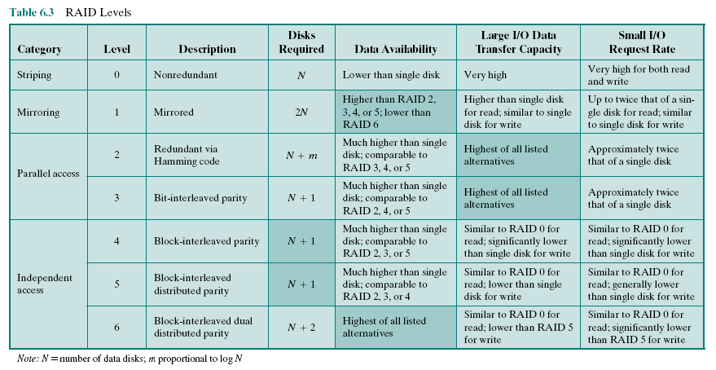
Table 6.3 RAID Levels
Notes:
We now examine each of the RAID levels. Table 6.3 provides a rough guide
to the seven levels. In the table, I/O performance is shown both in terms of data
transfer capacity, or ability to move data, and I/O request rate, or ability to satisfy
I/O requests, since these RAID levels inherently perform differently relative
to these two metrics. Each RAID level’s strong point is highlighted by darker
shading.

Slide 20
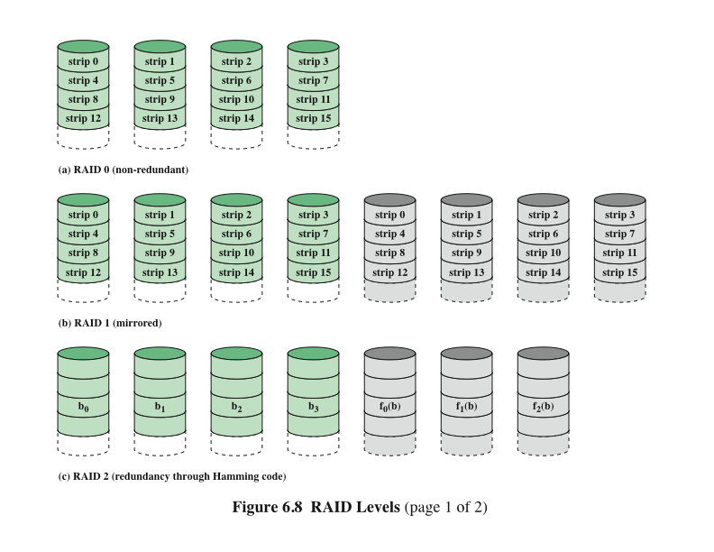
RAID Levels 0, 1, 2
Notes:
Figure 6.8 illustrates the use of the seven RAID schemes to support a
data capacity requiring four disks with no redundancy. The figures highlight the
layout of user data and redundant data and indicates the relative storage requirements
of the various levels. We refer to these figures throughout the following
discussion.

Slide 21
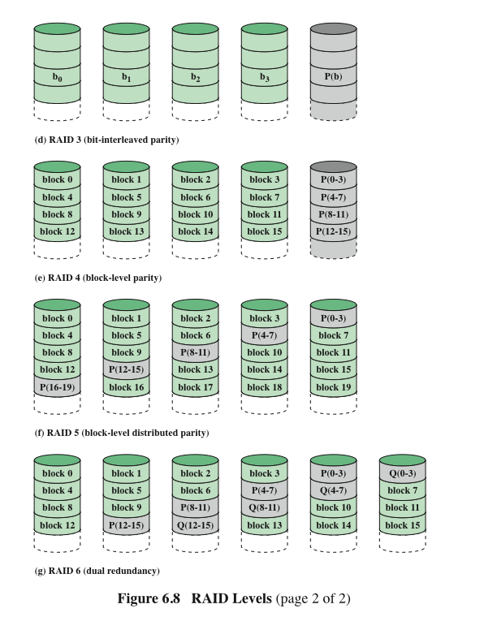
RAID Levels 3, 4, 5, 6
Notes:
Figure 6.8 continued.

Slide 22
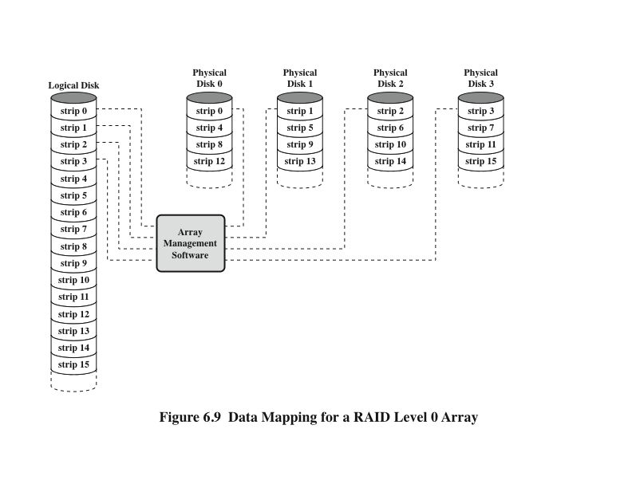
Data Mapping for a RAID Level 0 Array
Notes:
But RAID 0, as with all of the RAID levels, goes further than simply distributing
the data across a disk array: The data are striped across the available disks. This is
best understood by considering Figure 6.9. All of the user and system data are viewed
as being stored on a logical disk. The logical disk is divided into strips; these strips
may be physical blocks, sectors, or some other unit. The strips are mapped round
robin to consecutive physical disks in the RAID array. A set of logically consecutive
strips that maps exactly one strip to each array member is referred to as a stripe.
In an n-disk array, the first n logical strips are physically stored as the first strip on
each of the n disks, forming the first stripe; the second n strips are distributed as the
second strips on each disk; and so on. The advantage of this layout is that if a single
I/O request consists of multiple logically contiguous strips, then up to n strips for
that request can be handled in parallel, greatly reducing the I/O transfer time.
Figure 6.9 indicates the use of array management software to map between
logical and physical disk space. This software may execute either in the disk subsystem
or in a host computer.

Slide 23
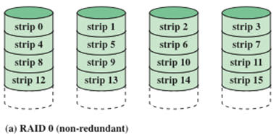
RAID Level 0
Addresses the issues of request patterns of the host systemand layout of the data
Impact of redundancy does not interfere with analysis
RAID 0 for High Data Transfer Capacity
RAID 0 for High I/O Request Rate
For applications to experience a high transfer rate two requirements must be met:
A high transfer capacity must exist along the entire path between host memory and the individual disk drives
The application must make I/O requests that drive the disk array efficiently
For an individual I/O request for a small amount of data the I/O time is dominated by the seek time and rotational latency
A disk array can provide high I/O execution rates by balancing the I/O load across multiple disks
If the strip size is relatively large multiple waiting I/O requests can be handled in parallel, reducing the queuing time for each request
Notes:
The performance of any of the
RAID levels depends critically on the request patterns of the host system and on
the layout of the data. These issues can be most clearly addressed in RAID 0, where
the impact of redundancy does not interfere with the analysis. First, let us consider
the use of RAID 0 to achieve a high data transfer rate. For applications to experience
a high transfer rate, two requirements must be met. First, a high transfer capacity
must exist along the entire path between host memory and the individual disk drives.
This includes internal controller buses, host system I/O buses, I/O adapters, and host
memory buses.
The second requirement is that the application must make I/O requests that
drive the disk array efficiently. This requirement is met if the typical request is for
large amounts of logically contiguous data, compared to the size of a strip. In this
case, a single I/O request involves the parallel transfer of data from multiple disks,
increasing the effective transfer rate compared to a single-disk transfer.
In a transaction-oriented environment, the user is typically more concerned with
response time than with transfer rate. For
an individual I/O request for a small amount of data, the I/O time is dominated by the
motion of the disk heads (seek time) and the movement of the disk (rotational latency).
In a transaction environment, there may be hundreds of I/O requests per second.
A disk array can provide high I/O execution rates by balancing the I/O load
across multiple disks. Effective load balancing is achieved only if there are typically
multiple I/O requests outstanding. This, in turn, implies that there are multiple independent
applications or a single transaction-oriented application that is capable of
multiple asynchronous I/O requests. The performance will also be influenced by the
strip size. If the strip size is relatively large, so that a single I/O request only involves
a single disk access, then multiple waiting I/O requests can be handled in parallel,
reducing the queuing time for each request.

Slide 24
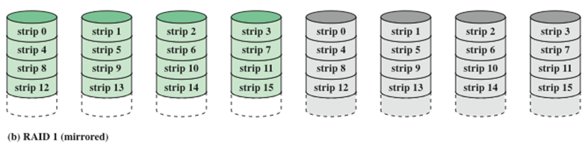
RAID Level 1
Characteristics
Differs from RAID levels 2 through 6 in the way in which redundancy is achieved
Redundancy is achieved by the simple expedient of duplicating all the data
Data striping is used but each logical strip is mapped to two separate physical disks so that every disk in the array has a mirror disk that contains the same data
RAID 1 can also be implemented without data striping, although this is less common
Positive Aspects
A read request can be serviced by either of the two disks that contains the requested data
There is no “write penalty”
Recovery from a failure is simple, when a drive fails the data can be accessed from the second drive
Provides real-time copy of all data
Can achieve high I/O request rates if the bulk of the requests are reads
Principal disadvantage is the cost
Notes:
RAID 1 differs from RAID levels 2 through 6 in the way in which redundancy is
achieved. In these other RAID schemes, some form of parity calculation is used to
introduce redundancy, whereas in RAID 1, redundancy is achieved by the simple
expedient of duplicating all the data. As Figure 6.8b shows, data striping is used, as
in RAID 0. But in this case, each logical strip is mapped to two separate physical
disks so that every disk in the array has a mirror disk that contains the same data.
RAID 1 can also be implemented without data striping, though this is less common.
There are a number of positive aspects to the RAID 1 organization:
1. A read request can be serviced by either of the two disks that contains the requested
data, whichever one involves the minimum seek time plus rotational
latency.
2. A write request requires that both corresponding strips be updated, but this
can be done in parallel. Thus, the write performance is dictated by the slower
of the two writes (i.e., the one that involves the larger seek time plus rotational
latency). However, there is no “write penalty” with RAID 1. RAID levels
2 through 6 involve the use of parity bits. Therefore, when a single strip is
updated, the array management software must first compute and update the
parity bits as well as updating the actual strip in question.
3. Recovery from a failure is simple. When a drive fails, the data may still be
accessed from the second drive.
The principal disadvantage of RAID 1 is the cost; it requires twice the disk
space of the logical disk that it supports. Because of that, a RAID 1 configuration
is likely to be limited to drives that store system software and data and other highly
critical files. In these cases, RAID 1 provides real-time copy of all data so that in the
event of a disk failure, all of the critical data are still immediately available.
In a transaction-oriented environment, RAID 1 can achieve high I/O request
rates if the bulk of the requests are reads. In this situation, the performance of RAID 1
can approach double of that of RAID 0. However, if a substantial fraction of the I/O
requests are write requests, then there may be no significant performance gain over
RAID 0. RAID 1 may also provide improved performance over RAID 0 for data
transfer intensive applications with a high percentage of reads. Improvement occurs
if the application can split each read request so that both disk members participate.

Slide 25
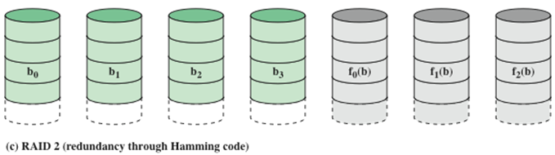
RAID Level 2
Characteristics
Performance
Makes use of a parallel access technique
In a parallel access array all member disks participate in the execution of every I/O request
Spindles of the individual drives are synchronized so that each disk head is in the same position on each disk at any given time
Data striping is used
Strips are very small, often as small as a single byte or word
An error-correcting code is calculated across corresponding bits on each data disk and the bits of the code are stored in the corresponding bit positions on multiple parity disks
Typically a Hamming code is used, which is able to correct single-bit errors and detect double-bit errors
The number of redundant disks is proportional to the log of the number of data disks
Would only be an effective choice in an environment in which many disk errors occur
Notes:
RAID levels 2 and 3 make use of a parallel access technique. In a parallel access
array, all member disks participate in the execution of every I/O request. Typically,
the spindles of the individual drives are synchronized so that each disk head is in the
same position on each disk at any given time.
As in the other RAID schemes, data striping is used. In the case of RAID 2
and 3, the strips are very small, often as small as a single byte or word. With RAID 2,
an error-correcting code is calculated across corresponding bits on each data disk,
and the bits of the code are stored in the corresponding bit positions on multiple
parity disks. Typically, a Hamming code is used, which is able to correct single-bit
errors and detect double-bit errors.
Although RAID 2 requires fewer disks than RAID 1, it is still rather costly.
The number of redundant disks is proportional to the log of the number of data
disks. On a single read, all disks are simultaneously accessed. The requested data
and the associated error-correcting code are delivered to the array controller. If
there is a single-bit error, the controller can recognize and correct the error instantly,
so that the read access time is not slowed. On a single write, all data disks and parity
disks must be accessed for the write operation.
RAID 2 would only be an effective choice in an environment in which many
disk errors occur. Given the high reliability of individual disks and disk drives,
RAID 2 is overkill and is not implemented.

Slide 26
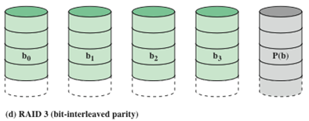
RAID Level 3
Performance
Redundancy
In the event of a drive failure, the parity drive is accessed and data is reconstructed from the remaining devices
Once the failed drive is replaced, the missing data can be restored on the new drive and operation resumed
In the event of a disk failure, all of the data are still available in what is referred to as reduced mode
Return to full operation requires that the failed disk be replaced and the entire contents of the failed disk be regenerated on the new disk
In a transaction-oriented environment performance suffers
Requires only a single redundant disk, no matter how large the disk array
Employs parallel access, with data distributed in small strips
Instead of an error correcting code, a simple parity bit is computed for the set of individual bits in the same position on all of the data disks
Can achieve very high data transfer rates
Notes:
RAID 3 is organized in a similar fashion to RAID 2. The difference is that RAID
3 requires only a single redundant disk, no matter how large the disk array. RAID
3 employs parallel access, with data distributed in small strips. Instead of an error correcting
code, a simple parity bit is computed for the set of individual bits in the
same position on all of the data disks.
In the event of a drive failure, the parity drive is accessed and data
is reconstructed from the remaining devices. Once the failed drive is replaced, the
missing data can be restored on the new drive and operation resumed.
In the event of a disk failure, all of the data are still available in what is referred
to as reduced mode. In this mode, for reads, the missing data are regenerated on the
fly using the exclusive-OR calculation. When data are written to a reduced RAID 3
array, consistency of the parity must be maintained for later regeneration. Return to
full operation requires that the failed disk be replaced and the entire contents of the
failed disk be regenerated on the new disk.
Because data are striped in very small strips, RAID 3 can achieve
very high data transfer rates. Any I/O request will involve the parallel transfer of
data from all of the data disks. For large transfers, the performance improvement is
especially noticeable. On the other hand, only one I/O request can be executed at a
time. Thus, in a transaction-oriented environment, performance suffers.

Slide 27
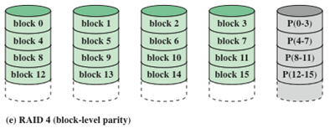
RAID Level 4
Characteristics
Makes use of an independent access technique
In an independent access array, each member disk operates independently so that separate I/O requests can be satisfied in parallel
Data striping is used
Strips are relatively large
To calculate the new parity the array management software must read the old user strip and the old parity strip
Performance
Involves a write penalty when an I/O write request of small size is performed
Each time a write occurs the array management software must update the user data the corresponding parity bits
Thus each strip write involves two reads and two writes
Notes:
RAID levels 4 through 6 make use of an independent access technique. In an independent
access array, each member disk operates independently, so that separate
I/O requests can be satisfied in parallel. Because of this, independent access arrays
are more suitable for applications that require high I/O request rates and are relatively
less suited for applications that require high data transfer rates.
As in the other RAID schemes, data striping is used. In the case of RAID
4 through 6, the strips are relatively large. With RAID 4, a bit-by-bit parity strip
is calculated across corresponding strips on each data disk, and the parity bits are
stored in the corresponding strip on the parity disk.
RAID 4 involves a write penalty when an I/O write request of small size is performed.
Each time that a write occurs, the array management software must update
not only the user data but also the corresponding parity bits.
To calculate the new parity, the array management software must read the old
user strip and the old parity strip. Then it can update these two strips with the new
data and the newly calculated parity. Thus, each strip write involves two reads and
two writes.
In the case of a larger size I/O write that involves strips on all disk drives, parity
is easily computed by calculation using only the new data bits. Thus, the parity drive
can be updated in parallel with the data drives and there are no extra reads or writes.
In any case, every write operation must involve the parity disk, which therefore
can become a bottleneck.

Slide 28
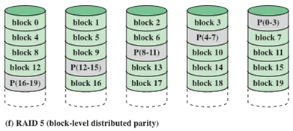
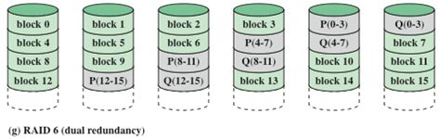
RAID Level 5
RAID Level 6
Characteristics
Characteristics
Organized in a similar fashion to RAID 4
Difference is distribution of the parity strips across all disks
A typical allocation is a round-robin scheme
The distribution of parity strips across all drives avoids the potential I/O bottleneck found in RAID 4
Two different parity calculations are carried out and stored in separate blocks on different disks
Advantage is that it provides extremely high data availability
Three disks would have to fail within the mean time to repair (MTTR) interval to cause data to be lost (usually expressed in hours)
Incurs (bears) a substantial write penalty because each write affects two parity blocks
Notes:
RAID 5 is organized in a similar fashion to RAID 4. The difference is that RAID
5 distributes the parity strips across all disks. A typical allocation is a round-robin
scheme, as illustrated in Figure 6.8f. For an n-disk array, the parity strip is on a
different disk for the first n stripes, and the pattern then repeats.
The distribution of parity strips across all drives avoids the potential I/O
bottle-neck found in RAID 4.
RAID 6 was introduced in a subsequent paper by the Berkeley researchers
[KATZ89]. In the RAID 6 scheme, two different parity calculations are carried out
and stored in separate blocks on different disks. Thus, a RAID 6 array whose user
data require N disks consists of N + 2 disks.
Figure 6.8g illustrates the scheme. P and Q are two different data check algorithms.
One of the two is the exclusive-OR calculation used in RAID 4 and 5. But
the other is an independent data check algorithm. This makes it possible to regenerate
data even if two disks containing user data fail.
The advantage of RAID 6 is that it provides extremely high data availability.
Three disks would have to fail within the MTTR (mean time to repair) interval to
cause data to be lost. On the other hand, RAID 6 incurs a substantial write penalty,
because each write affects two parity blocks. Performance benchmarks [EISC07]
show a RAID 6 controller can suffer more than a 30% drop in overall write performance
compared with a RAID 5 implementation. RAID 5 and RAID 6 read
performance is comparable.

Slide 29
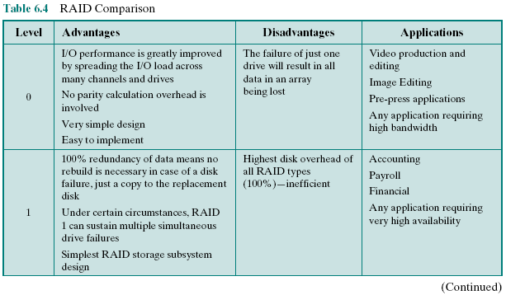
Table 6.4: RAID Comparison (page 1 of 2)
Notes:
Table 6.4 is a comparative summary of the seven levels.

Slide 30
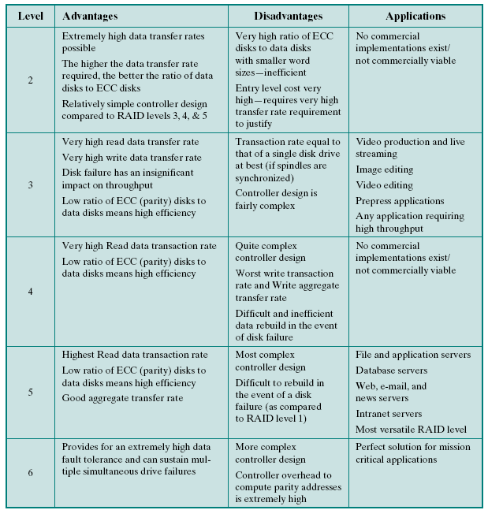
Table 6.4
RAID Comparison (page 2 of 2)
Notes:
Table 6.4 RAID comparison (page 2 of 2)

Slide 31

If you have any question ...
Ask google, don’t ask me <3

