Slide 1
Chapter 5:
Counting

Slide 2
Objectives
Some questions we can face:
  “How can we determine the complexity of an algorithm?”
  “How many cases possible are there to arrange n objects?”
  “How can we generate input data from given initial data?”
  A password consists of six characters. How many such password with some criteria?
  How many bit strings of length n that do not have two consecutive 0s?

Slide 3
Contents
The basics of Counting
Recurrence relations
Divide – and – Conquer Algorithms and recurrence relations

Slide 4
5.1- The Basics of Counting
Basic Counting Principles : Product rule, sum rule, The Inclusion-Exclusion Principle
Tree Diagrams
Notes:
- The basic rules of counting, which we will study in Section 5.1, can solve a tremendous variety of problems. For instance, we can use these rules to enumerate the different telephone numbers possible in the Viet Nam, the allowable passwords on a computer system, and the
different orders in which the runners in a race can finish.

Slide 5
Basic Counting Principle
Ex: Distribute 3 distinct balls to 2 bags
We must do 3 times, each time we have 2 ways to select a bags.
2.2.2 = 2³ ways
v
A
v
v
B
v
A
v
A
A
v
v
B
B
v
A
v
There are r^{n} ways to distribute n distinct objects to r bags
v
B
v
A
v
A
B
v
v
B
B

Slide 6
Basic Counting Principle
12 teams. How many ways to select 3 teams for the first, second and third teams
I
II
III
Select 1/ 12
→ 12 ways
After select 1 team for the first position, one of 11 teams can be select into the second team
➔ 11 ways
After select 1 team for the second position, one of 10 remaining teams can be select into the third team
➔ 10ways
12.11.10= 1320 ways

Slide 7
Basic Counting Principle: Product rule
Suppose that a procedure can be broken down into a sequence of two tasks. If there is n₁ ways to do the first task, there is n₂ ways to do the second task, then there are n₁n₂ ways to do the procedure.
Example 1: 2 persons, 12 rooms. How many ways are there to assign different room to these two person?
12 ways can be applied to assign the first
11 ways can be applied to assign the second after the first assigned.
➔ 12.11= 132 ways.
Examples 3, 4, 5,6,7,8,9: Refer to pages 336, 337
Notes:
- Examples on pages 336,337: counting functions, counting one-to-one functions, counting subsets of a finite set, counting number of bit strings by using the product rule.

Slide 8
Basic Counting Principle: Sum rule
If a task can be done either in one of n₁ ways or in one of n₂ ways, where none of the set of n₁ ways is the same as any of the set of n₂ ways, then there are n₁ + n₂ ways to do this task.
Example 11: There are 37 faculties, 83 students. A person either a faculty or student can be choose to attend a committee. How many ways are there to select such person?
37 + 83= 120 ways
Examples 12, 13: Refer to page 339

Slide 9
Basic Counting Principles…
Example 14: Name of a variable in BASIC language, an case insensitive language, is a string of 1 or 2 characters in which the first must be a character, the second may be an alphanumeric characters, and must be different from 5 two-character keywords . How many different variable names are there?
26 characters (a..z), 10 digits (0..9)
Name with 1 character: 26
Name with 2 character: 26.36 -5 =931
➔ There are 957 different names
Notes:
- Many counting problems cannot be solved using just the sum rule or just the product rule. However, many complicated counting problems can be solved using both of these rules in combination.

Slide 10
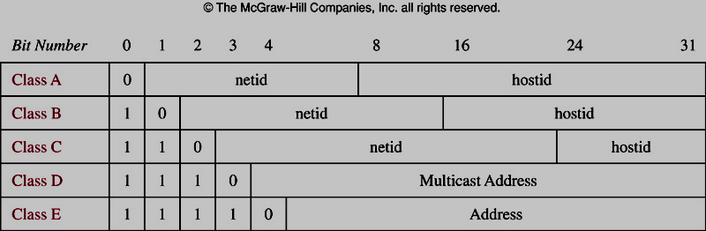
Basic Counting Principles…
Example 16 – page 341:Counting Internet Address
Class A address: largest networks
Class B address: medium-sized networks
Class C address: smallest networks.
IPv4
Notes:
In Version 4 of the Internet Protocol (IPv4), an address is a string of 32 bits.
The total number of IPv4 addresses available is 3,737,091 ,842.

Slide 11
Basic Counting Principles:
The Inclusion-Exclusion Principle
Suppose that a task can be done in n₁ or n₂ ways, but that some ways in the set of n₁ ways are the same as some ways in the set of n₂ ways.
n_{s} : number of ways that are the same in two sets of ways.
Total ways n= n₁+ n₂ –n_{S}
Example 17: How many 8-bit strings either start with 1 or end with 00?
2⁷ + 2⁶ – 2⁵ = 160 – Refer to page 342
|A∪B|=|A| + |B| - |A∩B|
Notes:
- We can phrase the inclusion-exclusion principle in terms of sets, where the total number of ways is the number of elements in the union of two sets.

Slide 12
Basic Counting Principles:
The Inclusion-Exclusion Principle
Example 18:
350 applications, in which
A1: 220 people majored in IT
A2: 147 people majored in business
A3: 51 people majored both in IT and business
How many applicants majored neither in IT nor business?
Number of applicants who majored either IT or business = (|A1| + |A2| - |A3|) = 220+147-51=316
Result: 350 – 316 = 34
Notes:
- Note that the principle of inclusion-exclusion can be generalized to find the number of ways to do one of n different tasks or, equivalently, to find the number of elements in the union of n sets, whenever n is a positive integer. But this is not considered here.

Slide 13
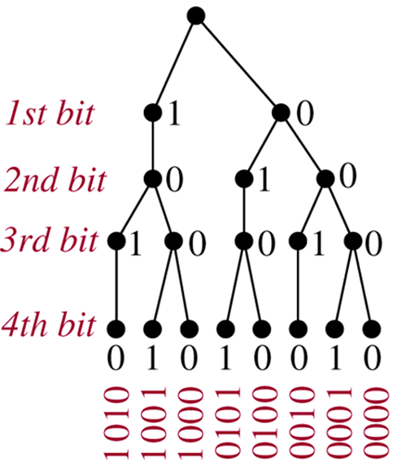
Tree Diagrams
Counting problem can be solved using Tree Diagram.
Example: How many 4-bit strings do not have two consecutive 1s?
Notes:
Counting problems can be solved using tree diagrams. A tree consists of a root, a number of branches leaving the root, and possible additional branches leaving the endpoints of other branches.
To use trees in counting, we use a branch to represent each possible choice.
The possible outcomes are represented by the leaves.

Slide 14
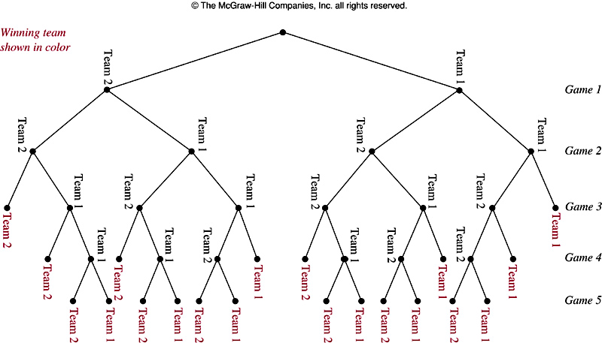
Example 20: A playoff between two teams consists of at lost 5 games. The first team that wins 3 games wins the playoff. In how many different ways can the playoff occur?

Slide 15
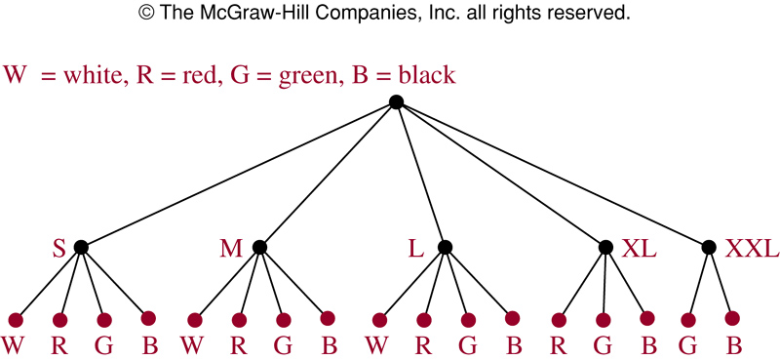
Example 22: T-Shirts come in 5 sizes: S, M, L, XL, XXL. Each size comes in 4 colors, W, R, G, B excepts for XL, which comes only in R, G, B, and XXL, which comes only in G and B.
How many different shirts a souvenir shop have to stock to have at least one of each available size and color of the T_shirt?

Slide 16
Summary
Product rule: Suppose that a procedure can be broken down into a sequence of two tasks. If there is n1 ways to do the first task, there is n2 ways to do the second task, then there are n1n2 ways to do the procedure.
Sum rule: If a task can be done either in one of n1 ways or in one of n2 ways, where none of the set of n1 ways is the same as any of the set of n2 ways, then there are n1 + n2 ways to do this task.

Slide 17
Summary
Inclusion-Exclusion Principle: Suppose that a task can be done in n1 or n2 ways, but that some ways in the set of n1 ways are the same as some ways in the set of n2 ways.

