Slide 1
Chapter 7:
Recurrence Relations

Slide 2
7.1. Recurrence Relations
Definition 1: Recurrence relation on the sequence { a_{n} }:
a_{n} is expressed in terms of one or more of previous items for all n with n ≥ n₀
{a_{n}} is called a solution of recurrence relation.
Example 1: a₀=3, a₁= 5 a_{n}=a_{n-1} – a_{n-2} , n>1
Example 2: Determine whether {a_{n}} = 3n, n ≥ 0 is a solution of the recurrence relation a_{n}= 2a_{n-1} – a_{n-2}, n ≥ 2?
Initial conditions: Terms that precede the first item where the recurrence takes effect.
Notes:
Some of the counting problems that cannot be solved by using basic principle rules can be solved by finding relationships, called recurrence relations, between the terms of a sequence.
In example 1, a₀=3, a₁= 5 are the initial conditions (a₀, a₁ are terms that precede a₂, which is the first item where the recurrence takes effect).
The recurrence relation and initial conditions uniquely determine a sequence. A recurrence relation, together with initial conditions, provide a recursive definition of the sequence.

Slide 3
Modeling with Recurrence Relations
Problem ← Modeling with recurrence relation
Example 3 (page 451): Compound interest Problem – Lãi gộp:
P₀: Initial deposite
r: interest rate per year
P_{n}: amount at the n^{th} year
P_{n}= P_{n-1} + rP_{n-1}
➔ P_{n}= (1+r)^{n}P₀
Notes:
We can use recurrence relations to model a wide variety of problems, such as finding compound interest, counting rabbits on an island, determining the number of moves in the Tower of Hanoi puzzle, and counting bit strings with certain properties.

Slide 4
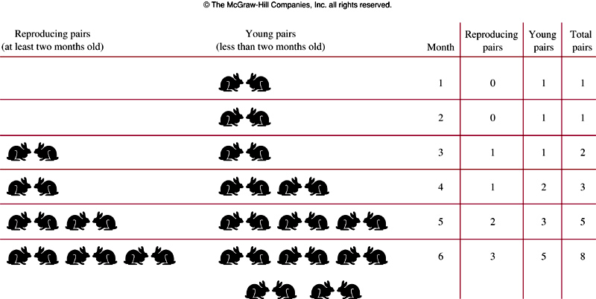
Fibonacci numbers of Leonardo Pisano
Example 4: : f₁=f₂=1; f_{n}= f_{n-2} + f_{n-1}
Notes:
f_{n}: the number of pairs of rabbits after n months.
f_{n} = number of old pairs (f_{n-1}) + number of newborn pairs (f_{n-2}).
Each newborn pair comes from a pair at least 2 months old.

Slide 5
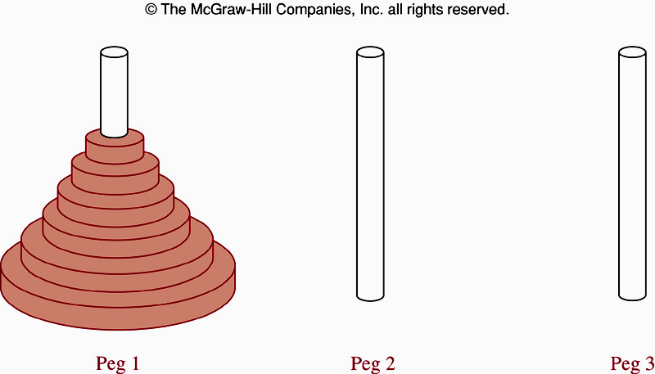
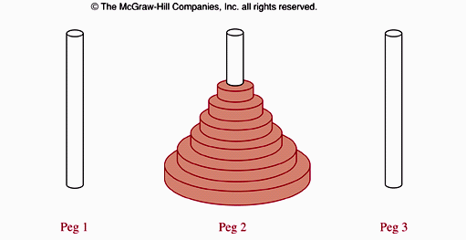
The Tower of Hanoi Problem- Ex5, page 452
How many steps this problem is solved if there are n disks on the peg 1?
Notes:
A popular puzzle of the late nineteenth century invented by the French mathematician Edouard Lucas, called the Tower of Hanoi.
Three pegs mounted on a board together with disks of different sizes. Initially these disks are placed on the first peg in order of size, with the largest on the bottom.
Rules: Disks to be moved one at a time from one peg to another as long as a disk is never placed on top of a smaller disk.
Goal: all the disks on the second peg in order of size, with the largest on the bottom.
Question: How many moves needed to solve the Tower of Hanoi problem with n disks?

Slide 6
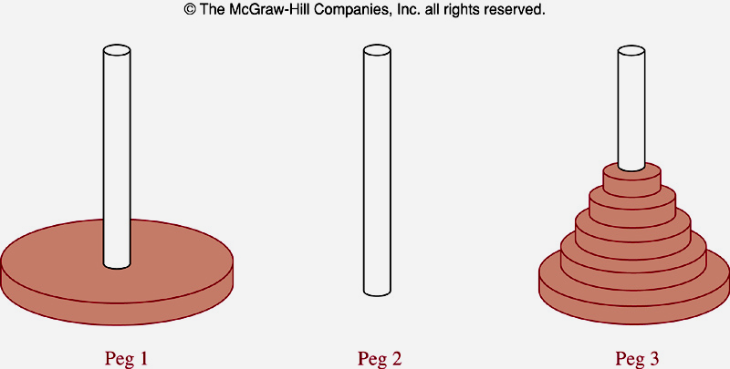
The Tower of Hanoi Problem- Ex5, page 452
Let H_{n} is the number of moves needed to solve the Tower of Hanoi problem. We will set up a recurrence relation for the sequence H_{n}.
Begin with n disk on peg 1.
We transfer the top n-1 disk from peg1 to peg3 → H_{n-1} moves .
We transfer the largest disk from peg1 to peg 2 → 1 move
We transfer n-1 disk from peg3 to peg 2
H_{n}= 2H_{n-1} + 1
H₁=1 ➔H_{n}= 2^{n} -1 ( See page 453)
n=64 → 2⁶⁴-1=18 446 744 073 709 551 615. With 1 move/sec → 500 billion years.

Slide 7
Find recurrence relation and give initial conditions for the number of bit strings of length n that do not have two consecutive 0s. How many such bit strings are there of length five.
a_{n}: number of bit string of length n that do not have two consecutive 0s.
One bit string can terminate with bit 1 or 0
Format of a bit string that do not have two consecutive 0s:
End with 1
Any bit string of length n-1 with no two consecutive 0s
1
End with 0
Any bit string of length n-2 with no two consecutive 0s
1 0
a_{n} = a_{n-1} + a_{n-2} for n ≥ 3 { Fibonacci sequence }
a₁=2 { two string “0” and “1” }
a₂= 3 { “10” , “01” , “11” }
With n=5
a₃ = a₂+ a₁ =5
a₄= a₃ + a₂ = 5+3=8
a₅=a₄ + a₃ = 8+5=13
Notes:
With n = 4: strings end with 0: 0000, 0010, 0100, 0110, 1000, 1010, 1100, 1110 → a₂ strings
strings end with 1: 0001, 0011, 0101, 0111, 1001, 1011, 1101, 1111 → a₃ strings
- a₄ = a₂ + a₃

Slide 8
Counting valid codewords valid codeword: String of decimal digits that contains an even number of 0 digits.
a_{n}: number of valid n-digit codewords
Find a recurrence relation for a_{n}
a₁=9 // “1”, “2”, …, “9” ➔ “0” is not used
Study a_{n}:
Valid codeword with n-1 digits
1..9
9a_{n-1} ways
Invalid codeword with n-1 digits ( number of 0s is odd)
0
10^{n-1} - a_{n-1} ways
All possible codewords minus valid codewords
a_{n}= 9a_{n-1} + 10^{n-1} - a_{n-1} = 8a_{n-1} + 10^{n-1}
Notes:
- 1230407869 is valid, whereas 120987045608 is not valid.

Slide 9
7.3. Divide-and-Conquer Algorithms and recurrence Relations
Divide: Dividing a problem into one or more instances of the same problem of smaller size
Conquer: Using the solutions of the smaller problems to find a solution of the original problem, perhaps with some additional work.
Notes:
- Many recursive algorithms take a problem with a given input and divide it into one or more smaller problems.

Slide 10
Divide-and-Conquer Recurrence Relations
n : size of the original problem
n/b : size of the sub-problem
f(n) : number of operation required to solve the original problem.
→ f(n/b) : number of operation required to solve a sub-problem.
g(n): overhead for additional work of the step conquer.
Divide-and-conquer recurrence relation:
f(n) = af(n/b) + g(n)
Notes:
- g(n): extra operations are required in the conquer step of the algorithm to combine the solutions of the sub-problems into a solution of
the original problem.

Slide 11
Recurrence Relations for Binary Search
procedure binary-search(x, i, j)
if i>j then location=0
m= ⎣(i+j)/2⎦
if x= a_{m} then location =m
else if x< a_{m} then location= binary-search(x, i, m-1)
else location= binary-search(x, m+1, j)
f(n) = f(n/2) +2
Notes:
- In binary search, a problem of size n has been reduced to ONE problem of size n/2.

Slide 12
Recurrence Relations for Finding Maximum of a sequence
procedure max(i,j: integer ,a_{i},a₂₊₁,…,a_{j}: integers)
if i=j then
begin
max:= a_{i}
end
else
begin
m= ⎣(i+j)/2⎦
max1= max (i,m,a_{i},a_{i+1},…,a_{m})
max2= max (m+1,j,a_{m+1},a_{m+2},…,a_{j})
if max1>max2 then max:= max1
else max:=max2
f(n) = 2f(n/2) +1
Notes:
- The problem is reduced to finding the maximum of each of two smaller sequences. A problem of size has been reduced into TWO problems of size n/2.

Slide 13

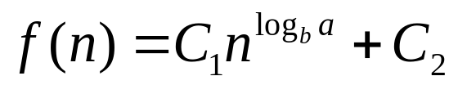
Theorem 1
Let f be an increasing function that satisfies the recurrence relation f(n)= af(n/b) + c
whenever n is divisible by b, where a ≥ 1 , b is an integer and greater than 1, and c is a positive real number. Then
Furthermore, when n=b^{k}, where k is a positive integer,
Where C₁=f(1) + c/(a-1) and C₂= -c/(a-1)
Proof: page 477
Notes:
- We can use the equation of f(n) to estimate the size of functions that satisfy divide-and-conquer recurrence relations.

Slide 14
Using Theorem 1
Example 6: f(n)= 5f(n/2) + 3, f(1)=7. Find f(2^{k}), k is a positive integer. Estimate f(n) if f is increasing function.
Using theorem 1: a= 5, b=2, c=3, n=2^{k}
C₁=f(1) + c/(a-1) = 7+3/(5-1)= 7+3/4=31/4
C₂= -c/(a-1) = -3/(5-1)= -3/4
n^{loga} = 2^{kloga} = a^{k} { loga ≡ log₂a }
f(n)= f(2^{k}) C₁a^{k} + C₂ = a^{k}.31/4 -3/4
f is increasing function , a>1 → f(n) = O(n^{loga}) = O(n^{log5})
Estimate the number of comparisons used by a binary search
f(n) = f(n/2) +2, a=1 → f(n) = O(log n) // theorem 1
Estimate the number of comparisons to locate the maximum element in a sequence
f(n) = 2f(n/2) +1, a=2 → f(n) = O(n^{log a}) = O(n) // theorem 1

Slide 15
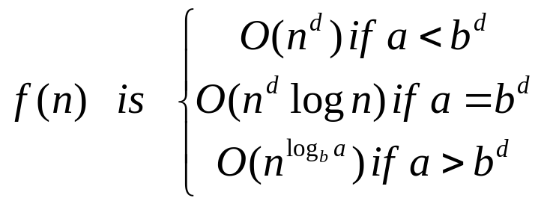
Theorem 2: Master Theorem
Let f be an increasing function that satisfies the recurrence relation f(n) = af(n/b) + cn^{d}
Whenever n= b^{k}, where k is a positive integer, a ≥ 1, b is an integer greater than 1, and c and d are real numbers with c positive and d nonnegative. Then
Notes:
The Master theorem is useful in analyzing the complexity of many important divide-and-conquer algorithms.
Theorem 1 is a special case of this theorem.

Slide 16
An Demonstration: Closest-Pair Problem
n points in the plane. How to determine the closest-pair of points?
(1) Determine the distance of every pair of points.
(2) Determine the pair of points that have minimum distance.
➔ C(n,2)= n(n-1)/2= O(n²)
Michal Samos proposed an approach that is O(nlogn) only.
Michal Samos’s approach
(1) Sorting points in order of increasing x coordinates → O(nlog(n))
(2) Sorting points in order of increasing y coordinates → O(nlog(n))

Slide 17
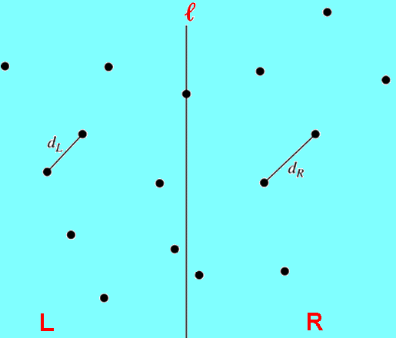
An Demonstration: Closest-Pair Problem
(3) Using recursive approach to divide the problem into 2 subproblem with n/2 points (left and right points based on x coordinates). Let ℓ is the line that partitions two subproblems. If there is any point on this dividing line, we decide these points among the two parts if necessary)
(4) Finding out closest-pair of points in two side ( d_{L}, d_{R})
(5) Let d=min(d_{L}, d_{R})
16 points
8 points
8 points

Slide 18
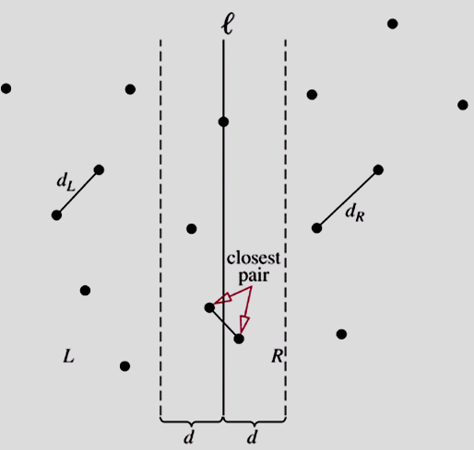
An Demonstration: Closest-Pair Problem
(6) Studying area [l-d,l+d]. This area may be contains the result.
(7) Because we sorted points by their y coordinate. We examine for points p in the strip of width 2d that has the line l as its center with upward direction.

Slide 19
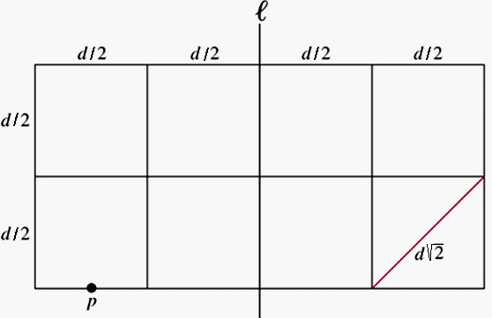
An Demonstration: Closest-Pair Problem
Total number of points in the strip does not exceed n and there are at most 8 points, including p, can lie in or on the 2dxd rectangle.
➔A point will be computed with 7 others.
At most 7n distances need to be compare with d to find the minimum distance between points.
The increasing function f(n) satisfies the recurrence relation :
f(n) = 2f(n/2) + 7n
➔ By the Master Theorem, it follows that f(n) is O(nlogn)
Notes:
The pigeonhole principle: If N objects are placed into k boxes, then there is at least one box containing at least ⎡N/k⎤ objects.
If there are more than 8 points in or on the 2dxd rectangle, there are at least two point in/on at least one d/2 x d/2 square and the distance between two points is less than or equal to the diagonal length (and <d).

Slide 20
Summary
Recurrence relation on the sequence { a_{n} } is an expression in which a_{n} is expressed in terms of one or more of previous items for all n with n ≥ n₀ . {an} is called a solution of recurrence relation.
Initial conditions: Terms that precede the first item where the recurrence takes effect.
Modeling with recurrence relation: Finding out an recurrence relation for input of a problem.

Slide 21
Summary
Divide: Dividing a problem into one or more instances of the same problem of smaller size
Conquer: Using the solutions of the smaller problems to find a solution of the original problem, perhaps with some additional work
Recurrence relation: f(n) = af(n/b) + g(n)

Slide 22
Summary – Theorem 1
Let f be an increasing function that satisfies the recurrence relation f(n)= af(n/b) + c
whenever n is divisible by b, where a ≥ 1 , b is an integer and greater than 1, and c is a positive real number. Then
Furthermore, when n=b^{k}, where k is a positive integer,
Where C₁=f(1) + c/(a-1) and C₂= -c/(a-1)
Proof: page 477

Slide 23
Summary – Theorem 2- Master Theorem
Let f be an increasing function that satisfies the recurrence relation f(n) = af(n/b) + cn^{d}
Whenever n= b^{k}, where k is a positive integer, a ≥ 1, b is an integer greater than 1, and c and d are real numbers with c positive and d nonnegative. Then

Slide 24
THANKS

