Slide 1
Chapter 9-Graphs
“One graph is worth a thousand logs.”
Michal Aharon, Gilad Barash, Ira Cohen and Eli Mordechai.

Slide 2
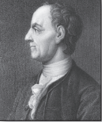
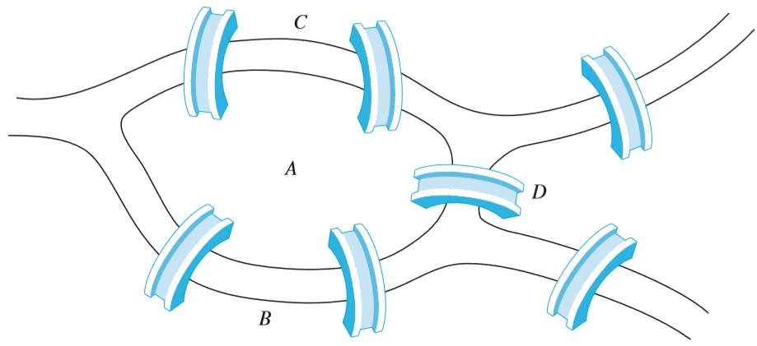
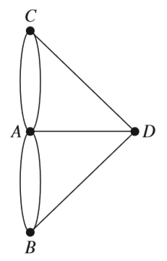
Introduction
LEONHARD EULER
(1707–1783)
The Seven Bridges of Königsberg.
Multigraph Model

Slide 3
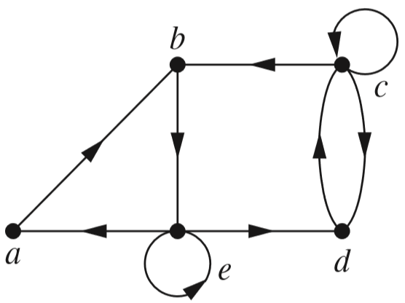
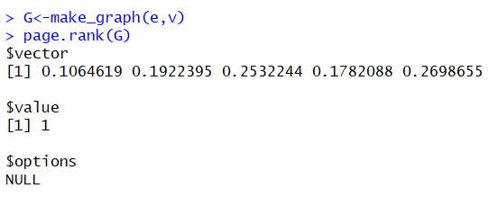
Introduction
Web Graph
Google PageRank
A network with 5 websites and links

Slide 4
Objectives
9.1- Graphs and Graph Models
9.2- Graph Terminology and Special Types of Graphs
9.3- Representing Graphs and Graph Isomorphism
9.4- Connectivity
9.5- Euler and Hamilton Paths
9.6- Shortest Path Problems

Slide 5
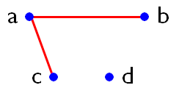
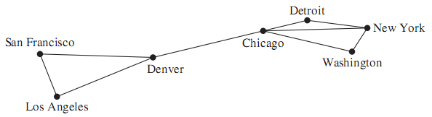
Graphs
Graphs = (vertices, edges) ➔ G = (V, E)
V = vertices = { a, b, c, d }
E = edges = { {a, b}, {a, c} }
Computer network

Slide 6
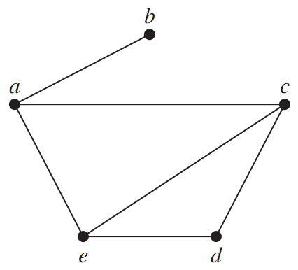
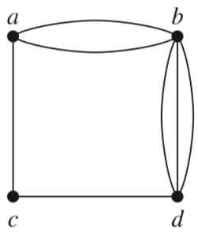
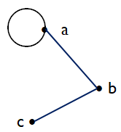
Simple graphs
Non-simple graph
with multi-edges
Non-simple graph
with loops
Simple graph

Slide 7
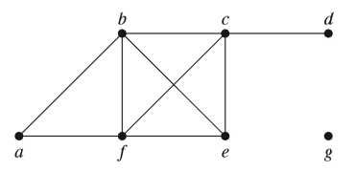
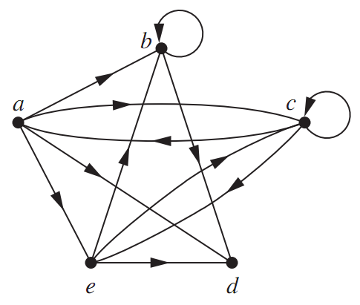
Types of graphs
An undirected graph
A directed graph
(digraph)

Slide 8
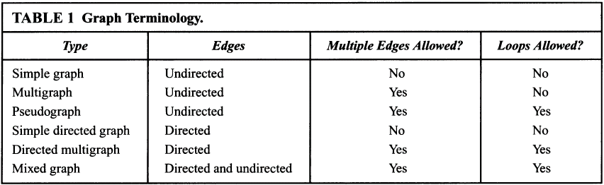
Graphs and Graph Models….
Notes:
The terminology for the various types of graphs is summarized in Table 1.
Three key questions can help us understand the structure of a graph:
Are the edges of the graph undirected or directed (or both)?
If the graph is undirected, are multiple edges present that connect the same pair of vertices?
Are loops present?

Slide 9
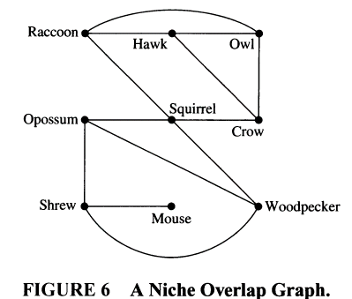
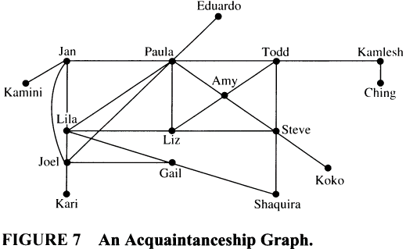
Graphs and Graph Models….
Niche Overlap Graph in Ecology
(sinh thái học) – Đồ thị lấn tổ
Acquaintanceship Graph
Đồ thị cho mô hình quan hệ giữa người
Notes:
If the relationship between objects is symmetric → an undirected graph is used. Otherwise, a directed graph usually works best.
A Niche Overlap Graph: representing competition between species in an ecosystem, where each species is represented by a vertex and an undirected edge connects two vertices if the two species represented by these vertices compete → no loop, no multiple edges → simple graph.
An Acquaintanceship Graph: representing represent whether two people know each other, that is, whether they are acquainted, where each person is represented by a vertex and an undirected edge is used to connect two people when these peo­ple know each other → no loop, no multiple edges → simple graph.

Slide 10
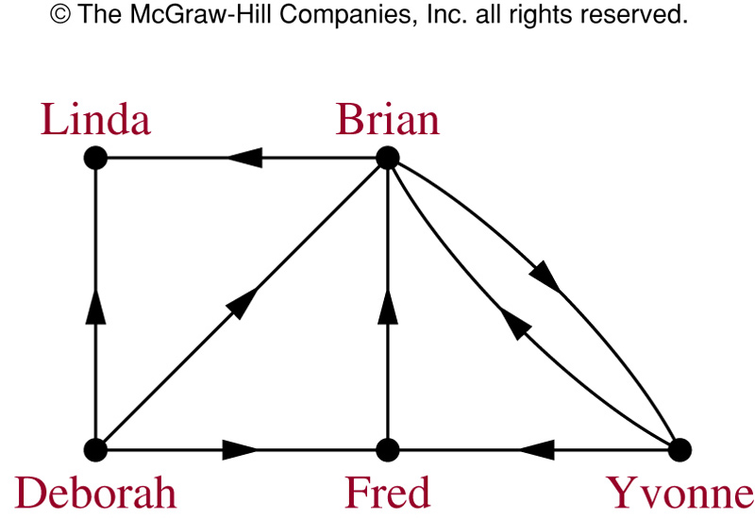
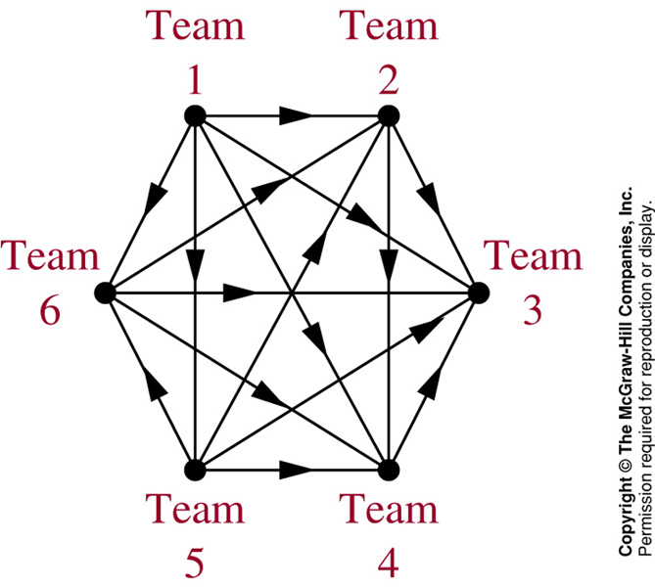
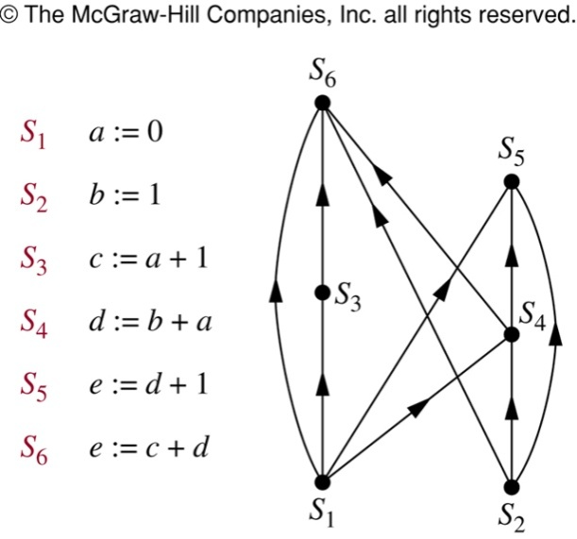
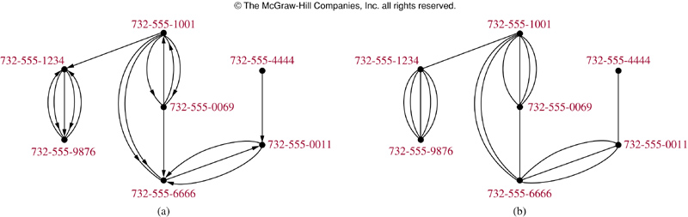
Graphs and Graph Models….
An Influence Graph
A Graph Model of a Round-Robin Tournament
An Precedence Graph
Call Graph
Notes:
A Round Robin Tournament Graph: a tournament where each team plays each other team exactly once is called a round-robin tournament. Each team is represented by a vertex and (a, b) is an edge if team a beats team b → directed graphs with no loop and no multiple edges.
An Precedence Graph: in computer programs, some statements requires results of statements not yet executed. Each statement is represented by a vertex, and there is an edge from one vertex to a second vertex if the statement represented by the second vertex cannot be executed before the statement represented by the first vertex has been executed → directed graph, no loop, no multiple edges.
Other graph models: Influence Graphs, Call Graphs

Slide 11
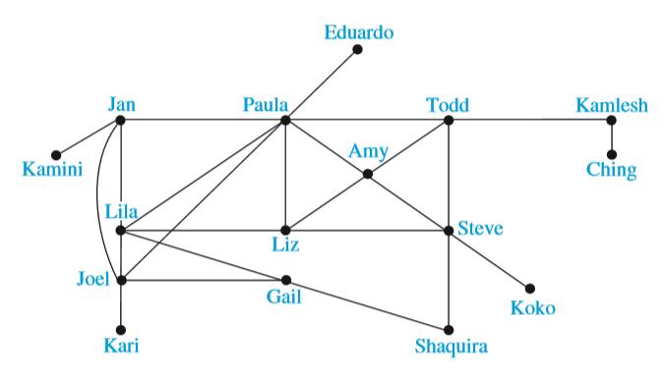
Graph models - Social networks

Slide 12
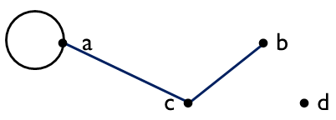
Basic Terminology
If an edge {u, v} exists, then u and v are called adjacent
The edge {u, v} is called incident with u and v
vertex | adjacency list
a | a, c
b | c
c | a, b
d
edge | incident vertices
{a, a} | a
{a, c} | a, c
{c, b} | c, b

Slide 13
Basic Terminology
The degree of a vertex v:
= the number of edges incident with v, except that a loop at a vertex contributes twice.
Notation: deg(v)
vertex | degree
a | 3
b | 1
c | 2
d | 0
b is called pendant
d is called isolated
∑_{degree}= 6
Remark: ∑_{degree} = 2| Edges |

Slide 14
THE HANDSHAKING THEOREM (for undirected graphs)
3 edges: {a, a}, {c, b}, {a, c}
deg(a) = 3
deg(b) = 1
deg(c) = 2
deg(d) = 0
∑_{deg}= 6
THE HANDSHAKING THEOREM:
(one edge = two degrees)
Σ_{v∈V}deg(v) = 2|E|
“the sum of the degrees is twice the number of edges”.
always EVEN

Slide 15
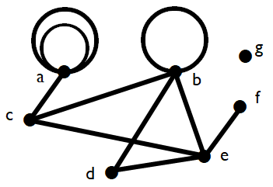
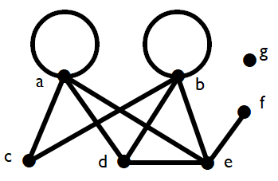
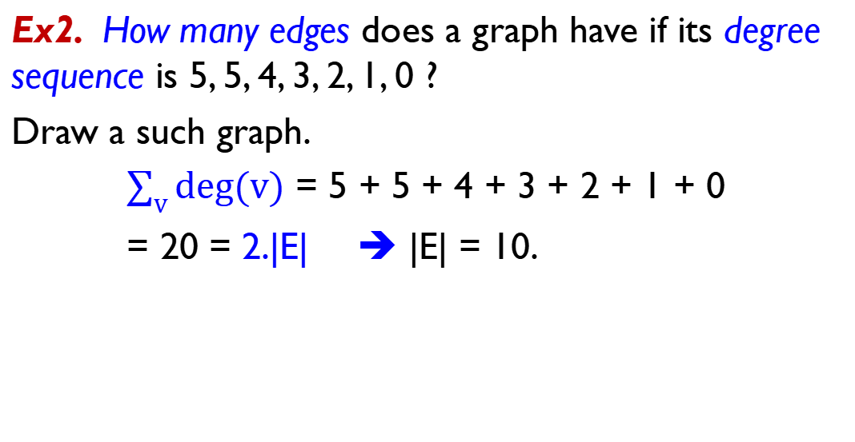
THE HANDSHAKING THEOREM - Examples
Ex2. How many edges does a graph have if its degree sequence is 5, 5, 4, 3, 2, 1, 0 ?
Draw a such graph.
$\sum_{v}{deg⁡(v)}$ = 5 + 5 + 4 + 3 + 2 + 1 + 0
= 20 = 2.|E| ➔ |E| = 10.

Slide 16
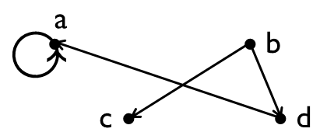
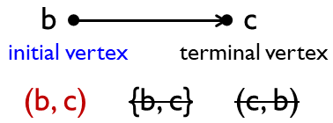
Directed graphs -Basic Terminology
Vertex | In-degree deg⁻ | Out-degree deg⁺
a | 2 | 1
b | 0 | 2
c | 1 | 0
d | 1 | 1
∑_{deg-} = ∑_{deg+}
= 4
directed edges

Slide 17
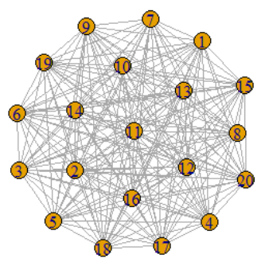
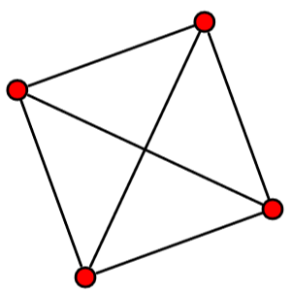
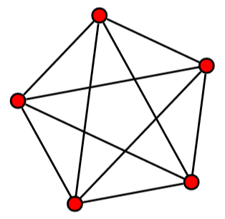
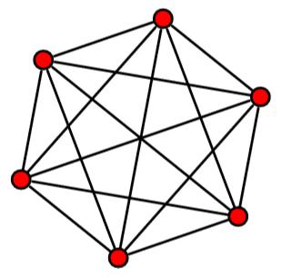
Special simple graphs
Complete graphs K_{n} (n ≥1)
K₄
K₅
K₆
K₂₀

Slide 18
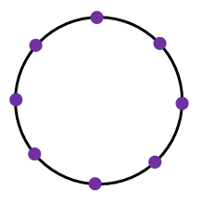
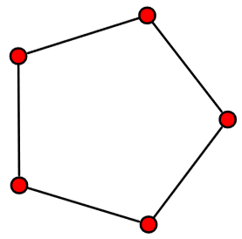
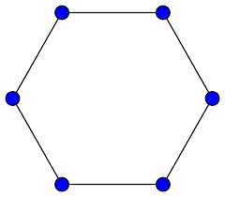

Cycles C_{n}
Cycles C_{n} (n $ 3$)
C₅
C₆
C₈

Slide 19
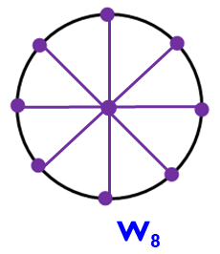
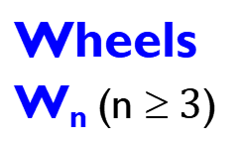
Wheels W_{n}
Cycles
C_{n}
C₅
C₆
C₈
Wheels
W_{n} (n $ 3$)
•
•
W₅
W₆

Slide 20
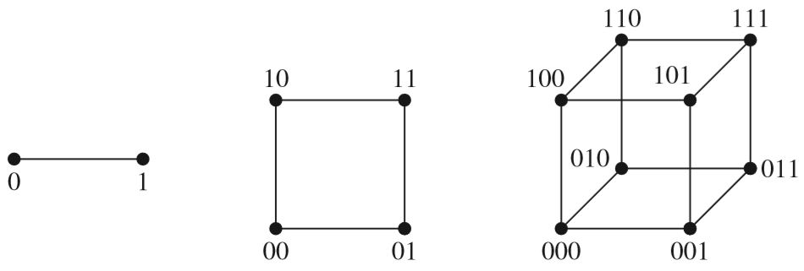
n-cubes Q_{n}
n-dimensional hypercube
1-D
2-D
3-D
Graph | |V| = number of vertices | |E| = number of edges
Q_{n} | 2^{n} | n.2^{n-1}

Slide 21
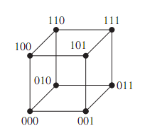
n-cube Q_{n}
Construct Q₄ from two copies of Q₃
0
1
0
0
0
0
1
1
0
1
1
0
0
1
1
0
1
1

Slide 22
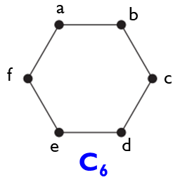
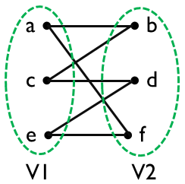
Bipartite graphs
A simple graph G = (V, E) is called bipartite if:
V = V1∪ V2, V1 ∩ V2 = ∅
no edge connects two vertices in V1
no edge connects two vertices in V2
We call the pair (V1,V2) a bipartition of V.
Ex. Study graph C₆ (cycle)
V = { a, b, c, d, e, f }
V1 = {a, e, c} ae ac ec
V2 = {b, f, d} bf bd fd
➔ C₆ is bipartite
➔

Slide 23
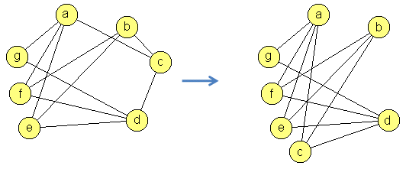
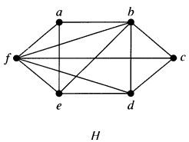
Bipartite Graphs…
bipartite
Edge considered | Set 1 | Set 2
ab | a | b
ae | a | b, e
af | a | b, e, f
bc | ac
be | a, c, e
➔ Non- bipartite
Conflict

Slide 24
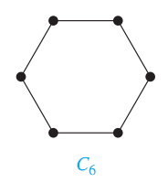
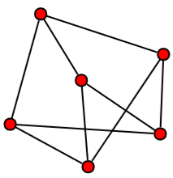
Bipartite graphs
Ex.
a
b
Let color the vertices using 2 different colors
Two adjacent vertices must have different colors (e.g., red and black)
•
➔ C₆ is bipartite
V1 = {a, c, e}
V2 = {b, d, f}
f
•
c
•
e
d
a
c
•
•
d
bipartite
V1 = {a, e, f}
V2 = {b, c, d}
b
•
f
e

Slide 25
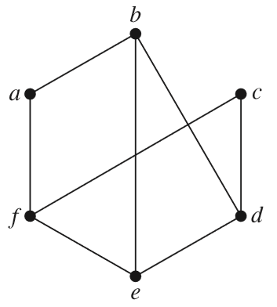
Example
Ex. Is the graph G bipartite?
•
•
?
➔ G is not bipartite
•
G

Slide 26
K_{m,n} - Complete bipartite graphs
m = 3
n = 5
K_{3,5}

Slide 27
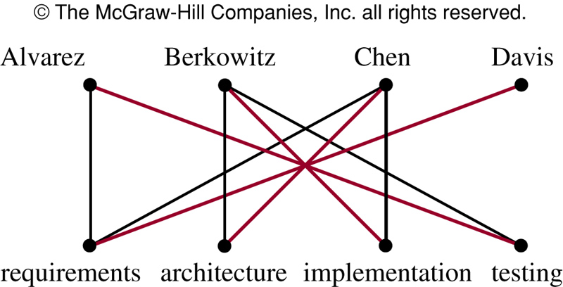
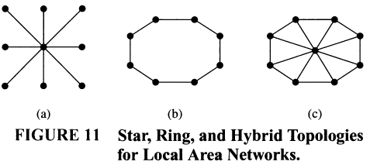
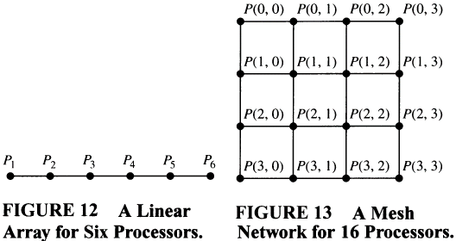
Some Applications of Special Types of Graphs
Figure 10: Modeling the jobs for which employees have been trained
Notes:
Local Area Networks: The various computers in a building, such as minicomputers and per­sonal computers, as well as peripheral devices such as printers and plotters, can be connected using a local area network.
Interconnection Networks for Parallel Computation: A linear array for n processors or a mesh network n = m² processors → Computers made up of many separate processors, each with its own memory, helps overcome the limitations of computers with a single processor.

Slide 28

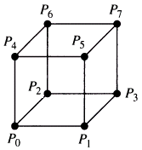
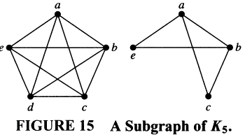
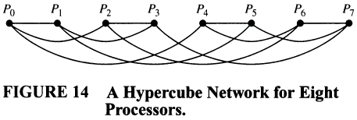
New Graphs From Old
Notes:
- Sometimes we need only part of a graph to solve a problem. For instance, we may care only about the part of a large computer network that involves the computer centers in New York, Denver, Detroit, and Atlanta → subgraphs are used.

Slide 29

Isomorphism
THE SAME

Slide 30


Isomorphism
a
b
m
n
G1 = (V1, E1), G2 = (V2, E2)
G1 and G2 are called isomorphic if
function f: V1 → V2
One-to-one
Onto
a, b are adjacent in V1
⇔ f(a), f(b) are adjacent in V2
•
•
•
•
•
•
•
•
p
q
c
d
function f = {(a, m); (b, p); (d, n); (c, q)}
➔ Two graphs are called isomorphic

Slide 31




Isomorphism of Graphs
Pull out
Notes:
Isomorphic simple graphs also must have the same number of edges and the degrees of the vertices in isomorphic simple graphs must be the same. In figure 9, H has a vertex of degree one, namely, e, whereas G has no vertices of degree one → they are not isomorphic.
In figure 10, deg(a) =2 → a must correspond to t, u, x, or y in H (vertices of with degree 2) → a must be adjacent to another vertex of degree two in G. This is impossible.

Slide 32


Isomorphic?
YES

Slide 33

Isomorphic?
G
H
G and H are NOT isomorphic
(in H: deg(e) = 1, no vertex in G has degree 1)

Slide 34

Representing graphs
Adjacency matrix
Incidence matrix
edge 1 edge 2 … edge m
Vertex 1
Vertex 2
…
Vertex n

Slide 35

Adjacency matrices
 | a | b | c | d
a | 0 | 0 | 1 | 0
b | 0 | 0 | 1 | 2
c | 1 | 1 | 0 | 1
d | 0 | 2 | 1 | 0
Adjacency matrix.
A = [a_{ij}],
where a_{ij} = the number of edges that are associated to {v_{i}, v_{j}}

Slide 36
In 2010 the Web graph was estimated to have at least 55 billion vertices and one trillion edges.
➔ More than 40 TB of computer memory would have been needed to represent its adjacency matrix.

Slide 37

Incidence matrices
edges
e₆
e₁
 | e₁ | e₂ | e₃ | e₄ | e₅ | e₆
a | 1 | 1 | 0 | 0 | 0 | 0
b | 1 | 0 | 0 | 0 | 0 | 1
c | 0 | 1 | 0 | 0 | 0 | 0
d | 0 | 0 | 1 | 1 | 0 | 0
e | 0 | 0 | 1 | 0 | 1 | 0
f | 0 | 0 | 0 | 1 | 1 | 0
g | 0 | 0 | 0 | 0 | 0 | 0
e₂
e₃
e₅
e₄
Vertices = { a, b, c, d, e, f }
Edges = { e₁, e₂, e₃, e₄, e₅, e₆ }

Slide 38


Incidence matrices
If the edge e_{j} is incident with the vertex v_{i}
the (v_{i}, e_{j})-entry = 1
Else
the (v_{i}, e_{j})-entry = 0

Slide 39

A path of length n
A path of length n from u to v:
A sequence of n consecutive edges
Ex.
a, e, f, c, d
is a path of length 4.






Slide 40
Circuits
A circuit is a path of length greater than zero that starts and ends at the same vertex.
Ex.
c, b, e, a, d, c is circuit.






Slide 41
Simple paths/circuits
A path/circuit is simple if it does not contain the same edge more than once.
Ex.
b, e, a, b, f, c
is a simple path.
c, b, e, a, d, e, b, f, c
is NOT a simple circuit.







Slide 42


Connectedness in Undirected Graphs
Connected = there is a path between every pair of distinct vertices of the graph.
Not connected = disconnected.
G
A disconnected with
3 connected components
G is connected

Slide 43



Connectedness in Directed Graphs
Strongly connected vs weakly connected
G
H
G: strongly connected
➔ weakly connected
✪
H: weakly connected
connected
Notes:
A directed graph is weakly connected if and only if there is always a path between two vertices when the directions of the edges are disregarded.
Note that if a directed graph is strongly connected, then it is also weakly connected.

Slide 44




Counting Paths Between Vertices
How many paths of length four from a to d in the simple graph G?
The adjacency matrix of G is given below
(ordering the vertex as a, b, c, d)
to
from
G
Result = 8


Slide 45

Shortest-path problems
weight : trọng số
Notes:
Many problems can be modeled using graphs with weights assigned to their edges.
A basic graph model: representing cities by vertices and flights by edges.
Problems involving distances: assigning distances between cities to the edges.
Problems involving flight time: assigning flight times to edges.
Problems involving fares: assigning fares to the edges.

Slide 46


Shortest-path problems

Slide 47
Dijkstra’s algorithm
c
d
∞
11
∞
3
3
14
12
11
11
12
3
6
a
0
2
0
4
∞
z
23
25
23
5
8
9
16
∞
∞
8
7
9
7
9
b
e
S = {a,
c,
b,
e,
d,
z}
The shortest path from a to z: a, c, e, d, z

Slide 48

Dijkstra’s Algorithm
O(n²)
time complexity
Notes:
Dijkstra’s algorithm for finding the shortest path between a and z in a connected simple undirected weighted graph.
Dijkstra’s algorithm proceeds by finding the length of a shortest path from a to a first vertex, the length of a shortest path from a to a second vertex, and so on, until the length of a shortest path from a to z is found.
The algorithm relies on a series of iterations.
S: a distinguished set of vertices is constructed by adding one vertex at each iteration.
L(v): the label of vertex v.
A vertex w is labeled with the length of a shortest path from a to w that contains only vertices already in the distinguished set.
The vertex added to the distinguished set is one with a minimal label among those vertices not already in the set.

Slide 49
Euler and Hamilton paths - introduction
Can one travel across all the bridges once and return to the starting point?
LEONHARD EULER
(1707–1783)
The Seven Bridges of Königsberg.
Multigraph Model

Slide 50

Euler circuit/path - definitions
An Euler path/circuit in a graph G is a simple path/circuit containing every edge of G.
G₁ has an Euler circuit
a, b, e, d, c, e, a
G₃ has no an Euler circuit,
But G₃ has an Euler path
a, c, d, e, b, d, a, b

Slide 51


Euler circuit
Theorem.
A connected multigraph, ≥ 2 vertices,
has an Euler circuit ⇔ every vertex has even degree
3
NOT OK
2
2
OK
4
2
2

Slide 52
How to construct an Euler circuit?
procedure Euler(G: connected, every vertex has even degree)
construct a simple circuit in G
H:= G – circuit // remove passed edges
while H has edges
construct a simple subcircuit in H beginning at a vertex in circuit
H: = H – subcircuit // remove passed edges
circuit : = add subcircuit to circuit
{ circuit is an Euler circuit }
a •
• d
b •
• c
G
e •
• f
• c
H
e •
• f
circuit: a, b, c, d, a
subcircuit: c, e, f, c
➔ circuit: a, b, c, e, f, c, d, a

Slide 53
Euler path
Theorem.
A connected multigraph has
an Euler path but not an Euler circuit
⇔
it has exactly
two vertices of odd degree
Note that: an Euler circuit is also an Euler path

Slide 54


Hamilton Paths and Circuits
Hamilton circuit/path:
A simple circuit/path passes through every vertex exactly once.
start
?
end
Hamilton path
No Hamilton circuit
a,b,c,d,e is a Hamilton path
Notes:
Note that Hamilton circuits and Hamilton paths are SIMPLE paths, which do not contain the same edge more than once.
Not that having an Hamilton circuit implies the existence of an Hamilton path.

Slide 55

Example - A Hamilton circuit for Q₃

Slide 56
Hamilton Paths and Circuits
There are
NO known simple necessary and sufficient criteria
for the existence of
Hamilton circuits

Slide 57



Hamilton circuits - sufficient conditions
Dirac’s theorem.
Ore’s theorem.
G is a graph:
simple
n ( ≥ 3) vertices
∀v_{i}, deg(v_{i}) ≥ $\frac{n}{2}$

G has a Hamilton circuit
2 3
2
3 3
?
G is a graph:
simple
n ( ≥ 3) vertices
∀u, ∀v, non-adjacent
deg(u) + deg(v) ≥ n

G has a
Hamilton circuit

Slide 58

The Traveling Salesman Problem
Total Distance
= 58 + 133 + 137 + 113 + 147
= 588
Salesman starts in one city (ex. Detroit). He wants to visit n cities exactly once and return to his starting point (Detroit). In which order should he visit theses cities to travel the minimum total distance ?
Notes:
- The Traveling Salesman Problem is an important problem involving weighted graphs.

Slide 59


The Traveling Salesman Problem
$$\frac{4!}{2}=12$$
Exhaustive search technique // vét cạn
[(n-1) (n-2) (n-2) … 3.2.1]/2 = (n-1) !]/2 ➔ O((n-1)!) complexity
➔ Approximation algorithm

Slide 60
Summary
9.1- Graphs and Graph Models
9.2- Graph Terminology and Special Types of Graphs
9.3- Representing Graphs and Graph Isomorphism
9.4- Connectivity
9.5- Euler and Hamilton Paths
9.6- Shortest Path Problems

Slide 61
THANKS

