Slide 1


NAHU eCommerce Instructions
►►Dues Report & Associate Member Tracking

Slide 2

Step 1. Go to ww.nahu.org
Step 2. Sign in

Slide 3

Step 3. Resources
Step 4. Leadership Reports

Slide 4

Step 5. Chapter Dues Reports
Step 6. Click on READ MORE

Slide 5
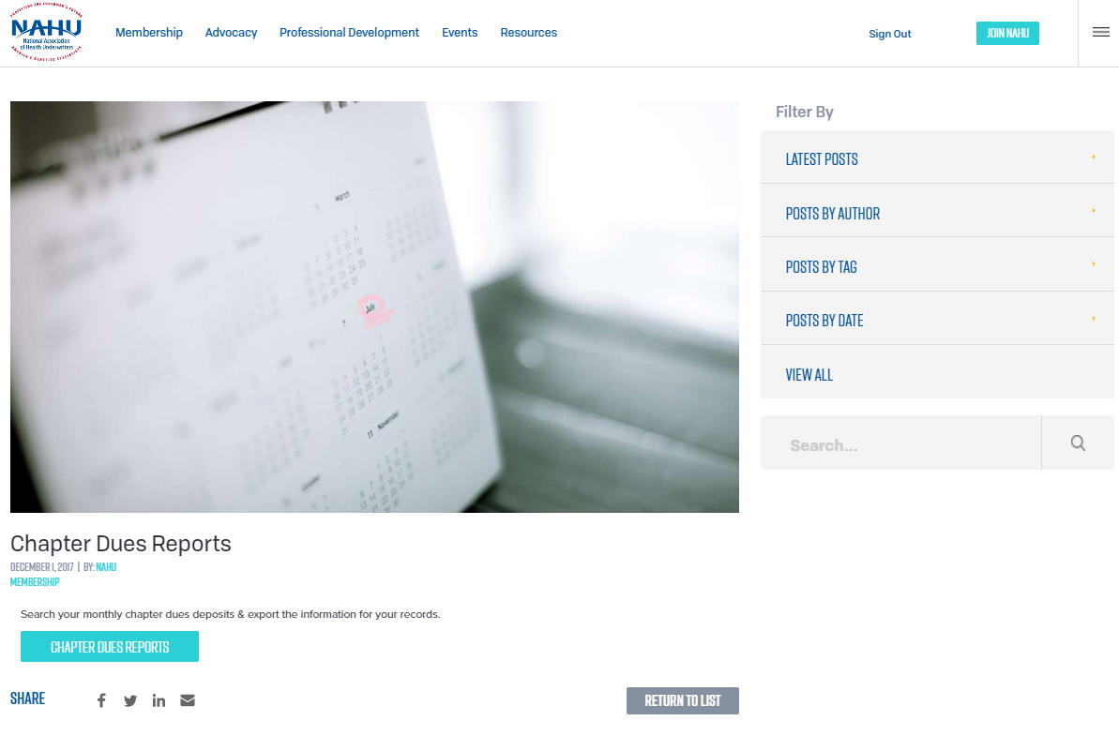
Step 7. Click on CHAPTER DUES REPORTS box

Slide 6
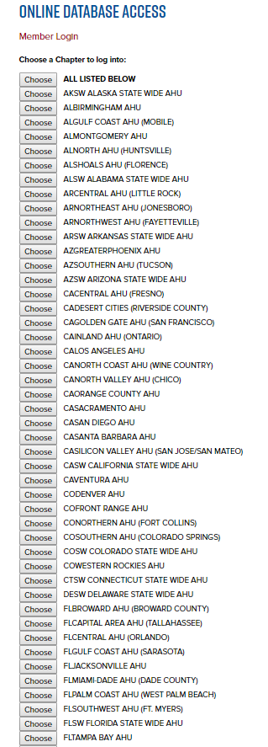
Step 8. Scroll
up or down to choose your chapter

Slide 7
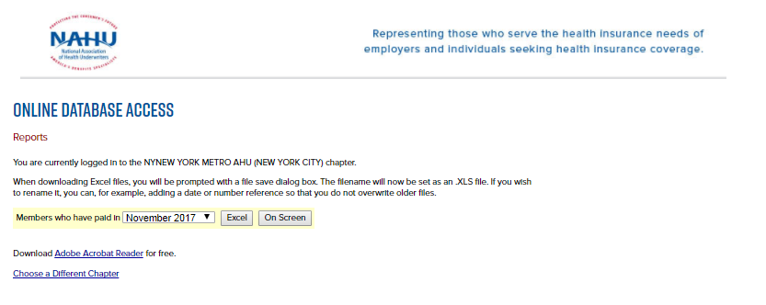
Step 9. Pick a date from the drop-down menu
Step 10. Click on Excel box to view it in the spreadsheet

Slide 8
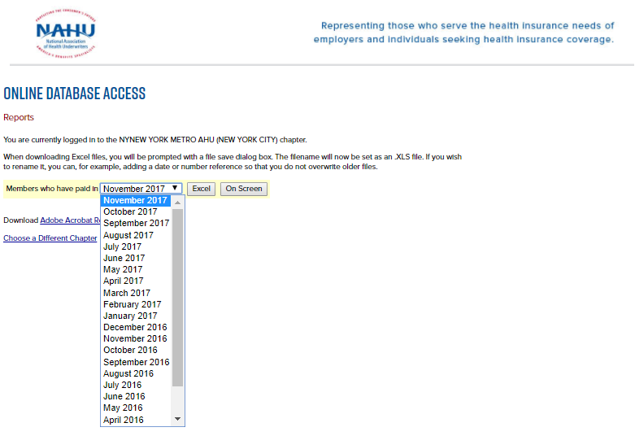

Step 11. For example pick January 2017 & hit Excel
Step 12. Your list appears at the bottom of screen. Click on the box.

Slide 9
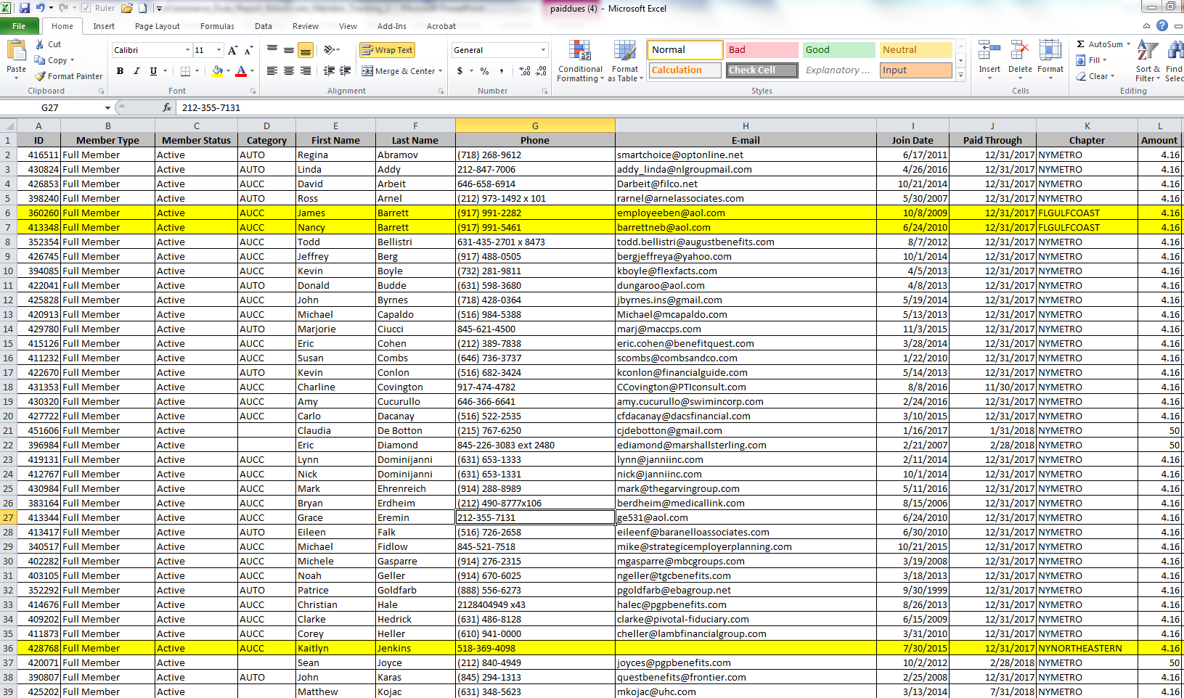
Step 13. Your Dues Report is completed. Anyone listed with a different chapter than yours (highlighted in yellow, Lines # 6 ID 360260, #7 ID 413348, #36 ID 428768) is your associate member.

