Slide 1
Price Transparency
1

Slide 2
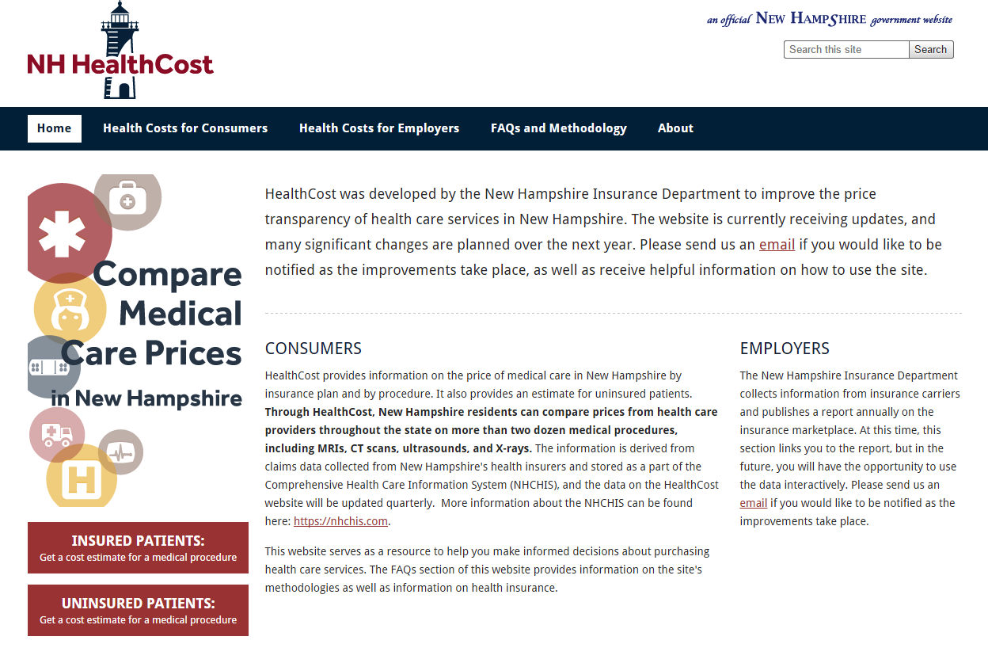
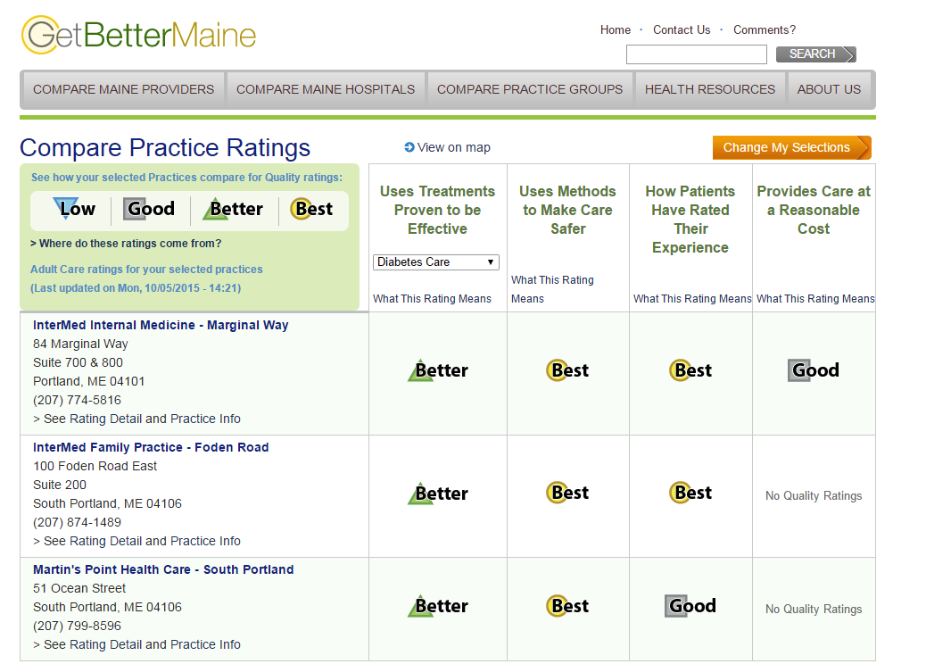
Price and Quality Transparency
Transparency is important to:
Create educated healthcare consumers
Create accountability for price and quality variation among providers
Enable purchasers to judge value
2
Notes:
This section of slides present the importance of cost and quality transparency in health care. This first slide discusses the need for transparency.
How much does it cost? Is it high quality?
These are questions consumers routinely ask about products and services when they make most purchases. But when it comes to their health care, this information is hard to find.
As health care costs continue to rise, purchasers remain focused on strategies that can help to bring costs under control. These pressures have facilitated a movement by many purchasers to engage consumers – their employees and their dependents – more fully in their health care decisions. This includes taking on a greater share of their health care costs.
In their efforts to manage costs, health care purchasers, including large employers and states, recognize consumers need information on both health care price and quality. In recent years, information about quality has become more transparent; however, meaningful price information is still difficult to obtain.
Making reliable, useful information about the cost and quality of care is more important now than ever for people who get, give, and pay for care. Consumers with high deductible plans need the information to make informed choices. Research published in the journal Health Affairs shows that when consumers have access to well-designed reports on price and quality, 80 percent will select the highest-value health care provider.
Price and quality information is also a fundamental building block enabling employers and other purchasers to implement value-based purchasing strategies. These include benefit designs that steer employees to high-quality, low-cost providers, such as reference pricing, centers of excellence and narrower networks. Transparency also spurs providers to improve quality and forces them to own up to their prices.
The screen shots are of the Get Better Maine Web site, which compares quality among providers, and the New Hampshire HealthCost website, which compares prices. The best of both words will be web sites with both prices and quality information. They go hand in hand.
Source: Health Affairs
Hibbard, JH., et al. “An Experiment Shows That a Well-Designed Report on Costs and Quality Can Help Consumers Choose High-Value Health Care,” Health Affairs 2012; 31(3): 560–568.

Slide 3
Defining Price Transparency
The National Association of Health Underwriters defines price transparency as “empowering the healthcare consumer with the cost and quality information necessary to make an educated and informed choice on a particular service, treatment, procedure or appliance before they make a buying decision.”
3
Notes:
This slide is the National Association of Health Underwriters definite of price transparency.

Slide 4



Employers’ Need for Price Transparency
Employers are asking employees to get engaged, educated and empowered
Empowered employees can help drive better quality and efficiency
Unwarranted price variation needs to be exposed to help identify high-value providers.
4
Notes:
This slide explains why employers should favor transparency
Employers facing rising healthcare expenditures are asking employees to get engaged, educated and empowered to take on more responsibility & seek more efficient, high-quality care.
Some large employers believe that pressure from employees is a powerful and underused lever for improving quality and efficiency.
For this strategy to succeed, we need to expose unwarranted price variation, and employees need price and quality information to help identify high-value providers.
Price transparency is essential for strategies like reference pricing

Slide 5
States Are Not Filling the Void…
2015 Report Card on State Price Transparency Laws
1-A 2-Bs 2-Cs 45-Fs
5
Notes:
This slide discussed state efforts to provide price transparency.
In 2015 Catalyst for Payment Reform (CPR) and the Health Care Incentives Improvement Institute, two organizations dedicated to advancing price and quality transparency, issues a Report Card on State Price Transparency Laws.
The Report Card looks at whether states have passed laws or regulations requiring health care price information be made public. It also examines how well those laws are being implemented by providing residents with access to meaningful price information through public websites and the use of all-payer claims databases (APCDs) as data sources for those sites. The results of the analysis show that 90% of states fail to provide adequate price information to consumers.

Slide 6
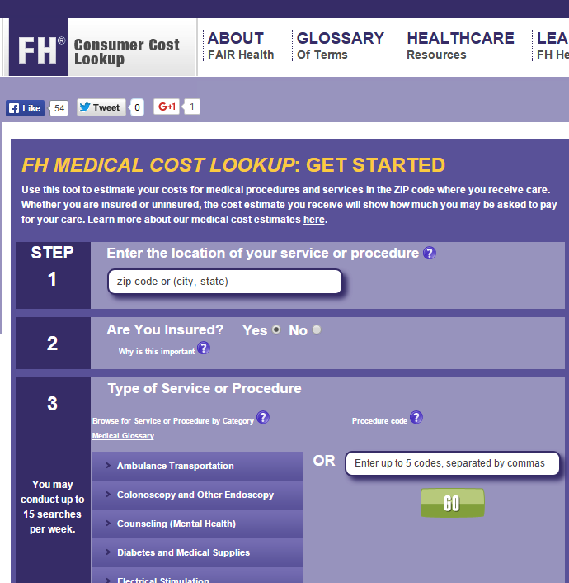
Private Price Tools on the Rise
The private sector is stepping up with information about price and in some cases quality.
Health plans
Independent vendors: Castlight Health, Change Healthcare, Fair Health, gooru, Healthcare Bluebook, Zest Health
6
Notes:
This slide is for discussing how, despite what’s happening at the state level, information about prices is becoming more widely available because of private sector efforts.
Pressure from purchasers for greater information about prices is fueling the private sector efforts to make that information more widely available. Giving employees in high deductible plans information about out of pocket costs is becoming an essential part of benefit design.
Health plans, with their extensive data on claims, contractual reimbursement, credentialing and quality information may be best positioned to disclose price and quality information today. Some plans are trying to offer members access to shopping and transparency tools; however, many of these tools are currently limited in their scope and in the specificity of provider prices. This is partly due to pressure from the providers with whom they negotiate, operational challenges with respect to the data, and limitations of existing consumer portals.
Blue Cross Blue Shield of North Carolina unveiled a web-based treatment cost estimator in 2011 that allowed its customers to see the average costs of dozens of common elective procedures. They expanded it in 2015 with an online consumer tool that provides cost information on more than 1,200 procedures. It made those prices available to anyone with an Internet connection. Customers got access to an enhanced tool that adds information about providers’ quality of care and an estimator that allows customers to consider the out-of-pocket costs for specific procedures.
Shown on the slide is the web site for Fair Health, which was created in 2009 as part of a settlement between New York state and insurers over industry practices for setting out of network reimbursement rates to patients. FAIR Health’s database has charge data for billions of billed medical and dental services and procedures. The website’s cost lookup tools helps consumers convert charge data into an estimate of what they might have to pay, based on their zip code.
Many of the existing tools are clunky, although that is changing. The Pacific Business Group on Health performed a “secret shopper” study of the tools developed by major health plans that found wide variation in their functionality and cost comparison capabilities.
The presence in the market of other independent vendors such as Castlight Health, Change Healthcare, gooru, Healthcare Bluebook, Zest Health is spurring the creation of better tools at a faster rate.
Some purchasers are turning to third-party vendors – separate from their health plans – to create tools for their consumers. However, this requires health plans to release purchasers’ data to a third-party vendor, which many health plans have not yet agreed to do.
Sources: Pacific Business Group on Health
http://www.pbgh.org/storage/documents/PBGH_Cost_Calc_Summary_Grid.pdf

Slide 7
The Data Sharing “Spat”
Many health plans restrict data use by self-funded purchasers
Some plans do not allow purchasers to give price data to other third party vendors
They argue that price information is proprietary and confidential
Plans making significant investments in more sophisticated and proprietary transparency tools worry that providing data to other vendors supports competing products
7
Notes:
This slide discusses why it is hard even for self-funded employers to obtain data from health plans that manage their claims.
Due to restrictions on data use from health plans, many self-funded purchasers face challenges with using their own claims data to build transparency tools for their consumers.
Some health plans do not allow purchasers who want price transparency to use their own data with a third party vendor to analyze and offer information on prices, arguing that price information is proprietary and confidential, even though it was the purchaser’s funds that paid these claims.
Health plans are developing more sophisticated and proprietary transparency tools using claims data. Their investment in these tools is significant and they have concerns that providing claims data to their other vendors will introduce or support competing products.

Slide 8


Employers Using Price, Quality Information for Reference Pricing
Consumers seeking care from providers above the reference price may be subject to additional out-of-pocket financial liability
$20K
$15K
Price Variation
Identical Service
$10K
REFERENCE PRICE
Consumers seeking care from providers at or below the reference price are typically responsible for normal or no cost-sharing
$5K
$0
Frequency and Cost of Services Performed
Catalyst for Payment Reform
8
Notes:
This slide talks about why transparency is crucial to certain payment reforms.
Transparency is critical to payment reforms such as reference pricing. Without price and quality information, employees would be driving blind.
Reference pricing establishes a standard price for a drug, procedure, service or bundle of services, and generally requires that health plan members pay any allowed charges beyond this amount. Reference pricing has been shown to lower the cost and increase value in prescription plans, and is now expanding in the United States to selected medical and surgical services. Many employers already use reference pricing to establish premium contributions for health benefit plans which are more expensive than a “base” plan.
Reference pricing begins with health plans or employers seeing high variability in price for a procedure or service in their claims data, coupled with the fact that the higher prices are not associated with better quality or outcomes. The health plan then sets a standard allowable price for that procedure or service that would allow patient members a high level of coverage at an adequate number of providers. Quality can also be factored into providers’ qualification for being paid the reference price. Members choosing providers with higher allowable fees must pay some or all of the difference, encouraging them to seek. Without price information, none of this works.
Safeway is a national grocery chain that provides health insurance to over 180,000 employees and dependents. It turned to reference pricing after discovering a ten-fold variations in the price of colonoscopies in a local market without variations in quality. This led them to pilot a reference price program for colonoscopies. Safeway launched a program in 2009 that set a reference price of $1,500 for colonoscopies. Patients who choose a provider with a price of less than $1,250 paid nothing out of pocket while those choosing a provider whose price was more than $1,250 would pay the difference. Safeway has since expanded its reference pricing program to cover many other tests and procedures.
CalPERs provides coverage for over 1.3 million employees, dependents, and retirees in the State of California, turned to reference pricing for orthopedic surgery after they determined they were paying California hospitals facility fees ranging from less than $10,000 to over $120,000 for total knee and hip replacements. CalPERs set the reference price at $30,000. Its plan administrator determined that forty-seven hospitals charged less than this amount and had sufficient quality and patient satisfaction scores to qualify as “value-based purchasing centers.” At these centers, patients would be responsible for 10% of the hospital charge up to $30,000. If the patient elected to visit a provider who charged more than $30,000, the patient would be responsible for their 10% co-insurance on the fee under $30,000 plus the entire fee in excess of $30,000.
CalPERS saved $2.8 million in the first year alone
Sources
Berkeley Center for Health Technology http://bcht.berkeley.edu/docs/Vol.4.3.Reference-Pricing.pdf
Health Affairs http://content.healthaffairs.org/content/32/8/1392.abstract

Slide 9

What Employers Can Do About It
Tips to Encourage Employee Use of Plan Cost Tools
Incentivize employees
Email campaign
Follow up promotion strategy
Engage spouses and dependents
Engage influencers and stakeholders
Use testimonials
Highlight health plan tools in existing benefits communications
Incorporate tools in new hire onboarding
9
Notes:
This slide discusses the elements of a program to encourage employees to use price tools.
Online cost calculator tools can help employees better understand and use their benefits. The Pacific Business Group on Health designed a program to drive usage of these sites. It incentivizes employees not only to register to use the tools, but to repeatedly use them.
According to PBGH, the best practices for such as program are:
Use incentives: Incentives should be rewarded not just based on registration but also based on performing a doctor search or cost calculation.
Design an e-mail campaign featuring incentives and easy to follow instructions
Phase in the promotion strategy: early adopter employees will use the tool first, and then encourage others, so reminders and follow-ups to the original e-mail are helpful. Share interactive demonstration videos, conduct online training sessions, or hold town halls when possible.
Engage spouses and dependents with a home print campaign: mail similar materials to the home address or include in open enrollment materials.
Engage influencers and stakeholders: ask line managers, team captains, and other central communicators to mention he health plan shopping tools. Ask employees who have used the tools to offer testimonials and share via brief videos on the HR portal.
Make the health plan shopping tools stand out in your existing benefits communications, using the messaging above.
Make registration and a health plan shopping tools “walk through” a part of the new hire onboarding process.
Develop promotion strategy with follow-up emails, interactive demonstration videos, online training sessions and town halls. Engage spouses and dependents through home mailings and materials in open enrollment materials.
Source: http://www.pbgh.org/storage/documents/PBGH_TipSheet_02.pdf

