Slide 1
State of U.S. Healthcare

Slide 2

Healthcare Costs & the Economy
Projected 2024 U.S. healthcare spending = $5.46 trillion, 19.6% GDP
2
Notes:
This slide is an introductory slide to illustrate the impact of health care on the U.S. economy.
Spending for health care in U.S. hit $2.9 trillion in 2013. If the U.S. health care system were a country, it would be the sixth largest economy in the world.
Spending is projected to rise to $5.4 trillion in less than 10 years, and account for about 1 in every five dollars of gross domestic product.
According to the Center for Medicare & Medicaid Services, that’s a growth rate of 5.8 percent a year.
Recent reports show that health spending is rising more rapidly after five years of record low increases, as the economy improves
*Source: CMS https://www.cms.gov/Research-Statistics-Data-and-Systems/Statistics-Trends-and-Reports/NationalHealthExpendData/NationalHealthAccountsProjected.html

Slide 3
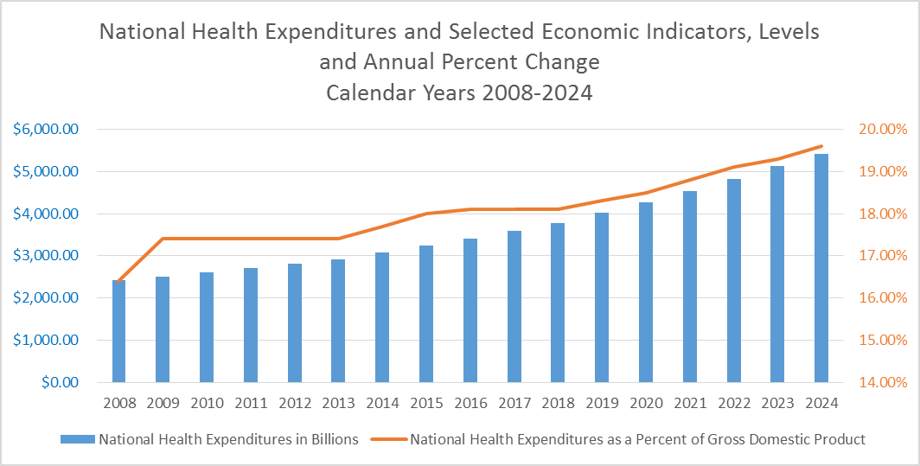
Up, Up and Away: U.S. Healthcare Spending Projections
Centers for Medicare and Medicaid Services
3
Notes:
This slide is intended an alternative way of introducing the cost trend for healthcare. The numbers and percentages are actual through 2013 and projected for 2014-2024. The blue bars are total national health expenditures. The orange line represents healthcare spending as a percent of GDP
Spending for health care in U.S. hit $2.9 trillion in 2013. If the U.S. health care system were a country, it would be the sixth largest economy in the world.
Spending is projected to rise to $5.4 trillion in less than 10 years, and account for about 1 in every five dollars of gross domestic product.
According to the Center for Medicare & Medicaid Services, that’s a growth rate of 5.8 percent a year.
Recent reports show that health spending is rising more rapidly after five years of record low increases, as the economy improves
Source: CMS National Health Expenditures Data https://www.cms.gov/Research-Statistics-Data-and-Systems/Statistics-Trends-and-Reports/NationalHealthExpendData/NationalHealthAccountsProjected.html

Slide 4
Employers Foot the Bill
Employers paid 58% of employees’ healthcare costs in 2014.
A typical family of four has $23,215 in medical costs each year
Employer pays $13,520
Employee pays $9,695
($5,908 in payroll deductions and $3,787 in out-of-pocket costs.)
4
Notes:
This slide is intended to illustrate the burden on both employers and employees.
Employers continue to subsidize their employees’ healthcare costs by paying an average of 58 percent of the total cost of health care in 2014. Of the $23,215 in medical costs for a typical family of four, the employer pays about $13,520 while the employee pays the remaining $9,695, which is a combination of $5,908 in employee payroll deductions and $3,787 in out-of-pocket costs when they utilize medical services.
According to CMS, private business remained the largest health care payer in 2013, footing the bill for 21 percent of national healthcare expenditures, slightly ahead of Medicare’s 20 percent.
Sources
2014 Milliman Medical Index Research Report http://www.milliman.com/mmi/
CMS National Health Expenditures Fact Sheet https://www.cms.gov/Research-Statistics-Data-and-Systems/Statistics-Trends-and-Reports/NationalHealthExpendData/NHE-Fact-Sheet.html

Slide 5
What Is Driving Healthcare Costs?
There is no single driver responsible for the nation’s high and rising healthcare costs.
There is no single strategy to meet this challenge.
5
Notes:
This slide is intended to introduce the topic of health care cost drivers.
Health insurance is expensive because healthcare is expensive. Everybody has their favorite scapegoat for the high cost of health care, but the fact is, the factors driving healthcare cost growth are complex and multifaceted
- No single driver is responsible for the nation's high and rising health care costs.
- Likewise, no single policy solution will be adequate to meet this challenge.

Slide 6
What Is Driving Healthcare Costs?
Fee-for-service reimbursement
Fragmentation in care delivery
Administrative burden
Population aging, rising rates of chronic disease and co-morbidities
Advances in medical technology
Lack of transparency about cost, quality
Tax treatment of health insurance
Tax treatment of health insurance
Insurance benefit design
Cultural biases influencing care utilization
Healthcare market consolidation
High unit prices of medical services
The health care legal and regulatory environment
Structure and supply of the health professional workforce
6
Notes:
This slide is intended to show how complex the healthcare cost growth equation is. Because the finger pointing about health acre costs can be partisan, we are using a report from the Bipartisan Policy Center. The center was founded in 2007 by former Senate Majority Leaders Howard Baker, Tom Daschle, Bob Dole and George Mitchell.
A September 2012 study from the Bipartisan Policy Center identified the top drivers of healthcare costs. They include:
Fee-for-service reimbursement
Fragmentation in care delivery
Administrative burden on providers, payers and patients
Population aging, rising rates of chronic disease and co-morbidities, as well as lifestyle factors and personal health choices
Advances in medical technology
Tax treatment of health insurance
Insurance benefit design
Lack of transparency about cost and quality, compounded by limited data, to inform consumer choice
Cultural biases that influence care utilization
Changing trends in healthcare market consolidation and competition for providers and insurers
High unit prices of medical services
The health care legal and regulatory environment, including current medical malpractice and fraud and abuse laws
Structure and supply of the health professional workforce, including scope of practice restrictions, trends in clinical specialization, and patient access to providers.
Source: http://bipartisanpolicy.org/wp-content/uploads/sites/default/files/BPC%20Health%20Care%20Cost%20Drivers%20Brief%20Sept%202012.pdf

Slide 7
Chronic Disease Drives Healthcare Spending
U.S. Healthcare Spending by Number of Chronic Conditions in 2010
7
Notes:
This slide is intended to introduce a major problem facing our healthcare system: the soaring prevalence of chronic disease and the resources it takes to treat people with chronic disease. It also sets up the following slide, which shows where we do and do not do a good job of treating people with chronic disease outside of expensive hospital settings.
The soaring prevalence of chronic disease is a major cost driver, because people with multiple chronic conditions are the heaviest users of the healthcare system
86% of our healthcare spending is for patients with one or more chronic conditions, like diabetes, hypertension, asthma or depression.
71% of healthcare spending is for patients with more than one chronic conditions. That’s right, 71¢ of every dollar of healthcare spending goes to treating people with multiple chronic conditions.
In fact, 31.5% of all Americans, almost a third of the population, are now living with multiple chronic conditions.
Many of these conditions are preventable and can be routinely managed outside of the hospital. But if they are not managed well, these patients can end up in and out of the emergency room and the hospital.
Source: Agency for Healthcare Research and Quality
http://www.ahrq.gov/sites/default/files/wysiwyg/professionals/prevention-chronic-care/decision/mcc/mccchartbook.pdf

Slide 8
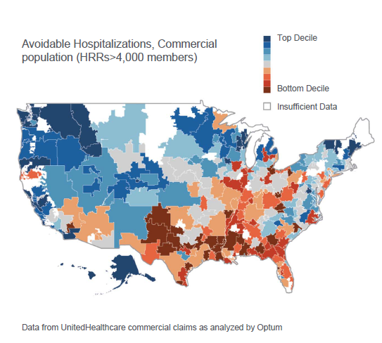
Quality Varies Widely
There is a radical difference in
potentially avoidable hospitalization rates across the country
8
Notes:
This slide shows how the quality of care varies widely across the country and builds on the previous slide that notes the importance of trying to treat people with chronic conditions outside of expensive hospital settings.
Health care researchers have developed a measure to look at how well we do at treating people with chronic conditions outside the hospital. This is a pretty good indicator of how good a job primary care doctors and specialists are doing to help people manage conditions like diabetes, asthma or heart disease.
They look at the people who are hospitalized, analyze the diagnoses, and see which ones should have been treated more effectively outside the hospital. This measures what are called “potentially avoidable hospitalizations.” An example is a patient with diabetes who ends up in the hospital because their blood sugar is out of control.
Reducing potentially avoidable hospitalizations with timely and effective outpatient care is seen as a promising way to improve care and lower health care costs.
A community’s rate of avoidable hospitalizations is a pretty good snap shot of the quality of care and other dynamics in a community.
High rates of avoidable hospitalizations are associated with chronic illness, low economic resources and poor health behaviors.
This chart is based on claims data from UnitedHealthcare. It shows that even among individuals with health insurance, gaps in care coordination, patient engagement and chronic condition management lead to avoidable, expensive hospitalizations. Rates are highest in the South and certain rural and urban regions, indicated by the orange and red shades.
Source: Optum http://academyhealth.org/files/2013/sunday/simon.pdf

Slide 9
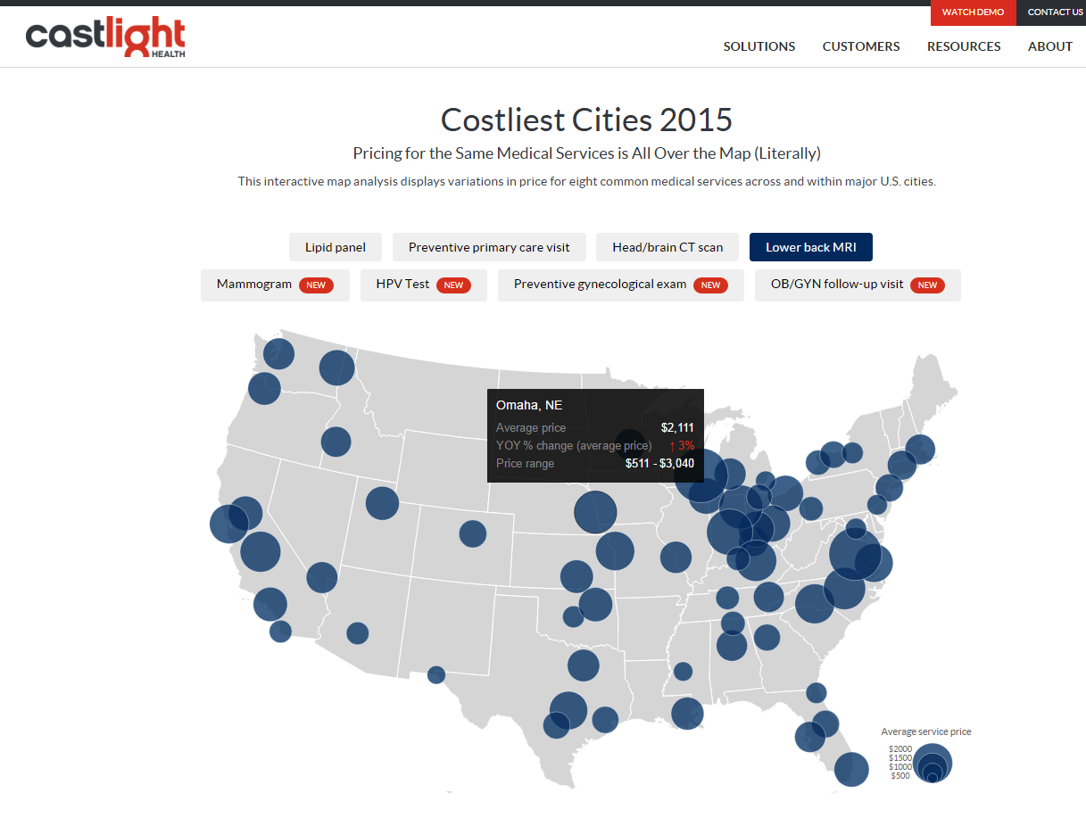
Price Varies Widely
9
Notes:
This slide is to introduce the concept of price variation in health care.
We’ve all heard and read stories about the just how widely healthcare prices can vary depending on where you get it. This slide is a screen taken in November 2015 on Castlight’s web site. Castlight is one of many new companies that have emerged in the last five years to help employer’s and their employees manage their health benefits, and among its services is price transparency. The differences size of the circles track the variation in the average price for a lower back MRI/ The larger the circle, the higher the average price.. But the variations aren’t just among markets, they are also within markets. As the popup for Omaha shows, prices in that market ranged from $511 to $3,040, a nearly six fold difference. The average price was $2,111.

Slide 10
Price Varies Widely
Price for service in the U.S. can vary as much as
600%
10
Notes:
This slide is a further illustration of price variation.
We’ve all heard and read stories about the just how widely healthcare prices can vary, such as knee replacement surgery, which can vary by tens of thousands of dollars depending on where you get it.
The Center for Studying Health System Change looked at eight health care markets in 2010—Cleveland; Indianapolis; Los Angeles; Miami; Milwaukee; Richmond, Va.; San Francisco; and rural Wisconsin. It found wide variation what private insurers paid hospitals and physicians across and within local markets. It suggests that some providers, particularly hospitals, have significant market power to negotiate higher-than-competitive prices.
In these 8 markets, average inpatient hospital payment rates of four large national insurers ranged from 147 percent of what Medicare pays in Miami to 210 percent in San Francisco. In extreme cases, some hospitals command almost five times what Medicare pays for inpatient services and more than seven times what Medicare pays for outpatient care.
Source: Ginsburg PB. Wide variation in hospital and physician payment rates evidence of provider market power. Center for Studying Health System Change, 2010. Available from: www.hschange.com/CONTENT/1162/

Slide 11
Price Varies Widely: Massachusetts Hospitals
11
Notes:
This slide is a further illustration of price variation.
This is analysis of prices paid to hospitals in Massachusetts for selected diagnosis groups. It shows just how prices can vary. For example, prices paid for an appendectomy varied by more than 11-fold for a severity-1 stay and 16-fold for a severity-2 stay. Prices paid for each of the other selected DRGs varied less significantly, but in no instance did they vary by less than 300 percent statewide.
Source: Mathematica Policy Research http://www.chiamass.gov/assets/docs/cost-trend-docs/cost-trends-docs-2011/price-variation-report-executive-summary.pdf

