Slide 1
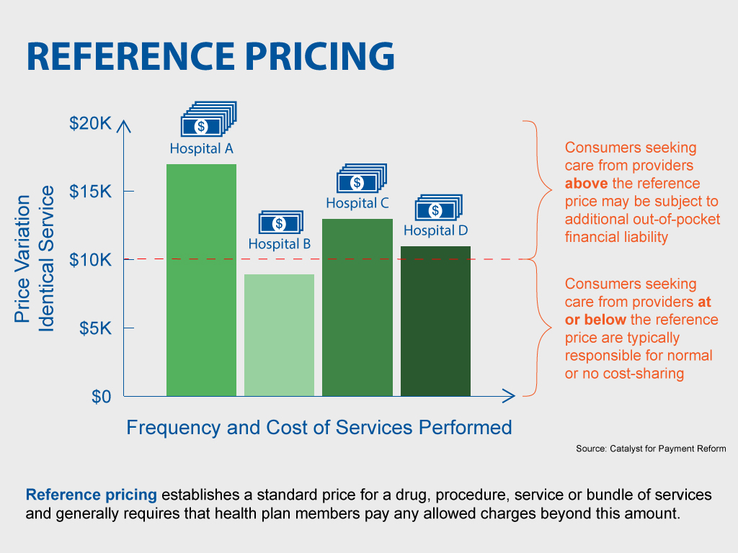
YOUR LOGO HERE

