Slide 1


NAHU eCommerce Instructions
►►►Mass Email from eCommerce

Slide 2

Step 1. Go to ww.nahu.org
Step 2. Sign in

Slide 3

Step 3. Resources
Step 4. Leadership Reports

Slide 4

Step 5. eCommerce
Step 6. Click on READ MORE

Slide 5

Step 7. Click on ECOMMERCE box

Slide 6
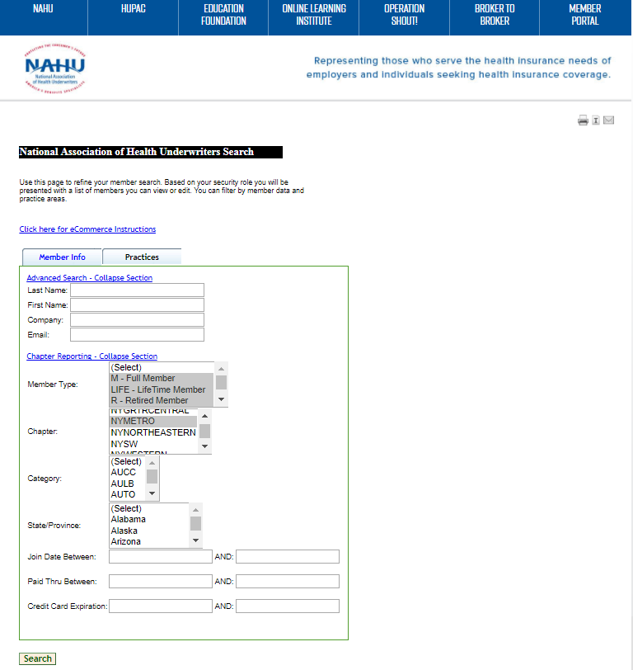
Step 7. Select M, hold CTRL button & click on LIFE & R for active members
Step 8. Select Your Chapter or hold CTRL button to select multiple chapters
Step 9. Leave other boxes blank & hit SEARCH

Slide 7
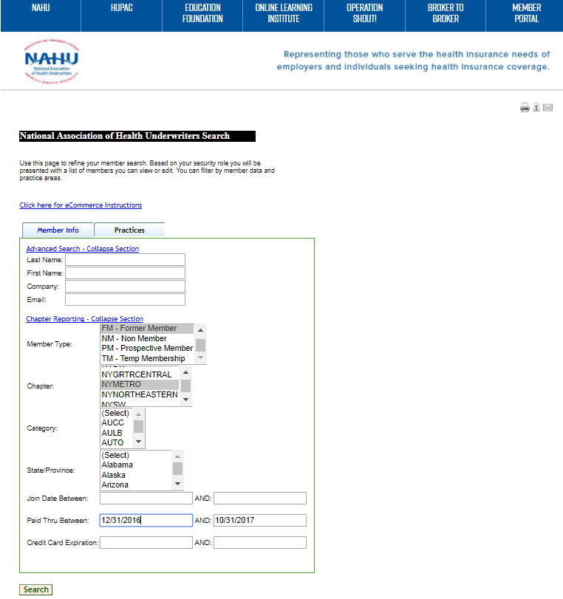
Step 7. alternatively FM for former members
Step 8. Select Your Chapter or hold CTRL button to select multiple chapters
Step 9. for instance: enter preferred paid thru date parameters
Step 9. Hit SEARCH

Slide 8
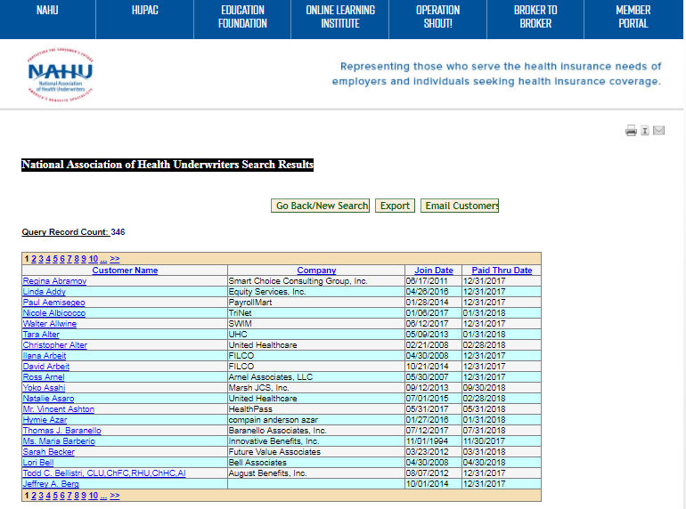
Step 10. click on Email Customers box

Slide 9
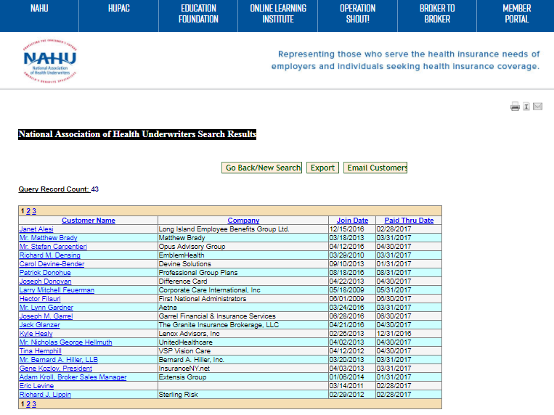
Step 10. click on Email Customers box

Slide 10
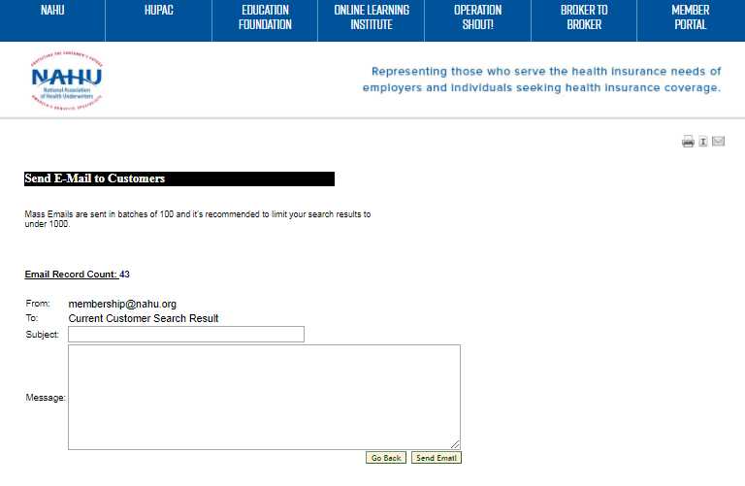
Step 11. Enter SUBJECT line
Step 12. Type in or copy & paste your message in the MESSAGE box
Step 12. Hit SEND Email to complete mass emailing

Slide 11
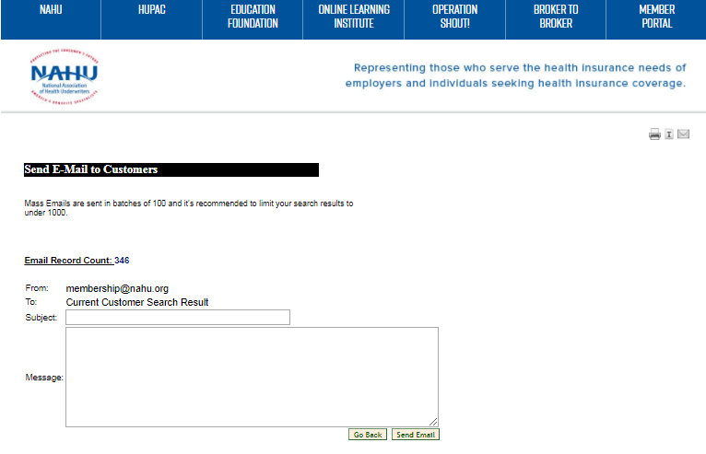
Step 11. Enter SUBJECT line
Step 12. Type in or copy & paste your message in the MESSAGE box
Step 12. Hit SEND Email to complete mass emailing

