Slide 1


NAHU eCommerce Instructions
►►►New Member Report

Slide 2

Step 1. Go to ww.nahu.org
Step 2. Sign in

Slide 3

Step 3. Resources
Step 4. Leadership Reports

Slide 4

Step 5. Sponsor Reports
Step 6. Click on READ MORE

Slide 5

Step 7. Click on SPONSOR INFORMATION box

Slide 6
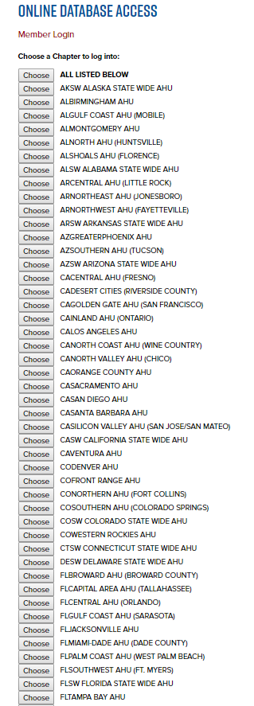
Step 8. Scroll
up or down to choose your chapter

Slide 7
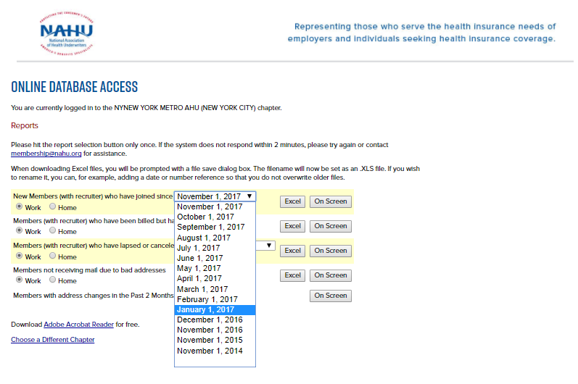
Step 9. Pick this line for new joined members
Step 11. Click on Excel box to view it in the spreadsheet
Step 10. Pick a time period from drop-down menu

Slide 8
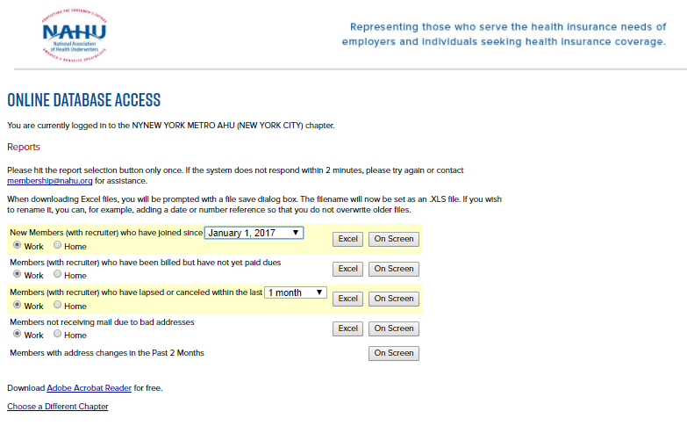

Step 12. For example pick Jan 1, 2017 & hit Excel
Step 13. Your list appears at the bottom of screen. Click on the box.

Slide 9
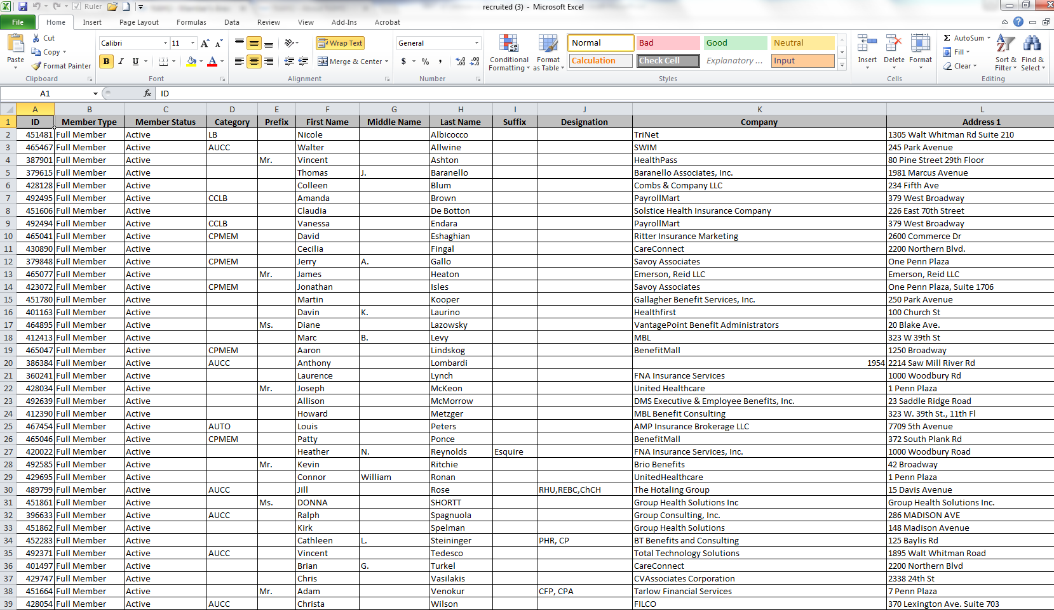
Step 14. Your New Report with Sponsor Information is completed.

