Slide 1


NAHU eCommerce Instructions
►►►Credit Card Expiration Report

Slide 2

Step 1. Go to ww.nahu.org
Step 2. Sign in

Slide 3

Step 3. Resources
Step 4. Leadership Reports

Slide 4

Step 5. eCommerce
Step 6. Click on READ MORE

Slide 5

Step 7. Click on ECOMMERCE box

Slide 6
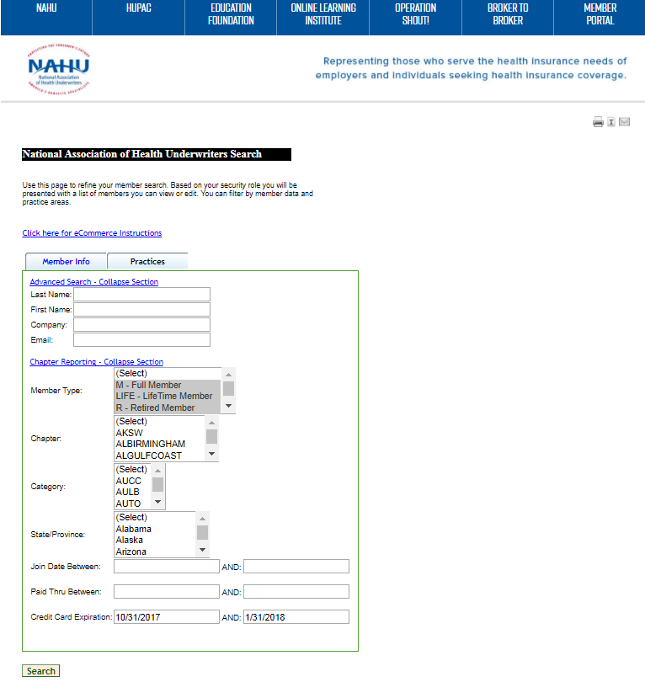
Step 7. Select M, hold CTRL button & click on LIFE & R for active members
Step 8. Select Your Chapter or hold CTRL button to select multiple chapters
Step 9. Select credit card expiration dates: use this format as an example
Step 10. hit SEARCH

Slide 7
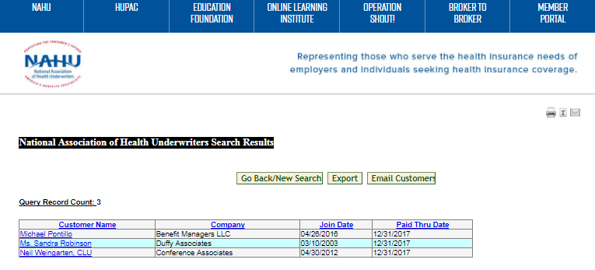
Step 10. click on EXPORT box

Slide 8
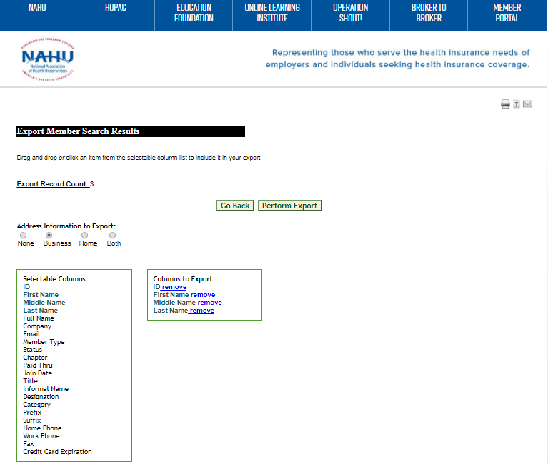
Step 11. Pick one as address selection
Step 12. Click & add line items from the left column to export & view in your spreadsheet

Slide 9
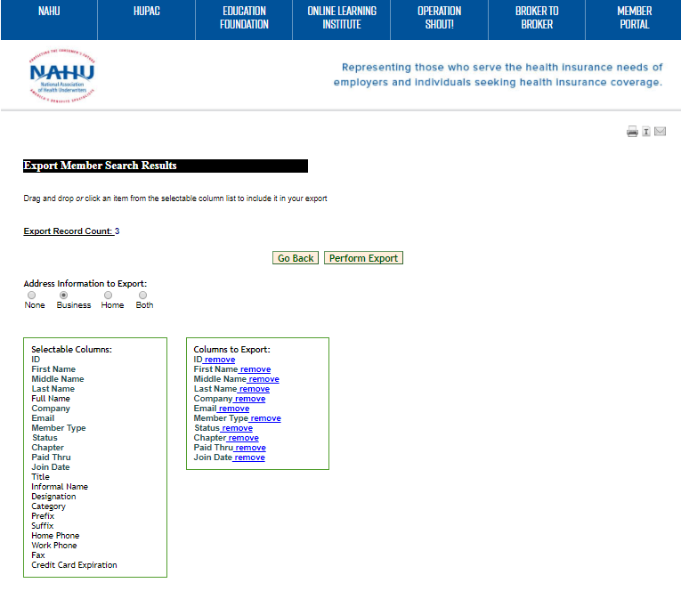
Step 13. Click on PERFORM Export box

Slide 10

Step 14. Your list appears at the bottom of screen. Click on the box.

Slide 11
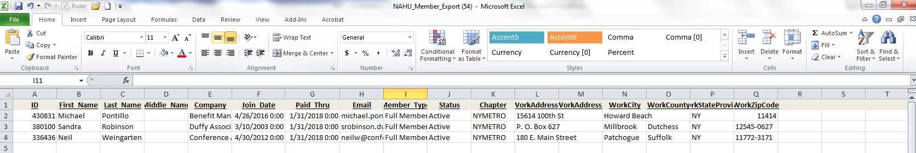
Step 15. Your Credit Card Expiration Report is completed.

