Slide 1


Working with the Media
Working with the Media
A Guide for NAHU Members
A Guide for NAHU Members
Presented By:
Kelly Loussedes
Vice President of Public Relations
Presented By:
Kelly Loussedes
Vice President of Public Relations

Slide 2
Media Relations Roles
Media Coordinator/Media Chair
Media Spokesperson
Media “Journalist”

Slide 3
Media Coordinator/Chair
The Media Chair coordinates media activity within the chapter. The Media Chair does NOT need to be a “spokesperson” but does need to coordinate the communication between the “spokesperson” and media.
Identify media outlets and reporters in the area using local, state and NAHU resources
Identify MR spokespersons on specific issues
Monitor media outlets daily
Establish relationships with local reporters
Respond to media requests for information and interviews
Prepare and submit press releases, media advisories, LTEs and Op-eds with approval of local and state leaders and NAHU staff

Slide 4
Media Spokesperson
The Media Spokesperson needs broad general knowledge of our issues and typically is the “go-to” person for broadcast media outlets.
Identify yourself as a local or state media spokesperson
“Speak With One Voice”
Establish relationships with local media
Respond to reporter requests for information and interviews
Respond to MR Coordinator requests
Prepare and submit LTEs and Op-Ed pieces for publication with approval of local and/or state leaders and NAHU staff

Slide 5
Media Relations “Journalist”
A member with expertise in a specific area, willing to write and submit Op-Eds and LTE, and serve as a resource for the Media Spokesperson.
Identify yourself as a local, state or NAHU Media Journalist, and about which topics you can write about
Utilize NAHU’s MR tools and resources to help draft articles and Op-Ed pieces
Coordinate with Media Spokesperson, MR Coordinator and NAHU staff to “Speak With One Voice”
Forward articles submitted to local and state awards chairs

Slide 6
NAHU Media Relations Tools
Media Relations Tab on Homepage
Multiple media guidebooks
Press release templates
List of canned editorials
PowerPoint presentations on media relations
FREE ads
FREE radio PSAs
Sound Bytes
Sample press kit
So much more … !

Slide 7
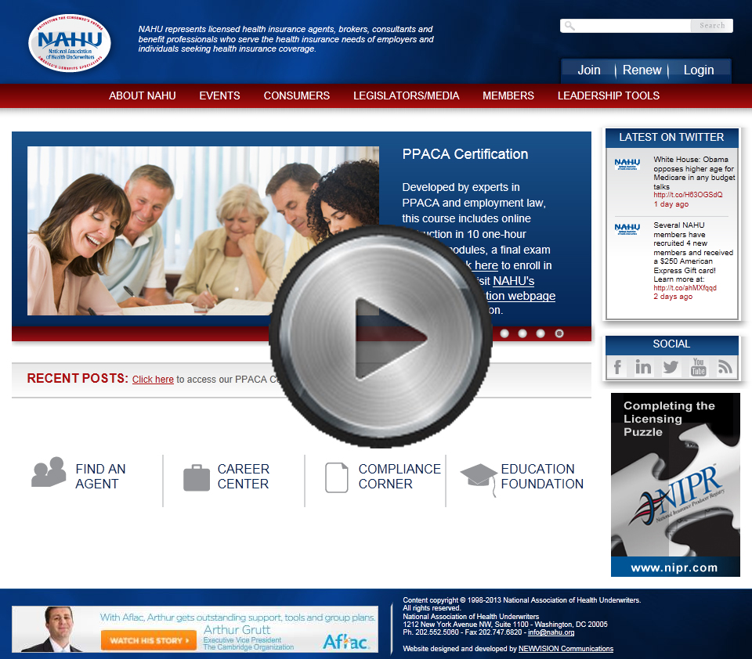
Media Resources Tutorial

Slide 8
MR Guidebooks
“How To” Media Guide
Press Conference Guide
Health Insurance Awareness Week Guide
Guide to Buying Media
Guide to Planning a Press Conference
Guide to Hosting a Medicare Community Event

Slide 9
Find an Agent Feature
Extremely popular resource on the NAHU homepage.
Profiled on major media outlets like the CNN, FOX News, New York Times, Wall Street Journal, USA Today and countless others.

Slide 10
Media Spokesperson Database
The Media Spokesperson Database is comprised of NAHU members who are experts on important NAHU issues such as MLR, Exchanges, Medicare, HSAs, long-term care and the uninsured.
We recently made enhancements to our media spokesperson database housed on the homepage of the NAHU website.

Slide 11
NAHU Sound Bytes
Compiled list of responses for you to use when reporters call
We want to make you the expert
NAHU needs to “Speak With One Voice”

Slide 12
Brokers Making A Difference
Campaign that highlights the value of professional agents and brokers.
Booklet of personal testimonials to use in the media or while lobbying your legislators concerning the need to include agents and brokers in any reformed system
Condensed version that highlights the most touching stories
Several Op-Eds
Website – www.brokersmakingadifference.com
Send your stories in to stories@nahu.org

Slide 13
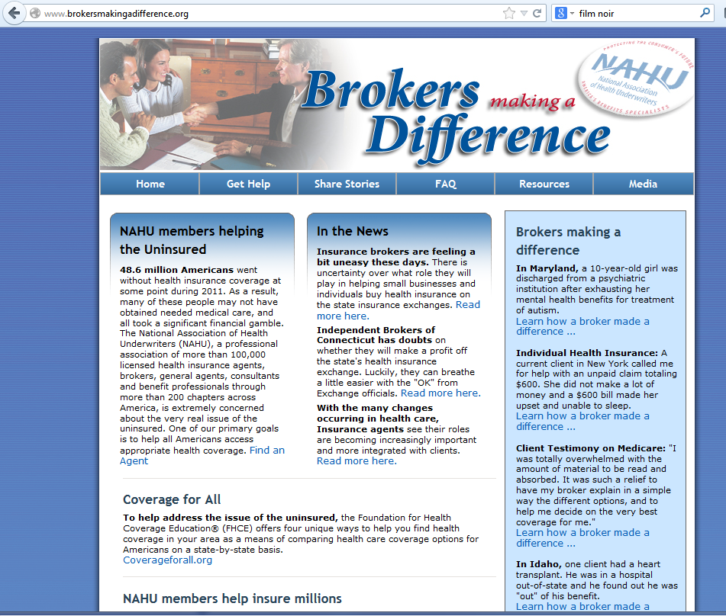

Slide 14
Value of the Agent Campaign
Brochure highlights the role of the agent
30-second radio spots that stress the importance of having a professional health insurance agent to help consumers and employers navigate through the complexities of our health care system
Value of the Agent Ads
Several Value of the Agent Op-Eds and press releases

Slide 15
Value of Media Relations
What Can Media Outreach Do?
Project a positive image about our industry
Generate understanding of role in health care
Educate public about insurance
Identify NAHU members as a source of information
Provide balanced commentary
Advance legislative agenda

Slide 16
Nuts and Bolts of Media Relations Know your local media
Types
Print – daily and weekly newspapers, trade publications and magazines
Broadcast – radio and TV
Be a Media Monitor!

Slide 17
Distinctions Between Print and Broadcast
Print
Allows more in-depth coverage
Often more lead-time
Great range of venues
Broadcast
Sound bites – message must be more concise
Must have experienced spokesperson
Notes:
Mention Online

Slide 18
OPPORTUNITIES FOR VISIBILITY
Chapter News
Legislative Activities
“Day on the Hill”
Meeting with Governor or Legislators
Awards, Member Professional Achievements
Charitable Activities
Speaking Engagements
Public Hearings
Client Feature Stories
Feature Material
Consumer Tips or Advice
National News
Reaction
Local Impact

Slide 19
Content – Message Mgt
Localize story or issue
Refer to local people and how issue will affect them and local businesses
Use quotes from local people about the story
Craft meaningful, short messages with relevance to community
Tell why it is relevant with facts/statistics and tangible examples

Slide 20
Tools of the Trade
When and how to use the tools
Building a press list
Letter of introduction
Press release
Media advisory
Photo
Letter to the editor
Editorial/Op-Eds
Bylined article

Slide 21
Initiating the Media Process Step by Step
Finding the Right Media Outlets
NAHU has access through PR Newswire to current media lists by state and subject matter.
List should include print, television and radio reporters. Remember to also include weekly and community newspapers.
Make sure to include name, phone number, fax number, email, and address.

Slide 22
Media Materials – What Kinds and How Do They Help?
Letter of Introduction
Your credentials
Topic/issues you can address
An offer to provide a background briefing
Contact number, e-mail address
Follow up by phone with every contact…just like in sales!

Slide 23
When and How to Use the Tools
Press Release - Announces “news”
Include contact information and date of release
Include an eye-catching “headline”
Describe the “core” news message in first paragraph (who, what, when, where, why)
Expand the news story in following paragraphs
Include a quote from a recognized spokesperson in the organization
Close with a “boilerplate” paragraph about the organization announcing the news
Limit to 1 or 1 1/2 pages
Use ### at end of release

Slide 24
When and How to Use the Tools
Media Advisory - Announces an upcoming news event or offers a resource person to address a current “hot” issue
Include an eye-catching “headline”
Distribute several days in advance of the news event
Use a “What, When, Where, Why” format
Bullet the main points
Provide contact information and date

Slide 25
When and How to Use the Tools
Photograph - Attach a “cut-line” to the photo that identifies the person(s) in the photo and describes what is pictured
Include with appropriate news announcements (promotion, awards, partnerships)
Ask the reporter how they want the photo sent to them

Slide 26
When and How to Use the Tools
Letter to the Editor - Responds to an article or editorial that has appeared in a publication
Make certain it relates directly to the topic
Include name of article, date and page for reference
Be concise and brief (usually 100-200 words)
Share your unique perspective
Give examples
Close with your name, title and affiliation
(Advance Chapter approval required if identified)

Slide 27
When and How to Use the Tools
Op-Ed - An “opinion piece” submitted by an individual or on behalf of an organization to a publication. Placement can be paid for or a publication may decide to publish on its own.
Needs to be linked to a topical issue of interest.
Offers a unique perspective.
Is brief (usually 300-600 words).
Includes name of author and affiliation.

Slide 28
When and How to Use the Tools
Bylined Article - A lengthier article (primarily used in trade publications) authored by an organization’s staff or member on a topical issue
Offer to write an article for the publication
Do not prepare an article without discussing it with the editor

Slide 29
Social Media Sites
Twitter: Short, up-to-the-minute information
LinkedIn: Professional networking
Facebook: Sharing your life—personal and professional
Blogs: Relay detailed information on a specific topic
News Stories: Community forum to add to discussion

Slide 30
Social Media Etiquette
Stay Positive
Everything you learned in kindergarten
Don’t be a Debbie Downer
State your credentials
When to Post
Is it worth your time and effort?
Are you only posting because you’re angry?
Has someone already said it?
What to Post
Be responsible in what you say
If it mentions NAHU, we can ask you to take it down

Slide 31
Media Relations Award
Winners will be recognized for media relations activities that have placed them in the forefront in all areas of media relations activities, including the following:
Media Relations committee in place
Press list of local media contacts
Sending press releases
Publication of Op-Eds and other editorials
Prints and broadcast press hits
Keeping NAHU informed on press exposure
Attend “Working with the Media” webinars

Slide 32
Media Coverage
So far in 2013, NAHU received more than 10,100 press hits.
In 2012, NAHU received more than 7,500 press hits.
In 2011, NAHU received more than 4,400 press hits.
In 2010, NAHU received more than 3,000 press hits.

Slide 33
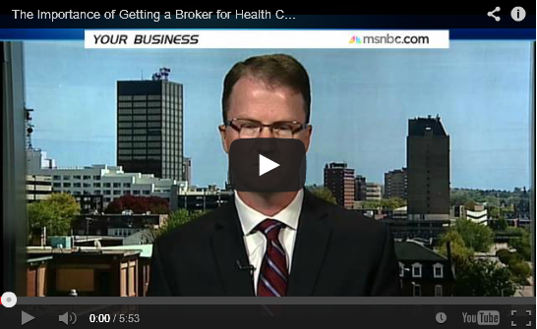
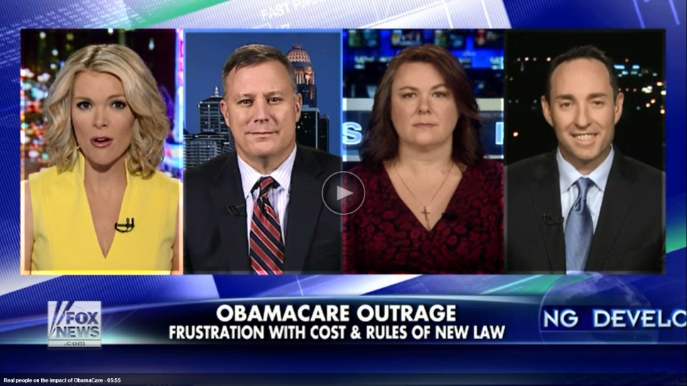


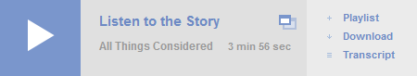

2013 Sound Byte Highlights

Slide 34




2013 Print Highlights
“Kelly Fristoe, an insurance agent, said the majority of his clients had also sought early renewals. ‘Where I live, we have a younger workforce, and that’s where the increases are taking place,’ he said. ‘The majority of my business is under 45 years old, and they’re seeing rate increases as well.’”
“In Americus, Ga., broker Russ Childers says he has just received the rates for his small-business clients, and many of them are significantly higher — unless the company employs a lot of older workers. His advice to clients: "When in doubt, early renew.’”
“[Jessica] Waltman was briefing state insurance regulators by telephone Thursday about enrollment problems in the new health insurance marketplaces. She said the problem was occurring mostly in the 36 states in the federal marketplace.”
“A broker can help you find a health-care plan that suits your needs and budget at no charge, as most are compensated by insurance carriers. You can find a broker in your state by visiting the website for the National Association of Health Underwriters at NAHU.org.”

