Slide 1
NAHU Membership
Core Competencies for the
Membership Volunteer

Slide 2
Welcome to your Leadership Role
Why did you choose/agree to be a membership chair?
What are your expectations as a leader?
What are your goals?
Notes:
Serving as a membership chair in your chapter is a great volunteer position for those members who love to work directly with and engage with other members of the association. If you are a people person, then this is the job for you! In this role you have the opportunity to meet and to get to know your fellow members. Many relationships that are built at NAHU last a lifetime and they are beneficial both professionally and personally. Membership chairs are NAHU cheerleaders who love the association and want others to benefit from joining!
Serving as a membership chair can be overwhelming at first especially as you learn all the systems in place that can assist with membership management. Before you get into the details take a few moments and think about why you chose/agreed to be a membership chair. What are your expectations as a leader and what do you wish to accomplish? Take a moment to frame your year as a membership chair and let this be your guide throughout the year. Is your goal to increase chapter membership by 5% in one year? Do you want to develop new retention activities that will help your chapter keep more of the members they have? Do you want to improve communication with your members and develop a new membership newsletter? It is probably not a single item you want to accomplish but rather a list of items.

Slide 3
Overview of Responsibilities
Primary Responsibilities for a membership chair:
Recruiting and promoting NAHU to new members.
Developing retention activities.
Promoting the membership GAIN contest.
Maintaining good membership records.
Communicating with your members.
Attending teleconferences.
Notes:
You have the ability to frame your year as a volunteer and to set goals and to have a vision for what you want to accomplish. However, there are basic responsibilities that naturally fall under the membership chairs purview. Primarily, membership chairs are responsible for recruiting and promoting NAHU to potential members. The goal should be to increase membership and to have new members join. What is your membership story? Why did you join NAHU? This a great place to start in developing your elevator speech!
Also, it is important to keep the members we have and this is accomplished by developing chapter retention activities. Maintaining or having a system to track membership is essential. NAHU has many tools, especially eCommerce and monthly membership reports, that makes this process simple for you.
Communicating membership items to your members is vitally important. For example, if the NAHU national office is having a nationwide membership campaign it is important to promote this to your membership to ensure everyone knows about it and can take part. If your chapter is having it’s own membership contest – promote it, promote it, promote it. The rule of thumb is if you think you have said it or promoted it enough times – you are only just beginning!
Attend all teleconferences! Attending teleconferences helps you stay informed of what is happening nationally, regionally, at the state level and local chapter level. It is also a great way to learn from others and to share ideas. When you are invited to a teleconference make sure to attend and to mark it on your calendars as a high priority!
There is a lot of responsibility that falls under the membership chair and it is not expected that you do it all alone. Building a membership team is essential for your success and the success of your chapter’s membership!

Slide 4
Your Membership Team
Establish a membership team!
Vice Chair
Assign small projects
Ad hoc committees
Notes:
Spending the time to appoint the right people to serve with you is critical. Nothing will help you more than appointing the right people and creating an action driven team!
First, appoint your vice chair. This person will be your right hand and will work closely with you throughout the year. This is also important because this individual will hopefully serve as your predecessor. Serving as a vice chair will make for a much smoother transition into the role of chair.
If there are small tasks that need to be done at a chapter event or if there is a special membership project – assign small tasks to other volunteers. This will help ensure that everyone is working together to achieve the common goal.
If your board decides to develop a larger project that falls under membership it is essential that you put a team together to ensure success! Use ad hoc committees so that work is evenly distributed and not to overwhelming for any one person.
Above all make your membership work fun! There are endless ways to be creative and to build friendly competition into membership activities.

Slide 5
Staying Informed
Attend teleconferences
Attend webinars
Read NAHU communications
Monthly Membership Connection
Monthly regional lapse list email
Monthly Leader Newsletter
Monthly NAHU News
Weekly Washington Update
Notes:
Open lines of communication are essential for success! No one expects you to be the expert or to know all the answers. However, your success will depend on knowing where to go to stay informed or where to find the information.
Attend all teleconferences you are invited to! The type of call you will be invited to attend will depend if you are a state or local membership chair. Regardless – make sure to attend the calls. Teleconferences allow for information sharing, reviewing what is working and what is not working, the opportunity to address problems and/or concerns and most importantly to share successes!
If you are invited to a membership training webinar – make sure and attend! You can never learn to much about membership.
Read communications that are sent from NAHU national. In particular, make sure to read the monthly Membership Connection, which is a monthly newsletter dedicated to membership topics. A regional lapse email is sent out monthly that includes a list of lapses for each chapter – make it a practice to make sure the lapses on this list are contacted by the chapter. By doing this you are guaranteed higher retention rates. The monthly Leader is sent from NAHU and focuses on information that all chapter leaders need to be made aware. The monthly NAHU News is for all members and highlights happenings that all members need to know. The weekly Washington Update will keep you up-to-date on what is happening legislatively.
If you read these email communications you will always know what is happening at the national level.

Slide 6
NAHU Resources
Online Membership Tools
Located at www.nahu.org
Click Leadership Tools
Membership Tools
Click Tools
Notes:
NAHU’s national office has extensive online resources available to membership chairs. To access the tools go to www.nahu.org; Leadership tools; Membership tools – tools. In this section of the website you will find a library of resources that will assist you with membership management.

Slide 7
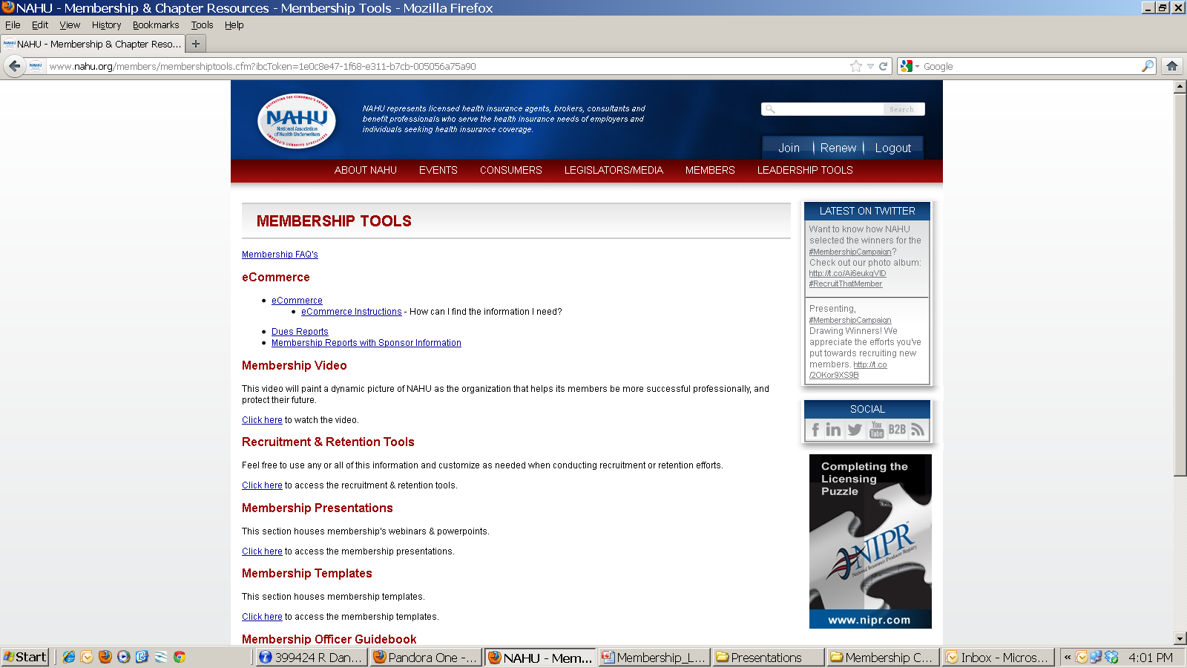
Membership Tools
To access:
www.nahu.org
Leadership Tools
Membership Tools
Tools
Notes:
On the Membership Tools page you will find access to a variety of items. As new items are developed they are posted here so make sure to check back often.
The top section will give you access to eCommerce – the online reporting tool for extracting membership reports. This is a direct link to NAHU’s database so it extracts real time information. This is the tool that you would use to extract a full membership roster, extract your billed not paid list, former members and new members. This is the most important tool that you have available to use as a membership officer. Learning the functionality of this program will enable you to manage your chapter’s membership and at any given time know exactly who your current members are, who has recently joined, and lapsed.
For instance, at your board meetings you can extract a list of billed not paid members and take it with you. Review the list at the board meeting and assign volunteers to contact the lapsed members. It is likely that someone on the board will know the dropping member, can contact them and get them to renew right away! Another great idea is to have a list of new members and request that board leaders contact each new member personally and welcome them to the association. These types of activities go a long way!
On this same webpage you will find recorded eCommerce training webinars under Membership Presentations. It is highly recommended that membership officers attend the eCommerce trainings. If you don’t know how to operate eCommerce please contact NAHU membership staff and someone on the team will be happy to assist!
On this same webpage you will find access to:
NAHU Marketing Video – this can be shown at the opening of chapter events.
Recruitment and Retention Tools – this section includes sample letters, marketing pieces, and membership tools that you may find useful. Feel free to rob and duplicate the items from this page. If you have a great piece that your chapter has used with success – send it to your national membership team and it can posted as a resource.
Membership Presentations – here you will find recordings of past webinars.
Membership Officer Guidebook – a guidebook that outlines the responsibilities of membership officers.
Blitz Handbook – a guidebook on how to conduct a membership blitz.

Slide 8
GAIN Contest
Runs from May 1 – April 30 of each year.
Four Contest Categories:
New Members
Growth Rate
Retention Rate
Overall – Membership Cup!
Notes:
The GAIN contest is a national contest that rewards members, chapters and regions that excel at recruitment and retention. The GAIN contest (Get Agents Involved Now) has a long history and chapters who actively participate and want to win have a great time with the competition! The winners are announced at NAHU’s Annual Convention during the awards ceremony and winning chapters are recognized in our monthly HIU publication, on our website and in other communications. Winning in any of the four categories is a great accomplishment for any chapter and is something to be proud of.
Get your chapter excited about the GAIN contest and winning! Talk about the GAIN contest at every board meeting and review your chapter’s current standings. Make sure to review where the chapter stands against a “rival” chapter and do what you can to make sure your chapter wins!
You will hear about the GAIN contest throughout the year and current standings are posted monthly on NAHU’s Monthly Membership Reports.

Slide 9
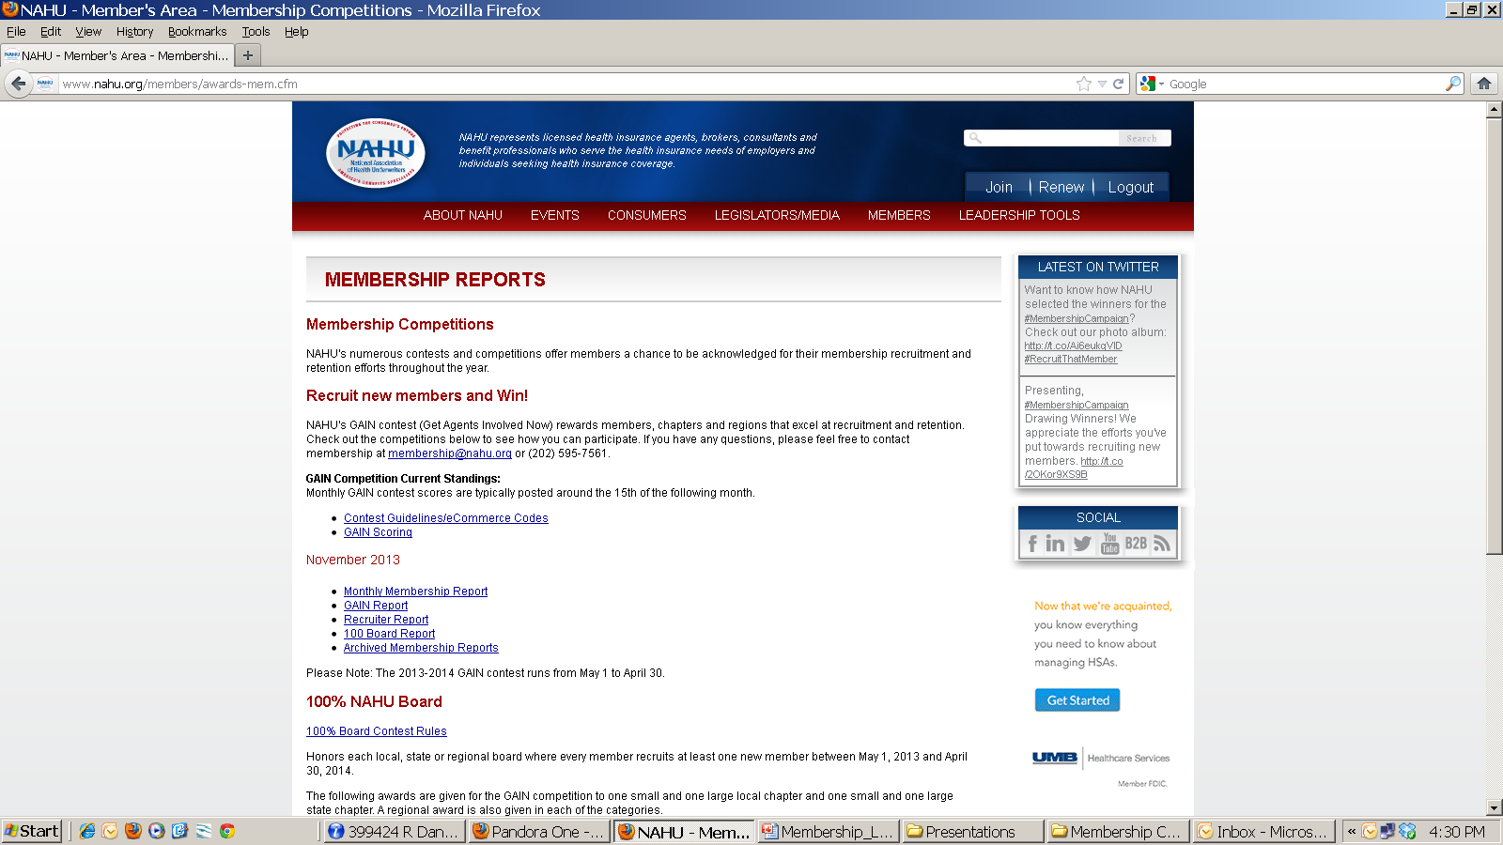
Membership Reports
To access:
www.nahu.org
Leadership Tools
Membership Tools
Reports
Notes:
To access the membership reports, go to www.nahu.org, click on Leadership Tools, Membership Tools, then Reports. The membership reports include the monthly membership report, GAIN report, Recruiters report and 100% Board report.
The GAIN report is a report that you can review to get a quick look at how each chapter is doing in the GAIN contest.
The Recruiters report shows members who have recruited new members and how many they have recruited for the recruiter of the year contest.
The 100% Board report gives the board members from each chapter and the number of members they have recruited – this is a great report to take to board meetings so you can let each board member know how they are doing with member recruitment. It is a great way to keep healthy competition amongst board members and keep them excited about membership.

Slide 10
Membership Reports
Posted online on the 15th of each month.
Gives current membership counts for each region, state and chapter.
Current rankings in the GAIN contest.
Use to report NAHU’s membership number.
Notes:
The monthly membership report is posted on the 15th of each month and gives current membership counts for each region, state and chapter. As a membership officer you should review this report and take it with you to every board meeting. This is the report that NAHU uses to track our overall national membership number and retention rate. There are also archived membership reports online dating back to 2008. This enables you to trend your chapter’s membership over time and to give a historical perspective on your chapter’s membership.

Slide 11
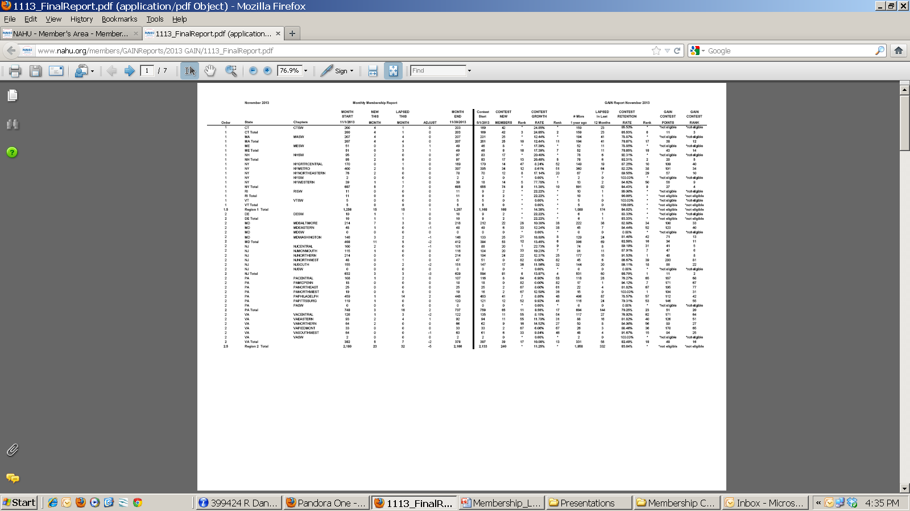
Monthly Membership Reports
To access:
www.nahu.org
Leadership Tools
Membership Tools
Reports
Notes:
The monthly membership report gives the count of members at the beginning of the month, the count of new members, count of lapsed members, any adjustments, and the final count for the month. It also gives you the month’s retention rate. The right hand side of the report gives you information on where each chapter is ranking for the GAIN contest.

Slide 12
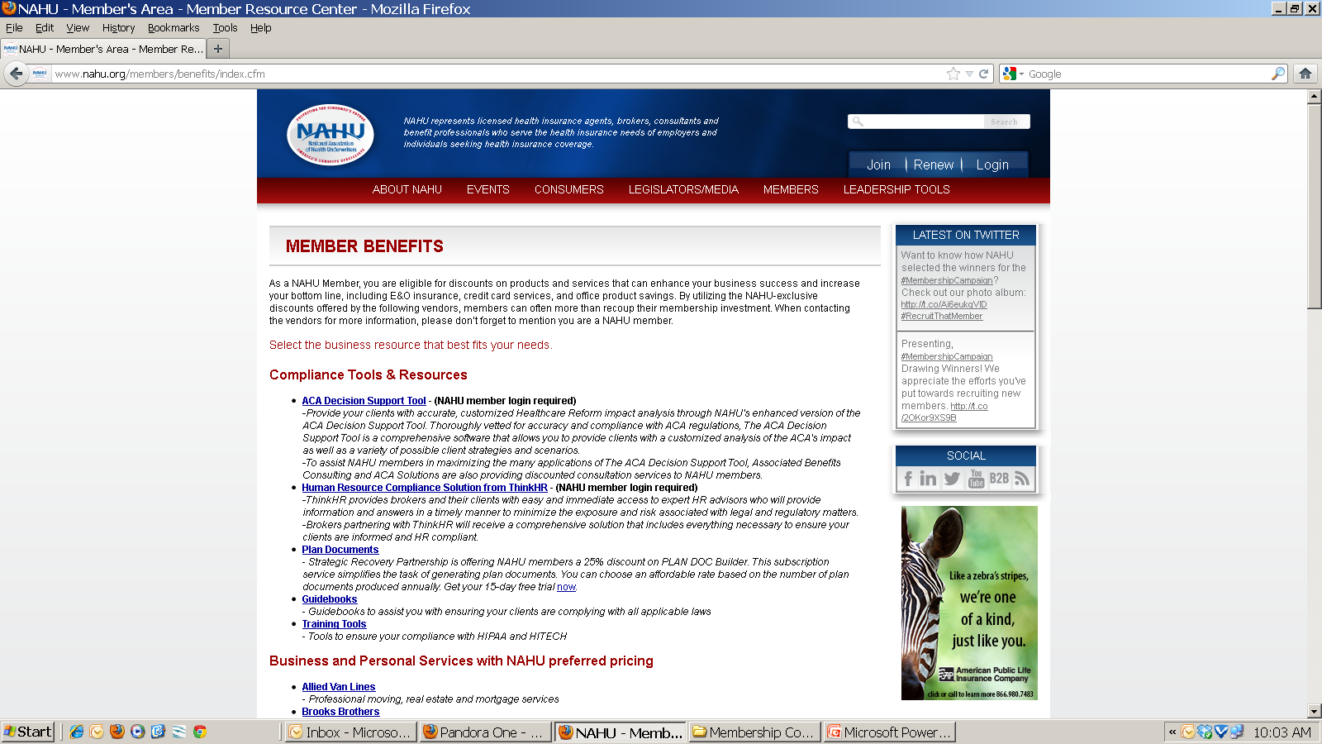
Member Benefits
To access:
www.nahu.org
Members
Benefits
Notes:
Be familiar with all NAHU member benefits. The NAHU website is a great resource for reviewing all the benefits that our members receive. For instance, our Compliance Corner is full of helpful compliance information. In addition, NAHU has several discounted member benefit programs that range from discounted shipping with UPS to discounts on the ACA Decision Support Tool, PlanDoc Builder and ThinkHR. The list of discount programs is located online under members, then click on benefits. This list is updated as we add programs to our list of benefits. Remember – you can take advantage of these programs too!

Slide 13
Retention
Keep the members we have!
Notes:
The basic principle behind retention is simple – keep the members we have. But how do we do this? The national office sends out mailed invoices, email reminders and makes phone calls. While our national retention rate is 83% on average – what is your chapters retention rate? Could we do better? The answer is yes! Did you know that 60% of our new members (1-2 years) drop their membership? What would happen if we could cut that in half? The only way to grow membership is to keep the members we have and then to add new ones. When we lose one member it takes two new members to join to achieve growth.

Slide 14
Retention
When does retention begin?
Notes:
The correct answer to one simple question will help your chapter increase the number of members who pay their dues. When does retention begin?
Many people believe that the retention process begins when the national office sends out the first renewal notice to our members. While we will always send out emails, mail invoices, make phone calls, etc. as basic renewal functions and these are all important tasks that must be completed. This is not when retention begins – this is the start of the renewal process. Retention begins as soon as the new member joins. When a new member first joins and sends that payment they have an expectation of what they want to receive and it is up to us to deliver it. How do we work toward this end? What is the most important one thing that we can do to ensure we are meeting member needs?

Slide 15
Building Member Relationships
Personal contact with members
Member Recognition
Short term projects
Networking
Notes:
Building member relationships . Members are more apt to renew if they feel like they have a relationship with the association. How does a chapter build relationships with its members?
Personal Contact is Key! Personal contact with members will help establish relationships with members and then you can also learn about their expectations. This can be accomplished as soon as the new member joins by having board members do welcome calls each month to the chapter’s new members. Follow up with new members when they do not attend a chapter event – let them know they were missed and that you hope to see them at the next one.
Member recognition is another great way to build a relationship. It makes the member feel important and part of the organization. Some things a chapter can do is recognize new members on the website with a possible bio of the member. Consider a short interview or quote from the member on why they joined and what they hope to gain from the organization. Recognize your members on an ongoing basis through a volunteer or member of the month or quarter. Highlight this achievement on the web and in newsletters.
Ask new members to volunteer for a short term project that can be completed easily and the member can feel good about their contribution. Then follow up with a handwritten thank you note.
Networking is a key reason for members to belong to an organization. People join associations to belong to something bigger and to be a part of something.
Highlight all events and make sure new members are invited, possibly by a phone call from a mentor or local board member. When new members arrive to an event, the worst thing that can happen is for the member not to feel welcome. Make sure that either the mentor or board members are assigned the task of greeting and introducing the member to the group.
As a membership chair you want your members to have positive thoughts when they receive their renewal notice. Members will not renew when they think - I didn’t get anything from my membership. I am not renewing because basically the money is not worth it. You want them to renew because they “feel part of something” and they will be missing out if they don’t renew.

Slide 16
Recruitment Campaigns and Contests
Membership Blitz
Chapter Contests
National Membership Campaigns
Notes:
How do you get new members to join?
A membership blitz is a one-day event that is held to increase an association’s membership. A blitz works well because it is a complete team effort. A group of members
volunteer to dedicate 2-3 hours on a specific day to make calls at a prearranged location to recently lapsed and prospective members in your area. We have seen as many as 25 new
members recruited during one 2-hour period. There is a blitz handbook available online in the membership tools section.
Build chapter contests and reward members for recruiting new members! The way to organize a contest is rather endless. But keep it fun and make it where members want to participate.
Make sure to promote any national membership campaigns that are occurring. In addition, many chapters build off national membership campaigns and have a spin off campaign at the chapter level.

Slide 17
Who to Contact?
NAHU Staff
Local chairs – contact your state chairs
State chairs – contact your regional chair
Notes:
There is always someone to help you with questions. You can always contact NAHU staff – there is dedicated membership staff that will help you with your question. A staff directory is located at www.nahu.org under About NAHU.
If you are a local chair – contact your state chair or your regional chair that is on the national membership council.
If you are a state chair – contact your regional chair that is on the national membership council. There is a directory of national committees and contact information online at www.nahu.or under About NAHU – Leadership Committees.
Remember – with membership keep it fun, competitive and exciting! Engage with your board and keep them excited about membership. Set goals that are achievable and build relationships with your new members.

