Slide 1

February's Media Hit Report

Slide 2

Total Press Hits
This Month
540

Slide 3

Media By Type
ONLINE:
Bloomberg BNA
Atlanta Journal-Constitution
U.S. News & World Report
Fresno Bee
Tyler Morning Telegraph Washington Examiner Lexington Herald-Leader
San Antonio Express-News San Francisco Chronicle
Wichita Eagle
Sacramento Bee
Miami Herald
NEWSPAPERS:
Hartford Courant
Washington Times
Star-Democrat
Asheville Citizen-Times Greensboro News & Record
Des Moines Register
Tennessean
St. Louis Post-Dispatch
Knoxville News-Sentinel
San Antonio Express-News

Slide 4
Media By Type
TRADE PUBS
& MAGAZINES:
Modern Healthcare
Kaiser Health News
FierceHealthcare
The Hill
BenefitsPro
Insurance News Net
New York Times News Service
Employee Benefit Adviser
California Broker
BROADCAST:
KUHF-FM
WNJT-TV
KNX-AM
News 13 This Morning - WLOS-TV
KUAM-TV
KNDO-TV
CNBC
WNET-TV
WTOL
WWBT-TV

Slide 5
Number of Hits by Region/State
Delaware: 1 hit
Benzinga
Washington, D.C.: 29 hits
Associated Press (3), U.S. News & World Report, Washington Examiner (2), The Washington Times, AAMC Reporter, American Health Line, Kaiser Health News (2), BBC World News, Congressional Testimony, CQ Weekly, FierceHealthcare (3), The Hill, Lifezette (2), McClatchy Newspapers, Morning Concult, EIN News Publications (2) & Citybizlist (4)
Maryland: 7 hits
Citybizlistn (4), Star-Democrat, Talbot Spy & PRWeb
New Jersey: 22 hits
Caucus New Jersey - WNJT-TV (5), Classroom Close-up, NJ - New Jersey TV (NJTV) (2), One on One With Steve Adubato - WNJT-TV (3), WNJT-TV (8) & BestWire (4)
Pennsylvania: 4 hits
Insurance News Net (2), HR Morning & Centre Daily Times
Virginia: 18 hits
Bloomberg BNA, Loudoun Times-Mirror (2), Benefit News (4), WWBT-TV, Employee Benefit Adviser (7), ArcaMax & Targeted News Service (2)
REGION 1
Connecticut: None
Maine: 1 hit
Hartford Courant
Massachusetts: None
New Hampshire: None
New York: 21 hits
New York Times (2), Employee Benefit News, BuzzFeed, Pharma & Healthcare Monitor, Patch (3), Mondaq (2), The Open Mind, WNET-TV (4) & My informs (6)
Rhode Island: 4 hits
GoLocalProv News (4)
Vermont: None
REGION 2

Slide 6
Number of Hits by Region/State
Illinois: 9 hits
Sauk Valley Newspaper (2), Becker's Hospital Review, Daily Herald - Cook County (2), Tristates Radio, Peoria Public Radio & WUIS-FM
Indiana: 6 hits
Journal & Courier, WFIE-TV (2), Republic, WBAA, WVPE & WBND-TV
Kentucky: 3 hits
KyForward & WAVE-TV (2)
Michigan: 5 hits
StreetInsider (2), Huron Daily Tribune, WEMU-FM & Wgvu news
Ohio: 16 hits
Columbus Dispatch (2), 9 On Your Side at 5PM - WCPO-TV, States News Service (3), WOIO-TV, WOHL-TV, WVXU-FM, WTOL-TV, Tire Review, WXIX-TV (2) & WFMJ-TV (2)
West Virginia: 3 hits
WVNS-TV, WBOY-TV, WVPB-FM & WTRF-TV
REGION 4
Iowa: 4 hits
Sioux City Journal, Waterloo-Cedar Falls Courier, KWWL-TV & KTIV-TV
Minnesota: 3 hits
Star Tribune (2) & Daily Journal
Nebraska: 6 hits
Omaha World-Herald, Lincoln Journal Star, Norfolk Daily News, Hastings Tribune & KLKN-TV (2)
North Dakota: 1 hit
Prairie Public Broadcasting
South Dakota: 1 hit
Yankton Daily Press & Dakotan
Wisconsin: 1 hit
WDJT-TV, WUWM-FM & Wisconsin Public Radio
REGION 3

Slide 7
Number of Hits by Region/State
Arkansas: None
Kansas: 1 hit
Wichita Eagle
Louisiana: 2 hits
KSLA-TV & WVUE-TV
Missouri: 3 hits
Kansas City Star & St. Louis Post-Dispatch (2)
Oklahoma: 1 hit
KWTV-TV
Texas: 15 hits
Fort Worth Star-Telegram, San Antonio Express-News (2), Tyler Morning Telegraph, Odessa American, Gilmer Mirror, ExpressNews, KLTV-TV, KRHD-TV, KTRE-TV, KAUZ-TV & KUHF-FM (4)
REGION 5
Alabama: 3 hits
WAFF-TV, WSFA-TV & AL.com
Florida: 6 hits
WFLX-TV, Capital Soup, Miami Herald, Bradenton Herald (2), & FOX 29
Georgia: 3 hits
WALB-TV, Telegraph, & Georgia Health
Mississippi: 3 hits
Sun Herald, WDAM-TV & WLOX-TV
North Carolina: 14 hits
Greensboro News & Record (7), Charlotte Observer, News & Observer, Asheville Citizen-Times, News 13 at 5am - WLOS-TV (2) & WECT-TV
South Carolina: 5 hits
The Herald, Sun News, WCSC-TV, Island Packet, The State & WMBE-TV
Tennessee: 6 hits
Tennessean (2), Knoxville News-Sentinel, Orlando Medical News, Commercial Appeal & WMC-TV
REGION 6

Slide 8
Number of Hits by Region/State
REGION 8
Arizona: None
Colorado: 3 hits
BenefitsPro & The Gazette (2)
Idaho: 1 hit
Idaho Statesman
Montana: None
New Mexico: None
Utah: 1 hit
St. George News
Wyoming: None
Alaska: None
California: 17 hits
Sacramento Bee, Modesto Bee, Fresno Bee, Mount Shasta Herald, Tribune, BioSpace, IT Business Net (2), Consumer Electronics Net, KNX-AM, JD Supra, Program Business, KUSI-TV, California Broker, Insure.com, DMN Newswire & Review Seeker
Hawaii: 2 hits
KHNL-TV & KFVE-TV
Nevada: None
Oregon: 1 hit
The Lund Report
Washington: 4 hits
News Tribune, Bellingham Herald, Tri-City Herald & KNDO-TV
REGION 7

Slide 9
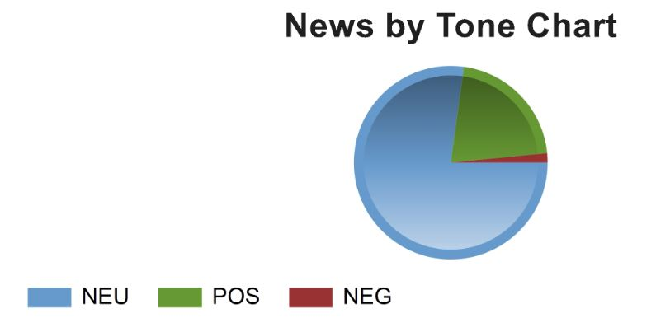
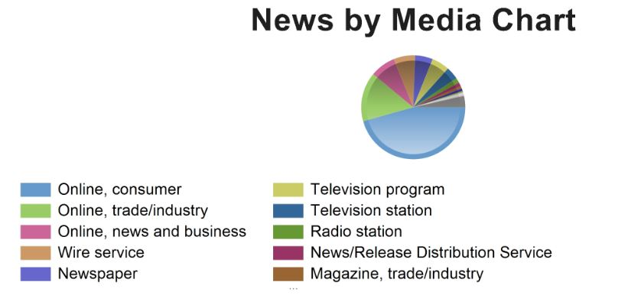
CHART BY TONE
CHART BY MEDIA

Slide 10
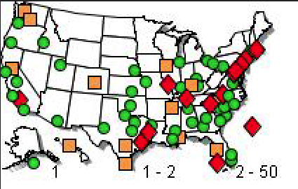
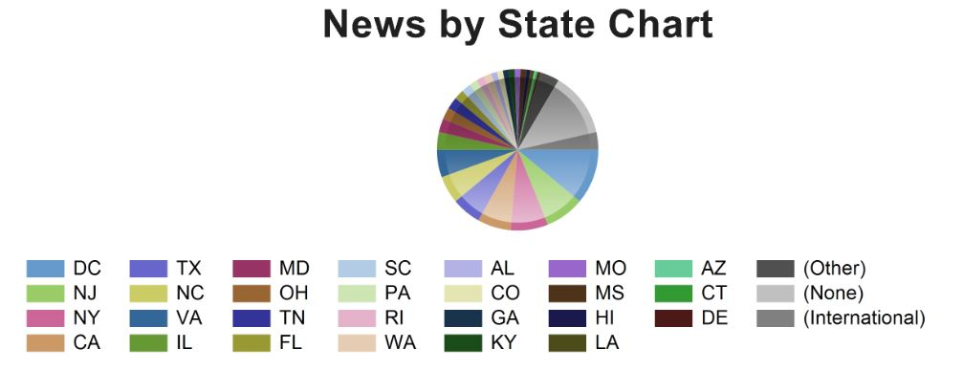
NEWS BY
U.S. MAP
CHART BY STATE

Slide 11


Slide 12




NAHU's Twitter page has 8,779 followers.
NAHU tweeted 144 times over this period.
NAHU's tweets earned 82,100 impressions, averaging roughly 2,900 impressions per day.
NAHU's tweets had an average engagement rate of 1.5 percent, receiving 392 link clicks, 280 retweets, and 296 likes.
NAHU's Facebook page has 3,163 likes.
NAHU posted 141 times. NAHU's Facebook posts reached roughly 1,050 people per day.
NAHU's posts were shared around 10 times per day and people reacted roughly 15 times per day.
Review February’s Social Media Analytics

Slide 13

IMPORTANCE OF MEDIA COVERAGE
We often send these clips to policymakers to alert them of the issues we are facing. The more high-profile media coverage we received, the more attention policymakers will pay to our issues.
Media placement means an increased understanding of the issues in the public, both inside and outside the industry.
Media attention increases NAHU name recognition and branding.
We do not pay for our media placements. All coverage received by our members is free business promotion, which promotes NAHU members as subject-matter experts.
Good information and solid sound bytes provided by an NAHU member means other reporters will want to use that member as a resource.

