Slide 1

January's Media Hit Report

Slide 2

Total Press Hits
This Month
571

Slide 3

Media By Type
ONLINE:
Amarillo Globe-News
Atlanta Journal-Constitution
NPR
Columbia Star
Connecticut MirrorColumbus Dispatch
Houston Chronicle
Omaha World-Herald
San Antonio Express-News San Francisco Chronicle
Lincoln Journal Star
Miami Herald
NEWSPAPERS:
Chicago Tribune
Roanoke Times
New York Times
Dallas Morning News
Kansas City Star
Des Moines Register
Tulsa World
St. Louis Post-Dispatch
Oklahoman
Winston-Salem Journal
Virginian-Pilot

Slide 4
Media By Type
TRADE PUBS
& MAGAZINES:
Healthcare Payer News
Kaiser Health News
National Underwriter Life & Health
BenefitsPro
Insurance and Financial Advisor
Insurance Business America
California Broker
Pharma & Healthcare Monitor
The Journal Record
BROADCAST:
Majic 102.3
Utah's Morning News/KSL-AM
NewsChannel 10 This Morning
FOX News
9 On Your Side at 5PM/WCPO-TV
CNBC
FOX News Channel
WTOL
BBC World News
KTRS-AM
WBOY-TV

Slide 5
Number of Hits by Region/State
Delaware: 2 hits
Benzinga and WDDE-FM
Washington, D.C.: 7 hits
Associated Press, Kaiser Health News, BBC World News, NPR, EIN News Publications (2) & Citybizlist
Maryland: 3 hits
Citybizlist, WSDL 90.7, WBOC-TV, WBOC-TV2, WYPR-FM & PRWeb
New Jersey: 10 hits
Caucus New Jersey - WNJT-TV (10)
Pennsylvania: 7 hits
WFMZ-TV & Centre Daily Times
Virginia: 13 hits
Roanoke Times, Virginian-Pilot (2), WUPV-TV, WWBT-TV (2), WHRO-FM, WVIR-TV, Employee Benefit Adviser (2) & Targeted News Service (2)
REGION 1
Connecticut: None
Maine: 1 hit
Healthcare Finance News
Massachusetts: 2 hit
Boston Business Journal & mHealth Intelligence
New Hampshire: None
New York: 15 hits
Pharma & Healthcare Monitor, PR Newswire (3), Profit Quotes, Patch (2), Times Union (2), WRVO, The Open Mind, WNET-TV & My informs
Rhode Island: 4 hits
GoLocalProv News (4)
Vermont: None
REGION 2

Slide 6
Number of Hits by Region/State
Illinois: 8 hits
Sauk Valley Newspaper (2), Becker's Hospital Review, Daily Herald - Cook County (2), Tristates Radio, Peoria Public Radio & WUIS-FM
Indiana: 6 hits
Journal & Courier, WFIE-TV (2), Republic, WBAA, WVPE & WBND-TV
Kentucky: 3 hits
KyForward & WAVE-TV (2)
Michigan: 5 hit
StreetInsider (2), Huron Daily Tribune, WEMU-FM & Wgvu news
Ohio: 16 hits
Columbus Dispatch (2), 9 On Your Side at 5PM - WCPO-TV, States News Service (3), WOIO-TV, WOHL-TV, WVXU-FM, WTOL-TV, Tire Review, WXIX-TV (2) & WFMJ-TV (2)
West Virginia: 3 hits
WVNS-TV, WBOY-TV, WVPB-FM & WTRF-TV
REGION 4
Iowa: 4 hits
Sioux City Journal, Waterloo-Cedar Falls Courier, KWWL-TV & KTIV-TV
Minnesota: 3 hits
Star Tribune (2) & Daily Journal
Nebraska: 6 hits
Omaha World-Herald, Lincoln Journal Star, Norfolk Daily News, Hastings Tribune & KLKN-TV (2)
North Dakota: 1 hit
Prairie Public Broadcasting
South Dakota: 1 hit
Yankton Daily Press & Dakotan
Wisconsin: 1 hit
WDJT-TV, WUWM-FM & Wisconsin Public Radio
REGION 3

Slide 7
Number of Hits by Region/State
Arkansas: 2 hits
kuar.org & KASU
Kansas: 2 hits
KOAM-TV & Kansas Public Radio
Louisiana: 8 hits
KSLA-TV (2), WAFB-TV, WWNO-FM, WRKF-FM & WVUE-TV (2)
Missouri: 4 hits
Kansas City Star, KFVS-TV, Lake Expo & KMOV-TV
Oklahoma: 9 hits
Tulsa World, Oklahoman, KWGS.org, KQCW-TV, KWTV-TV (2), KSWO-TV, Journal Record & KOTV-TV
Texas: 17 hits
San Antonio Express-News (2), Times Record News (2), Amarillo Globe-News, Houston Chronicle, KLTV-TV (2), KRHD-TV (2), KXXV-TV, KTRE-TV, KWES-TV, KAUZ-TV (2) & KCBD-TV
REGION 5
Alabama: 8 hits
WAFF-TV (2), WSFA-TV (3), WBRC-TV, WKRG-TV, WLRH.org
Florida: 8 hits
WFLX-TV (2), Florida Politics, Saint Petersblog, Miami Herald, Bradenton Herald, WZVN-TV, WFSU, WUWF, WFIT & HealthyState
Georgia: 10 hits
WLTZ-TV, WALB-TV (2), WFXG-TV, WABE-FM, WTVM-TV, Telegraph, WTOC-TV, Columbus Ledger-Enquirer & Atlanta Journal-Constitution
Mississippi: 6 hits
Sun Herald, WDAM-TV (2), WLBT-TV & WLOX-TV (2)
North Carolina: 11 hits
Greensboro News & Record (3), Star-News, WBTV-TV, WUNC-FM, WCQS-FM, WFDD-FM, WSFX-TV & WECT-TV (2)
South Carolina: 9 hits
Columbia Star (3), WCSC-TV (2), WIS-TV, Island Packet, The State & WMBE-TV
Tennessee: 5 hits
wutc.org, WMOT-FM, WRCB-TV & WMC-TV (2)
REGION 6

Slide 8
Number of Hits by Region/State
Arizona: 3 hits
KOLD-TV (2) & AZ Family
Colorado: 1 hit
Aspen Public Radio
Idaho: 2 hits
Idaho Statesman & Boise State Public Radio
Montana: 1 hit
Montana Public Radio
New Mexico: 1 hit
KUNM
Utah: 4 hits
West Valley City Journal, Standard-Examiner & Utah's Morning News - KSL-AM
Wyoming: None
REGION 8
Alaska: 1 hit
Alaska Business Monthly
California: 19 hits
San Francisco Chronicle, Modesto Bee Fresno Bee, Merced Sun Star, Capital Public Radio, KUSI-TV (2), KPBS-TV, KFMB-AM (760 AM Talk Radio), Merced Sun Star, Tribune, JD Supra, Program Business, Spoke, GateHouse Media, TutorialFinder.com, KALW California Broker & KVCR-FM
Hawaii: 2 hits
KHNL-TV (2)
Nevada: 2 hits
KTVN-TV & KVVU-TV
Oregon: 2 hits
The Jefferson Public Radio Network & KLCC-FM
Washington: 9 hits
Seattle Post‑Intelligencer, News Tribune, Bellingham Herald, Tri-City Herald, KHQ-TV, KUOW-FM, Olympain, KNDO-TV (2) & KHQ-TV
REGION 7

Slide 9
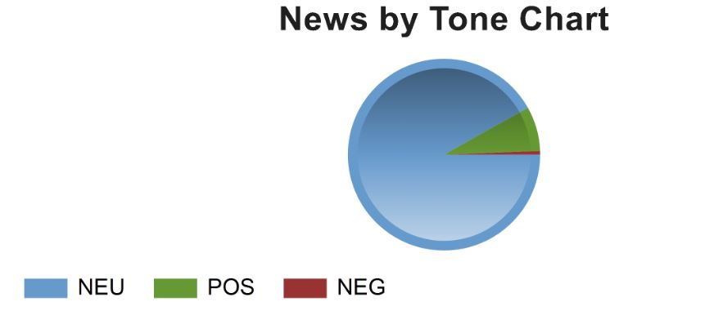
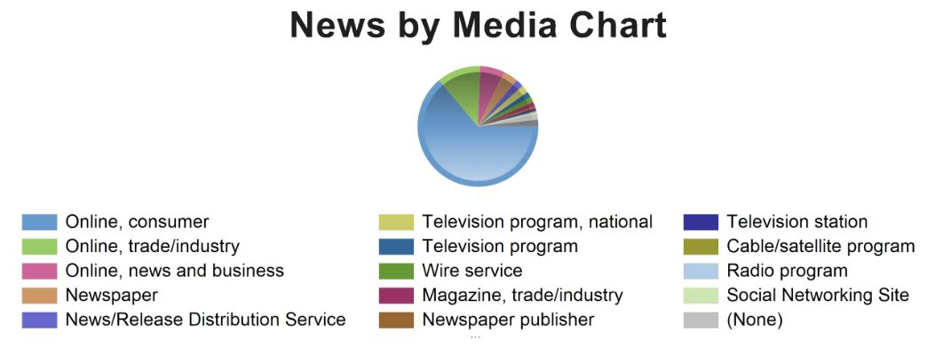
CHART BY TONE
CHART BY MEDIA

Slide 10
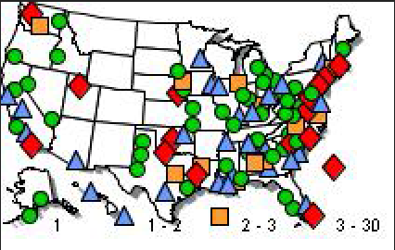
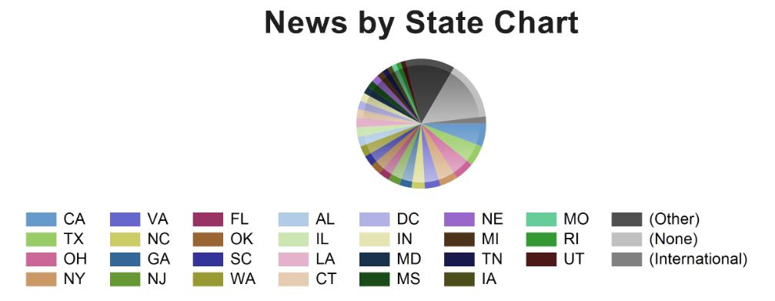
NEWS BY
U.S. MAP
CHART BY STATE

Slide 11


Slide 12




NAHU's Twitter page has 8,707 followers.
NAHU tweeted 84 times over this period.
NAHU's tweets earned 46,100 impressions, averaging roughly 1,500 impressions per day.
NAHU's tweets had an average engagement rate of 1.4 percent, receiving 402 link clicks, 86 retweets, and 54 likes.
NAHU's Facebook page has 3,128 likes.
NAHU posted 84 times. NAHU's Facebook posts reached roughly 949 people per day.
NAHU's posts were shared around 10 times per day and people reacted roughly 9 times per day.
Review January’s Social Media Analytics

Slide 13

IMPORTANCE OF MEDIA COVERAGE
We often send these clips to policymakers to alert them of the issues we are facing. The more high-profile media coverage we received, the more attention policymakers will pay to our issues.
Media placement means an increased understanding of the issues in the public, both inside and outside the industry.
Media attention increases NAHU name recognition and branding.
We do not pay for our media placements. All coverage received by our members is free business promotion, which promotes NAHU members as subject-matter experts.
Good information and solid sound bytes provided by an NAHU member means other reporters will want to use that member as a resource.

