Slide 1

MEDIA HIT HIGHLIGHTS
SEPTEMBER 2016

Slide 2

BY THE NUMBERS
In September, NAHU received more than 343 press hits.
In August, NAHU received more than 385 press hits.
In July, NAHU received more than 363 press hits.
So far in 2016, NAHU has received 4,359 press hits.
In 2015, NAHU received more than 7,300 press hits.

Slide 3





PRINT MEDIA IN SEPTEMBER
Gap plans, used to cover out-of-pocket expenses like high deductibles, are becoming increasingly popular among consumers and businesses.
The rising price of insurance is driving the trend, explains insurance broker Ryan Hillenbrand, president of the Missouri Association of Health Underwriters.
"People see the prices of individual
insurance and they say, 'Boy, a
$6,000 deductible seems really
high. I don't want something that
gives me that much risk,' " Hillenbrand says. "That's why [the gap insurance] market is heating up a little bit more.“ Listen to the full interview here.
“The biggest mistake is tuning out, says Kelly Moore, president of Moore Benefits in Irvine, Calif. “Many people will spend more time looking at what kind of phone or TV they’ll buy than planning for their financial security.”
“While one change may seem small on the face of it, it may have a big impact on the family,” says Greg Hodges, principal of Hodges-Mace, an employee benefits adviser in Atlanta. For example, the health plan might change its provider network and exclude your doctor.”
“Employees start in the wrong place,” says Carolyn Goodwin, president of Goodwin Benefits Group in Dallas. “They look at price before they pick a plan and then complain because the plan they picked has a higher deductible and extra copays that they cannot afford.”
For 2016, Blue Cross cut rates on average by
about 5 percent for most small groups,
according to Commerce Department data. So,
with the 2017 rate request “they’re trying to
recoup some of their expenses,” said Bob Stein, a benefits consultant who is president of the Minnesota Association of Health Underwriters, a trade group for brokers.
Stein said he’s telling clients they should expect increases in the neighborhood of 6 to 8 percent, which is simply a reflection of what’s happening to the underlying cost of health care.
Shyam says they will do so, but Jonathan Katz,
an insurance broker with Virginia Health Plans in
Herndon, Va., says some would rather take a chance or may not have the money.
It can also appear "completely random" and involve people who aren't even immigrants. says Katz, Parents who were born in Virginia hospitals have even been asked to prove their new babies are here legally. Even a birth certificate may not be enough; he has had to provide pediatrician records on behalf of clients' babies as well.
"The most maddening part of the whole data matching issue is that there is no conclusive way to know they’ve accepted the documents," says Katz, who has sold insurance for 25 years
Hundreds of thousands of North Carolinians just dodged a bullet and don’t even know it. The Sept. 23 news article “Blue Cross plans to continue offering ACA coverage in all 100 N.C. counties” passed largely unnoticed. Had the decision been different, North Carolina would have yet again been the lead story on the national nightly news.
Letter-to-the-Editor of Liz Gallops, President of NCAHU

Slide 4

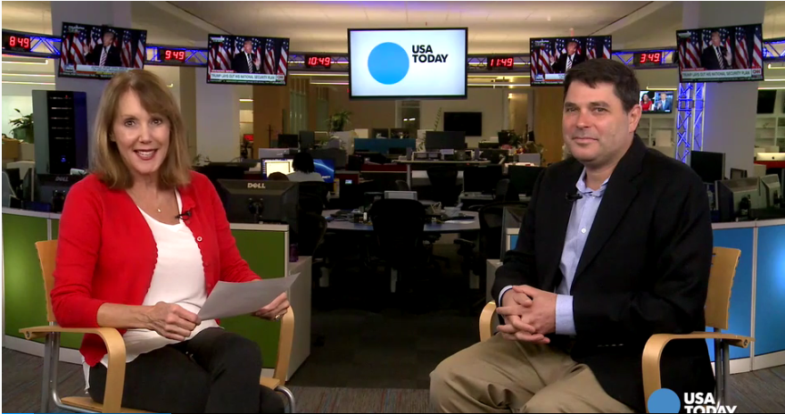
BROADCAST MEDIA IN SEPTEMBER
NAHU member and the Missouri AHU Membership Chair Becki Jennings interviewed with Morning Magazine on KRMS Radio Station in Missouri. At about the 26:07-minute mark on the 9 a.m. segment, you'll hear Becki discussing the gap in insurance carriers in the exchange.
Ryan Hillenbrand, president of the Missouri AHU, was featured on a NPR broadcast interview explaining how the rising price of insurance is driving the trend. "People see the prices of individual insurance and they say, 'Boy, a $6,000 deductible seems really high. I don't want something that gives me that much risk,'
Our Virginia AHU member, Jonathan Katz, was featured on a national broadcast segment for USA Today. In his interview with healthcare reporter Jayne O'Donnell, he discussed the problems facing consumers enrolling for Obamacare. Katz states, “Parents who were born in Virginia hospitals have even been asked to prove their new babies are here legally. The most maddening part of the whole data matching issue is that there is no conclusive way to know they’ve accepted the documents," says Katz, who has sold insurance for 25 years.

Slide 5



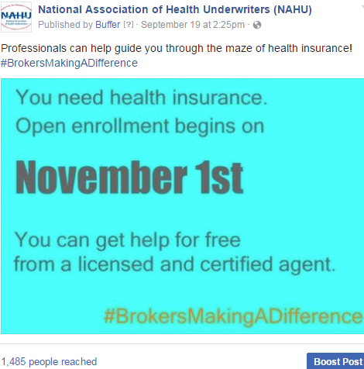

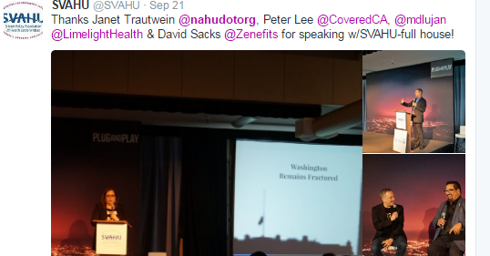

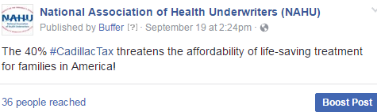

POPULAR SEPTEMBER
SOCIAL MEDIA POSTS
Facebook
Twitter

Slide 6
SEPTEMBER UPDATE:
SOCIAL MEDIA CAMPAIGN
Since its launch in last year, NAHU's social media campaign has tremendously increased our social media presence, numbers and viewership on our Facebook and Twitter pages. We are excited to share September’s analytics indicating the campaign's great progress.
Twitter:
In August, NAHU's page has 8,485 followers.
NAHU's tweets earned 60,000 impressions, averaging roughly 2,000 impressions per day.
NAHU's tweets had an average engagement rate of 0.7 percent during this period, receiving 172link clicks, 82 retweets, and 75 likes.
NAHU tweeted 81 times over this period.
Facebook:
NAHU's Facebook page has 3,076 likes.
NAHU's Facebook posts reached roughly 609 people per day.
NAHU's posts were shared around 23 times per day and people reacted roughly 7 times per day.
NAHU posted 82 times over this period.
*Key Terms: The engagement rate for a tweet is the number of users who clicked, favorited, shared, or replied to a tweet as a percentage of the number of users who saw the tweet. The engagement rate in the report is the average engagement rate for all of NAHU’s tweets in the given month. The reach on Facebook is the number of different people who see any of NAHU’s content -- whether in their newsfeed, on NAHU’s profile, or otherwise.

Slide 7
IMPORTANCE OF MEDIA COVERAGE
We often send these clips to policymakers to alert them of the issues we are facing. The more high-profile media coverage we received, the more attention policymakers will pay to our issues.
Media placement means an increased understanding of the issues in the public, both inside and outside the industry.
Media attention increases NAHU name recognition and branding.
We do not pay for our media placements. All coverage received by our members is free business promotion, which promotes NAHU members as subject-matter experts.
Good information and solid sound bytes provided by an NAHU member means other reporters will want to use that member as a resource.

