Slide 1

MEDIA HIT HIGHLIGHTS
AUGUST 2016

Slide 2

BY THE NUMBERS
In August, NAHU received more than 385 press hits.
In July, NAHU received more than 363 press hits.
In June, NAHU received more than 1191 press hits.
So far in 2016, NAHU has received 4,016 press hits.
In 2015, NAHU received more than 7,300 press hits.

Slide 3







PRINT MEDIA IN AUGUST
J.P. Galaris serves on several carrier advisory councils and dedicates countless hours to benefit the entire market. He also served as the NY Metro Association of Health Underwriters (AHU) President and received awards such
as the NY Metro AHU Lifetime Achievement
Award and the NY State AHU Daniel E.
Colacino Legislative Achievement Award.
“Aetna deals latest blow to Obamacare, pulls out of most markets” reported that in 2017 Aetna, one of the nation’s largest health insurers, will sell exchange plans in just four states, down from 15 states this year (“Aetna deals latest blow to Obamacare, pulls out of most markets,” Web, Aug. 15).
Letter-to-the-Editor by Janet Trautwein, NAHU CEO
"It's a burden on a process supposed to increase competition," said Dave Mordo, chairman of the National Association of Health Underwriters' Legislative Council. "Your shopping limitations increase by a lot.“
But the National Association of Insurance Commissioners and the National Association of Health Underwriters say the proposed rule wouldn’t necessarily result in a healthier mix of enrollees in the marketplaces because short-term plans usually exclude pre-existing conditions. “Only the healthy consumers would have coverage options available to them; unhealthy consumers would not,” the NAIC commented.
It may also be worth it to read the paper, said Mordo. With so many payers leaving the exchanges, patients "might want to also check if there are news items. For instance if we read something about [an insurance company's] profits being down, that might be an omen for the future."
Still, industry experts said New Jerseyans
would have benefited from Oscar and
other competitors coming into the market.
"It’s a little bit of a blow to the consumer world, unfortunately,” said Toby Stark, president of the New Jersey Association of Health Underwriters, a trade group representing health insurance brokers.
Edward W. McConnell holds a Bachelor's of Science in Business from The University of Minnesota's Carlson School of Management and is involved with the Northern Illinois Association of Health Underwriters.

Slide 4

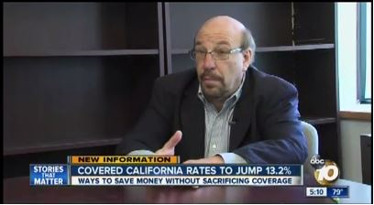
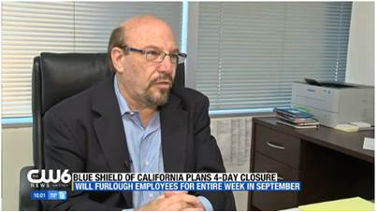
BROADCAST MEDIA IN AUGUST
Susan Rider of our Indiana AHU chapter was featured on her state’s local Fox News Channel 59. She provides insight on how difficult it is for major insurers to make money on the federal marketplace that is meant to attract low rates for low-income Americans.
Our San Diego AHU member, Craig Gussin, was featured on two broadcast stations – The CW 6 San Diego and ABC News Channel 10. His comments on the CW Network regarded healthcare provider Blue Shield of California suspending their operations for four days, furloughing an estimated 6,000 employees. On ABC News, Gussin comments on Covered California’s rate increase to 13.2% and how it will greatly affect California citizens.

Slide 5


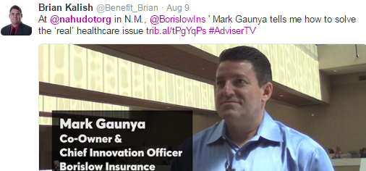
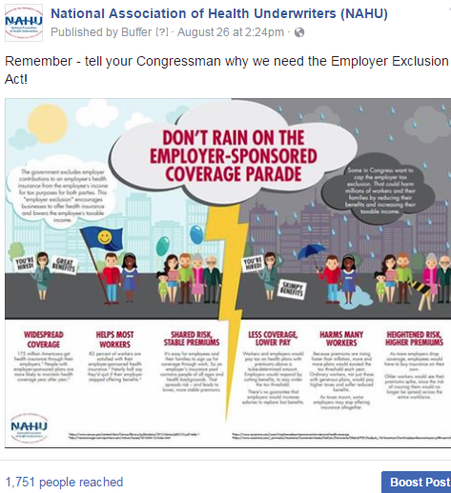


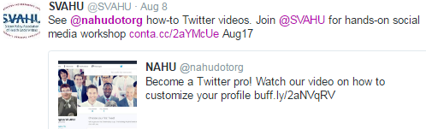
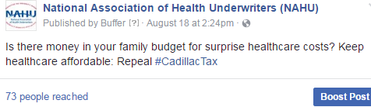
POPULAR AUGUST
SOCIAL MEDIA POSTS
Facebook
Twitter

Slide 6
AUGUST UPDATE:
SOCIAL MEDIA CAMPAIGN
Since its launch in last year, NAHU's social media campaign has tremendously increased our social media presence, numbers and viewership on our Facebook and Twitter pages. We are excited to share August’s analytics indicating the campaign's great progress.
Twitter:
In August, NAHU's page has 8,323 followers.
NAHU's tweets earned 62,000 impressions, averaging roughly 2,000 impressions per day.
NAHU's tweets had an average engagement rate of 0.9 percent during this period, receiving 250 link clicks, 104 retweets, and 118 likes.
NAHU tweeted 87 times over this period.
Facebook:
NAHU's Facebook page has 3,039 likes.
NAHU's Facebook posts reached roughly 789 people per day.
NAHU's posts were shared around 11 times per day and people reacted roughly 9 times per day.
NAHU posted 87 times over this period.
*Key Terms: The engagement rate for a tweet is the number of users who clicked, favorited, shared, or replied to a tweet as a percentage of the number of users who saw the tweet. The engagement rate in the report is the average engagement rate for all of NAHU’s tweets in the given month. The reach on Facebook is the number of different people who see any of NAHU’s content -- whether in their newsfeed, on NAHU’s profile, or otherwise.

Slide 7
IMPORTANCE OF MEDIA COVERAGE
We often send these clips to policymakers to alert them of the issues we are facing. The more high-profile media coverage we received, the more attention policymakers will pay to our issues.
Media placement means an increased understanding of the issues in the public, both inside and outside the industry.
Media attention increases NAHU name recognition and branding.
We do not pay for our media placements. All coverage received by our members is free business promotion, which promotes NAHU members as subject-matter experts.
Good information and solid sound bytes provided by an NAHU member means other reporters will want to use that member as a resource.

