Slide 1

MEDIA HIT HIGHLIGHTS
JUNE 2016

Slide 2

BY THE NUMBERS
In June, NAHU received more than 1191 press hits.
In May, NAHU received more than 211 press hits.
So far in 2016, NAHU has received 3,268 press hits.
In 2015, NAHU received more than 7,300 press hits.

Slide 3





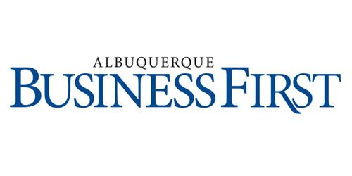
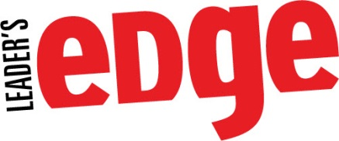
PRINT MEDIA IN JUNE
Insurance broker Liz Gallops in Raleigh, North Carolina, says she tries to let customers vent about large increases. Some see insurance bills that surpass their mortgage payments. The state's
biggest insurer is proposing average increases
of nearly 19 percent.
"I've had people yell on the phone," she said. "I've
had people curse."
Ken Stevenson said he ordered brand-name and generic versions of the arthritis drug Celebrex. The Celebrex cost $150 and its generic version, $75. At a Tallahassee pharmacy, Celebrex alone would have cost him $300 in out-of-pocket costs after insurance, he said.
“I’m a believer,” said Stevenson, who is president-elect of the Florida Association of Health Underwriters, a trade group for health insurance agents. “We are in a world economy…and if you can get a drug from another country at a lower price, why not do it?”
Wichita Falls insurance broker Kelly Fristoe said the burden of premium increases will fall hardest on rural communities where Blue Cross Blue Shield is in many cases the only option. Metropolitan areas like Houston, Dallas, and Austin attract more insurers.
"This is going to be a very big disrupter of the market," said Fristoe. Some relatively healthy people "would probably be willing to roll the dice and take their chances" by dropping coverage, even if it means they might be fined.
In addition to being president of CBI, Michael Embry currently serves as the National Association of Health Underwriters (NAHU) treasurer on the board of trustees.
“Comprehensive Benefits, Inc. has always focused
on service as the foundation of our business
philosophy,” explains Michael A. Embry Sr., RHU,
President, Comprehensive Benefits, Inc. Embry
continues, “We are very honored and excited to
partner with UBA. Our client commitment, ‘Service is the Key,’ remains unchanged as we continue to provide personalized service for our clients through UBA’s expanded resources.”
“It’s costly—a $25 billion tax increase which
would essentially double the current state
budget,” says Kendra Johnson, benefits
consultant with Flood and Peterson.
Johnson, who specializes in healthcare reform and has extensive involvement with the local and statewide divisions of the National Association of Health Underwriters, is referring to the fact that the board running the system initially would be political appointees determined by the governor and leaders of both parties.
The annual National Association of Health Underwriters convention is being held in Albuquerque this year and that means hotels are booked and restaurant are full.
Janelle Brookhouser, media chair for the organization, said the event has attracted 700 members from around the nation, and the money they spend in the city, along with the money spent by any companions traveling with them, has an estimated $1 million impact on the surrounding community.

Slide 4


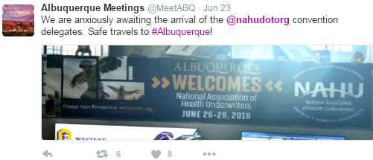
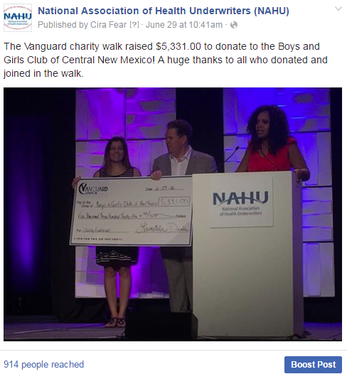

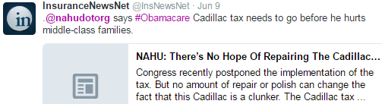
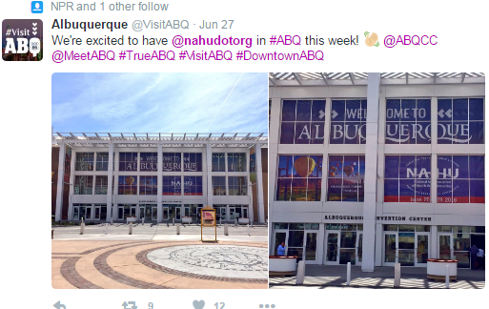
POPULAR JUNE
SOCIAL MEDIA POSTS
Twitter
Facebook

Slide 5
JUNE UPDATE:
SOCIAL MEDIA CAMPAIGN
Since its launch in last year, NAHU's social media campaign has tremendously increased our social media presence, numbers and viewership on our Facebook and Twitter pages. We are excited to share June’s analytics indicating the campaign's great progress.
Twitter:
In June, NAHU's page has 7,999 followers.
NAHU's tweets earned 65,400 impressions, averaging roughly 2,200 impressions per day.
NAHU's tweets had an average engagement rate of 0.8 percent during this period, receiving 238 link clicks, 90 retweets, and 114 likes.
NAHU tweeted 80 times over this period.
Facebook:
NAHU's Facebook page has 2,973 likes.
NAHU's Facebook posts reached roughly 1,031 people per day.
NAHU's posts were shared around 12 times per day and people reacted roughly 21 times per day.
NAHU posted 88 times over this period.
*Key Terms: The engagement rate for a tweet is the number of users who clicked, favorited, shared, or replied to a tweet as a percentage of the number of users who saw the tweet. The engagement rate in the report is the average engagement rate for all of NAHU’s tweets in the given month. The reach on Facebook is the number of different people who see any of NAHU’s content -- whether in their newsfeed, on NAHU’s profile, or otherwise.

Slide 6
IMPORTANCE OF MEDIA COVERAGE
We often send these clips to policymakers to alert them of the issues we are facing. The more high-profile media coverage we received, the more attention policymakers will pay to our issues.
Media placement means an increased understanding of the issues in the public, both inside and outside the industry.
Media attention increases NAHU name recognition and branding.
We do not pay for our media placements. All coverage received by our members is free business promotion, which promotes NAHU members as subject-matter experts.
Good information and solid sound bytes provided by an NAHU member means other reporters will want to use that member as a resource.

