Slide 1

October's Media Hit Report

Slide 2

Total Press Hits
This Month
475

Slide 3

Media By Type
ONLINE:
Alaska Dispatch News
Atlanta Journal-Constitution
CNNMoney
Columbia Star
Dallas Morning News
Des Moines Register
Yahoo! Finance
Omaha World-Herald
Orange County Register
POLITICO
Standard-Examiner
TIME Magazine
NEWSPAPERS:
Chicago Tribune
Roanoke Times
New York Times
Dallas Morning News
Dayton Daily News
Des Moines Register
San Diego Union-Tribune
St. Louis Post-Dispatch
Greensboro News & Record
Winston-Salem Journal
Virginian-Pilot

Slide 4
Media By Type
TRADE PUBS
& MAGAZINES:
Healthcare Payer News
Kaiser Health News
LifeHealthPro
BenefitsPro
Insurance and Financial Advisor
Insurance Business America
Best's Review
Agency Sales Magazine
The Journal Record
BROADCAST:
Majic 102.3
Chad Hartman - WCCO-AM
NewsChannel 10 This Morning
FOX News
CNBC
FOX News Channel
WTOL
KFDA-TV
WECT-TV
KTRS-AM
WBOY-TV

Slide 5
Number of Hits by Region/State
Delaware: 3 hits
Benzinga and WGMD-FM (2)
Washington, D.C.: 6 hits
Kaiser Health News (3), Washington Free Beacon, The Daily Signal & EIN News Publications
Maryland: 3 hits
Citybizlist, Insurance and Financial Advisor & PRWeb
New Jersey: 8 hits
CNBC, Courier News, Best's Review, NJBIZ (2), Home News Tribune & BestWire (2)
Pennsylvania: 7 hits
Pottsville Republican & Herald (2), Scranton Times-Tribune, Standard-Speaker (2), ProducersWEB.com & GantDaily
Virginia: 6 hits
Roanoke Times, Virginian-Pilot, WUPV-TV, WWBT-TV, Independent Agent & Targeted News Service
REGION 1
Connecticut: None
Maine: 1 hit
Healthcare Payer News
Massachusetts: 1 hit
Fidelity
New Hampshire: None
New York: 32 hits
Kelly File - FOX News Channel, New York Times, FOX Business, POLITICO, CNNMoney, TIME Magazine (2), FOX News Channel (4), PR Newswire (2), My informs (9), Daily Gazette, WRVO, WNYC-FM (2), Patch (3), Yahoo Finance (3), WABC-AM & Kilmeade and Friends - FOX News Radio Network
Rhode Island: 3 hits
GoLocalProv News (3)
Vermont: None
REGION 2

Slide 6
Number of Hits by Region/State
Illinois: 10 hits
Chicago Tribune (3), Chicago Sun-Times, Sauk Valley Newspaper (2), Agency Sales Magazine, Becker's ASC Review, Manufacturing Close-Up & RealClearPolitics.com
Indiana: 10 hits
Journal Gazette (5), WFIE-TV (2), WCSI (2) & WBND-TV
Kentucky: 4 hits
State Journal, Times-Tribune & WAVE-TV (2)
Michigan: 1 hit
Herald-Palladium
Ohio: 8 hits
Dayton Daily (2), States News Service (2), WTOL-TV, WXIX-TV & WFMJ-TV (2)
West Virginia: 3 hits
WVNS-TV, WBOY-TV & WTRF-TV
REGION 4
Iowa: 3 hits
Des Moines Register (2) & Iowa City Press-Citizen
Minnesota: 14 hits
KEYC-TV, Star Tribune (10) & Minneapolis/St. Paul Business Journal, St. Paul Pioneer Press, Chad Hartman - WCCO-AM
Nebraska: 4 hits
Omaha World-Herald & KLKN-TV (2)
North Dakota: None
South Dakota: None
Wisconsin: 1 hit
WKBT-TV
REGION 3

Slide 7
Number of Hits by Region/State
Arkansas: 1 hit
KFSM-TV
Kansas: None
Louisiana: 3 hits
KSLA-TV (2) & WAFB-TV
Missouri: 7 hits
St. Louis Post-Dispatch (5), KFVS-TV & Night Shift with Scott Sherman - KTRS-AM (Big 550)
Oklahoma: 5 hits
KQCW-TV, KWTV-TV, KSWO-TV, Journal Record & KOTV-TV
Texas: 28 hits
Dallas Morning News (2), San Antonio Express-News(2), Times Record News (4), Amarillo Globe-News, Austin American-Statesman, KLTV-TV (2), KRHD-TV (2), KXXV-TV (2), KFDA-TV, KTRE-TV, KWES-TV, KAUZ-TV (2), StockNod, Crossroads Today, BCNN1 & NewsChannel 10 (4)
REGION 5
Alabama: 4 hits
WAFF-TV (2) & WSFA-TV (2)
Florida: 7 hits
WFLX-TV (2), WBBH-TV, BizPac Review, Financial Buzz, Brian Kilmeade - WOKV-AM & Close-Up Media
Georgia: 7 hits
WLTZ-TV (2), WALB-TV (2), WFXG-TV, WTVM-TV (2) & Atlanta Journal-Constitution
Mississippi: 4 hits
WDAM-TV (3) & WLOX-TV
North Carolina: 10 hits
Greensboro News & Record (5), Winston-Salem Journal (2), Star-News & WECT-TV (2)
South Carolina: 5 hits
Columbia Star, WCSC-TV (2), WIS-TV & WMBE-TV
Tennessee: 6 hits
Daily News, Patriot Post, WRCB-TV & WMC-TV (3)
REGION 6

Slide 8
Number of Hits by Region/State
Arizona: 4 hits
KOLD-TV (2), AZ Family & Jewish News of Greater Phoenix
Colorado: 12 hits
LifeHealthPro, BenefitsPro (3), Durango Herald (2), Pharmacy Choice (5) & Insurance Business America
Idaho: None
Montana: 1 hit
KRTV-TV
New Mexico: 1 hit
770 KKOB AM News Radio
Utah: 5 hits
Daily Herald (2), Uintah Basin Standard & Standard-Examiner, Vernal Express
Wyoming: None
REGION 8
Alaska: 2 hits
Alaska Dispatch News (2)
California: 23 hits
San Francisco Chronicle, Orange County Register, San Diego Union-Tribune (2), Record Searchlight, Hit & Run, DMN Newswire (2), KUSI-TV (3), KMJ-FM, KFMB-TV, KFMB-AM (760 AM Talk Radio), Reason, Program Business, Spoke, Valley Post & Before It’s News
Hawaii: 1 hit
KHNL-TV
Nevada: 1 hit
KTVN-TV
Oregon: 2 hits
The Bulletin
Washington: 5 hits
Seattle Post‑Intelligencer, Seattle Times, KNDO-TV (2) & KHQ-TV
REGION 7

Slide 9
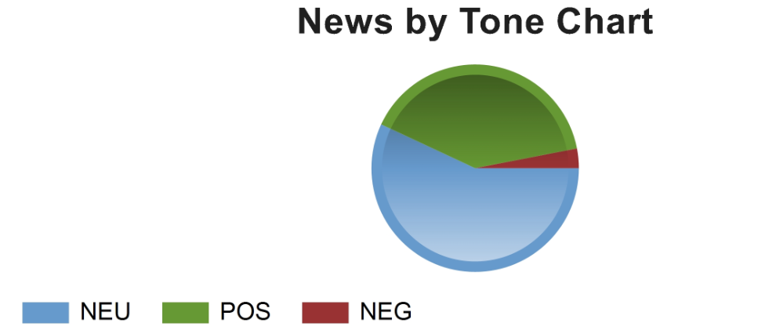
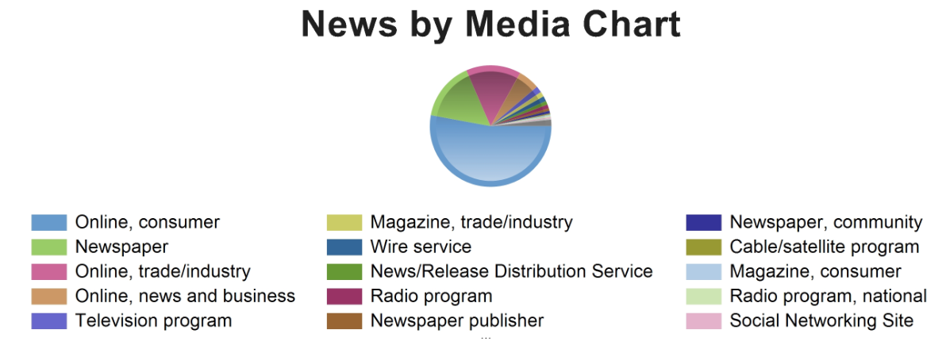
CHART BY TONE
CHART BY MEDIA

Slide 10
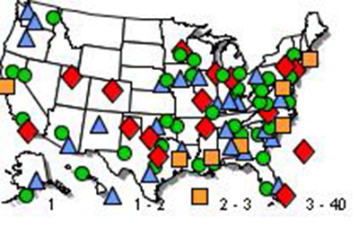
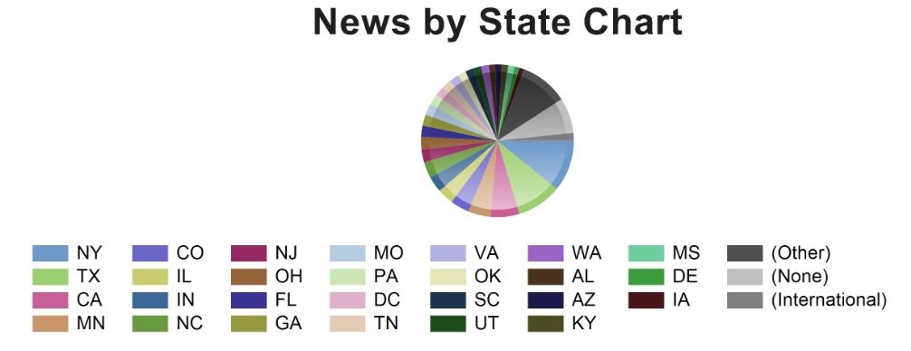
NEWS BY
U.S. MAP
CHART BY STATE

Slide 11


Slide 12




NAHU's Twitter page has 8,537 followers.
NAHU tweeted 87 times over this period.
NAHU's tweets earned 56,700 impressions, averaging roughly 2,000 impressions per day.
NAHU's tweets had an average engagement rate of 1.2 percent, receiving 230 link clicks, 227 retweets, and 111 likes.
NAHU's Facebook page has 3,089 likes.
NAHU posted 83 times. NAHU's Facebook posts reached roughly 241 people per day.
NAHU's posts were shared around 8 times per day and people reacted roughly 3 times per day.
Review October’s Social Media Analytics

Slide 13

IMPORTANCE OF MEDIA COVERAGE
We often send these clips to policymakers to alert them of the issues we are facing. The more high-profile media coverage we received, the more attention policymakers will pay to our issues.
Media placement means an increased understanding of the issues in the public, both inside and outside the industry.
Media attention increases NAHU name recognition and branding.
We do not pay for our media placements. All coverage received by our members is free business promotion, which promotes NAHU members as subject-matter experts.
Good information and solid sound bytes provided by an NAHU member means other reporters will want to use that member as a resource.

