Slide 1

July's Media Hit Report

Slide 2

Total Press Hits
This Month
201

Slide 3

Media By Type
ONLINE:
Associated Press
Bloomberg News
Boston Herald
Chicago Tribune
Entrepreneur
Idaho Statesman
New York Times Reuters
San Francisco Chronicle
Tennessean
Utah Pulse
Yahoo! Finance
NEWSPAPERS:
Huntington Herald-Press
Fort Wayne Journal Gazette
Greensboro News & Record
Claiborne Progress
San Diego Union-Tribune
South Bend Tribune
Naples Daily
Minnesota Star Tribune
Columbus Dispatch
The Virginian-Pilot
Washington Times

Slide 4
Media By Type
TRADE PUBS
& MAGAZINES:
TIME Magazine
Travel + Leisure Magazine
Fortune Magazine
California Broker
BenefitsPro
Business Journals
Business Insider
Employee Benefit Adviser
Fort Worth Business
Citybizlist
Insurance News Net
BROADCAST:
ABC News
NBC News
FOX News
CNBC
99.5 FM Radio
KUSI-TV
WTOL
KNX-AM
WNMT-AM
95.5 FM
KRHD-TV

Slide 5
Number of Hits by Region/State
Delaware: 1 hit
Benzinga
Washington, D.C.: 11 hits
Associated Press, NAHU (7), SRNNews.com & Leader's Edge Magazine
Maryland: 3 hits
Citybizlist - Baltimore
New Jersey: 1 hit
CNBC
Pennsylvania: 3 hits
Bucks County Courier Times, The Mercury & The Daily Item
Virginia: 10 hits
Daily Item, Daily Press (3), Employee Benefit News (3), WUPV-TV, The Virginian-Pilot (2) & Targeted News Service
REGION 1
Connecticut: 6 hits
Connecticut Post, The Advocate, Greenwich Time News-Times, CT News Junkie & TMCnet.com
Massachusetts: 1 hit
Citybizlist Boston
New Hampshire: None
New York: 17 hits
New York Times, Yahoo! Finance (4), Reuters (2), Travel + Leisure Magazine, TIME Magazine, Fortune Magazine, Patch (2), Business Insider (2), Tech Insider, Citybizlist - New York & Metro New York
Rhode Island: 4 hits
GoLocalProv News
Vermont: None
REGION 2

Slide 6
Number of Hits by Region/State
Illinois: 7 hits
Chicago Tribune, Sauk Valley Newspaper (2), Strategy Business Group, Morningstar StockInvestor, Wolters Kluwer CCH Group News & Press Release Point
Indiana: 7 hits
Greater Fort Wayne Business Weekly, 98.5 WBOW, Huntington Herald-Press, 100.7 MIX-FM, The Journal Gazette, South Bend Tribune & WFIE-TV
Kentucky: 1 hit
WAVE-TV
Michigan: 8 hits
Crain's Detroit Business, WKZO-AM, WHTC-AM, WNWN-FM, WLMI-FM, Z96.5, 95.5 FM & StreetInsider
Ohio: 5 hits
Youngstown Business Journal, The Vindicator & WFMJ-TV
West Virginia: None
REGION 4
Iowa: None
Minnesota: 9 hit
Minneapolis Star Tribune (4), KDAL-AM, WNMT-FM, WUSZ-FM, KTCO 98.9 & WNMT-AM
Nebraska: 1 hit
KLKN-TV
North Dakota: 1 hit
KFGO-AM
South Dakota: 2 hits
KWSN-AM & KELO-AM/KELO-FM
Wisconsin: 7 hits
WIXX, WIFC, WSAU-AM, WTAQ, WHBL-AM, 1440 WNFL & WYDR-FM
REGION 3

Slide 7
Number of Hits by Region/State
Arkansas: None
Kansas: None
KFJX-TV & KOAM-TV
Louisiana: 3 hits
KSLA-TV, WAFB-TV & SportsNOLA
Missouri: 1 hit
KFVS-TV
Oklahoma: 1 hit
KQCW-TV
Texas: 5 hits
Midland Reporter-Telegram, KLTV-TV, KRHD-TV, KXXV-TV & KIII-TV
REGION 5
Alabama: 3 hits
WFLX-TV
Florida: 5 hits
Naples Daily News (2), Financial Buzz, WFLX-TV & Capital Soup
Georgia: 2 hits
WLTZ-TV & WALB-TV
Mississippi: 1 hit
WDAM-TV
North Carolina: 5 hits
Greensboro News & Record (4) & WECT-TV
South Carolina: 5 hits
Greenville Business Magazine, Columbia Star (2), WIS-TV & WCSC-TV
Tennessee: 1 hit
The Tennessean, Claiborne Progress & WRCB-TV
REGION 6

Slide 8
Number of Hits by Region/State
Arizona: 2 hits
KOLD-TV
Colorado: 5 hits
BenefitsPro (3), Denver Business Journal & Insurance Business America
Idaho: 1 hit
Idaho Statesman
Montana: None
New Mexico: None
Utah: 2 hits
Utah Pulse & The Herald Journal
Wyoming: None
REGION 8
California: 14 hits
Entrepreneur, San Francisco Chronicle, California Broker, ZDNet News, Spoke, BioSpace, KUSI-TV, Business Wire (2), TutorialFinder, DMN Newswire, KNX-AM (2) & San Diego Union-Tribune
Hawaii: None
Nevada: 1 hit
KTVN-TV
Oregon: None
Washington: 1 hit
KNDO-TV
REGION 7

Slide 9
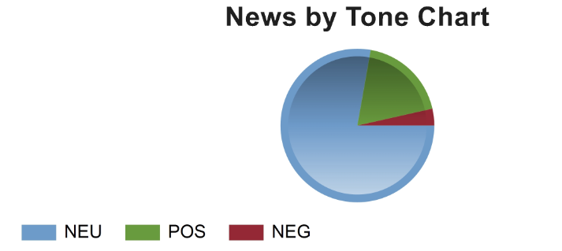
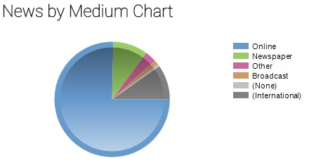
CHART BY TONE
CHART BY MEDIA

Slide 10
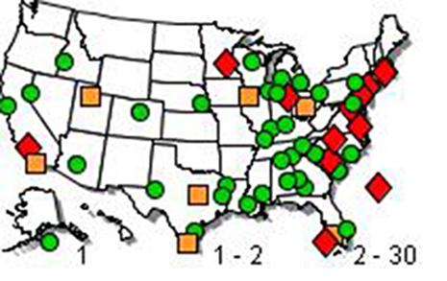
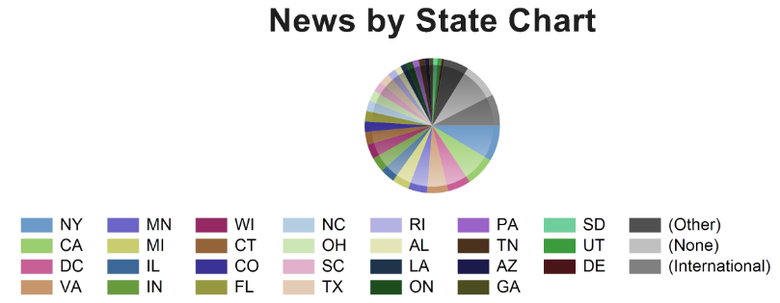
NEWS BY
U.S. MAP
CHART BY STATE

Slide 11
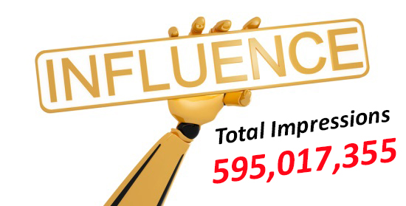

Slide 12




NAHU's Twitter page has 8, 121 followers.
NAHU tweeted 79 times over this period.
NAHU's tweets earned 67,600 impressions, averaging roughly 2,200 impressions per day.
NAHU's tweets had an average engagement rate of 0.8 percent, receiving 245 link clicks, 80 retweets, and 103 likes.
NAHU's Facebook page has 3,006 likes.
NAHU posted 84 times. NAHU's Facebook posts reached roughly 679 people per day.
NAHU's posts were shared around 10 times per day and people reacted roughly 9 times per day.
Review July’s Social Media Analytics

Slide 13

IMPORTANCE OF MEDIA COVERAGE
We often send these clips to policymakers to alert them of the issues we are facing. The more high-profile media coverage we received, the more attention policymakers will pay to our issues.
Media placement means an increased understanding of the issues in the public, both inside and outside the industry.
Media attention increases NAHU name recognition and branding.
We do not pay for our media placements. All coverage received by our members is free business promotion, which promotes NAHU members as subject-matter experts.
Good information and solid sound bytes provided by an NAHU member means other reporters will want to use that member as a resource.

