Slide 1

May's Media Hit Report

Slide 2

Total Press Hits
This Month
211

Slide 3

Media By Type
ONLINE:
Associated Press
Bloomberg News
Deseret News
Lubbock Avalanche-Journal
POLITICO
Staten Island Advance
St. Louis Post-Dispatch
Tulsa World
Washington Examiner
NEWSPAPERS:
Albuquerque Journal
Alaska Journal of Commerce
Asbury Park Press
Chicago Tribune
New Jersey Courier-Post
Greensboro News & Record
Houston Chronicle
Oklahoman

Slide 4
Media By Type
TRADE PUBS & MAGAZINES:
BenefitsPro
Business Journals
California Broker
Employee Benefit
Adviser
LifeHealthPro
PR Newswire
International Business Times
Insurance News Net
BROADCAST:
ABC News
NBC News
FOX News
CBS News
CNBC
99.5 FM Radio
KLKN-TV
KOTV-TV
WBOY-TV

Slide 5
Number of Hits by Region/State
Delaware: None
Washington, D.C.: 7 hits
Associated Press (2), Washington Examiner (2), Leader's Edge Magazine & Whistleblower
Maryland: 3 hits
Insurance and Financial Advisor & PR Web
New Jersey: 19 hits
CNBC, Asbury Park Press (6), Home News Tribune (3), Courier-Post , SYS-CON Media, BestWire (2), Tapinto.net (2) & Daily Journal.
Pennsylvania: 11 hits
Insurance News Net (4), Times-Tribune (2), Citizens Voice (2),WICU-TV (2) & Pennsylvania Cable Network
Virginia: 6 hits
POLITICO, Employee Benefit Adviser (3) & WUPV-TV (2)
REGION 1
Connecticut: None
Maine: None
Massachusetts: 1 hit
RevCycle Intelligence
New Hampshire: None
New York: 14 hits
Bloomberg News (2), Patch (5), Staten Island Advance, PR Newswire (2), International Business Times, Minyanville, Ticker Technology and Profit Quotes
Rhode Island: 7 hits
GoLocalProv News (5) & WLNE-TV (2)
Vermont: None
REGION 2

Slide 6
Number of Hits by Region/State
Illinois: 5 hits
Chicago Tribune, WAND-TV, Sauk Valley (2) & Register-Mail
Indiana: 2 hits
WFIE-TV (2)
Kentucky: 3 hits
Corbin Times-Tribune, WAVE-TV & WDRB-TV
Michigan: 1 hit
WWTV-TV
Ohio: 7 hits
Lima News (2), WXIX-TV (2), WTOL-TV, WOIO-TV & WFMJ-TV
West Virginia: 4 hits
WBOY-TV, WOWK-TV, WTRF-TV & WVNS-TV
REGION 4
Iowa: None
Minnesota: None
Nebraska: 2 hits
KLKN-TV (2)
North Dakota: None
South Dakota: None
Wisconsin: None
REGION 3

Slide 7
Number of Hits by Region/State
Arkansas: 1 hit
KAIT-TV
Kansas: 4 hits
KFJX-TV(2), KCTV-TV & KOAM-TV
Louisiana: 2 hits
KSLA-TV & KPLC-TV
Missouri: 4 hits
St. Louis Post-Dispatch (2) & KFVS-TV (2)
Oklahoma: 7 hits
The Oklahoman, Tulsa World (2), KQCW-TV, KSWO-TV, KWTV-TV & KOTV-TV
Texas: 25 hits
Lubbock Avalanche-Journal (3), Houston Chronicle (2), My Sweet Charity, KLTV-TV, KRHD-TV (2), KCEN-TV (2), KBMT-TV, KTRE-TV, KTEN-TV (2), KWES-TV (2), KCBD-TV (2), KXXV-TV, KIII-TV (2), KAUZ-TV & KYTX-TV (2)
REGION 5
Alabama: 5 hits
Birmingham Business Journal, WSFA-TV (2) & WAFF-TV (2)
Florida: 4 hits
Cape Coral Breeze (2), Suncoast News & WFLX-TV
Georgia: 4 hits
WTVM-TV, WTOC-TV, WALB-TV & WLTZ-TV
Mississippi: 6 hits
Daily Times Leader, WLOX-TV (2), WDAM-TV (2) & WLBT-TV
North Carolina: 11 hits
Greensboro News & Record (5), Star-News (2), Tabor-Loris Tribune, WSFX-TV, WECT-TV & Citybizlist - Charlotte/Raleigh
South Carolina: 5 hits
WIS-TV, WMBF-TV & WCSC-TV (3)
Tennessee: 3 hits
WRCB-TV(2) & WMC-TV
REGION 6

Slide 8
Number of Hits by Region/State
Arizona: 1 hit
KOLD-TV
Colorado: 4 hits
The Denver Business Journal & Pharmacy
Choice (3)
Idaho: None
Montana: None
New Mexico: 1 hit
Albuquerque Journal
Utah: 3 hits
Deseret News (3)
Wyoming: None
REGION 8
Alaska: 2 hits
Alaska Journal of Commerce (2)
California: 10 hits
Marin Independent Journal (2), Program Business, KUSI-TV (2), California Broker, Equities.com, BioSpace, TutorialFinder.com & Spoke
Hawaii: 3 hits
KHNL-TV & KFVE-TV (2)
Nevada: 3 hits
KTVN-TV (2) & KVVU-TV
Oregon: 1 hit
KPTV-TV
Washington: 5 hits
The Wenatchee World, KHQ-TV (2), KNDU-TV & KNDO-TV
REGION 7

Slide 9
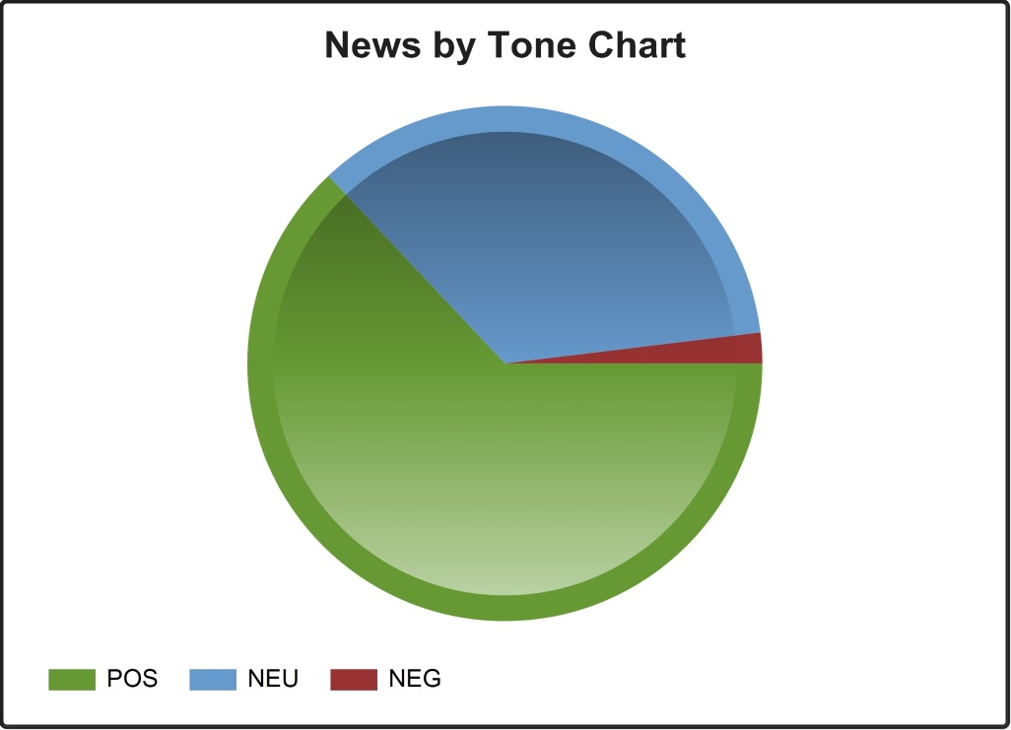
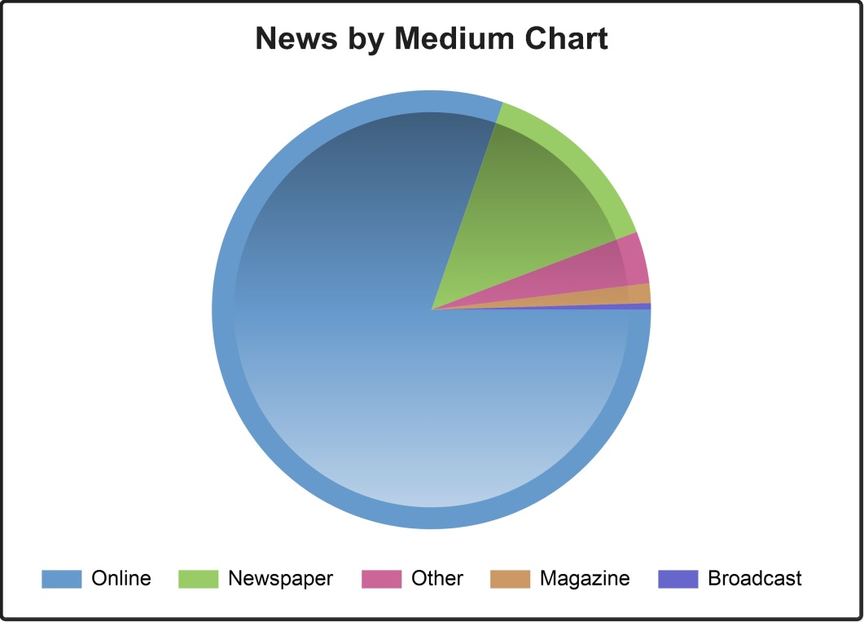
CHART BY TONE
CHART BY MEDIA

Slide 10
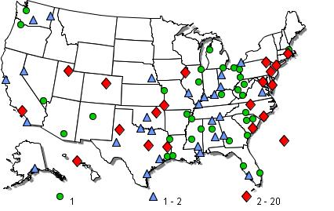
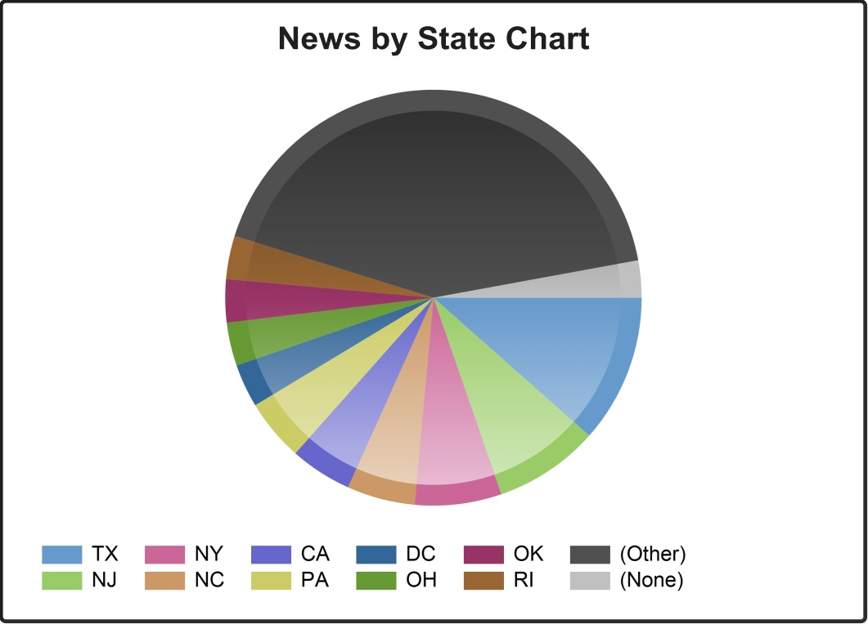
NEWS BY
U.S. MAP
CHART BY STATE

Slide 11
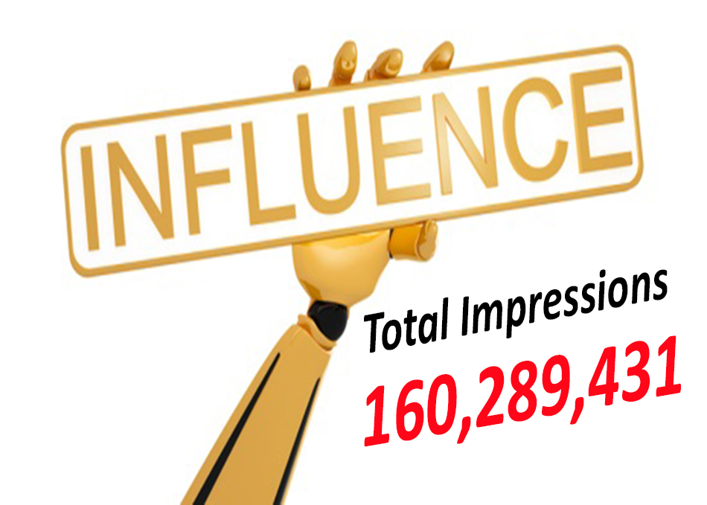

Slide 12




NAHU's Twitter page has 7,939 followers.
NAHU tweeted 76 times over this period.
NAHU's tweets earned 95,700 impressions, averaging roughly 3,100 impressions per day.
NAHU's tweets had an average engagement rate of 0.5 percent, receiving 215 link clicks, 64 retweets, and 105 likes.
NAHU's Facebook page has 2,926 likes.
NAHU posted 74 times. NAHU's Facebook posts reached roughly 987 people per day.
NAHU's posts were shared around 13 times per day and people reacted roughly 17 times per day.
Review May’s Social Media Analytics

Slide 13

IMPORTANCE OF MEDIA COVERAGE
We often send these clips to policymakers to alert them of the issues we are facing. The more high-profile media coverage we received, the more attention policymakers will pay to our issues.
Media placement means an increased understanding of the issues in the public, both inside and outside the industry.
Media attention increases NAHU name recognition and branding.
We do not pay for our media placements. All coverage received by our members is free business promotion, which promotes NAHU members as subject-matter experts.
Good information and solid sound bytes provided by an NAHU member means other reporters will want to use that member as a resource.

