Slide 1

April's Media Hit Report

Slide 2

Total Press Hits
This Month
176

Slide 3

Media By Type
ONLINE:
Associated Press
Bloomberg News
Boston Herald
Huffington Post
Good Day Sacramento
St. Louis Post-Dispatch Wichita Falls Times Reuters
Yahoo! News
Yahoo! Finance
NEWSPAPERS:
Chicago Tribune
Denver Post
Miami Herald
New York Times Oklahoman
Roanoke Times
San Antonio Express-News
Minnesota Star Tribune
USA Today
Washington Times

Slide 4
Media By Type
TRADE PUBS & MAGAZINES:
BenefitsPro
Best's Review
Business Journals
Crain's Chicago Business
Employee Benefit
Adviser
Fort Worth Business LifeHealthPro
Insurance News Net
Tallahassee Magazine
BROADCAST:
ABC News
NBC News
FOX News
FOX Business
CNBC
99.5 FM Radio
KUSI-TV
CNS News

Slide 5
Number of Hits by Region/State
Delaware: 1 hit
Benzinga
Washington, D.C.: None
Maryland: 3 hits
Insurance and Financial Advisor & PR Web
New Jersey: 3 hits
Courier-Post, B.
Pennsylvania: 5 hits
Insurance News Net, ProducersWEB & County Daily Times
Virginia: 1 hit
Targeted News Service
REGION 1
Connecticut: 6 hits
LifeHealthPro, BenefitsPro & Pharmacy Choice
Massachusetts: 7 hits
Boston Herald, Boston Business Journal, The Republican, Life & Health Advisor & Worcester Business Journal
New Hampshire: 1 hit
Virtual Strategy Magazine
New York: 18 hits
Poughkeepsie Journal, International Business Times, New York Post, Modern Medicine, Patch, New York Daily News, Minyanville Media, BigNews.biz
Rhode Island: 3 hits
GoLocalProv News
Vermont: None
REGION 2

Slide 6
Number of Hits by Region/State
Illinois: 4 hits
Sauk Valley Newspaper, Daily Herald - Cook County & Press Release Point
Indiana: 8 hits
Greater Fort Wayne Business Weekly, Goshen News, The Journal Gazette, Evansville Courier & Press & WFIE-TV
Kentucky: 1 hit
WAVE-TV
Michigan: 3 hits
Daily Tribune, Advisor & Source Newspapers (2), StreetInsider
Ohio: 3 hits
Youngstown Business Journal, The Vindicator & WFMJ-TV
West Virginia: None
REGION 4
Iowa: 1 hit
The Daily Freeman-Journal
Minnesota: 1 hit
KEYC-TV
Nebraska: 3 hits
Kearney Hub (2) & KLKN-TV
North Dakota: 1 hit
KXMD-TV
South Dakota: None
Wisconsin: None0
REGION 3

Slide 7
Number of Hits by Region/State
Arkansas: None
Kansas: 2 hits
KFJX-TV & KOAM-TV
Louisiana: 1 hit
KSLA-TV
Missouri: 2 hits
St. Louis Post-Dispatch (2)
Oklahoma: 5 hits
The Oklahoman (5)
Texas: 26 hits
Lubbock Avalanche-Journal (4), Today in Amarillo - KAMR-TV, Houston Chronicle (2), Times Record News, Pasadena Citizen, Gilmer Mirror (4), Pearland Journal, Deer Park Broadcaster, Bay Area Citizen, Magnolia Potpourri, East Montgomery County Observer, Houston Community Newspapers - Sugar Land (2), KLTV-TV, KRHD-TV, KCEN-TV, StockNod & Spring Observer
REGION 5
Alabama: None
Florida: 1 hit
WFLX-TV
Georgia: 1 hit
WLTZ-TV, WALB-TV & Citybizlist Atlanta
Mississippi: 1 hit
WDAM-TV
North Carolina: 12 hits
Greensboro News & Record (8), Greater Triad Business Journal, Kenly News, WECT-TV & Citybizlist - Charlotte/Raleigh
South Carolina: 3 hits
Greenville Business Magazine, Newberry Observer & WCSC-TV
Tennessee: 1 hit
The Tennessean
REGION 6

Slide 8
Number of Hits by Region/State
Arizona: 1 hit
KOLD-TV
Colorado: 6 hits
BenefitsPro (2), LifeHealthPro (3) & Pharmacy Choice
Idaho: None
Montana: 1 hit
The Missoulian
New Mexico: None
Utah: 1 hit
Deseret News
Wyoming: None
REGION 8
California: 17 hits
The Advocate, Daily Democrat, Vallejo Times-Herald, The Mercury News (2), Monterey County Herald (2), KUSI-TV, Inside East Bay Area (3), The Reporter Newspaper, California Broker (2), BioSpace (2) Equities.com & Live Insurance News
Hawaii: 1 hit
KHNL-TV
Nevada: 1 hit
Nevada Appeal
Oregon: None
Washington: 1 hit
KNDO-TV
REGION 7

Slide 9
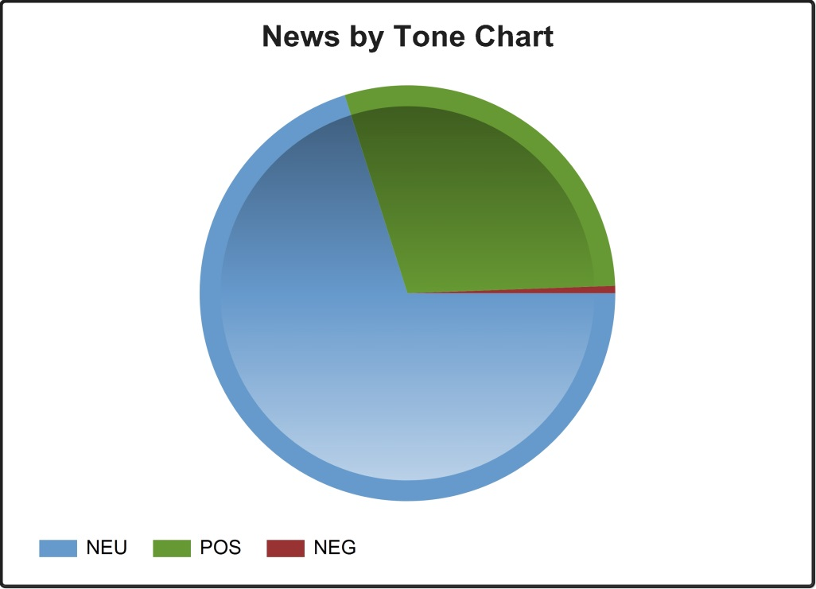
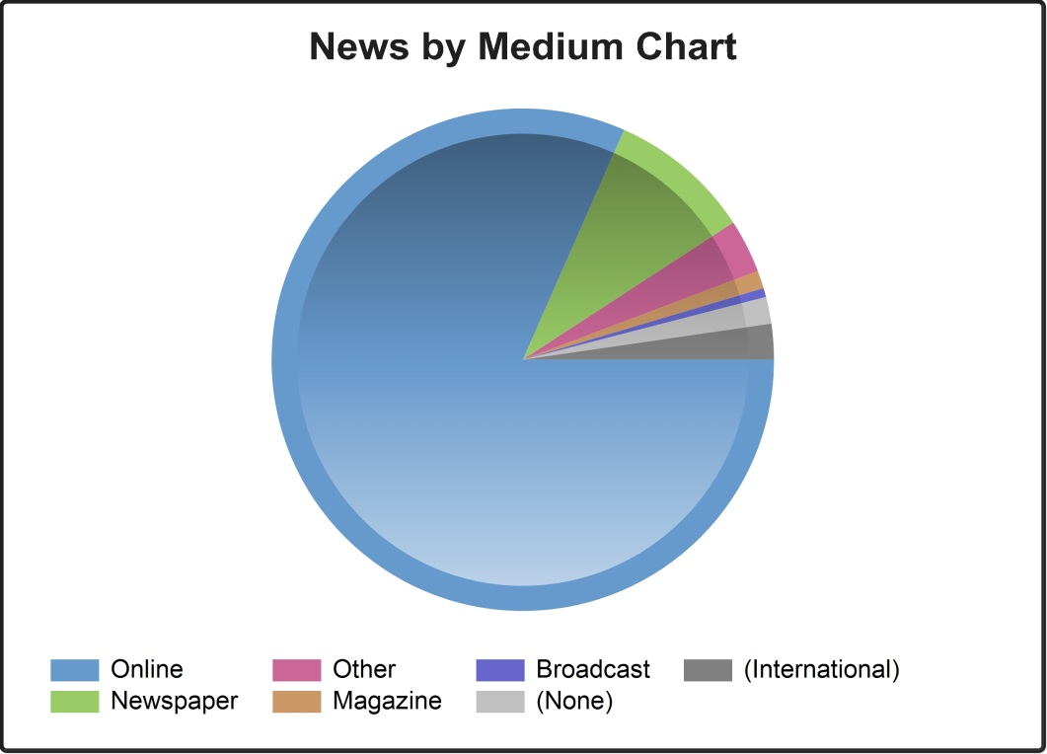
CHART BY TONE
CHART BY MEDIA

Slide 10
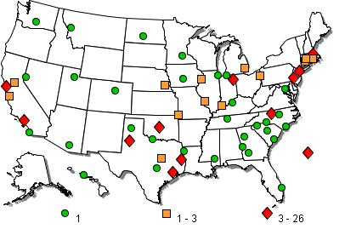
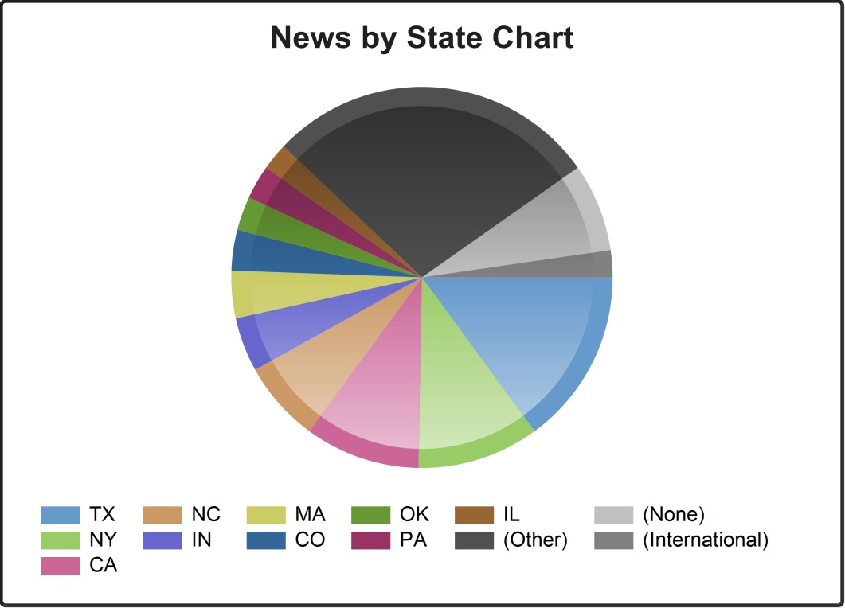
NEWS BY
U.S. MAP
CHART BY STATE

Slide 11
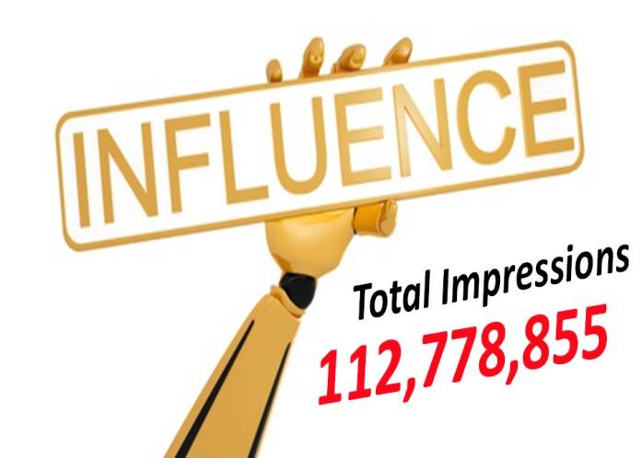

Slide 12




NAHU's Facebook posts reach, on average, 1,016 unique individuals each day.
NAHU's posts received, on average, 13 reactions per day and were shared 10 times per day this month.
In April, NAHU's profile was visited 2,416 times.
NAHU's tweets were seen on average 2,000 times per day this month.
NAHU's account gained 318 followers this month.
Review April’s Social Media Analytics
- Links to NAHU's infographics have been clicked over 750 times.
- Links to NAHU's Brokers Making a Difference page have been clicked over 325 times.

Slide 13

IMPORTANCE OF MEDIA COVERAGE
We often send these clips to policymakers to alert them of the issues we are facing. The more high-profile media coverage we received, the more attention policymakers will pay to our issues.
Media placement means an increased understanding of the issues in the public, both inside and outside the industry.
Media attention increases NAHU name recognition and branding.
We do not pay for our media placements. All coverage received by our members is free business promotion, which promotes NAHU members as subject-matter experts.
Good information and solid sound bytes provided by an NAHU member means other reporters will want to use that member as a resource.

