Slide 1
Using Programs to Drive Membership How Metro Detroit AHU has used programs to grow their membership
Steve Selinsky & Michelle Howard

Slide 2
Using Programs To Drive Your Membership
The Biggest value you can bring to members on a local level is quality programming and education opportunities
Focus on what agents want and need to succeed
Target existing & prospect membership
Partner with your carriers
Create programming that members value and cannot find other places
Decide if Programs are revenue driver or membership driver
Develop a marketing plan for programming and membership
Well Planned and promoted programs = More new and retained membership

Slide 3
Membership Growth
*500 2015-2016 Goal
2015 Membership
460
63% Growth

Slide 4
Meetings – Type & Frequency
Type
Breakfast, lunch, dinner, happy hour, no food and beverage
Cost
Venue
Hotel or banquet facility
Room rental
Food & beverage minimum
Deposits
Cancellation policy
AV costs
Opportunity for reward points?
Carrier offices, hospitals, community building, schools
Length of meeting & structure
Sample MDAHU Agenda
Networking/breakfast
Updates
Speaker

Slide 5
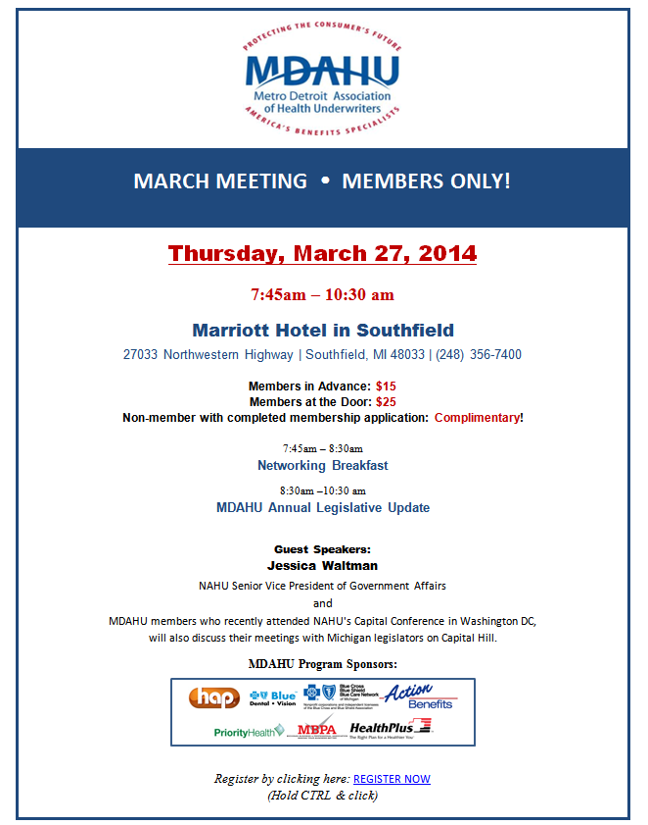
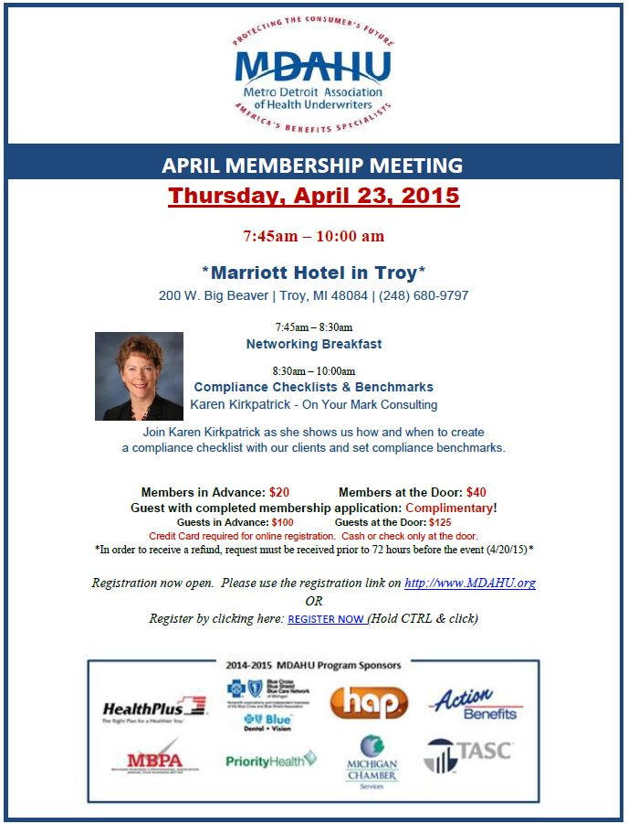
Sample Agenda/Flyer

Slide 6
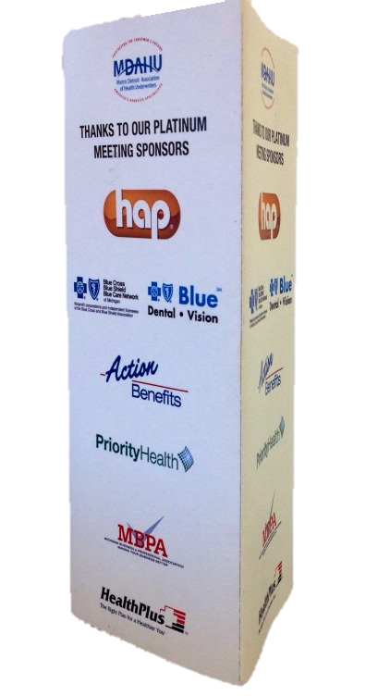
Budget
Set Budget
Sponsors
Platinum sponsor approach vs. per meeting approach
Sponsors’ benefit
Table top
Signage
Logo on screen
Infomercial
Logo on website
Verbal shout out
VIP perks
Bring a guest
Bring materials for promo table
Cost for members to attend
Member vs. non-member
New member incentive

Slide 7
Topics
Set Topics Ahead of Time
List of popular topics from MDAHU meetings
Where to find speakers
NAHU Speakers Bureau - http://www.nahu.org/education/speakers/findspeaker.cfm
Suggestions from audience?
Key is to set schedule early in year, line everything up and promote it!
Marketing Is Critical!

Slide 8
Promotion
Allow plenty of time to promote meeting (at least a month prior)
Use carriers and sponsors to promote to their agents
Call or reach out to prospective members or key producers
Make sure to sell your topic
Use tag lines that sell the topic and the meeting
Make agents feel as if they can’t afford to miss it
Again….Marketing Is Critical!

Slide 9

Registration
Invest in a system/service
http://www.cvent.com/
Prepay is the best way
Locks in the attendee
Chapter does not lose if member is a no-show
Have a dedicated person to handle and run registration
Registration list
Name tags
Receipts for non-prepaid members at the door
Flyers, etc.
Carrier table of information
Key meeting materials on the table

Slide 10
Meeting Set-Up
Confirm with hotel set-up, count, & any special needs (5 days prior to meeting)
Typical MDAHU meeting format
Room Set-up
AV Needs
Factor costs
Lavalier vs. podium
PowerPoint presentation to promote sponsors, chapter, & information (include next meeting info, special events, etc.)

Slide 11
Meeting Set-Up
Who will run or emcee your meeting?
Pledge of Allegiance
Stay on Time & Stay on Agenda
Assign board members to work the room and be greeters
Questions/No Questions from audience
Pre-submit questions
Questions on cards
From the floor
Speaker checklist
Reconfirm speaker needs and expectations ahead of time

Slide 12
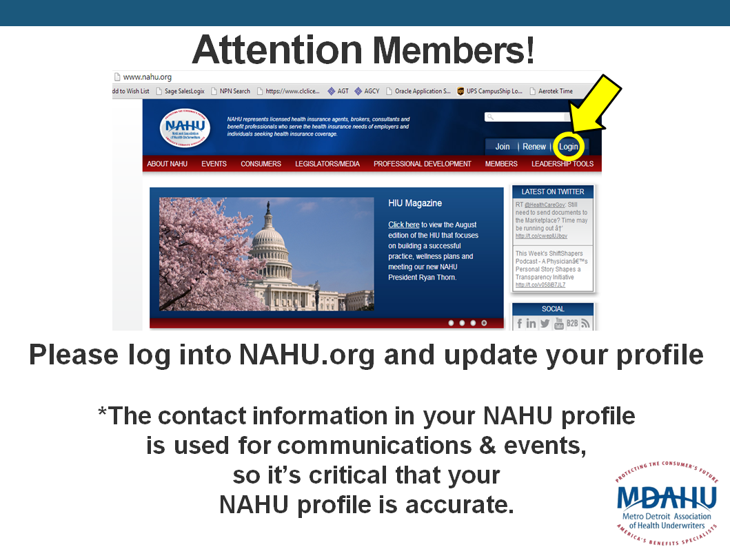
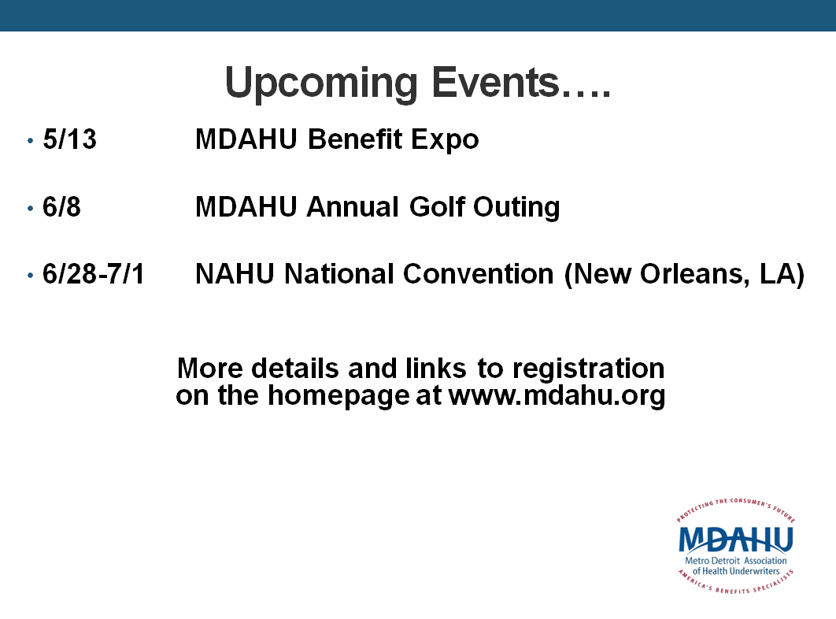
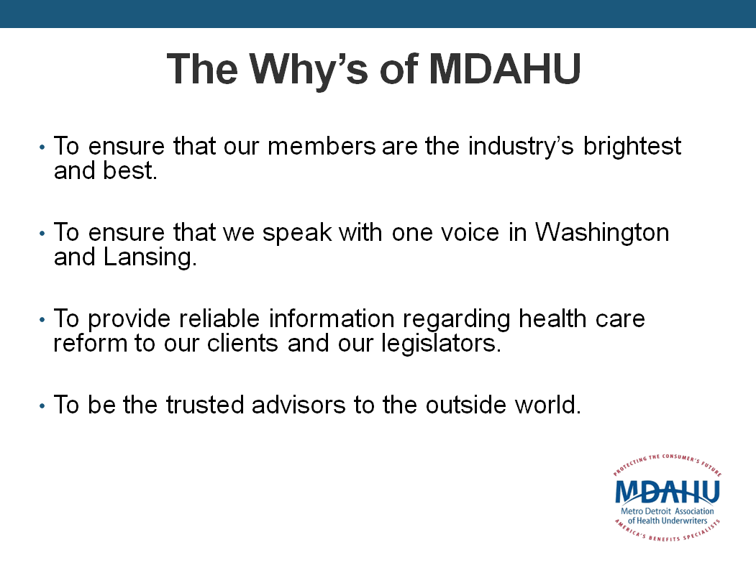

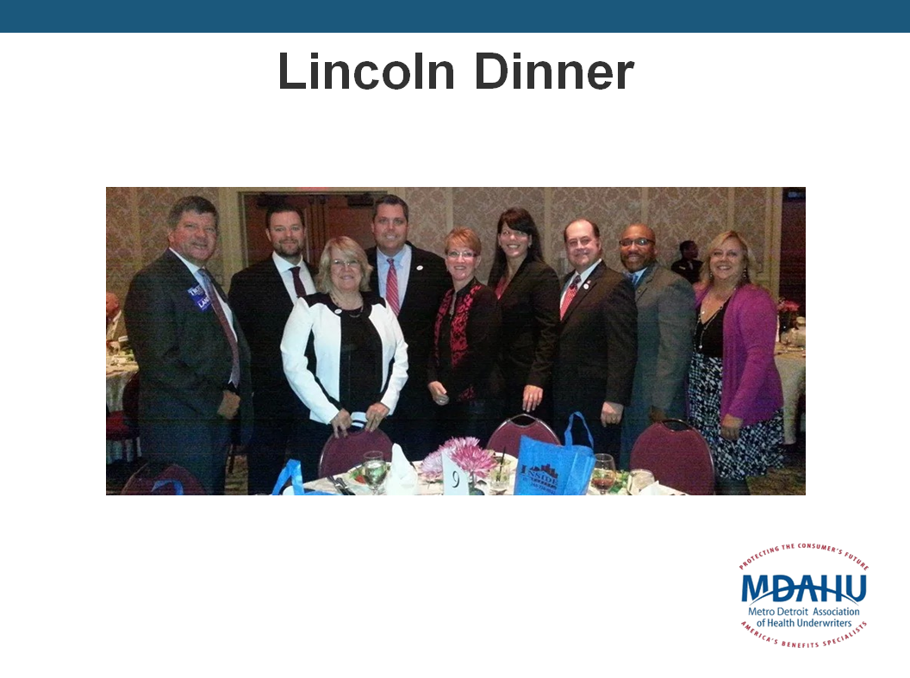

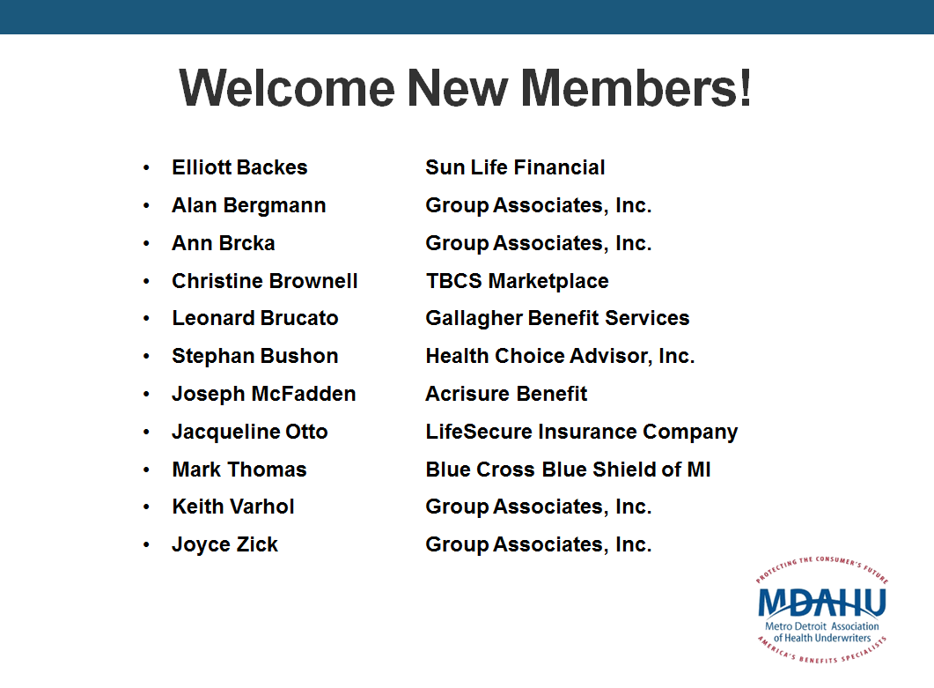
Sample Slideshow

Slide 13
Questions?
Michelle Howard mhoward1@hap.org
(248)443-8530
Steve Selinsky
sselinsk@hap.org
(248)443-4497

Slide 14
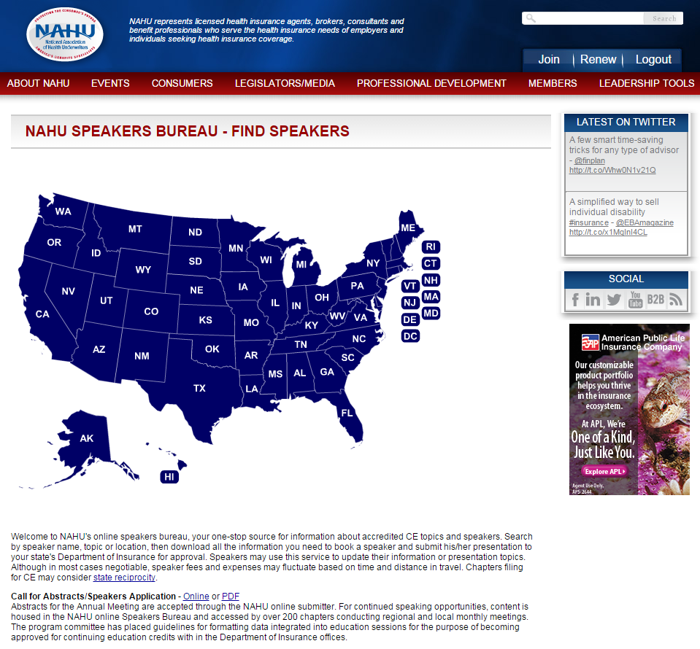

Slide 15
