Slide 1
Chapter Leadership Development
Notes:
Good morning all, and thanks for being here!
Who knows me?
Intros.
Prior positions at AHU, current position, work position.
What are we going to talk about today, and why?

Slide 2
Leadership 101
“One of the main responsibilities of a leader is to grow other Leaders”
- James Hunter
Action
Example
Notes:
Those of you at annual convention in Kansas City may remember our speaker, James Hunter. He said this:
I recently wrote an article on leadership, and what I believe it to be and to me, Leadership involves two things:
The first is action.
What do I mean by that?
How many of you have some periodic meeting? Maybe a monthly board meeting? For years I have attending a monthly board meeting which is always highly productive, informative.. Packed with great ideas. Your board meetings are probably similar. But has anyone in this room wondered what happens in the time between meetings? How much do we really accomplish? Between work, marriage, kids… LIFE… How much AHU business do we achieve in the 30 days between board meetings when we’re expected to report again? I admit that there have been months where I’ve dropped the ball, or let something slip down my priority list. What a good leader does between board meetings is take ACTIONS. Not necessarily big, humungous actions, but meaningful ones. We all need to ensure that the people we assign to lead our boards (and spoiler alert, that’s ALL the positions), are taking action in the time in between.
WHY? Well, not only does it get work done, but it sets the example. Future leaders, committee members, and even other board members are looking around for their best example of leadership to follow. Our actions help us lead by example and inspire those in line behind us.

Slide 3
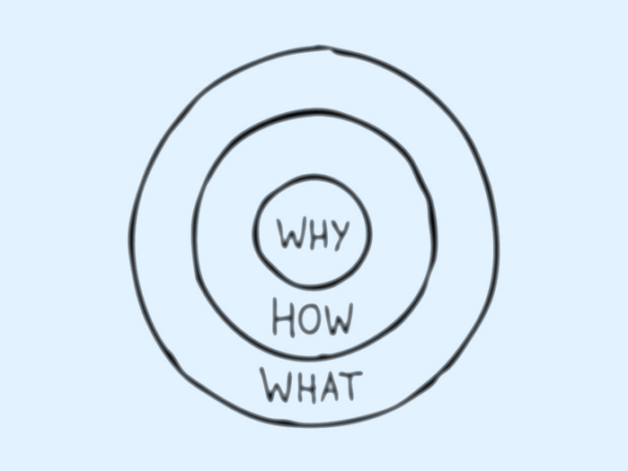
Why?
Why are we all in this room, right now?
  Passion
  2. Dedication
  3. Collaboration
Notes:
Everyone knows what they do. Most can articulate how they do it. Leaders, however, start with the hardest question ….why. And not for a paycheck….we all need that. Why this? Why now? Why you? Why AHU?

Slide 4
How?
The act of guiding individuals
through a process
  Vision
  2. Sharing/Delegating
  3. Leading by Example
Leadership is the ability to translate vision into reality.
Notes:
I loved this line from NAHU. We have so many bosses and managers; so many VP’s and President’s and CEO’s. How many of them are true leaders? If, as part of your role, you are instructing people on what they should do, you are not engaging in meaningful leadership. This isn’t what it’s about. When we take a look at the future of our organization we want to identify people who will continue our work and then we need to guide them; GROOM THEM; to become great. Not tell them how, but show them how.
And it’s easy to do.
Your vision is what you see, right? It’s what you imagine the future to be when you think about the time you’ll spend in this role. What will your contribution be? How will it look a year or two from now? You decide that from the very beginning.
That vision is your starting board for all those actions you’ll take along the way, and it’s important to share the vision with the people you need to help you so you can make that a reality.
Sharing the vision is the first step, but sharing the actions and delegating responsibility onto others not only helps a leader to achieve the goal they’ve set forth, but it allows future leaders; those people you’re hoping will be your successors; it allows them to get into the role and take similar actions to unite that vision.
And finally, leading by example. We all know that we should be doing that, but often we instruct others instead of lead them. Giving someone a step by step how-to only gives them the tools to do what you would do, and in leadership the goal is to teach people how to do what THEY do best. In your chapter you have a wealth of talent – board members and association members that have something unique to contribute to the vision. We should be capitalizing on the strengths of others in a way that benefits our association but also allows those people to do what they’re really good at because that’s how you get people to fall in love with it! We want an association that is culturally and intellectually diverse and we’re going to do that by asking people “what are you great at? And how can we use it?”

Slide 5
What?
Leadership creates structure
within the organization.
  Your Chapter Blueprint
  2. Succession Planning
  Accountability
      Future Leaders
Notes:
What kind of structure are we trying to build to ensure that we’re passing along a chapter that is successful now, and will continue to be lead into further success?
Have you ever heard Cerrina Jensen say, “Awards is your chapters blueprint to success?” – We all have! And she is absolutely right. Following that awards guideline forces your board members to take an action in order to facilitate a desired outcome. Right? So if you want all of your board members to earn the Triple Crown Award, then each of them needs to take three actions to qualify for that – participate in Operation Shouts (media), Donate to HUPAC (legislative), and recruit new members (membership).Tasking your board members with award criteria organically leads them into performing actions that contribute to the success of your chapter!
Succession Planning! My best and most consistent recommendation on successful succession planning is…. COMMITTEES! When you take on a role as a board member, your first order of business should be to build out your committee. Having committee members helps in a number of ways – you now have a team of members who are; 1. getting involved in the association, 2. holding YOU accountable to your board position and the tasks you’re delegating. 3. And ensuring that you have people who have familiarized themselves with your chair seat when you’re ready to step down or move up. You’re not just choosing someone from the crowd or making an ask to someone who might not have the drive or experience.

Slide 6
Identifying Future Leaders
Essential Skills:
  Effective Communication
  Listening vs. Speaking
  Discussing vs. Instructing
Character
  Leadership is about your character
  Contribute to others’ success
  Follow up & follow through
Notes:
So we know what we want, but how do we identify the people we want to lead us?
Honestly, and I’ll say this as a super hippie Portlander, half of the battle is intuition, isn’t it? Being able to pick up on cues, and words, and engagement from others when you meet. When I was in Kansas City last month I was sitting at the bar (of course), and very organically I met a broker I’d never met before. I truly had no idea who the heck he was even though we found that we’d been at the same AHU conferences for the last 3 or 4 years. It wasn’t until we found ourselves engaged in conversation that we were able to pick up that we shared the same qualities of leadership and some of that was just observing the way he listened and responded. I was easily able to identify in him the key qualities of a leader through our discussion. That’s partially intuition.
Effective communication. This is paramount. It is an absolute requirement. If you cannot effectively communicate your vision and action items to your committee, how can they apply their own skills to help? Effective communication is not showing up to a board meeting and dishing out responsibilities to board members – It is the art of conversation. It’s an exchange of ideas. It’s the ability to effectively made a collaborative plan and use those communication skills to bring people together. Communication isn’t just talking; it’s being able to listen and use the knowledge.
Have you ever heard someone say that everyone who seems to be listening is just waiting for their opportunity to respond? I think that’s truer than ever now. In this era of social media where we are constantly prompted to share. Share your thoughts, your ideas, your secrets, your life! But what if we listened? Could we find the very best future leaders if we actually listened to those words, and cues, and ideas without constantly thinking about what we should be doing next? The schedules we keep in this industry are insane! Slow down, pay attention, and listen.
Similarly - discussion over instruction. No one shows up to a board meeting and starts dishing out tasks for everyone (unless you’re the awards chair!). We expect our leader to prompt us into collaborative discussion, not tell us what to do. How often have we seen someone step into a leadership role under the belief that they’re now “in-charge”? How often have you seen a leader show up to a meeting and talk the entire time? That’s not our role. Our task, especially in this AHU setting, is to herd the ideas together and get the vision on paper. Then we can take the actions and set the example. But we can’t do that by bossing people around. No one wants to work with you if you’re always telling them instead of asking them.
And finally, it’s your content of character. Who has ever worked for a successful boss who was just… Not very cool? Difficult to talk to? Lacking in empathy? Kindness isn’t overrated. Nice guys don’t finish last anymore – we’ve all wised up! A great leader will contribute to other peoples success and you really can’t do that if you don’t care about it, right? So care. Be present, be involved, be cool. Follow up on the things waiting for your contribution, and follow through with people when you say you’ll do something. That’s how you establish trust. And you’ll need a lot of trust if you want people to follow your lead. And you do!

Slide 7
Development
Successful
Leaders
Successful
Chapter
Notes:
We’ve been doing all this talking about leadership for a reason. Because developing your board members – every single one of them, develops a successful chapter. If you can recruit and retain your best set of leaders, they are going to deliver you a successful chapter and ensure that legacy goes on. You can do great work during your term but if you don’t set the stage for people to follow you, the buck ends with you.
The leaders are the people that take action in between board meetings. They are the people that inspire the committee members to get involved a little more and a little more. They’re the ones that have figured out how this all fits together! Develop your leaders to develop your chapter and it’s future!

Slide 8
The Success Circle
Success
Board Member
(leader)
Committee
Accountability
Collaboration
Success
Delegation
Accountability
Notes:
Just for fun and because I wanted to make a chart of some kind… Remember the circle of success.
It starts with you guys – the board members.
You recruit your future leaders with your commitees.
Collaboration! Share the vision; exchange the ideas!
Stay accountable. Let people hold you accountable. Follow up and follow through on what you said you’d do.
Success.

Slide 9
Closing Discussion
What are your strategies for identifying great leaders
How do you make the ask?
Mentoring
Do you have a plan in place?
Following up & following through
Notes:
In closing, we have some time so I’d love some feedback from the room on what you’re doing in your chapters. What’s working, and what’s not?

Slide 10
Do. Or do not. There is no try.
- Yoda

