Slide 1
NAHU Chapter Basics
Keith Wallace
CLD Vice Chair
Seattle Washington

Slide 2
President - Role
Your role is to lead, organize and delegate the efforts of the committees. Once you have made your appointments and they have been approved by the board, give the chairs full rein to run their own committee. If your management strategy is based on the criteria from the Pacesetter and Presidential Citation awards, you will have a successful year.
Find the awards templates here: https://nahu.org/resources/awards/chapters
It has been my experience that many of the local boards are not aware of the Pacesetter Award criteria!

Slide 3
Presidents Guide to Leadership
https://nahu.org/resources/chapter-leadership-resources/guidebooks <- Here!
As local chapter president you will be responsible for providing the leadership and direction necessary to grow your chapter.
Your first month in office is an important period in your term. This is the time to get your board organized, establish a strategic plan and show your members that chapter is strong and moving forward.

Slide 4
President – Your first month in office
Review all of the information that you have collected, with special attention to awards criteria.
Review your state’s strategic plan, and integrate it into your chapter’s goals.
Make notes about specific goals you want to accomplish.
Hold a board meeting. This is one of the first official acts of the new president. It is an opportunity to meet with the board; new officers, retiring officers, new committee chairs and retiring committee chairs to discuss the “State of the Association” and formulate plans for the future!

Slide 5
Recommended committees
Structure will vary depending on size, scope and complexity of a chapters membership.
Board officers
President
President Elect
Vice-President
Secretary/Treasurer (often combined)
Recommended standing committees:
Membership
Legislation
Professional Development
Nominations
Special committees: Awards, HUPAC, Communications, Media Relation, Public Service
Executive Director (paid?)

Slide 6
Once the committees are appointed:
Invite the RVP and have them outline the positions, goals and functions of the national association
Call a board meeting at the earliest possible time or set up a strategic planning session to set goals
Clearly explain your duties and responsibilities and those of each officer, as well as the chairs for each committee. Specific officer handbooks can be found on the website.
Complete the Leadership Roster and send to chapters@nahu.org
Note: you can change this roster any time during the year!

Slide 7
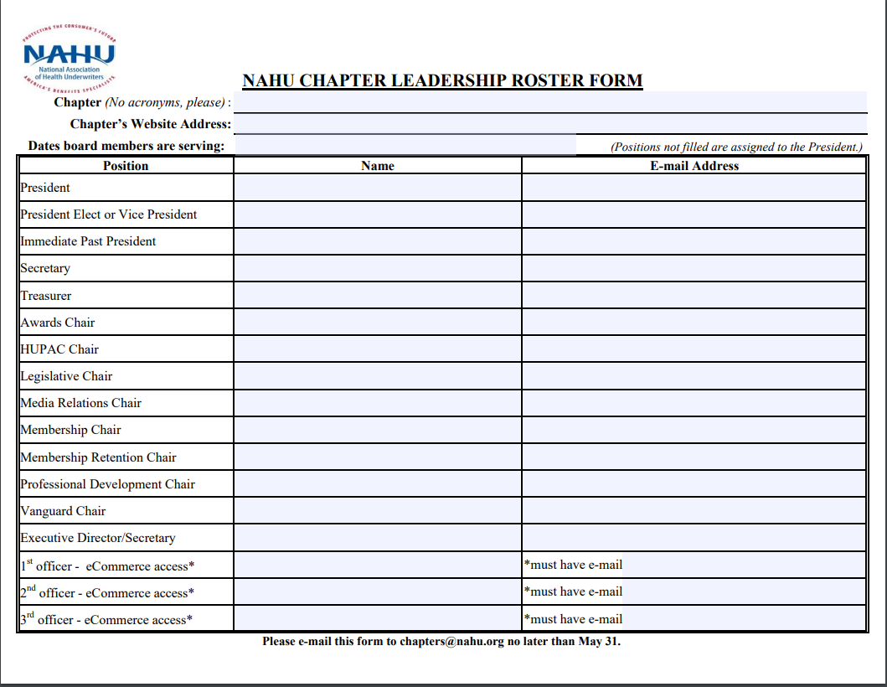
Chapter Leadership Roster Form

Slide 8
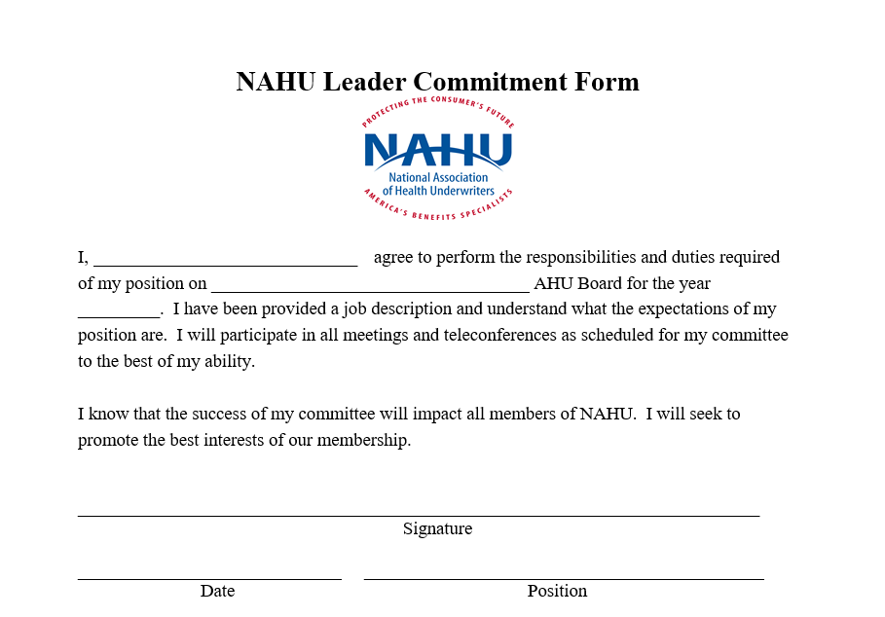
Chapter Leader Commitment Form

Slide 9
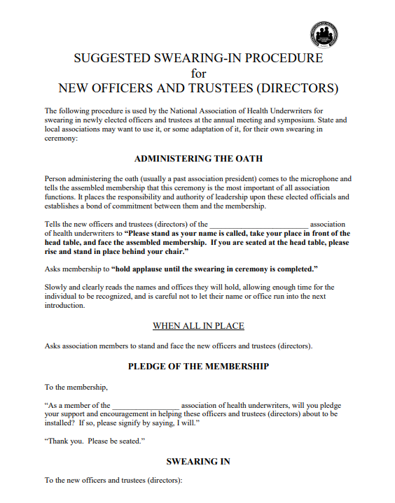
Swearing-In Procedure for Officers

Slide 10
Chapter Bylaws
Your chapter has adopted bylaws, which determine how your chapter is to be governed. It is important to give each member of your board, and all committee chairs, a copy of the current bylaws when they begin their term in office. If the bylaws are more than five years old you may want to consider asking the national office to review them. Send your request to chapters@nahu.org
New board members should always read the Bylaws before starting their term

Slide 11
Board meetings: Helpful Hints
Advise Board members well in advance of the meeting date(s)
Best to have the meeting at the same time each month
Some chapters have a provision that if a member misses a certain amount of meetings, they are dropped from the Board – discuss!
Start meetings on time and end them on time
Trivial and disorganized meetings discourage board members and should be avoided at all costs!
Advise committee chairs that reports will be expected each month

Slide 12
Suggested Board Meeting Agenda
Establish if you have a quorum voting on action items
Report of the President
Report of the Secretary (The minutes should be distributed prior to the meeting. The minutes need to be approved or corrected)
Report of the Treasurer
Committee Reports – START WITH AWARDS TO FIND LOW HANGING FRUIT
Old Business
New Business
Plans for next meeting
Many meetings are Zoom/Skype or GoTo Meetings

Slide 13
Committee reports: Helpful Hint
Have the Awards Chair be your first committee report
Use the Pacesetter Award application as your blueprint for activity and goals during the meeting!
The outline for the Pacesetter is for local chapters to perform activities that will promote successful activities.
Find the awards templates here: https://nahu.org/resources/awards/chapters
It has been my experience that many of the local boards are not aware of the Pacesetter Award criteria!

Slide 14
Chapter Certification
NAHU's Chapter Certification Program is a voluntary certification based on a rolling year’s activities. There are multiple levels of certification. Silver Certification is based on satisfying six of the fourteen criteria, Gold Certification is based on satisfying nine of the criteria and Platinum Certification is based on satisfying all of the criteria. State chapters are eligible for the Blue Ribbon of Excellence. Blue Ribbon of Excellence is based on the state chapter and all of its local chapters being certified.

Slide 15
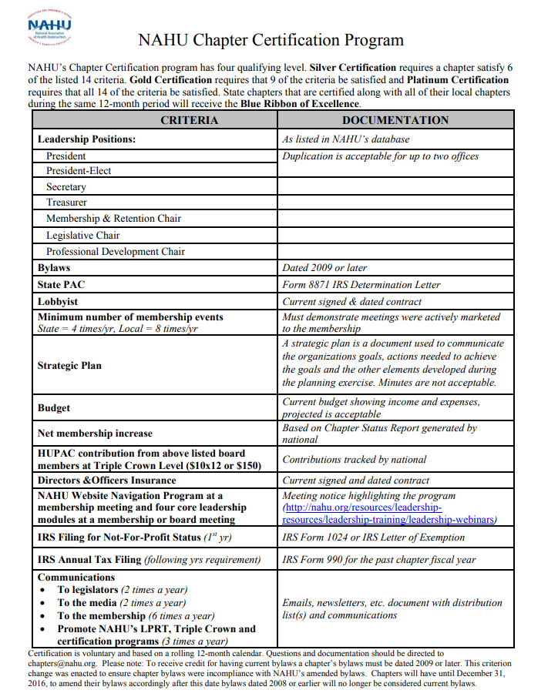
NAHU Chapter Certification Program

Slide 16
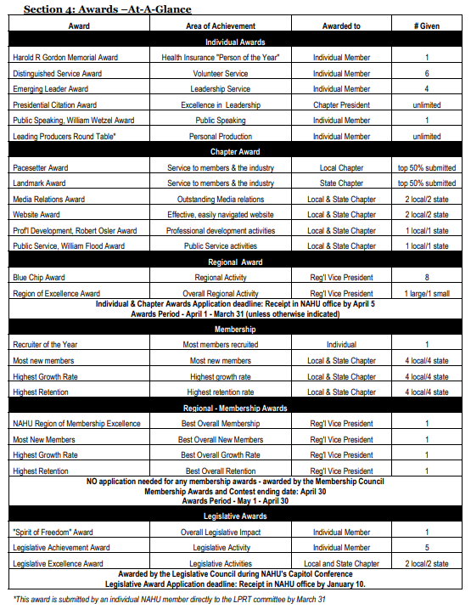
Awards-At-A-Glance

Slide 17
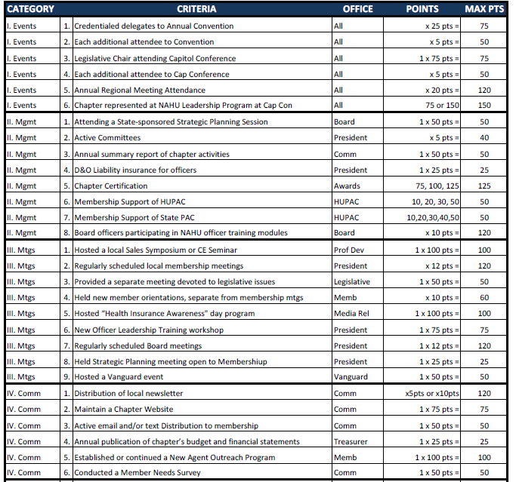
Pacesetter Award Criteria

Slide 18
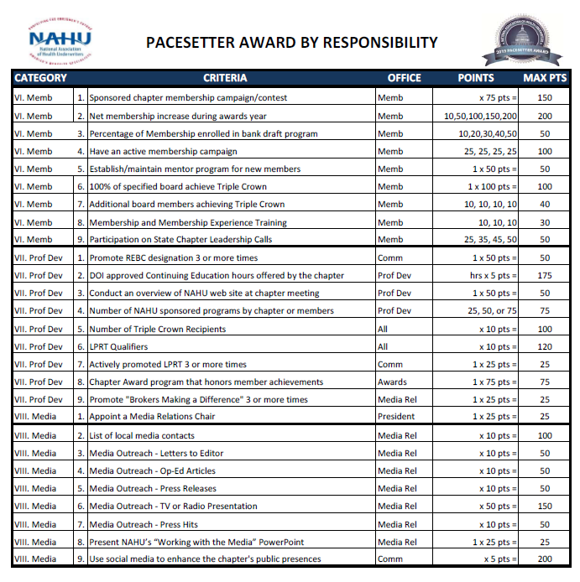
Pacesetter Award Criteria

Slide 19
President’s Triple Crown Program
NAHU created the President’s Triple Crown Program to recognize those members whose individual contributions to NAHU help advance the association’s mission.
Like baseball’s Triple Crown, it recognizes accomplishments in three key areas – they are:
HUPAC $12 x $12 draft program or contribute $150 a year
Membership: Recruit two or more new members
Advocacy: Use Operation Shout to send three or more messages

Slide 20
HUPAC
The mission of HUPAC is to raise funds from NAHU members for the purpose of supporting the political campaigns of candidates who believe in private sector solutions for the health and financial security of all Americans.
You can contribute to the either the Candidate Fund or the Administrative Fund.
Only personal contributions for the Candidates
Corporate contributions can be made for the Admin Fund

Slide 21
HUPAC Levels of Contribution
Supporter $12 a month or $150 yearly
365 Club $30 a month or $365 yearly
Congressional $42 a month or $500 yearly
Senatorial $63 a month or $750 yearly
Capitol Club $85 a month or $1,000 yearly
Double Diamond $250 monthly or $3,000 yearly
Triple Diamond $415 monthly or $5,000 yearly

Slide 22
Leading Producer Round Table
The Leading Producers Round Table (LPRT) formed in 1942 to recognize the successful underwriters of accident and health insurance. Today, the LPRT committee is committed to making LPRT the premier program for top health, disability, long-term care and worksite marketing insurance producers, carrier reps, carrier management, and general agency/agency managers.

Slide 23
LPRT Qualifying and Levels
Qualification can be based on Points or Income
www.nahu.org/members/lprt/application/single.cfm
Easiest way to qualify is attesting to your Personal or Agency Income
Soaring Eagle $300,000 Personal / $1,500,000 Agency
Golden Eagle $200,000 Personal / $1,000,000 Agency
Eagle $150,000 Personal / $750,000 Agency
President’s Council $100,000 Personal / $500,000 Agency

Slide 24
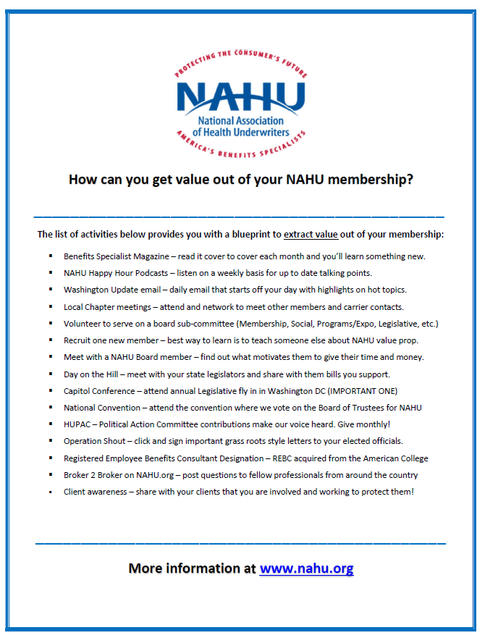
Ways to Extract Value from NAHU

Slide 25
How to get value from your NAHU Membership?
Read the Benefits Specialist Magazine cover to cover
Listen to weekly NAHU Podcasts
Washington Update daily email
Attend national events like CapCon and Annual Convention
Volunteer to serve on the board or a committee
Recruit new members – learn how to promote your membership
Contribute to HUPAC
Click, sign and send all Operation Shout messages
Read and participate in the B2B page at www.NAHU.org
Share your story of why you are a member!

Slide 26
Gotcha! Make sure to do these things!
Bylaws dated 2009 or later
IRS Filing for Not-For-Profit Status (1st yr) IRS Form 1024 or IRS Letter of Exemption
IRS Annual Tax Filing (following 1st year) IRS Form 990 Postcard
Nominations and Elections by end of May
Communications
To Legislators (2 times a year)
To the Media (2 times a year)
To the Membership (6 times a year)
Promote NAHU’s LPRT, Triple Crown and Certification programs (3 times a year)

Slide 27
Questions and Answers

