Slide 1


Strictly Private and Confidential
Business Plan for Expanding makeintern
.
Draft For Discussion Purposes Only
July 2014

Slide 2
About the document
Mohipuri Technologies Pvt Ltd is evaluating expansion model in India
In the first section, a broad overview of how makeintern have started and at what level we are as of now and then details on India growth with respect to the education / internship sector. Post which, the opportunities will be discussed
In the subsequent section, the competitive landscape is studied and assessed on parameters such as international branding, field expertise and geographical penetration
In Potential reach section, we have analyzed that how the students are growing in different tier of cities clusters on parameters of the need of internships
The next section provides the details of the expansion strategy that will be deployed in the next 5 years starting from June 2014.
The final section encompasses the financial projections of the next 5 years

Slide 3









Executive Summary
1
Market Overview
1
Competitive Landscape
1
Expansion Strategy
1
Financial Feasibility
1
Appendix
1

Slide 4



Slide 5
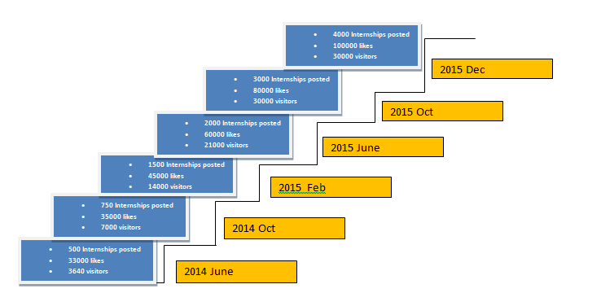
Executive Summary
Makeintern is a portal started with focusing on internships

Slide 6
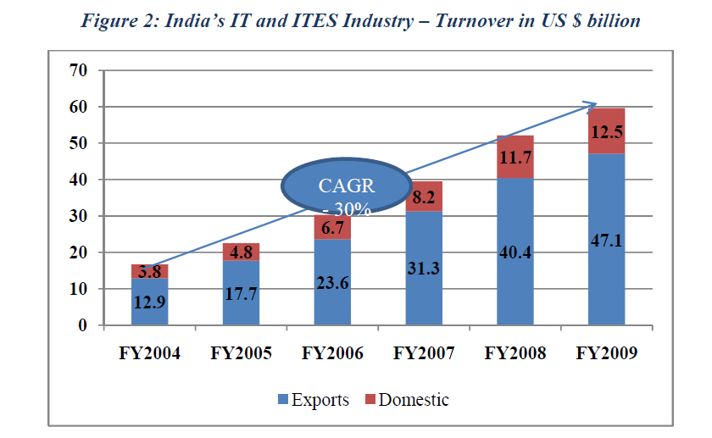
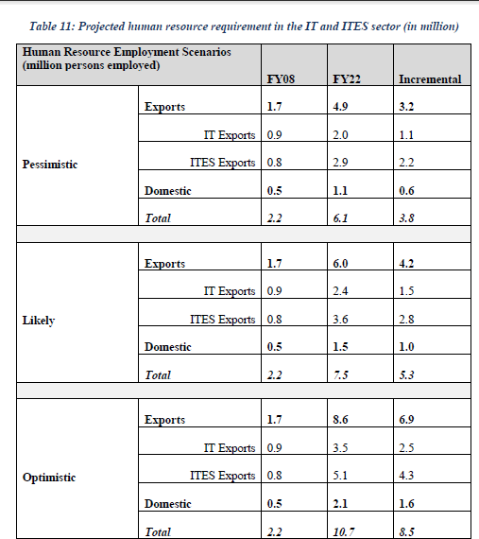
Growth in recruitments in ITES sector

Slide 7
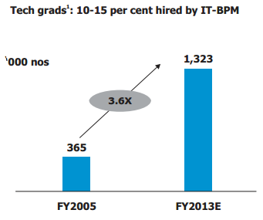
Demand for Interns and Fresher and growth
Domestic Market
Enormous opportunities in multiple sectors
  Energy
  Technology driven health care
  Medical Device Design
  Manufacturing
  Media
Domestic IT
Technical out turn up 3.6 times in 8 years
To attract companies colleges students need to create differentiation, this differentiation can be brought in if students have already worked in corporate while in college(Internship)
USD 50 billion market by 2020
Opportunities in
  Software products, IS outsourcing
  System Integration
  Mobile software applications
  Elearning

Slide 8
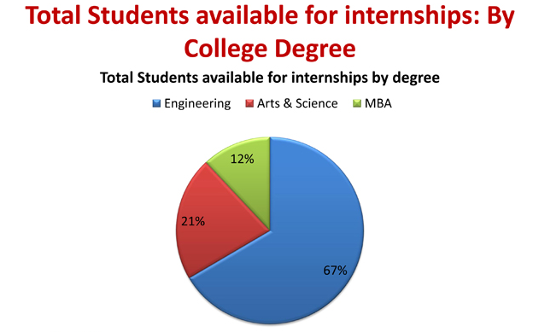
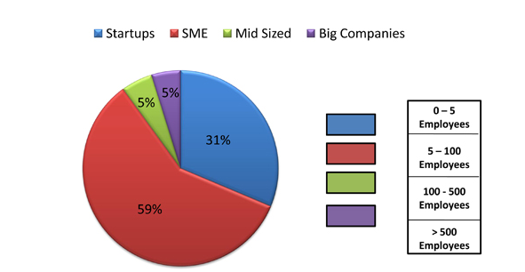
Demand for Interns and Fresher and growth
Size of the companies

Slide 9
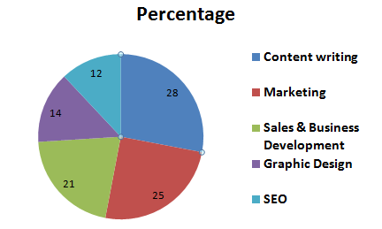
Demand for Interns and Fresher and growth
Split-up of market requirement

Slide 10
Demand for Interns and Fresher and growth
Split-up of market requirement

Slide 11




Competition in India for Internship
Internship market has a competition but we are way ahead of many of them
None of the active internship portal is more than 5 years, and makeintern being in market for over 1 year, reaching the right level is not far away
There are many opportunities of revenue which are not explored by other internship portals
Internship Providers
International players
Fully Active Players India
Startup early stage
1 | Internships.com(USA)
2 | internshipprograms.com
1 | Internshala.com
2 | Letsintern.com
3 | Twenty19.com
1 | www.indianinternship.com
2 | Hellointern.com
3 | www.campuswhizz.in

Slide 12





Competition Analysis :International Players(Internships.com)
ABOUT
Key Statistics
Internships.com, a division of CareerArc Group
Biggest advantage is the venture is part of a serial entrepreneur Robin Richards which has a great exposure of running a venture
Currently they are out of competition in India as they are more focused on USA market
The major focus is bringing traffic to the site and as much as companies as possible
Over all strength of employees is 60
Year of Est.
2009
Total no. of centers
20 Cities USA
Head Office
Burbank ,USA
USP: “ “They are into this industry since 6 years and they have huge number of companies registered , a feature in which students can easily refer to each other for internship.
Revenue Model
Current Revenue Model:
No revenue as of now focus to increase traffic and awareness
Future Revenue Model:
Improving the service and charging for there service
No Revenue

Slide 13

Competition Analysis: Internshala.com
ABOUT
Key Statistics
Gurgaon based venture, established in year 2010
80% posting on internshala is by startup and remaining 20% is SME
150,000 annual applications received by Internshala in Year 2013, expecting 50% growth each year
Along with company they also have gone to skill based courses
Online courses for students as they believe in skill building and better revenue opportunity in the courses
Year of Est.
2010
Total no. of centers
1
Head Office
Gurgaon
Approach: Internshala plans to expand towards online training ,career services for reaching expected revenue and they remain free for employer and student
SERVICES
Current Revenue Model:
Internship services Free
Online courses to the students
Career services such as resume and cover letter writing
Future Revenue Model:
Increasing foot prints to resume writing
Internship Service
Online courses
Resume writing
Virtual training

Slide 14
Competition Analysis: twenty19.com
ABOUT
Key Statistics
Twenty19.com was founded by Karthikeyan Vijayakumar, a graduate of BITS, Pilani.
As of 2013 180,000 college students registered and 5,300 companies as registered users.
They have grown but did not add any innovation to the internship portal
About 25 to 30 per cent of the students registered with Twenty19, 10 per cent with Internshala and 20 per cent with Letsintern have got internships, so matter of conversion , twenty19 is ahead of market
Year of Est.
2010
Total no. of centers
Single
Head Office
Chennai
Approach: There approach is to allow companies and students to apply free of cost and main revenue model is offline courses
Revenue Model
Current Revenue Model:
Internship services Free
Online courses to the students
Future Revenue Model:
Increasing foot prints to resume writing
Internship Service
Online courses

Slide 15

Competition Analysis: Letsintern.com
ABOUT
Key Statistics
Letsintern.com was established in 2009.
Letsintern says it grew more than five times on key metrics in 2013/14, including the numbers of students getting placed and companies hiring interns through the website
Letsintern focuses only on internship and did not move to offline or online courses as the other competitor did
4000 employers and 96000 students subscribed on the website
Year of Est.
2009
Total no. of centers
Gurgaon based
Head Office
NCR
Approach:
Revenue Model
Current Revenue Model:
Paid internship service for employers
Paid internship service for students
Future Revenue Model:
Fully focused on just improving the internships sector and no plans for any different revenue channel
Internship Service employer
Internship Service Students

Slide 16



Slide 17
Makeintern.com Expansion Model
We are lower in the student base but there is still huge opportunity in the area of internships
As of now main revenue mode for makeintern.com is advertising and workshop model, conducting workshops in different cities.
We easily expect to grow at much faster pace than competitors as we have different model then competitors.
Being into the co-orporate have good connect to the technologies for which are not being focused by competitors. i.e oracle DBMS
Revenue Model
Total Revenue Model
Calculations are as shown below
Internship Model Companies | 22%
Internship Model Student | 33%
E-Learning | 33%
Workshop | 41%
Advertising | 3%
Internship Service
Workshop Model
Advertising
E-learning

Slide 18



Slide 19



Key Market Characteristics
Value / Brand Conscious
Contrary to public perception, Indian customer is not cost conscious, but value conscious. A good brand /service and strong quality perception goes a long way in establishing reputation
Overseas internships
To bring quality and value to the Indian customers, makeintern will have to do tie-up with the companies overseas
Word-of-mouth publicity
Given India's close knit family culture and a highly relationship driven social fabric, it takes little time for a good service provider to build up reputation and attract more customers
Leverage on Workshop
Offline model is not only an opportunity to earn but also the best way to give a offline platform to give a warmth of the company by personal touch
Increasing colleges
As shown earlier the number of colleges are growing at the pace of 80% and similar is the progression is the need of corporate exposure to the students
Expand locally, Establish brand
Although there is huge scope in over all India , we plan to reach un reached colleges in east as none of the competitors have strong base in East

Slide 20
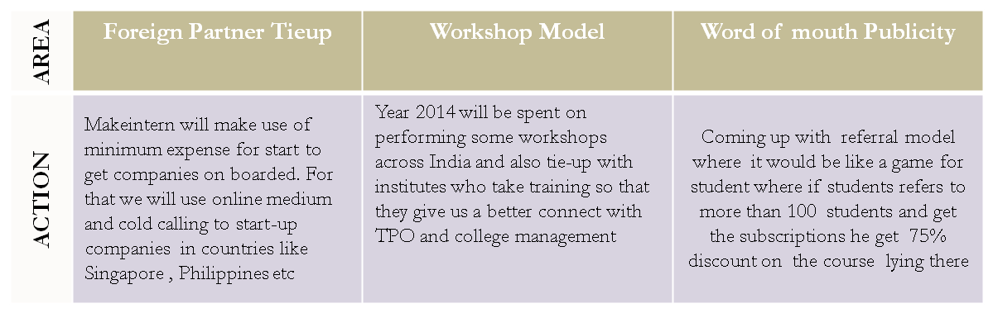

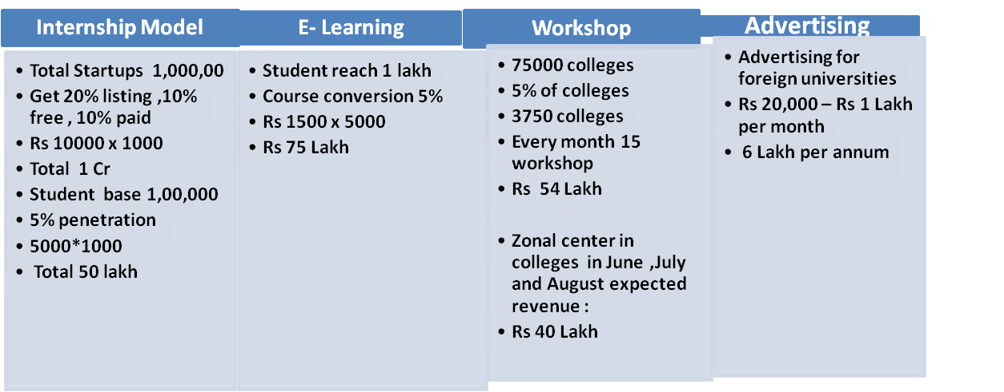
Translating Strategy to Action
MakeIntern
Revenue calculation For Dec 2015
There is lot of scope in asia pac – Philipines, vietnam, Malaysia etc. which is not yet considered

Slide 21

Expansion Plan
TIMELINE
Expanding the workshop Model get 3 workshops from colleges
Get 700 Internships on portal
CV parser to be implemented to be ahead of other players
Reach a revenue of approx 1.5 cr
Hiring of 2 HR’s for getting clients
To receive 2000 visitors per month
Get advertising for the website
Increasing the workshops
Get 7 workshops a month
Get 12 workshops a month and
Implement online webinars
To reach from 500 postings to 600 postings
Pitch for advertising on the page
July
2014
Aug
2014
Sept
2014
Oct
2014
Nov
2014
Dec
2014
Jan
2015
Feb
2015
Mar
2015
April
2015
May
2015
June
2015
July
2015
Aug
2015
Sept
2015
Oct
2015
Nov
2015
Dec
2015

Slide 22



Slide 23
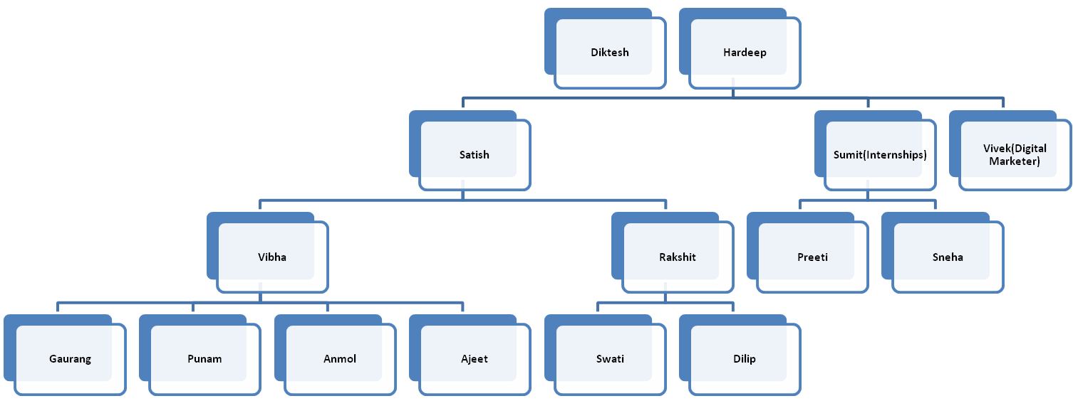
Funding Requirement
Current Team Structure
Current Expenditure per month
Salaries : Rs 3.5 Lakh per month
Promotion : Rs 20,000 per month
Office space +misc : Rs 40,000 per month
Website : Rs 10000 per month
Total per month expense : Rs 4,20,000
Current Revenue(Annum)
Companies : Rs 2,40,000
Workshop : Rs 90,00,000
Total Revenue : Rs 92,60,000

Slide 24
Head of expense | Expense set | Summary | Monthly Amount | Yearly Amount
Marketing | Online Marketing for internship | Campaign | 100000 | 1200000
 | Tie-ups with portal |  | 30000 | 360000
 | Email campaign | content | 20000 | 240000
 |  | Email service | 10000 | 120000
 | online marketing for courses |  | 100000 | 1200000
 |  |  |  | 3120000
Employees |  | 9 Workshop resource | 100000 | 1200000
 |  | 1 HR Executive | 15000 | 180000
 |  | 1 HR Executive | 20000 | 240000
 |  | 1 Business Developmenr Executive for Company Co-ordination | 40000 | 480000
 |  | 1 online course co-ordinator | 25000 | 300000
 |  | 1 video editor | 20000 | 240000
 |  | Tutor payment for 30 courses |  | 600000
 |  | 2 Resources for Webinar co-orindation | 50000 | 600000
 |  |  |  | 3840000

Slide 25
Head of expense |  | Expense set | Summary | Monthly Amount | Yearly Amount
Technical Support team |  | UI Designer | 20000 | 240000 | 1500000
 |  | Developer | 25000 | 300000
 |  | Digital marketer | 40000 | 480000
 |  | SEO Admin | 20000 | 240000
 |  | Content (Outsourced) | 20000 | 240000
 |  |  |  | 1500000
management team |  | Manager | 35000 | 420000 | 2820000
 |  | 2 Founders | 200000 | 2400000
Infrastructure expense |  | Rental | 30000 | 360000 | 1056000
 |  | Electricity | 8000 | 96000
 |  | Phone | 25000 | 300000
 |  | Hosting | 5000 | 60000
 |  | Misc | 20000 | 240000
 |  | Total |  |  | 12336000

