Slide 1
iFirstAid
Access Med+care anywhere anytime

Slide 2
Application
A mobile application that can be used by patient to interact with doctor over video for the first / basic level treatment by live calculating and sharing the patient health data
Target for supporting phone as well Tablet
Supported in Apple as well in Android device.

Slide 3
App target users
Patient
Doctor
Medicine delivery vendor
Clinic laboratory person – a vendor

Slide 4
App Features
Search the doctor
Read - write feedback about doctor
Online video appointment with Doctor
Live check up of patient health data
Medicine , sample delivery
User Medical drop box

Slide 5
App user pre-requisite
User should have
Mobile device
Device should have internet connection
User should have phone compatible endoscopy camera or point camera

Slide 6
Regular user workflow (Default)
User launches the app
App should have MAP view and list view as view page for displaying doctor information
Default view should be map view. App one part should have Map displaying his location mark and mark of all doctors available in radius of 10 KM
When user tap on any doctor POI then doctor information small pop over comes up
Though this popover user can navigate to all details available for doctor

Slide 7
Regular user workflow Contd..
Doctor POI color will be Blue and green
Green indicates doctor is available at the moment .
Doctor search
Top area of view screen should have search facility
Search criteria should be
Based on area like Pediatrician , general.. OR
Based on doctor name
Based on feedback rating

Slide 8
Regular user workflow Search Result..
Search Result will be shown in current view , could be Map view OR List View
MAP POI Quick view OR in list display should have information
Doctor Name
Location keyword (in list view)
Rating Icons
Specialist (?)
Call me button link
Fee
Experience
Recommended by any of your FB friend (Facebook)
Details / Feedback link
Working hours

Slide 9
Online video appointment with Doctor
User can take Video (online treatment )appointment to doctor.
User access the mobile app and check for any doctor available over video
User book the appointment
Consider Mobile app has minimum two views / UI window
In Window1 , Skype video will be telecasted < Doctor and patient will communicate over Skype>
In other window , Patient device data will get displayed
User uses the device like heart rate meter , BP measure meter , Ala , fever meter , torch or same way to telecast / display inside view of <Eye , Mouth / Throat / Lung… / etc >
Data value read on these device will get uploaded to cloud (Mobile app server) at real time
Mobile app read the data from cloud and displays the data value or graphical value of the data into mobile App Windows 2
Overall patient data should get displayed in Mobile application / data view screen at real time.

Slide 10
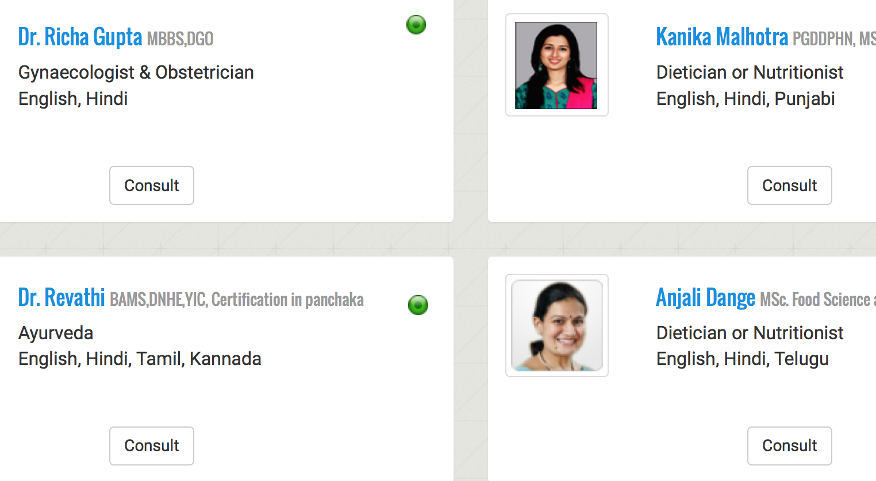
Registered Doctor live availability view in app

Slide 11
App screen view while Video Interaction
Patient live health data view
Like
Patient BP - ( app capture it)
Heart Rate - ( app capture it)
Temperature - ( app capture it)
Throat State – (User put endoscopy camera attached with phone in mouth , app displays the video)
Temperature.
Ear , Eye , Nose , Pulse rate
Doctor live video
Patient live video OR Patient
video in paused state

Slide 12
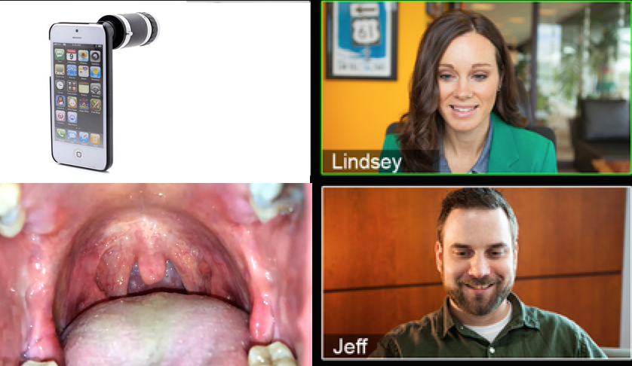
Live throat infection check up – user attach endoscopy / mini camera in phone and then focus the camera towards mouth – app capture the data and stream it into app data view screen.

Slide 13
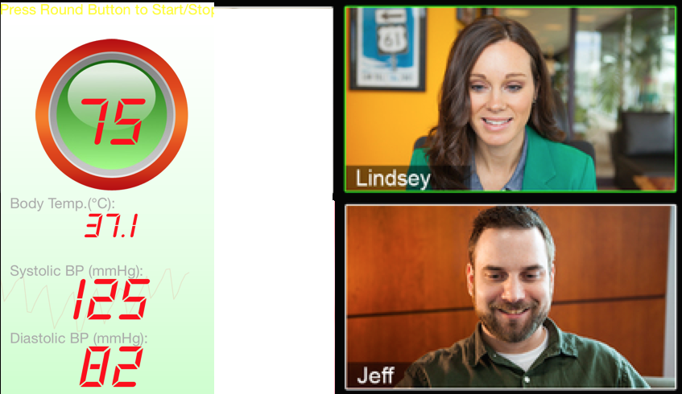
Live check up of patient BP – patient uses phone app to measure BP , once measured , app displays the BP data in app data view screen

Slide 14
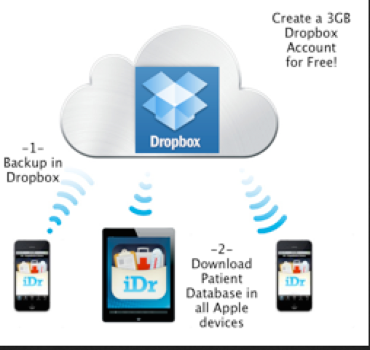
Medical drop box – Once consultation get over , Doctor writes prescription and it get stored in app medical drop box , ONLY patient OR doctor will have access to it.

Slide 15
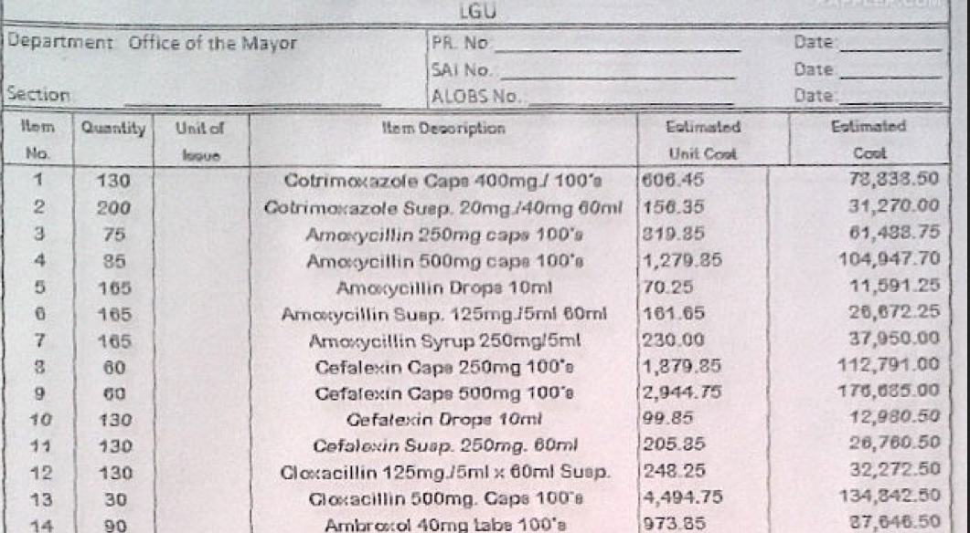
Medicine home delivery request – patient can request for medicine home delivery – app raises the medicine home delivery workflow, share with medicine store vendor the medicine list (only) as stored in medical drop box and delivery address as mentioned in medical drop box report

Slide 16
Regular User Workflow – online video appointment contd…
Advantage of Video mode medication
User don’t need to visit the clinic
User can connect to doctor from anywhere
Can be made 24/7
Different doctor will be available at different time for online
Can be used with across location doctor
It provides the opportunity to patient located at any part .. Say Bangalore .. To get first level treatment / advise from Doctor located at USA ( assume USA doctor also has registered with Mobile app for his availability / listing )
App medical drop box feature can be used by patient / doctor for sharing reports
User need to mention the booking time , Skype id
If needed then user can book appointment with more than one doctors , specialized in different area , and it will act as kind of conference over Skype.
User need to logged in to Skype and have accepted the contact request from Online Doctor ID .
Hospital / doctor assistance can initiate the contact acceptance process.

Slide 17
Regular User Workflow Medicine , sample delivery
Medicine list and delivery order can get get generated through
In Online Skype treatment , doctor can prepare medical subscription and add it to delivery needed list / order workflow
User can call and order medicine
User can login online and order for medicine
User can call or order line for sample collection also like blood sample , urine sample.
Unique Id / identity of sample should be given to patient , as well it should be pasted in bottle and as well in report / test result delivered

Slide 18
Regular user workflow Medical Drop box..
App will act as Medical drop box . It will help in maintaining medical record for user life time.
My Medical box will have Upload , View feature as well Share feature
Upload workflow
User take photo of Doctor receipt / x ray /..
Launch app
Tap the button upload
It brings up all stored photo in Camera
User selects photo(s)
All photo get uploaded at server
Photo get stored with date upload as prefix
All photos selected in bunch will be part of a single folder

Slide 19
Regular user workflow Medical Drop box..
While uploading photo , user will get option of adding “remark / text” as tag to photo(s) uploaded
View Workflow
It will list down all photo / folder thumbnail
Remarks should be shown as bottom title with..
There should be facility to search the photo based on tag text

Slide 20
Regular user workflow Medical Drop box..
Share
User can share file / folder as
Email attachment
Photo will be attached in email client
As App MyDoct app mobile link
User select picture file or folder
User tap the share button
This generates the Link , link can point to a picture or folder
Email client gets popped up with link embedded in mail body.
User sends the email.
Receiver
When receiver tap the link then
If app is already stored then App get launched and opens the photos in app viewer
If app is not installed
NOTE – its hard to stop uploading non medical related file and hence few different kind of file also might get uploaded.

Slide 21
Feedback
Thanks
Looking forward for your feedback

