Slide 1
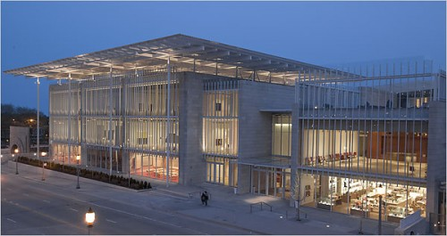
Indian Institute of Media (IIM)
Location: Lucknow, Uttar Pradesh

Slide 2
Why Lucknow or UP ?
The state has population of about 190 million which is almost a country in itself
The growth rate of the population is about 20% which is the highest growth rates in India
Literacy is about 67.68% , hence the market will keep on growing as the rate increases.
Number of graduates passing out in streams other than engineering & medical
No of school going kids above primary level are 50Lacs
35 Lacs student appear for High school 10th board examinations
30 Lacs student appear for Intermediate.
Some 20 Lacs are for ICSE & CBSE boards.
But the state has hardly any world class institution apart from IIM Lucknow.
Lucknow is among the best in tier 2 upcoming towns with great connectivity & Infrastructure
The relationship of Founders is such in this belt that the project cost would be just 1/ 3rd of what it would be at any other metro or tier II cities.

Slide 3
Objective
To create a World Class Institute
Almost every aspect of the media industry is touched upon, which ensures complete clarity to students. Some of them are mentioned below- Newspapers, TV News Channels, Portals, Radio Channels, Television Production Houses, Television Channels, AD Filmmaking Houses, Independent Filmmakers, Advertising Agencies, Media Planning Houses, Market Research Agencies, PR Agencies, Event Management Firms, Corporate Houses, Media Organizations, NGOs. There is no Media Institute in India which has courses covering all the mediums
After 2 years expansion to 2 more institutes in India & 1 more at Singapore or Dubai.

Slide 4
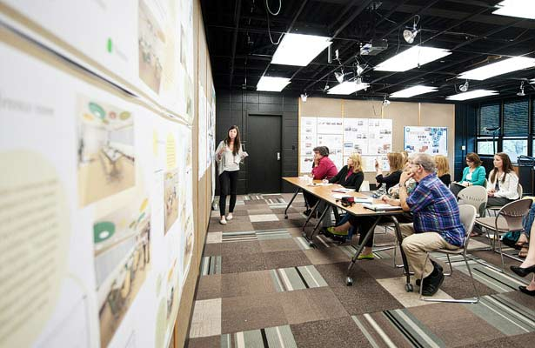
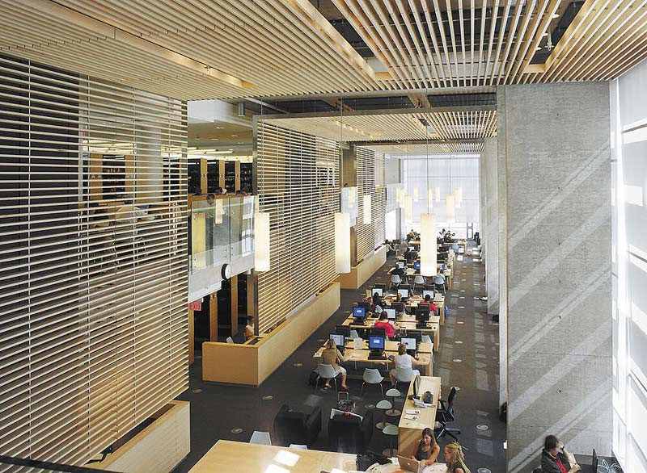
About Indian Institute of Media
A state of art campus in Lucknow with world class infrastructure
Courses offered: UG & PG- feeding every vertical of Media companies

Slide 5
Supply & Demand
Supply
Demand
No options
High number of students
Not qualified personnel
Numerous media companies
Entry in college
Entry in companies

Slide 6
Big Addressable Market
Number of students graduating in non-engineering & medical fields
There are around 12 lakh undergraduate (BA/BSc/BCom) seats in 138 government degree colleges, 331 government-aided degree colleges and 3,382 self-finance degree colleges
Spend limits are easily almost Rs. 200000 per student per year
TAM =1200000 x Rs. 200000 = Rs. 24000 crores per year
UP is as good as a country in size & population hence maximum number of voters so its relevance would be always big.

Slide 7
Under graduate key course
Programme offered –
Bachelor of Arts (Mass Communication)
The full-time programme is spread over a period of three years, and spaced out over six semesters of six months each, incorporating theoretical lectures, hands-on practical sessions,
tutorials, classroom presentations, take-home assignments, sporting & cultural events, field trips, study tours, project and internships.
Specializations –
Journalism including
• Print
• Electronic
• Cyber Media
Film & Television including
• Radio & Television Production
• Ad Film-making
• Documentary Film-making
• Film Studies
Advertising including
• Client Servicing
• Account Planning
• Media
• Creative - Copy & Visual
Public Relations including
• Corporate Communication
• Event Management
Duration -
Three-year full-time programme

Slide 8
Post graduate course
Post graduate diploma in Media Management - 2 years
Post graduate diploma in Journalism - 2 years
Certain differentiators
Post graduate diploma in digital media management - 2 years
Post graduate diploma in sales & distribution - 1 years
Post graduate diploma in communication & Leadership
for political aspirants. - 1 year

Slide 9
Fee structure planned
Bachelor of Media Studies | Fee Per Annum (Amt. in Rupees)
Tuition Fee (A) | Rs. 1,90,000/- per annum
Caution Deposit (refundable) (B) | Rs. 20,000/-
Total Fee with Deposit (A+B) | Rs. 2,10,000
Post Graduate Diploma in Media Studies | Fee Per Annum (Amt. in Rupees)
Tuition Fee (A) | Rs. 2,00,000/- per annum
Caution Deposit (refundable) (B) | Rs. 20,000/-
Total Fee with Deposit (A+B) | Rs. 2,20,000

Slide 10
Program profiles
Courses in General Communication include : Communication Theories, Social Change Communication, Media Research Methodology and Development Communication.
Courses in Journalism include : News Media, News Reporting, Editing, Feature Writing, Television News, Specialised Reporting, Business Journalism, Layout & Design for Print Publications, Journalism in Hindi, Television News Production, International Communication & Global Media Systems, Media Laws & Ethics, Trends in News Agency & Magazine Reporting, Development & Civic Journalism, News Room Production and Cyber Media.
Courses in Film & Television include : Aesthetics & Visual Communication, Photography, Audio-Visual Communication, Broadcast & Unconventional Media, Non-fiction Filmmaking, Storytelling, Camera & Lighting, Post Production, Audiography & Music, Scenic Design, Production Management, Electronic Media Production, Advertising Filmmaking, Television Channel Management & Programming, Evolving Media Technologies, Scripting, Direction and Graduate Film.
Courses in General Management include : Business Studies, Marketing, Mathematics, Corporate Social Responsibility, Consumer Behaviour, Statistics, Brand Management, Digital Marketing, Entrepreneurship, Human Resource Management, Marketing Research, Services Marketing, Rural Marketing, Sales & Distribution Management, Business Policy & Corporate Strategy, Organisational Behaviour, Global Environmental Challenges, International Business, Corporate Governance & Ethics, Accounting, Customer Relationship Management and Retail Marketing,
Courses in Advertising include : Advertising Management, Integrated Marketing Communication, Media Planning, Advertising Creative & Copywriting, Advertising Strategy and Social Media Communication.
Courses in Public Relations include : Public Relations, Event Management and Corporate Communication.
Courses in Humanities & Social Sciences include : Language Skills, Business Communication, Literature, Creative Writing, Theatre, History, Sociology, Economics, Political Science, Psychology, Culture Studies, International Relations, History of Cinema and Film Appreciation
Courses in Information Technology include : Business Automation Tools, Design Tools and Web Design.
Courses in Design include : Animation.

Slide 11
The team
Founder : Rajat Kumar – Presently working as Business Head for HT group UP
Co – Founder : Naveen Joshi – 35 years of experience as a Sr editor for many National dailies.
Co – Founder : Sunita Aron – 35 years of experience as a Sr editor for HT.
Co – Founder : Smita Kumar – 15 years of experience in institution administration.
Co – Founder : Saurabh Yadav – budding entrepreneur from IIM Kolkata

Slide 12
Current Status
The project is in the build up stage
Will be kicked off with a formation of society.
Land some 90,000 square feet already shortlisted with just 12Km from Lko main city.
We can immediately buy the land & start construction.
We would manage all affiliations, tie-ups & NOC’s.
We are all set to start admissions from the next session
Some 12 member faculty is also shortlisted.
We also plan to recruit international faculty.

Slide 13
Infrastructure planned
Modern classrooms To connect, communicate and converge.
Infrastructure plays a very important role in the learning process. It not only makes the learning environment more appealing, but also aids in the understanding process of the student. Studios, screening rooms, post-production suites etc. help students practice & gain experiential learning.
Seminar Halls – These are provided with overhead LCD projectors and public-address systems.
Screening Rooms – These are acoustically sealed, split air-conditioned mini-auditoriums with wall-to-wall carpeting and provided with overhead LCD projection systems and Dolby / DTS 7.1 surround sound system.
Audio-Visual Studio – A shooting floor along with a Production Control Room. The same is equipped with multiple digital cameras (five Panasonic DVX102 & four MD Panasonic 10000 cameras) and multi-channel digital mixers. Lighting equipment includes overhead moveable lighting grid, cool floods, spotlights & shadow caster.
Post-Production Suite – Five air-conditioned cubicles, as well as a post production laboratory, are equipped with non-linear edit systems to meet the students’ editing needs. The same has the following facilities : four Mac Pro with FCP and 10 iMac with Adobe Premier CS5. Additional software include Nundeo 5.0, Sound Forge 7.0 & FCE.
Photography Studio – The air-conditioned photography studio combines both manual and digital facilities. It has a darkroom with enlarger for manual D&P, as well as computers with contemporary software for digital imagery. The studio is equipped with professional lights, SLR cameras and other essential equipment.
Computer Laboratory – The air-conditioned computer laboratory has 39 terminals equipped with Pentium IV processor driven CPUs connected to LCD screens / overhead LCD projector. The laboratory is fully networked and provides high-speed broadband connectivity, with power back-up. A variety of Publishing, Post Production and Design Technology software are available. The entire campus is Wi-Fi enabled.
Library – The library has a well-stocked collection acquired since its inception, and covering a broad span of technical and non-technical subjects pertaining to mass media and communication management. A computerized cataloguing system provides instant access facility for any book, by title, author, publisher, or ISBN number. The library also subscribes to a wide assortment of national and international newspapers, magazines and journals, besides some other publications.
Audio-Visual Library – The audio-visual library has a comprehensive collection of films, documentaries, radio & television programmes in English, Hindi and other Foreign / Regional languages. Workstations are available to access these films at any time during working hours.

Slide 14
Financials
3 years of UG (400 students in each year)
2 years of PG (400 students in each year)
1st year gross revenues 15 CR
2nd year onwards gross revenues 18 Cr

Slide 15
Funding needed
Infrastructure set up 15 Cr
Operational expenses for 1st year 5 Cr
Marketing budget 5 Cr

