Slide 1

Saurabh Agarwal
Co-Founder
saurabh@theatreadda.com
+91-8800249990

Slide 2

TheatreAdda.com is an online platform for theatre enthusiasts /performers to connect with each other & showcase their work to larger audience across the world.
TheatreAdda.com aims to be the innovative platform to amalgamate Theatre to Movies and TV Serials, thus conduct online auditions of artists for movies and TV serials through a simpler and transparent method.

Slide 3
Problem Market Size Solution Why TheatreAdda.com? Current Status Funds Team
Unorganized Audition process for Movies & Television serials
Artists
Production Houses
Lack of connections in media to showcase their talent on a larger platform
Hesitate to approach casting agents because of their bad reputation and behavior
Wastage of time and money in traditional auditions
Struggle for recognition seems perpetual
Lot of time and money expenditure to conduct auditions at various places
Talent of various towns and cities is not accessible
Complete dependence on Casting agencies for fulfillment of their requirements
www.TheatreAdda.com

Slide 4
Problem Market Size Solution Why TheatreAdda.com? Current Status Funds Team
Media and Entertainment industry
18bn$ market, growing 16%YoY
Enablers for Target Market
Source: KPMG Report 13, Aranca research
Around 800 TV channels and more than 1500 movies produced in India in all languages
Talent is the basic requirement of this market and we look to serve multi million users in our endeavor
www.TheatreAdda.com

Slide 5
Problem Market Size Solution Why TheatreAdda.com? Current Status Funds Team
Go To Market Strategy
35 million viewership of punjabi television
TV industry INR 200 crore
Films 500 INR crore
Viacom 18 and Eros Now, and Indian biggies, including T-series, Tips, Subhash Ghai's Mukta Arts, Akshay Kumar's Grazing Goat and Jimmy Shergill's Productions, are looking to grab a share of the pie in producing and distributing products of the lucrative Punjabi film industry.
www.TheatreAdda.com

Slide 6
Problem Market Size Solution Why TheatreAdda.com? Current Status Funds Team
1
2
An online platform where all performing artists and production houses can come together to make the process of auditions more transparent and effective.
A one stop solution for people who wish to learn and make their career on screen by becoming part of the community.
TheatreAdda
4
3
An Adda of artists, where any aspiring or professional artist can apply for auditions from his/her home without travelling to different cities.
An Adda of production houses, where they can search for the talent online and conduct first level auditions from their respective offices.
www.TheatreAdda.com

Slide 7
Problem Market Size Solution Why TheatreAdda.com? Current Status Funds Team
1
We are addicted to movies and serials. Team TheatreAdda.com loves to watch TV series, movies and theatre performances
2
Team TheatreAdda.com has performed on stage and wish to make a difference in the lives of the people who are talented and want to make difference but don’t get an opportunity or medium to showcase it
3
A lot of ground research on the pain points and issues being faced by the artists and the production houses has been done and based on our findings, we have come up with the solution i.e TheatreAdda.com
www.TheatreAdda.com

Slide 8
Problem Market Size Solution Why TheatreAdda.com? Current Status Funds Team
Expenditure so far 3 lakhs (Web development, Company Registration, Trademark Registration, Festival Coordination, Customer acquisition etc)
Team is working on audition platform
Being part of biggest theatre festivals of India purely on value addition provided by us to the practitioners ( Bharat Rang Mahotsav’15)
4
3
120+ Theatre groups registered on the website, tie ups with most of them
Database of 2500+ theatre lovers and enthusiasts
2
1
www.TheatreAdda.com

Slide 9
Problem Market Size Solution Why TheatreAdda.com? Current Status Funds Team
We need funds
To Increase technical capability
To Build Relationship with production houses
To create barrier for new players
We are seeking for INR 50 Lakhs for a period of 6 months of operations
www.TheatreAdda.com

Slide 10
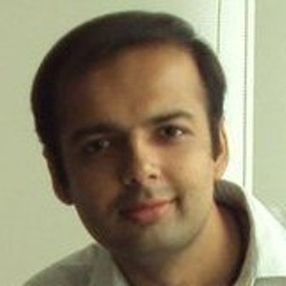
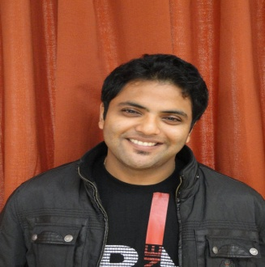

Problem Market Size Solution Why TheatreAdda.com? Current Status Funds Team
Abhinav Narang is a computer engineering graduate from MIT, Manipal and a postgraduate in Marketing from SOIL, Gurgaon. He has over 6.5 years of experience of Business Analysis, Algorithm Design, Product Management & Consulting in various domains. He has worked in various countries in Asia & Europe and currently working on creating TheatreAdda.com a global name in the Theatre world Linkedin- Abhinav
Saurabh Agarwal is a mechanical engineering graduate from MIT Manipal & a post graduate in Marketing from SIBM, Pune. He has over 5 years of experience of Sales,Digital Marketing, International Business Operations & Logistics Management. His aim is to showcase the hidden talent of theatre artists of rural India by giving them a global platform like TheatreAdda.com Linkedin- Saurabh
Anand Kaushik is a core techie by heart. He loves to code and learn new technologies. He is part of online startup community from last few years and was the CTO of education based online portal and now leading the technology vertical of TheatreAdda.com Linkedin- Anand
www.TheatreAdda.com

