Slide 1

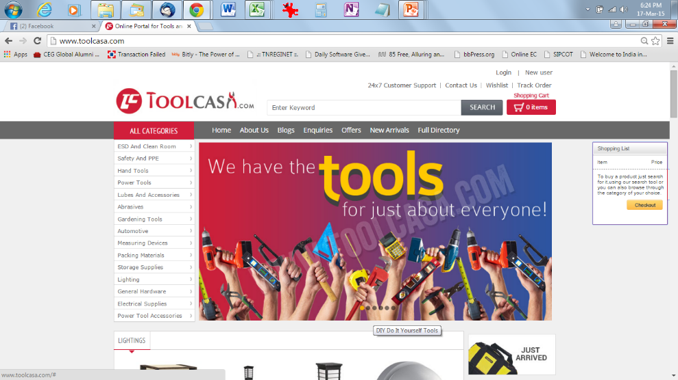
“Online portal for tools & industrial products”

Slide 2
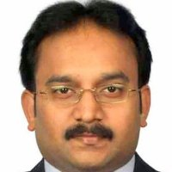


Founding Team
Sembian V
Harihar S
Balakrishnan B
20 Years Experience in Engineering, Automotive & Telecom Mfg
Speciliazed in Operations Mgmt, Supply Chain Mgmt
Last Held Position – Factory Head, Nokia Chennai
15 Years Experience with Automotive & Telecom Mfg, Program Mgmt
Speciliazed in Business Strategy Development , Supply Chain Mgmt
Last Held Position – Program Mgr, Nokia Chennai
16 Years Experience in Industrial Product Distribution
Specialized in Sales & Marketing, Business Development, Industrial Distribution
Last Held Position – Senior Manager, Castrol India

Slide 3


















Product Categories
Abrasives | Hand Tools | Power Tools | Safety | Electrical | Lights
Storage | Fastener | Cutting Tools | Lubricants | Cleaning | Welding
Packaging | Measurement | Hardware | AntiStatic | Gardening | Tapes & Adhesives

Slide 4
Market Potential
Total GDP @ $1877 B-2014, GDP Growth projected @ 6-7%
24-25% of of GDP is Industrial, 2-6% of industry MRO on Tools
Trade’ is15.8% of GDP, ~1% of Trade retail on Tools & HW

Slide 5






Our Customers & Current Supply Chain
10-15%
7-10%
3-5%
Margin at Each Stage
Individuals
Repairmen, DIY & Technicians
Dealers / Wholesalers
OEMs
Subdealers
Small Traders
Retail Outlets
Retailers
Institutions
Hospitals, Schools & Colleges
Re-Distributors
MSMEs
Micro, Small & Medium Enterprises
Large Corporates
OEMs, Tier 1, Tier 2

Slide 6
Problem Statement & Solution
Lack of One Stop Online Portal for Industrial Tools & Hardware Supplies
Convenience to buy Tools Online Anytime from Home/Office
Transparency of pricing of Products
Non Availability of Multi Brand Multi Category Online Tool Store
Limited Access to International Brands and Quality Products Online
Fragmented Supplier Base for Tools and Supplies
Online Tool Portal for All Types of Industrial Tools & Hardware Supplies

Slide 7
Opportunities
Offering
Convenience
Price
Transparency
Efficiency
Individuals
Repairmen, DIY & Technicians
One stop shop for multi types and brands of tools, hardware, consumables
24/7 Sales/Delivery Channels with Technical Support
Fewer Distribution Channels & Direct Savings in Purchase Price up to 20-25%
Transparent Procurement Process – Reduced chances for Malpractices/Leakages
Customized Account Management – Ordering, Inventory & Analytics Reports & related Services
Small Traders
Retail Outlets
Institutions
Hospitals, Schools & Colleges
MSMEs
Micro, Small & Medium Enterprises
Large Corporates
OEMs, Tier 1, Tier 2

Slide 8

Where we want to play…
OEMs / Wholesalers
Individuals
Dealers / Wholesalers
Subdealers
Small Traders
Retailers
Institutions
Re-Distributors
MSMEs
Large Corporates

Slide 9

ToolCasa Journey so far
WEB GO LIVE
INITIAL IDEAS
IT PLATFORM TRIALS
Apr 2014
Aug 2014
May 2015
Jan 2014
Jun 2014
Nov 2014
EBAY TRIALS
CORE TEAM SETUP
12000+ SKUs,
20 Categories
1100+ Orders , 800 Customers
100+ Delivery Locations
600+ Visitors Daily
74% New Visitors, 26% Return Visitors
72 Product Brand Tie-Ups

Slide 10
The Numbers so far
Orders
Customers
Payment Modes & Brands

Slide 11
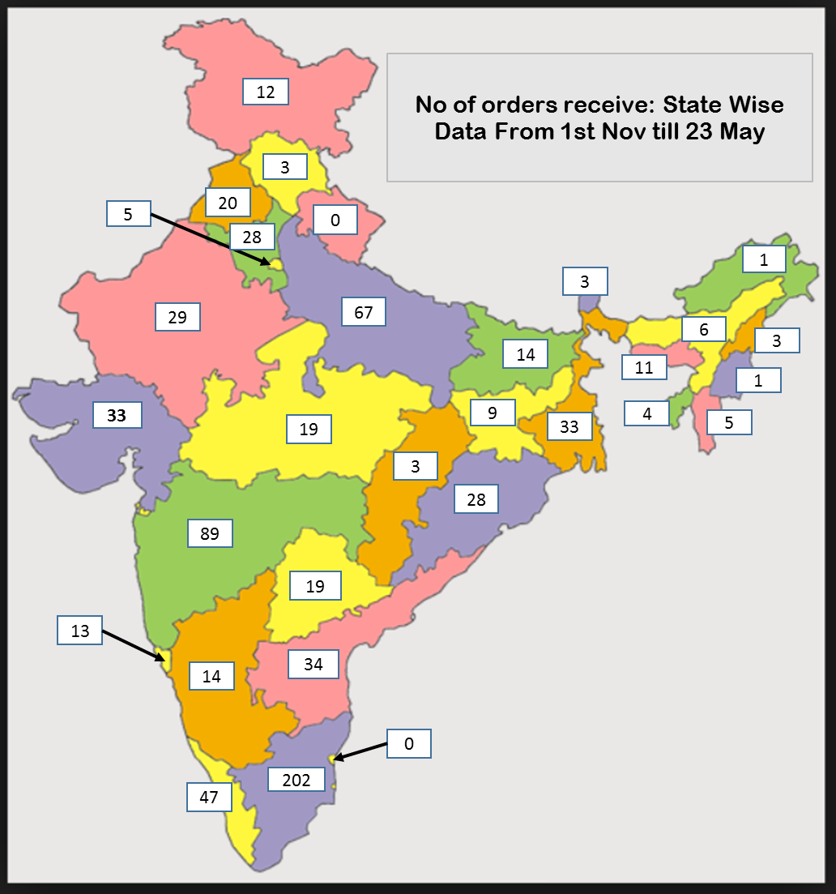
Categories & Deliveries
Deliveries across India

Slide 12
Funding Ask
Funding Ask – 2Mn USD
Purpose of Funding
IT Solution Development
Operation Scale Up
Resourcing – Operations Team
Zonal Presence
Marketing Scale Up ( Online )
Own Branding

Slide 13
Thank You
Contact Information
Harihar S – 91-8939-89-1329 - harihar@toolcasa.com
Sembian V – 91-98409-21462 – v.sembian@toolcasa.com

