Slide 1
Investment Teaser – Wellness & Fitness (Hybrid Model)
Phase #1 – Online Model
Dox ID # IC/FNCPM/PEP/1516/EC/01

Slide 2


Slide 3
Highlights
Industry Vertical : Wellness, Fitness & Beauty
Orientation : Consumer
Platform : Online + Offline
Business Model : Wahanda + Mytime + Stylebee + (Secret Sauces!)
Cities being covered : Mumbai & Pune (First Quarter)
Current Status :
31st July – Beta Launch (Web Portal + IOS & Android App)
5000+ Service Providers
Limited No. of Users for Testing

Slide 4
Industry Snapshot
Indian Wellness Industry ~ INR 100,000 Crores (2015E)
Beauty Care ~ INR 49,000 Crores
Alternate Therapy ~ INR 21,000 Crores
Health/Wellness F&B ~ INR 27,000 Crores
Indian Slimming & Fitness Industry ~ INR 70,000+ Crores
Consistent CAGR ~ 18-20%
Key Drivers :
People now invest a lot of money on themselves – Feel Healthy & Look Good
Being FIT & HEALTHY isn’t a fad or a trend anymore. It is a lifestyle.
Service Providers are experimenting & Scaling up fast
Venture Capital & Private Equity investments are aggressive as well

Slide 5
Inefficiencies
For Service Providers
Lack of Skilled Man Power remains the top challenge (Currently over 2,500 Thai skilled workers are employed in the Industry)
Lack of targeted discovery mechanisms for lead generation
Largely identified as a Women’s Industry (except Fitness)
For Consumers
Lack of Niche Discovery Mechanisms
Virtually no discovery mechanisms for travelers except for a JustDial, etc.
Lack of Access to Authentic Information & Knowledge
Unawareness on Structured Approaches to Wellness, Fitness and Beauty
Lack of Access to Consummating the Services Easily/Conveniently
Lots of Phone Calls / Waiting Loops / Frustration

Slide 6
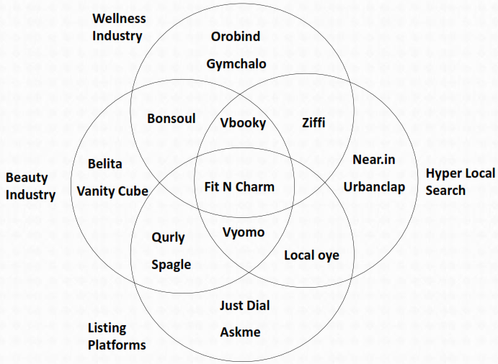
The Solution
NEWCO

Slide 7
The People
2 Founders
Founder #1 – A complete professional with over 13 years of multifunctional experience in an Automotive Industry. Certified Six Sigma Green Belt and a PLM Expert. Internet enthusiast. Diligent Entrepreneur who is extremely Well-Researched.
Founder #2 – A professional with 9 years of experience into product design & development, strategic thinking, competition analysis, data analysis and integration. An entrepreneur by passion.

Slide 8
Do we make any Money?
Several Revenue Streams for Online Model -
Listing Charges
Premium Listing
Advertising
Booking Commissions
And a few more!
Offline model : TBD
Revenue Generation :
Nominal Listing Fees – Q1
Fully Blown Revenue Model – Q2 onwards

Slide 9
Current Status
Web Portal – Ready to Launch
Version 2.0 being worked on!
iOS App – Ready to Launch
Android App – Being Tested
Data Collection in Process
Over 5000 Service Providers to be a part of Soft Launch
Mumbai & Pune to covered in the first Quarter
Digital Marketing – Ready to Launch
Video & Content – Being created for Launch, otherwise Perpetual
Private Limited Company Incorporated
Currently Bootstrapped with Founder investments of around 30-35 Lacs

Slide 10
Monies
Currently seeking an Early Stage Funding Round of approx. US$ 2 Mio
Structure : Equity Placement
Use of Funds : Infrastructure, People & Marketing burn through 12-15 Months
Dilution : TBD
Exit : TBD
Comparable Transactions :
Styleseat – US$ 10.2 Mio from Light Speed Ventures
Beautified – US$ 1.2 Mio from NEA, others
Vyomo – Unknown from Yuvraj Singh, INR 2 Cr from Taxiforsure Founder
Ziffi – US$ 2.4 Mio from Orios Venture Partners
Vbooky – Unknown as now

Slide 11
Disclaimer / Notice
This Summary Note (the ‘Note’) has been prepared by Instaura Consulting solely for the purpose of allowing interested investors an opportunity to evaluate a transaction.
The information contained in this Note is selective and is subject to updation, expansion, revision and amendment. Instaura Consulting has not independently verified any of the information and data contained herein and Instaura Consulting (nor any of its respective affiliates, subsidiaries, advisors and agents thereof), make any representations or warranties, express or implied, as to the accuracy, or completeness of such information and data. The information and data contained in this Note is confidential and may not be divulged or disclosed or reproduced or disseminated, in whole or part, to any person or entity except to your directors, officers, employees and professional advisers who need to know the information for the purpose of evaluating the transaction.
The information contained in this Note has been prepared to assist the recipients in making their own evaluation and does not purport to be all inclusive or to contain all of the information that may be material to the recipients’ decision to enter into a transaction. Recipients should conduct and rely upon their own examination, investigation and analysis of the business and operations and are advised to seek their own professional advice on legal, financial and taxation issues. The information and data contained herein are not substitutes for the recipient's independent evaluation and analysis. Instaura Consulting has no obligation to provide the recipient with access to any additional information or to update this Note with additional information or correct any inaccuracies herein, which may become apparent.
By accepting this Note, each recipient agrees that Instaura Consulting shall not have any liability for any representations (express or implied) contained in, or for any omissions from this Note or any other written or oral communications transmitted to the recipient by or on behalf of Instaura Consulting in the course of the recipient's evaluation of any transaction. Furthermore, upon request, the recipient agrees to return promptly all material received from Instaura Consulting without retaining any copies thereof.
Recipients of this Note shall not be deemed to be clients of Instaura Consulting, who shall accordingly not be responsible to such recipients for providing the protection, afforded to clients of Instaura Consulting or for providing advice in relation to any transaction or arrangement referred to herein. All communications, inquiries, requests for information must be directed to Instaura Consulting as advised below:
Mr. Gaurav Shah
Managing Partner
Instaura Consulting
E : instauraconsulting@outlook.com
T +91 77382 45353
CONTROLLED COPY
Issue Date : 05 JULY 2015
Issued By : GAURAV SHAH
Investment Banking Advisory Group
Instaura Consulting

