Slide 1
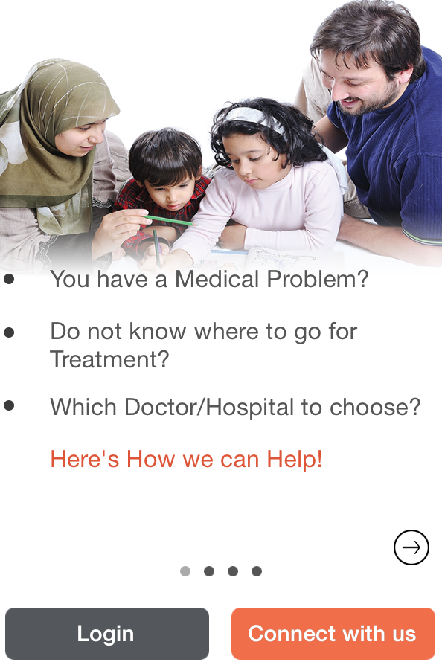
ihealthkonnect Solution- An Upcoming Healthcare Aggregator focused currently on Medical Tourism as a profitable revenue vertical
At Present ihealthkonnect Mobile App allows International users to
-Look for Best In Healthcare in India
-Connect to the Best Doctors, Best Hospitals Online for their medical condition
-Enhance’s network with Doctors who are influencers in Healthcare
-Healthcare, Medical Treatment to Fit Every Budget
-Upload Medical Reports and Records, carry them on the go
-Avail Free Medical Consultation
*

Slide 2
Healthcare sector – Pain Point ( Developing Countries)
Non Existent Healthcare in Africa, MENA , parts of Indian Subcontinent
-Lack of Specialist Doctors, Lack of Super Specialty Hospitals in Developing world
-Out of sync Doc:Patient Ratio( WHO Ratio 1:1000)
Kenya 8000 docs :40 million ( 1:5000)
Mozambique 550docs : 22 million (1:40000)
Iraq 14000 doc:35 million (1:2500)
-Concentration in Urban Centers- leads to a state of Perpetual Health crisis in Developing countries

Slide 3
Healthcare sector –Pain Point ( Developed World)
Excellent but Super Expensive Healthcare available in USA, Europe, Australia leads to Huge opportunity for medical tourism
-CABG in USA costs US$ 13300 vis a vis in US$ 6500 India
-Insurers looking cheaper options as cost of healthcare is exorbitant
-Underinsured or Un Insured Populations need for cheaper options
-Dental, Cosmetic, Plastic Surgeries are not covered by insurers

Slide 4
Price Comparison- Medical Procedures

Slide 5
ihealthkonnect – Opportunity
India Delivery
Half a Million Medical Tourists travelling to India, spending on an average
US$ 7000 is what we are looking at targeting
Bottoms Up, Addressable Market Size in 2015- 500000 x 1 % = 5000 Medical Patients x US$ 7000 = US$ 35000000, approximately Rs 213 cr
Estimated size in 2019, US$ 10 Billion
Bottoms Up, Addressable Market Size, 1% of the market- US$ 1 Billion
Global Delivery for Medical Tourism
Estimated Market Size in 2019- US$ 32.5 Billion
Bottoms Up Addressable Market Size 1%- US$ 3.25 Billion

Slide 6
THE BIG PICTURE- Medical Tourism in India- US$ 3.9 Billion, Global Medical Tourism- US$ 10 Billion
-Medical Tourism in India- US$ 3.9 Billion 2015, Estimated to US$ 10 Billion by 2019
Annual Growth Rate- 27% for the last 3 years
Global Medical Tourism Market- US$ 10 Billion 2015, US$ 32.5 Billion by 2019
Estimated Medical Arrivals Tourist Arrivals in India in 2015- 500,000
- India as a growing hub for medical tourism is leading to a huge
opportunity for Medical Tourism
* Source VCCircle Ficci Report, TMR Agencies USA for Global Medical Tourism

Slide 7
ihealthkonnect - The journey so far
Mobile app beta in Nov 2014, Formally launched in End Jan 2015 on both android and ios, - 5000+ downloads
-No of patient Queries- 7 for each day of advertising
-User Engagement – 250 Q & A’s pm since End Jan 2015
-Avg Income from Hospitals- Rs 2.5 lacs p.m, Business Generated for Partners – 1cr
-Notable Patients so far - Ugandan Health Minister & Family
Health Minister of Mozambique
Health Secretary- Namibia
-Call Center Operational, Access Via Skype, Whats app, Sms

Slide 8
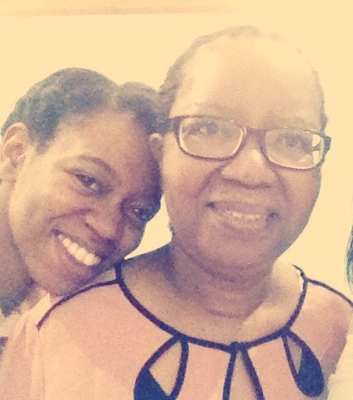
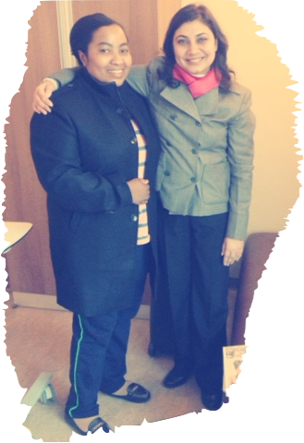

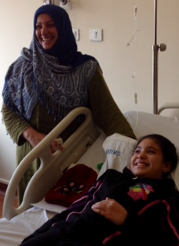
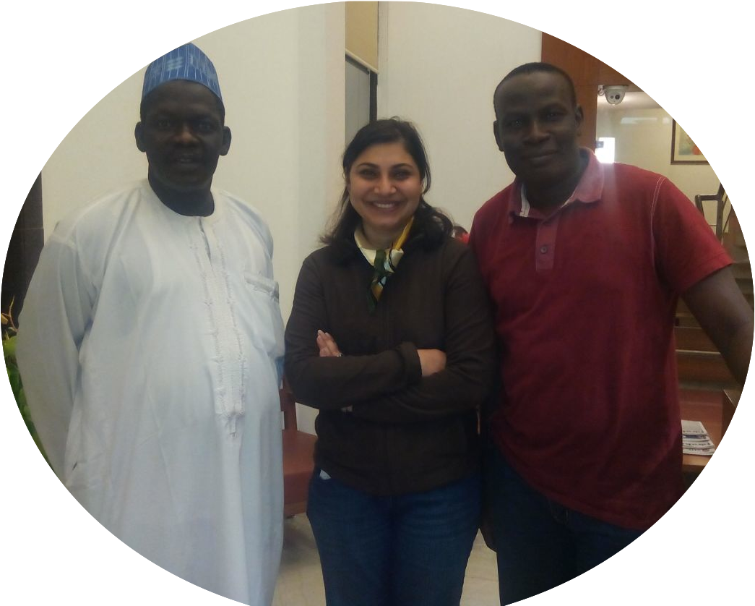
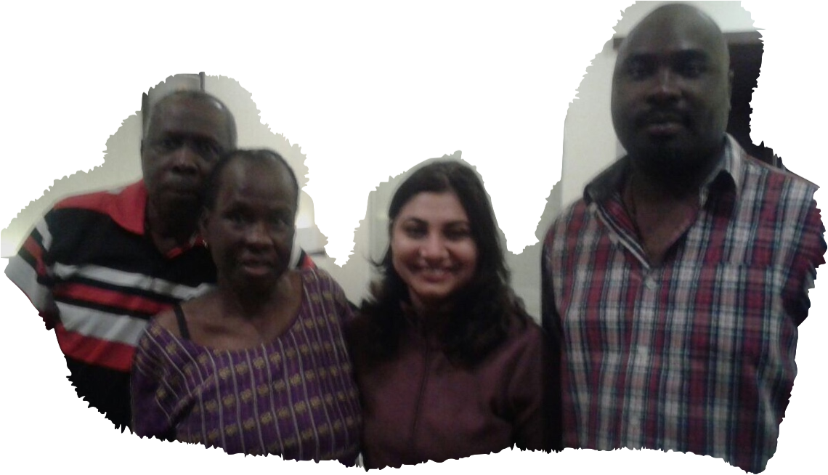
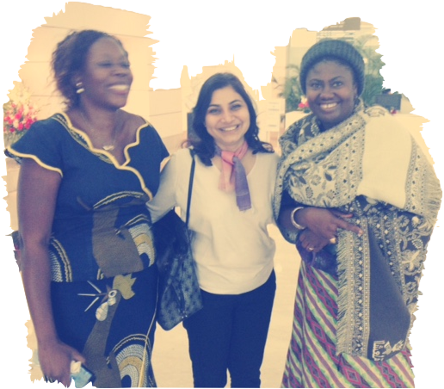
Current Current Revenue- Referral Fees
Current Users- Kenya, Nigeria, Tanzania,
Uganda, Ethiopia, South Sudan, Iraq

Slide 9
Sales Funnel

Slide 10
Go To Market
-Access to over 3000 doctors in the Referral network across Africa and MENA
-B2B partnerships in several countries to get patients to validate the business model quickly
( Insurers, NGO, Diagnostic Centers, Clinics)
- Partnerships with Non Profit Organizations to build patient network.
- Promotion of Mobile app through Medical camps
Cross Promotion of Mobile App to grab eye balls and downloads
SEO, SMO and other digital marketing activities
TV ads, Print Media and Outdoor Media would be utilized post fund raising for Brand Building

Slide 11
ihealthkonnect- A Bottoms Up Perspective
 | 2015 | 2016 | 2017 | 2018 | 2019
Gross Revenue | 1712200 | 51240000 | 144000000 | 648000000 | 1296000000
Expenses | 4721100 | 73709900 | 141475000 | 324723200 | 445245000
Net | 3008900 | 22469900 | 2525000 | 323276800 | 850755000

Slide 12
ihealthkonnect- Funding Requests
Half a million US $ - Funding Required for
Tap MENA, USA- Europe as Target Markets
- Investing and Up gradation of Technology
- Brand Building -Promotion of Mobile App, Marketing Costs
- Scaling up by having an Offline Model along with an Online Mobile solution
- 24 hrs Virtual Call Centre
- Investing in a good technology team

Slide 13

ihealthkonnect vs competition
 | Medical Tourism | EMHR to help patients with medical records and bills | Health Tips to Build on Daily App Engagement | Funding
Ihealthkonnect (India Focused, later expand to Global Delivery) |  |  |  | Bootstrapped
Medigo (Based in Germany, Not focused on India Delivery) |  |  |  | $9.1 million Accel , TA Ventures, Atlantic Internet

Slide 14
ihealthkonnect - Team India
Manisha Soin- An Alumnus from St. Stephens College, NIFT Delhi
I have helped scale up family business from a Rs 2 crore to a Rs 25 crore entity.
Marketing- Our marketing team consists of various Doctors and partnerships with healthcare providers in several countries which we have used to validate the model.
We have a backend team in India, of 3 which helps in Marketing Admin and Accounts.
Advisors- Mr. Rahul Narvekar- CEO, Founder Indian Roots , Serial Entrepreneur
Mr. Deepak Goel- Founder KarmaCircles
Mr. Sridhar Narayan- MD Global Environment Fund
Medical Director of a Chain of Hospitals

Slide 15
www.ihealthkonnect .com
Call Center +91-9560457555
Manisha Soin +91-9810884947
Sms, Whatsapp- +91-8800154449, Skype: ihealthkonnect
Email: manishasoin@ihealthkonnect.com
fb: www.facebook.com/ihealthkonnect
Twitter: @ManishaSoin1 @ihealthkonnect1
Linked in – http://www.linkedin.com/company/ihealthkonnect
https://in.linkedin.com/pub/manisha-soin/89/605/b88

