Slide 1
Lecture: 1
Review of Programming I

Slide 2
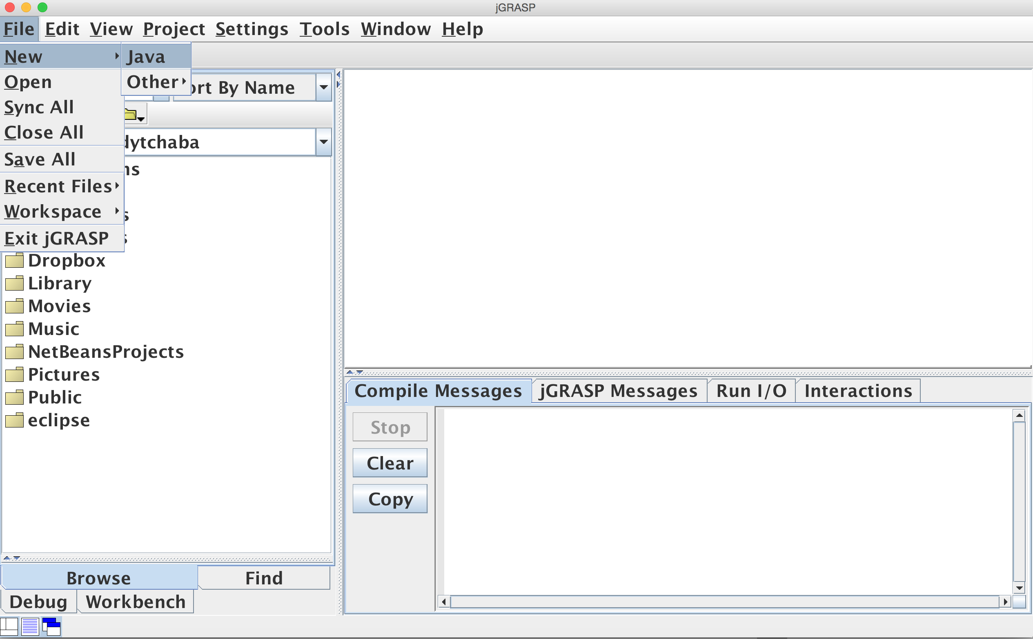
Creating A Class
Simply, open JGrasp, navigate to the menu bar
File >> New >> Java

Slide 3
Creating A Class
Your class name
public class MyFirstClass
{
public static void main(String[] args)
{
System.out.println("Hello World!");
}
}
- Your file should be saved with .java extension and the file name should match your file name.
- For example, The above file should be saved as:
MyFirstClass.java

Slide 4
Rules To Follow
The class name starts with a capital letter and every word in the class name starts with capital letter.
public class MyFirstClass
{
public static void main(String[] args)
{
System.out.println("Hello World!");
}
}

Slide 5
Rules To Follow
Every opening brace should have a closing brace.
public class MyFirstClass
{
public static void main(String[] args)
{
System.out.println("Hello World!");
}
}
Opening
Closing

Slide 6
Data Types
Numeric Data Types:
Java has six numeric data types for integers and Floating-point numbers.
byte
short
int
long
float
double

Slide 7
Data Types
Other Data Types:
boolean
  stores a boolean value, true or false.
char
  Stores a single character.

Slide 8
Variables
Variables are used to store values that might change during the program execution.
Every variable has a data type and name.
It only can be used after it is initialized.

Slide 9
Examples:
Data Type
Variable Name
Initial Value
int quantity = 5;
double price = 45.99;

Slide 10
Examples:
Data Type
Variable Name
int quantity = 5;
double price = 45.99;
Assignment Statement

Slide 11
Arithmetic Operators
+ Addition
- Subtraction
* Multiplication
/ Division
% Remainder

Slide 12
Arithmetic Operators/ Examples
int var1 = 16;
int var2 = 5;
int result = var1 + var2;
What’s the value of result now?
21
int var1 = 16;
int var2 = 5;
int result = var1 / var2;
What’s the value of result now?
3
Why not 3.2?
Because both var1 and var2 are integers, Java will perform an integer division, and the result will always be an integer.

Slide 13
Arithmetic Operators/ Examples
There are multiple ways to tell your program to do floating point division instead of integer division, here is one of them.
double var1 = 16;
double var2 = 5;
double result = var1 / var2;
What’s the value of result now?
3.2

Slide 14
Casting
Another way would be casting.
int var1 = 16;
int var2 = 5;
double result = (double)var1 / var2;
What’s the value of result now?
3.2

Slide 15

Assignments
int minutes = 43;
minutes++;
minutes = minutes + 1;
minutes = 55;
minutes--;
minutes = minutes – 4;
45
❌
❌
minutes:
43
❌
❌
55
54
50
❌
44

Slide 16
Arrays
Declaring an array requires to specify the data type the array will hold.
int[] integersArray;
double[] decimalsArray;
String[] stringArray;
float[] floatArray;
boolean[] booleanArray;
char[] charArray;
int integersArray[];
double decimalsArray[];
String stringArray[];
float floatArray[];
boolean booleanArray[];
char charArray[];

Slide 17
Arrays
Creating an array:
Declare & Create
int[] integersArray = new int[15];
double[] decimalsArray;
decimalArray = new double[20];
Declare Then Create

Slide 18
Arrays
Default values:
int[] integersArray = new int[4];
double[] decimalsArray = new double[10];
String[] stringArray = new String[5];
float[] floatArray = new float[12];
boolean[] booleanArray = new boolean[5];
char[] charArray = new char[5];
0
0.0
null
0.0
false
‘ \u0000 ’ which is null

Slide 19
Arrays
Initialization of arrays:
int[] integersArray = new int[4];
integersArray[0] = 13;
integersArray[1] = 29;
integersArray[2] = 75;
integersArray[3] = 59;

Slide 20
Arrays
Initialization of arrays:
int[] integersArray = {13, 29, 75, 59};

Slide 21
Arrays
Accessing array elements:
int[] integersArray = {13, 29, 75, 59};
System.out.println(integersArray[0]);
System.out.println(integersArray[1]);

Slide 22
Loops & Arrays
A loop can be used to access all the elements of an array.
The for loop is the perfect mechanism for stepping through array elements.
Remember that the first index of an array is:

Slide 23
A Example Works Better
Let’s declare, create and initialize an array named arr with 10 integers as follows:
int[] arr = {3, 6, 98, 45, 10, 54, 70, 36, 91, 104};
We want to print all those elements on separate lines using a for loop.

Slide 24
Memory
Output
i:
0
1
2
3
4
5
6
7
8
9
10
3
6
98
45
10
54
70
36
91
104
❌
public static void main(String[] args)
{
int[]arr = {3, 6, 98, 45, 10, 54, 70, 36, 91, 104};
for(int i = 0; i < arr.length; i++)
{
System.out.println(arr[i]);
}
}
❌
❌
❌
❌
❌
❌
❌
❌
❌

Slide 25
Methods
Methods are used to avoid code repetition.
It makes the code reusable and easier to maintain.
It might have a return type, or it can be void.

Slide 26
Methods
public static void main(String[] args)
{
int speed1 = 55;
int speed2 = 71;
int highestSpeed = max(speed1, speed2);
System.out.println(highestSpeed);
}
public static int max(int a, int b)
{
int result = 0;
if(a > b)
result = a;
else
result = b;
return result;
}
Example:
Output: 71
Access modifier
Return type

Slide 27
Arrays & Primitive Types
Arrays are objects, and they are passed to methods by reference.
Any change to the array in the method, will reflect the original array.
Primitive types are passed to methods by it’s value, any change won’t reflect the original value of the variable.

Slide 28
Arrays & Primitive Types
public static void main(String[] args)
{
int speed1 = 55;
changeVal(speed1);
System.out.println(speed1);
}
public static int changeVal(int speed1)
{
speed1 = 70;
}
Output: 55

Slide 29
Arrays & Primitive Types
public static void main(String[] args)
{
int[] speedArray = {50, 55, 60};
changeSpeed(speedArray);
System.out.println(speedArray[0]);
}
public static void changeSpeed(int[] speed)
{
speed[0] = 70;
}
Output: 70

Slide 30
Two Dimensional Arrays
  Data in a table can be represented using a two-dimensional (2D) array.
  Each element can be accessed through a row and column index.
  Each row of the 2D array is a 1D array.

Slide 31
What is a 2D Array?
  If we have multiple 1D arrays:
  Those separate 1D arrays can be represented by a 2D array.
array0
13 | 5 | 71 | 8 | 11
array0
13 | 5 | 71 | 8 | 11
21 | 6 | 19 | 4 | 27
5 | 62 | 106 | 8 | 3
2 | 5 | 7 | 91 | 539
array1
21 | 6 | 19 | 4 | 27
array1
array2
array2
5 | 62 | 106 | 8 | 3
array3
array3
2 | 5 | 7 | 91 | 539

Slide 32
Declare & Create a 2D Array
int[][] firstArray;
firstArray = new int [4][5];
int[][] firstArray = new int[4][5];
dataType[][] arrayName= new dataType[rows][columns];
Number of rows
Number of columns

Slide 33
Declare & Create a 2D Array
  Exactly like a single dimensional arrays, 2D arrays are objects.
  Arrays variables are called reference variables, because they reference an object in the memory.
  The array it self and all Java objects reside in a special place in the memory called the heap.

Slide 34
Initialize a 2D Array
int[][] x = new int[4][5];
x[0][0] = 13;
x[0][1] = 5;
x[0][2] = 71;
x[0][3] = 8;
x[0][4] = 11;
x[1][0] = 21;
x[1][1] = 6;
x[1][2] = 19;
x[1][3] = 4;
x[1][4] = 27;
x[2][0] = 5;
x[2][1] = 62;
x[2][2] = 106;
x[2][3] = 8;
x[2][4] = 3;
x[3][0] = 2;
x[3][1] = 5;
x[3][2] = 7;
x[3][3] = 91;
x[3][4] = 539;
Rows and Columns index start with 0 in 2D arrays

Slide 35
5 columns
[0]
[1]
[2]
[3]
[4]
13 | 5 | 71 | 8 | 11
21 | 6 | 19 | 4 | 27
5 | 62 | 106 | 8 | 3
2 | 5 | 7 | 91 | 539
[0]
[1]
4 rows
[2]
[3]

Slide 36
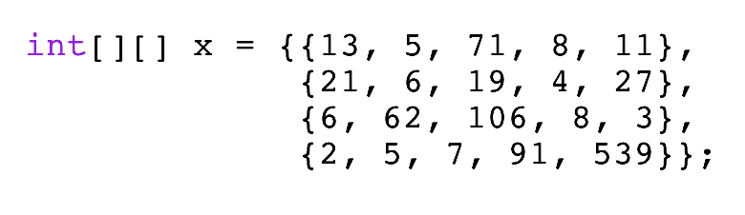

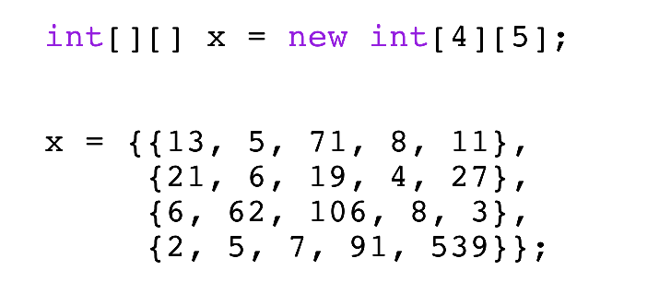

Initializing a 2D Array
  A 2D array can be declared, created and initialized in one step using the shorthand notation, known as array initializer.

Slide 37
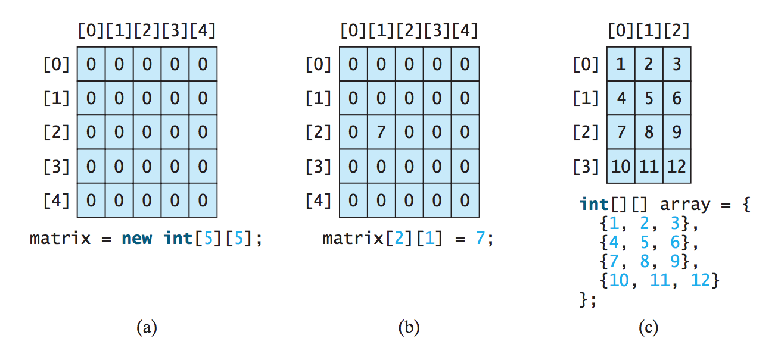

Slide 38
How to Access a 2D Array Elements?
  Each element is accessed by its row & column index.
  To print the element in the third row and second column, simply:
    System.out.println(x[2][1]);
  Remember: Row & column index always start at 0.

Slide 39
Example
System.out.println(x[0][2]);
[0]
[1]
[2]
[3]
[4]
System.out.println(x[2][1]);
13 | 5 | 71 | 8 | 11
21 | 6 | 19 | 4 | 27
5 | 62 | 106 | 8 | 3
2 | 5 | 7 | 91 | 539
[0]
[1]
[2]
[3]
❌
x[3][2] = 18;

Slide 40
Example
System.out.println(x[0][2]);
[0]
[1]
[2]
[3]
[4]
System.out.println(x[2][1]);
13 | 5 | 71 | 8 | 11
21 | 6 | 19 | 4 | 27
5 | 62 | 106 | 8 | 3
2 | 5 | 18 | 91 | 539
[0]
[1]
[2]
[3]
x[3][2] = 18;

Slide 41
Lengths of a 2D Array
  The length of a 2D array x is the number of rows x contains.
  We can obtain the length of the array using:
    x.length; returns 4
  To get the number of columns in a single row, we use:
    x[0].length; returns 5
    So far, all 2D arrays we worked with had the same number of columns for all rows, so x[0].length, x[1].length, x[2].length and x[3].length will have the same value.

Slide 42
Processing a 2D Array
  In most cases, nested loops are required.
  That means, we need a counter for the array rows and a counter for the array columns.
  If the array has n rows, the row indices are from 0 to n-1.
  If the array has m columns, the column indices are from 0 to m-1.

Slide 43
Printing a 2D Array
public class TwoDArray
{
public static void main(String[] args)
{
int[][] x = {{13, 5, 71, 8, 11},
{21, 6, 19, 4, 27},
{6, 62, 106, 8, 3},
{2, 5, 7, 91, 539}};
for(int row = 0; row < 4; row++)
{
System.out.print("Row " + row + ": ");
for(int col = 0; col < 5; col++)
{
System.out.print(x[row][col] + " ");
}
System.out.println();
}
}
}
row:
0
1
2
3
col:
0
1
2
3
4
0
1
2
3
4
0
1
2
3
4
0
1
2
3
4
Row 0:
13
5
71
8
11
Row 1:
21
6
19
4
27
Row 2:
6
62
106
8
3
Row 3:
2
5
7
91
539

Slide 44
Printing a 2D Array
public class TwoDArray
{
public static void main(String[] args)
{
int[][] x = {{13, 5, 71, 8, 11},
{21, 6, 19, 4, 27},
{6, 62, 106, 8, 3},
{2, 5, 7, 91, 539}};
for(int row = 0; row < x.length; row++)
{
System.out.print("Row " + row + ": ");
for(int col = 0; col < x[row].length; col++)
{
System.out.print(x[row][col] + " ");
}
System.out.println();
}
}
}
  Can we use the previous code on any array?
  If you said yes, Imagine if the other array has different number of rows and columns?
  The answer is NO.
  That’s why its important to use the length property!

Slide 45
Filling up an Array With User Input
import java.util.Scanner;
public class TwoDArray
{
public static void main(String[] args)
{
Scanner kbd = new Scanner(System.in);
System.out.print("Enter number of rows: ");
int numberOfRows = kbd.nextInt();
System.out.print("Enter number of columns: ");
int numberOfColumns = kbd.nextInt();
int[][] x = new int[numberOfRows][numberOfColumns];
System.out.print("Enter your numbers: ");
for(int row = 0; row < x.length; row++)
{
for(int col = 0; col < x[row].length; col++)
{
x[row][col] = kbd.nextInt();
}
}
for(int row = 0; row < x.length; row++)
{
for(int col = 0; col < x[row].length; col++)
{
System.out.print(x[row][col] + " ");
}
System.out.println();
}
}
}
Declare & Create the array with dimensions entered by the user
Fill up
Print

Slide 46
Passing Multidimensional Arrays to a Method
  Arrays are objects and passed by reference.
  Passing by reference means the memory address of the array is passed to the method.
  As a result, if the method does any changes to the array passed in, the changes will reflect the original array.
  It works the same way as passing a 1D array to a method.

Slide 47
Example
public class TwoDArrays
{
public static void main(String[] args)
{
int[][] x = {{1, 2, 3},
{4, 5, 6}};
changeArray(x);
System.out.println(x[0][0]);
System.out.println(x[0][1]);
}
public static void changeArray(int[][] array)
{
array[0][0] = array[0][0] * 10;
}
}
Output
Method call
10
2

Slide 48
Practice
  Create a 2D array with the n-by-n elements that has the following values.
  Find the sum of all elements of the array, then print the sum.
  Find the sum of the major diagonal elements, and print the result.
  Find the sum of the minor diagonal elements, and print the result.
3 6 13 9
5 29 30 25
21 25 12 19
31 25 15 14
[0]
[1]
[2]
[0]
Major
[1]
Minor
[2]

Slide 49
public static void main(String[] args)
{
int[][] x = {{3, 6, 13, 9},
{5, 29, 30, 25},
{21, 25, 12, 19},
{31, 25, 15, 14}};
int sumOfAll = 0;
int minor = 0;
int major = 0;
for(int row = 0; row < x.length; row++)
{
for(int col = 0; col < x[row].length; col++)
{
sumOfAll = sumOfAll + x[row][col];
if(row == col)
major = major + x[row][col];
if(row + col == x.length - 1)
minor = minor + x[row][col];
}
}
System.out.println("Sum of all elements: " + sumOfAll);
System.out.println("Sum of all major diagonal: " + major);
System.out.println("Sum of all minor diagonal: " + minor);
}

Slide 50
Practice
  Write a Java program that prompts the user to enter two integers n and m, and does the following:
  Create a 2D array with the n-by-m elements.
  Prompt the user to fill up the array.
  Find the largest element of the array, then print it.
  Modify the last program and use a method that takes a 2D array as a parameter and returns the largest element of that array.

Slide 51
Ragged Arrays
  Since each row of the 2D array is it self an array, rows can have different lengths.
  If different rows have different lengths, the 2D array is called a Ragged 2D array.
  Why we need ragged arrays?
  Suppose that we have 10 students, and we need to store the course grades for the 10 students in an array, We should use a ragged array since not all students are taking the same number of classes.

Slide 52
Ragged Arrays
array0
13 | 5 | 71 | 8
array1
array0
13 | 5 | 71 | 8
21 | 6 | 19
5 | 62
2
21 | 6 | 19
array1
array2
5 | 62
array2
array3
array3
2

Slide 53
Declare & Create a Ragged 2D Array
int[][] x = new int[4][];
x[0] = new int[4];
x[1] = new int[3];
x[2] = new int[2];
x[3] = new int[1];
x[0][0] = 13;
x[0][1] = 5;
x[0][2] = 71;
x[0][3] = 8;
x[1][0] = 21;
x[1][1] = 6;
x[1][2] = 19;
x[2][0] = 6;
x[2][1] = 62;
x[3][0] = 2;

Slide 54
Initializing a 2D Ragged Array
  A 2D ragged array can be declared, created and initialized in one step using the shorthand notation, known as array initializer.
int[][] x = {{13, 5, 71, 8},
{21, 6, 19},
{6, 62},
{2}};
int[][] x = new int[4][];
x[0] = new int[4];
x[1] = new int[3];
x[2] = new int[2];
x[3] = new int[1];
x = {{13, 5, 71, 8},
{21, 6, 19},
{6, 62},
{2}};

Slide 55
Lengths of a 2D Ragged Array
  The length of a 2D array x is the number of rows x contains.
  We can obtain the length of the array using:
    x.length; returns 4
  To get the number of columns in a single row, we use:
    x[0].length; returns 4
    x[1].length; returns 3
    x[2].length; returns 2
    x[3].length; returns 1
int[][] x = {{13, 5, 71, 8},
{21, 6, 19},
{6, 62},
{2}};

Slide 56
Processing a Ragged Array
  Using the previous array x, write a JAVA program to print:
  The sum of all the elements of x
  The maximum value in x
  The minimum value in x

Slide 57
public static void main(String[] args)
{
int[][] x = {{13, 5, 71, 8},
{21, 6, 19},
{6, 62},
{2}};
int sum = 0;
int max = x[0][0];
int min = x[0][0];
for(int row = 0; row < x.length; row++)
{
for(int col = 0; col <x[row].length; col++)
{
sum += x[row][col];
if(x[row][col] > max)
max = x[row][col];
if(x[row][col] < min)
min = x[row][col];
}
}
System.out.println("Sum of all elements: " + sum);
System.out.println("Maximum: " + max);
System.out.println("Minimum: " + min);
}

Slide 58
See you on Tuesday

