Slide 1
Lecture: 11
Exception Handling

Slide 2
What is an Exception
An exception is some type of an error or unusual event that is encountered by a program and must be dealt with.
Also it’s known as error trapping.
How does that happen? No matter how good programmer you are, things might go wrong during program execution.
If your program is designed to read a file during execution and that file is not there?

Slide 3
What is an Exception
Exception handling enables a program to deal with an exceptional situation then continue it’s normal execution.
Runtime errors occur while a program is running if the JVM detects an operation that is impossible to carry out.
For example, if you access an array using an index that is out of bounds, you will get a runtime error with an ArrayIndexOutOfBoundsException.
In Java, runtime errors are thrown as exceptions.
If the exception is not handled, the program will terminate abnormally.

Slide 4
What is an Exception
An exception is an object that represents an error or a condition that prevents execution from proceeding normally.
exceptions are objects of type Exception.
java.util.Exception extends Throwable.
The root class for exceptions is java.lang.Throwable which inherits directly from java.lang.Object.
Exception class has 75 child classes and each child class has many subclasses.
Creating an object of exception is called throwing an exception.

Slide 5
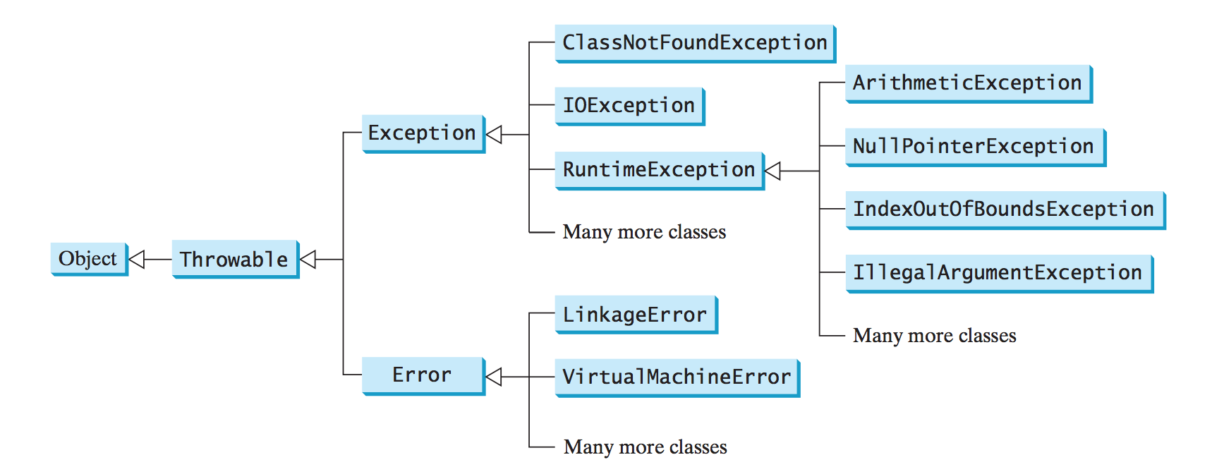
What is an Exception
The Throwable class is the root of exception classes. All Java exception classes inherit directly or indirectly from Throwable.

Slide 6
try-catch Block
try
{
// code to be executed in normal circumstances
// an exception is thrown
// more code
}
catch(Exception ex)
{
// handle the exception and recover
}
try block should be followed by catch block.
The catch block is like a method with a parameter(but it’s not a method).
The reference variable ex looks like a method variable, and is local to the catch block.

Slide 7
try-catch Block
try
{
// code to be executed in normal circumstances
// an exception is thrown
// more code
}
catch(Exception ex)
{
// handle the exception and recover
}
If no exception arise during the execution of the try block, the catch block is skipped.
If an exception arises, an exception object is thrown and passed to the catch block as a parameter, then the code in the catch block is executed.
The class name Exception indicates that the thrown exception must be of type Exception.

Slide 8
Would this code work perfectly all the time?
public static void main(String[] args)
{
Scanner kbd = new Scanner(System.in);
System.out.print("Enter two integers: ");
int n1 = kbd.nextInt();
int n2 = kbd.nextInt();
System.out.println(n1 + "/" + n2 + " is: " + (n1/n2));
}
Enter two integers: 5 2
5/2 is: 2
What happen when n2 is 0?
Enter two integers: 5 0
Exception in thread "main" java.lang.ArithmeticException: / by zero
at Ex.main(Ex.java:11)

Slide 9
Would this code work perfectly all the time?
public static void main(String[] args)
{
Scanner kbd = new Scanner(System.in);
System.out.print("Enter two integers: ");
int n1 = kbd.nextInt();
int n2 = kbd.nextInt();
if(n2 != 0)
System.out.println(n1 + "/" + n2 + " is: " + (n1/n2));
else
System.out.println("Can not divide by 0");
}
Though the above code addresses the problem, but this is not exception handling

Slide 10
public static void main(String[] args)
{
Scanner kbd = new Scanner(System.in);
System.out.print("Enter two integers: ");
int n1 = kbd.nextInt();
int n2 = kbd.nextInt();
try
{
if(n2 == 0)
throw new ArithmeticException();
else
System.out.println(n1 + "/" + n2 + " is: " + (n1/n2));
}
catch(ArithmeticException ex)
{
System.out.println("Can not divide by 0");
}
System.out.println("Continue Execution");
}
If n2 is zero, the code will throw ArithmeticException
The catch block will be executed.
The program control moves to the code after the catch block.

Slide 11
public static void main(String[] args)
{
Scanner kbd = new Scanner(System.in);
System.out.print("Enter two integers: ");
int n1 = kbd.nextInt();
int n2 = kbd.nextInt();
try
{
if(n2 == 0)
throw new ArithmeticException();
else
System.out.println(n1 + "/" + n2 + " is: " + (n1/n2));
}
catch(ArithmeticException ex)
{
System.out.println("Can not divide by 0");
}
System.out.println("Continue Execution");
}
Sample Runs:
Enter two integers: 5 2
5/2 is: 2
Continue Execution
Enter two integers: 6 0
Can not divide by 0
Continue Execution

Slide 12
public static void main(String[] args)
{
Scanner kbd = new Scanner(System.in);
System.out.print("Enter two integers: ");
int n1 = kbd.nextInt();
int n2 = kbd.nextInt();
try
{
if(n2 == 0)
throw new ArithmeticException();
else
System.out.println(n1 + "/" + n2 + " is: " + (n1/n2));
}
catch(Exception ex)
{
System.out.println("Can not divide by 0");
}
System.out.println("Continue Execution");
}
Is it possible to have the data type of ex as Execption instead ArithmeticExcpeption?
Yes, but How?
Polymorphism!
ArithmeticException extends RuntimeException
RuntimeException extends Exception
Exception extends Throwable.

Slide 14
Methods and Exceptions
Methods can throw exceptions when something goes wrong during the runtime.
If the method throws an exception, the method call should be inside try-catch block.
A method can throw more than one exception.

Slide 15

What happen if the method throws an exception that’s not handled?
public static void main(String[] args)
{
Scanner kbd = new Scanner(System.in);
System.out.print("Enter two integers: ");
int n1 = kbd.nextInt();
int n2 = kbd.nextInt();
int res = divide(n1, n2);
System.out.println(n1 + "/" + n2 + " is: " + res);
System.out.println("Continue Execution");
}
public static int divide(int n1, int n2)
{
int res = n1 / n2;
return res;
}
Enter two integers: 6 2
6/2 is: 3
Continue Execution
Enter two integers: 6 0
Exception in thread "main" java.lang.ArithmeticException
at ExceptionExamples.divide(ExceptionExamples.java:20)
at ExceptionExamples.main(ExceptionExamples.java:11)

Slide 16
If n2 is zero, the code will throw ArithmeticException
Execution will immediately stop and the method will throw the exception back to the main method.
The catch block will be executed.
The program control moves to the code after the catch block.
public static void main(String[] args)
{
Scanner kbd = new Scanner(System.in);
System.out.print("Enter two integers: ");
int n1 = kbd.nextInt();
int n2 = kbd.nextInt();
try
{
int res = divide(n1, n2);
System.out.println(n1 + "/" + n2 + " is: " + res);
}
catch(ArithmeticException ex)
{
System.out.println("Can not divide by 0");
}
System.out.println("Continue Execution");
}
public static int divide(int n1, int n2)
{
if(n2 == 0)
throw new ArithmeticException();
else
return n1 / n2;
}
Sample Runs:
Enter two integers: 6 2
6/2 is: 3
Continue Execution
Enter two integers: 4 0
Can not divide by 0
Continue Execution

Slide 17
Example
import java.util.*;
public class ExceptionExamples
{
public static void main(String[] args)
{
Scanner kbd = new Scanner(System.in);
int n;
do
{
System.out.print("Enter an positive integer: ");
n = kbd.nextInt();
}while(n < 1);
System.out.println("n is: " + n);
System.out.println("End");
}
}
Enter an integer: tree
Exception in thread "main" java.util.InputMismatchException
at java.util.Scanner.throwFor(Scanner.java:864)
at java.util.Scanner.next(Scanner.java:1485)
at java.util.Scanner.nextInt(Scanner.java:2117)
at java.util.Scanner.nextInt(Scanner.java:2076)
at ExceptionExamples.main(ExceptionExamples.java:11)
What would happen if the user enters a String instead of an integer?

Slide 18
InputMismatchException
Thrown by a Scanner to indicate that the token retrieved does not match the pattern for the expected type, or that the token is out of range for the expected type.
InputMismatchException extends NoSuchElementException
NoSuchElementException extends RuntimeException
RuntimeException extends Exception
Exception extends Throwable

Slide 19
InputMismatchException
public static void main(String[] args)
{
Scanner kbd = new Scanner(System.in);
int n = 0;
do
{
System.out.print("Enter a positive integers: ");
try
{
n = kbd.nextInt();
}
catch(InputMismatchException ex)
{
System.out.println("Not an integer, try again");
kbd.nextLine();
}
}while(n <= 0);
System.out.println("n is: " + n);
System.out.println("End");
}
If n is not an integer, the code will throw:
InputMismatchException
The catch block will be executed.
Sample Run:
Enter a positive integers: tree
Not an integer, try again
Enter a positive integers: -9
Enter a positive integers: 4
n is: 4
End

Slide 20
NumberFormatException
Thrown to indicate that the application has attempted to convert a string to one of the numeric types, but that the string does not have the appropriate format.
NumberFormatException extends IllegalArgumentException
IllegalArgumentException extends RuntimeException
RuntimeException extends Exception
Exception extends Throwable

Slide 21
NumberFormatException
Which methods throw NumberFormatException?
Integer.parseInt(str)
Double.parseDouble(str)
Long.parseLong(str)
Integer.valueOf(str)
Double.valueOf(str)
Long.valueOf(str)
And many more.

Slide 22
NumberFormatException
If s is not a numeric String, the code will throw
NumberFormatException
The catch block will be executed.
public static void main(String[] args)
{
Scanner kbd = new Scanner(System.in);
String s = "";
do
{
System.out.print("Enter an integer or Q to quit: ");
try
{
s = kbd.nextLine();
int n = Integer.valueOf(s);
System.out.println("n is : " + n);
}
catch(NumberFormatException ex)
{
if(!s.equals("Q"))
{
System.out.println("Not an integer, try again");
}
}
}while(!s.equals("Q"));
System.out.println("Bye!");
}
Enter an integer or Q to quit: Test
Not an integer, try again
Enter an integer or Q to quit: k
Not an integer, try again
Enter an integer or Q to quit: 65
n is : 65
Enter an integer or Q to quit: q
Not an integer, try again
Enter an integer or Q to quit: Q
Bye!

Slide 23
ArrayIndexOutOfBoundsException
Thrown to indicate that an array has been accessed with an illegal index. The index is either negative or greater than or equal to the size of the array.
ArrayIndexOutOfBoundsException extends IndexOutOfBoundsException
IndexOutOfBoundsException extends RuntimeException
RuntimeException extends Exception
Exception extends Throwable

Slide 24
Example
import java.util.*;
public class ExceptionExamples
{
public static void main(String[] args)
{
char[] chArray = {'b', 't', 'd', 'k'};
System.out.println(chArray[7]);
}
}
Exception in thread "main" java.lang.ArrayIndexOutOfBoundsException: 7
at ExceptionExamples.main(ExceptionExamples.java:8)
What would happen if we try to print the element at index 7?

Slide 25
ArrayIndexOutOfBoundsException
If we try to access an array index that’s not valid, the code will throw
ArrayIndexOutOfBoundsException
The catch block will be executed.
public static void main(String[] args)
{
char[] chArray = {'b', 't', 'd', 'k'};
try
{
System.out.println(chArray[2]);
System.out.println(chArray[7]);
}
catch(ArrayIndexOutOfBoundsException ex)
{
System.out.println("Not a valid index");
}
System.out.println("Bye");
}
Sample Run:
d
Not a valid index
Bye

Slide 26
StringIndexOutOfBoundsException
Thrown by String methods to indicate that an index is either negative or greater than the size of the string. For some methods such as the charAt method, this exception also is thrown when the index is equal to the size of the string.
StringIndexOutOfBoundsException extends IndexOutOfBoundsException
IndexOutOfBoundsException extends RuntimeException
RuntimeException extends Exception
Exception extends Throwable

Slide 27
Example
import java.util.*;
public class ExceptionExamples
{
public static void main(String[] args)
{
String s= "ABCD";
System.out.println(s.charAt(2));
System.out.println(s.charAt(10));
System.out.println("Bye");
}
}
C
xception in thread "main" java.lang.StringIndexOutOfBoundsException: String index out of range: 10
at java.lang.String.charAt(String.java:658)
at ExceptionExamples.main(ExceptionExamples.java:10)
What would happen if we try to print the character at index 10?

Slide 28
StringIndexOutOfBoundsException
If we try to access a String index that’s not valid, the code will throw
StringIndexOutOfBoundsException
The catch block will be executed.
public static void main(String[] args)
{
String s= "ABCD";
try
{
System.out.println(s.charAt(2));
System.out.println(s.charAt(10));
}
catch(StringIndexOutOfBoundsException ex)
{
System.out.println("Not a valid index");
}
System.out.println("Bye");
}
Sample Run:
C
Not a valid index
Bye

Slide 29
IllegalArgumentException
Thrown to indicate that a method has been passed an illegal or inappropriate argument.
IllegalArgumentException extends RuntimeException
RuntimeException extends Exception
Exception extends Throwable

Slide 30
IllegalArgumentException
public static void main(String[] args)
{
int[] a = {4, 9, 13, 9};
try
{
int sum = sumOfFirstTen(a);
System.out.print(sum);
}
catch(IllegalArgumentException ex)
{
System.out.println(ex.getMessage());
}
}
public static int sumOfFirstTen(int[] a)
{
if(a.length < 10)
throw new IllegalArgumentException("Length less than 10");
int sum = 0;
for(int i = 0; i < 10; i++)
sum += a[i];
return sum;
}
The method will throw IllegalArgumentException
The catch block will be executed.
Sample Runs:
Length less than 10

Slide 31
IllegalStateException
Thrown to indicate that a method has been invoked at an illegal or inappropriate time. In other words, the Java environment or Java application is not in an appropriate state for the requested operation.
IllegalStateException extends RuntimeException
RuntimeException extends Exception
Exception extends Throwable

Slide 32
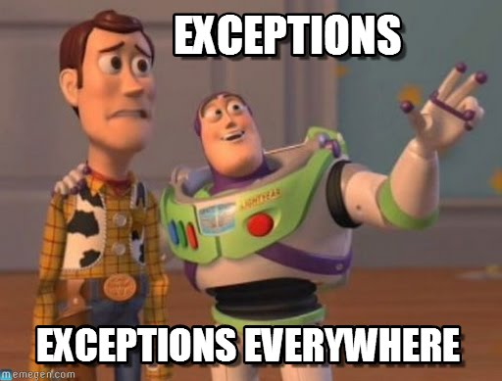
That’s all for today
Read chapter 12
No homework this week.
Enjoy the Research Lab

