Slide 1
Lecture: 12
Exception Handling

Slide 2
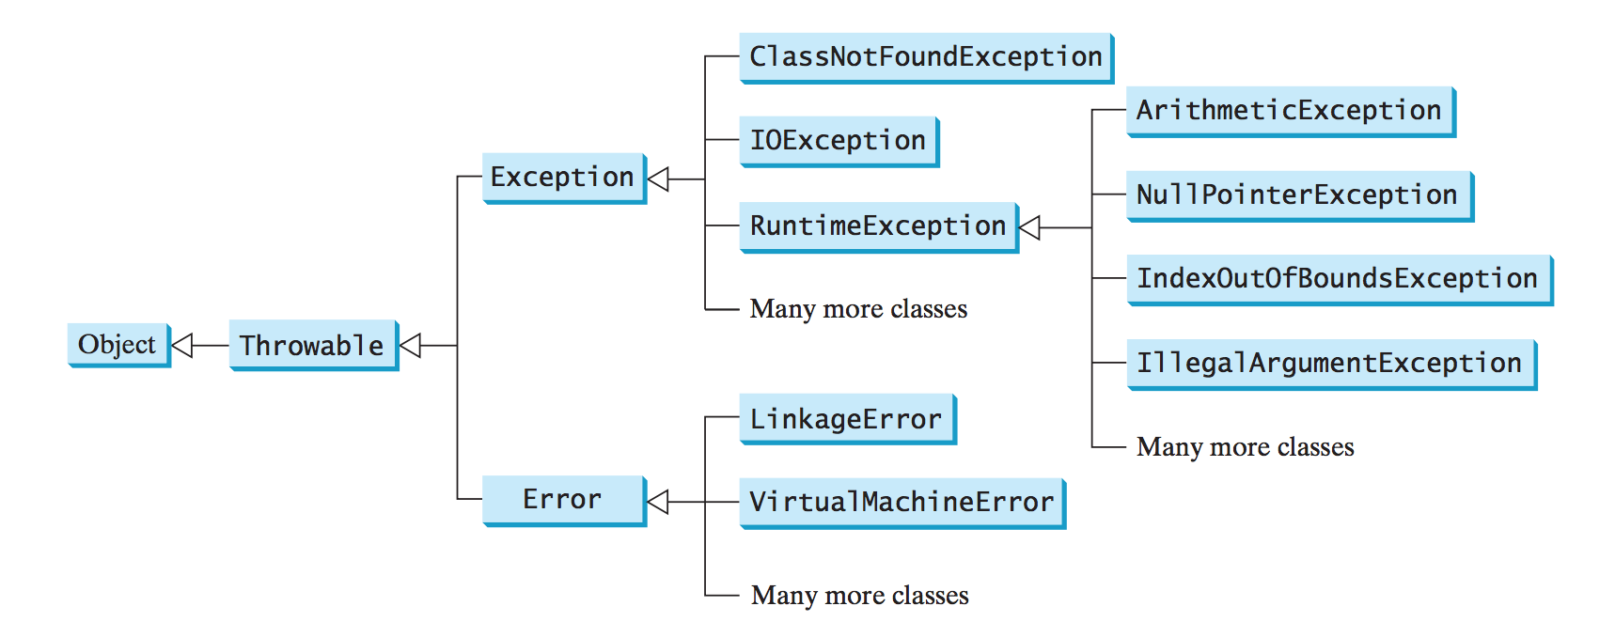

Slide 3
Multiple catch Blocks
In some cases, a method can throw more than one exception.
To do so, multiple catch blocks are needed.
Each catch block will handle one exception.

Slide 4
Multiple catch Blocks
public static void main(String[] args)
{
Scanner kbd = new Scanner(System.in);
int[] arr = {3, 90, 45, 75};
int n = 0;
try
{
System.out.print("Enter an integer for index: ");
n = kbd.nextInt();
System.out.println(arr[n]);
}
catch(ArrayIndexOutOfBoundsException ex)
{
System.out.println("Not a valid index.");
}
catch(InputMismatchException ex)
{
System.out.println("Not a valid integer.");
}
}
If the user enters an integer that’s not a valid index, the code will throw ArrayIndexOutOfBoundsException
If the user enters a non-integer value, the code will throw InputMismatchException
The proper catch block will be executed for each case.

Slide 5
Multiple catch Blocks
Sample Runs:
public static void main(String[] args)
{
Scanner kbd = new Scanner(System.in);
int[] arr = {3, 90, 45, 75};
int n = 0;
try
{
System.out.print("Enter an integer for index: ");
n = kbd.nextInt();
System.out.println(arr[n]);
}
catch(ArrayIndexOutOfBoundsException ex)
{
System.out.println("Not a valid index.");
}
catch(InputMismatchException ex)
{
System.out.println("Not a valid integer.");
}
System.out.println("Bye");
}
Enter an integer for index: 6
Not a valid index.
Bye
Enter an integer for index: d
Not a valid integer.
Bye
Enter an integer for index: 2
45
Bye

Slide 6
Multiple catch Blocks
public static void main(String[] args)
{
Scanner kbd = new Scanner(System.in);
int[] arr = {3, 90, 45, 75};
int n = 0;
try
{
System.out.print("Enter an integer for index: ");
n = kbd.nextInt();
System.out.println(arr[n]);
}
catch(Exception ex)
{
System.out.println("Catch them all.");
}
}
If you still want to have only one catch block, That’s possible but How it’s possible?
Polymorphism
Sample Runs:
Enter an integer for index: 7
Catch them all
Bye
Enter an integer for index: b
Catch them all
Bye

Slide 7
Multiple catch Blocks Rules
If no exceptions arise during the execution of the try block, the catch blocks are skipped.
Each catch block is examined in turn from first to last, to see whether the type of the exception object is an instance of the exception class in the catch block.
Each catch block will handle one exception.

Slide 8
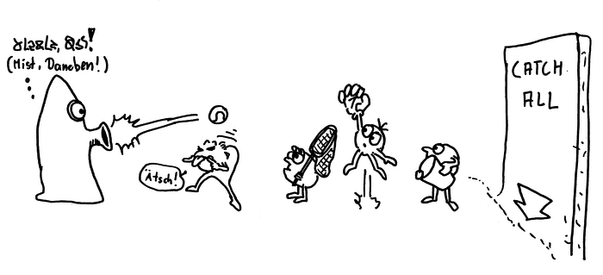


Multiple catch Blocks
try
{
//Code to execute
}
catch(RuntimeException e)
{
//Handle an exception
}
catch(Exception e)
{
//Handle an exception
}
try
{
//Code to execute
}
catch(Exception e)
{
//Handle an exception
}
catch(RuntimeException e)
{
//Handle an exception
}
The order in which exceptions are specified in catch blocks is important. A compile error will result if a catch block for a superclass type appears before a catch block for a subclass type.

Slide 9
Multiple catch Blocks

Slide 10
Getting Information from an Exception
An exception object contains valuable information about the exception.
We can use 3 useful methods in the java.lang.Throwable class to get information about an exception.
getMessage(): Returns the message that describes this exception object.
toString(): Returns the concatenation of three strings: (1) the full name of the exception class; (2) ":" (a colon and a space); (3) the getMessage() method.
printStackTrace(): Prints the Throwable object and its call stack trace information on the console.

Slide 11
A Method to throw an Exception
Let’s go back to the example we did earlier to divide an integer by another one.
Let’s set our method to throw an exception.
Also, let’s use the previous 3 methods from the java.lang.Throwable class.

Slide 12
public static void main(String[] args)
{
Scanner kbd = new Scanner(System.in);
System.out.print("Enter two integers: ");
int n1 = kbd.nextInt();
int n2 = kbd.nextInt();
try
{
int res = divide(n1, n2);
System.out.println(n1 + "/" + n2 + " is: " + res);
}
catch(ArithmeticException ex)
{
System.out.println(ex.getMessage());
System.out.println(ex.toString());
ex.printStackTrace();
}
System.out.println("Continue Execution");
}
public static int divide(int n1, int n2)
{
if(n2 == 0)
throw new ArithmeticException("Cannot divide by zero");
else
return n1 / n2;
}
Output:
Enter two integers: 8 0
Cannot divide by zero
java.lang.ArithmeticException: Cannot divide by zero
java.lang.ArithmeticException: Cannot divide by zero
at ExcepExamples.divide(ExcepExamples.java:45)
at ExcepExamples.main(ExcepExamples.java:21)

Slide 13
Enter two integers: 8 0
Cannot divide by zero
java.lang.ArithmeticException: Cannot divide by zero
java.lang.ArithmeticException: Cannot divide by zero
at ExcepExamples.divide(ExcepExamples.java:45)
at ExcepExamples.main(ExcepExamples.java:21)
ex.getMessage()
ex.toString()
ex.printStackTrace()

Slide 14
The finally clause
The finally clause is always executed regardless whether an exception occurred or not.
Occasionally, you may want some code to be executed regardless of whether an exception occurs or is caught.
The finally clause will be executed no matter what, even if there is a return statement in the method.

Slide 15
public static void main(String[] args)
{
  Scanner kbd = new Scanner(System.in);
try
{
System.out.print("Enter an integers: ");
int n1 = kbd.nextInt();
}
catch(InputMismatchException ex)
{
System.out.println("Not an integer.");
return;
}
finally
{
System.out.println("Print this no matter what.");
}
System.out.println("Bye.");
}
Output:
Enter an integers: 9.4
Not an integer.
Print this no matter what.

Slide 16
public static void main(String[] args)
{
  Scanner kbd = new Scanner(System.in);
try
{
System.out.print("Enter an integers: ");
int n1 = kbd.nextInt();
}
catch(InputMismatchException ex)
{
System.out.println("Not an integer.");
}
finally
{
System.out.println("Print this no matter what.");
}
System.out.println("Bye.");
}
Output:
Enter an integers: 9.4
Not an integer.
Print this no matter what.
Bye.

Slide 17
Rules for having try-catch-finally blocks
catch and finally blocks can’t exist without a try block.
try block must be followed by a catch or finally block.
No code should go between try-catch-finally blocks.

Slide 18

When to use Exceptions
Simple errors that can be handled by using if-else statement doesn’t require exception handling.
Use exceptions to handle unexpected errors, like Input Mismatch.
Do not handle too many exceptions in your code, it makes your code hard to read and trace.
If it’s a checked exception, it must be handled(Discussed later).

Slide 19

That’s all for today
Read chapter 12

