Slide 1
Lecture: 13
Exception Handling
The File Class
Chapter 12

Slide 2
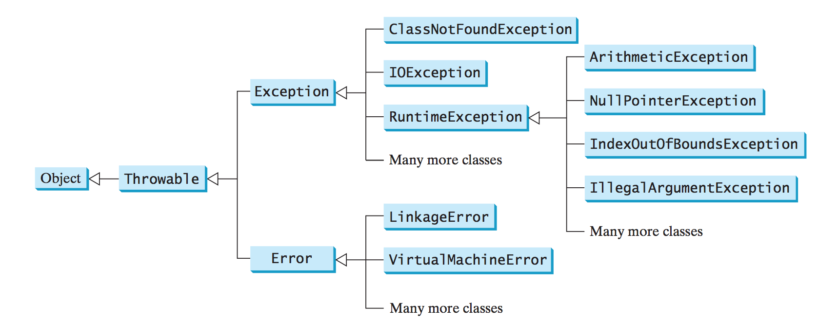

Slide 3
Checked and Unchecked Exceptions
Checked Exceptions: The compiler forces the programmer to check and deal with them in a try-catch block or declare it in the method header.
Basically, RuntimeExcpetion and Error with all their subclasses are known as unchecked exceptions.
All other exceptions are known as checked exceptions.
If it’s a checked exception, it must be handled.

Slide 4
The File class
The File class contains the methods for obtaining the properties of a file/directory and for renaming and deleting a file/directory.
Data stored in the program are temporary; they are lost when the program terminates.
To permanently store the data created in a program, you need to save them in a file on a disk or other permanent storage device.
The File class exist in the java.io package, so, the following import statement is required,
import java.io.File;

Slide 5
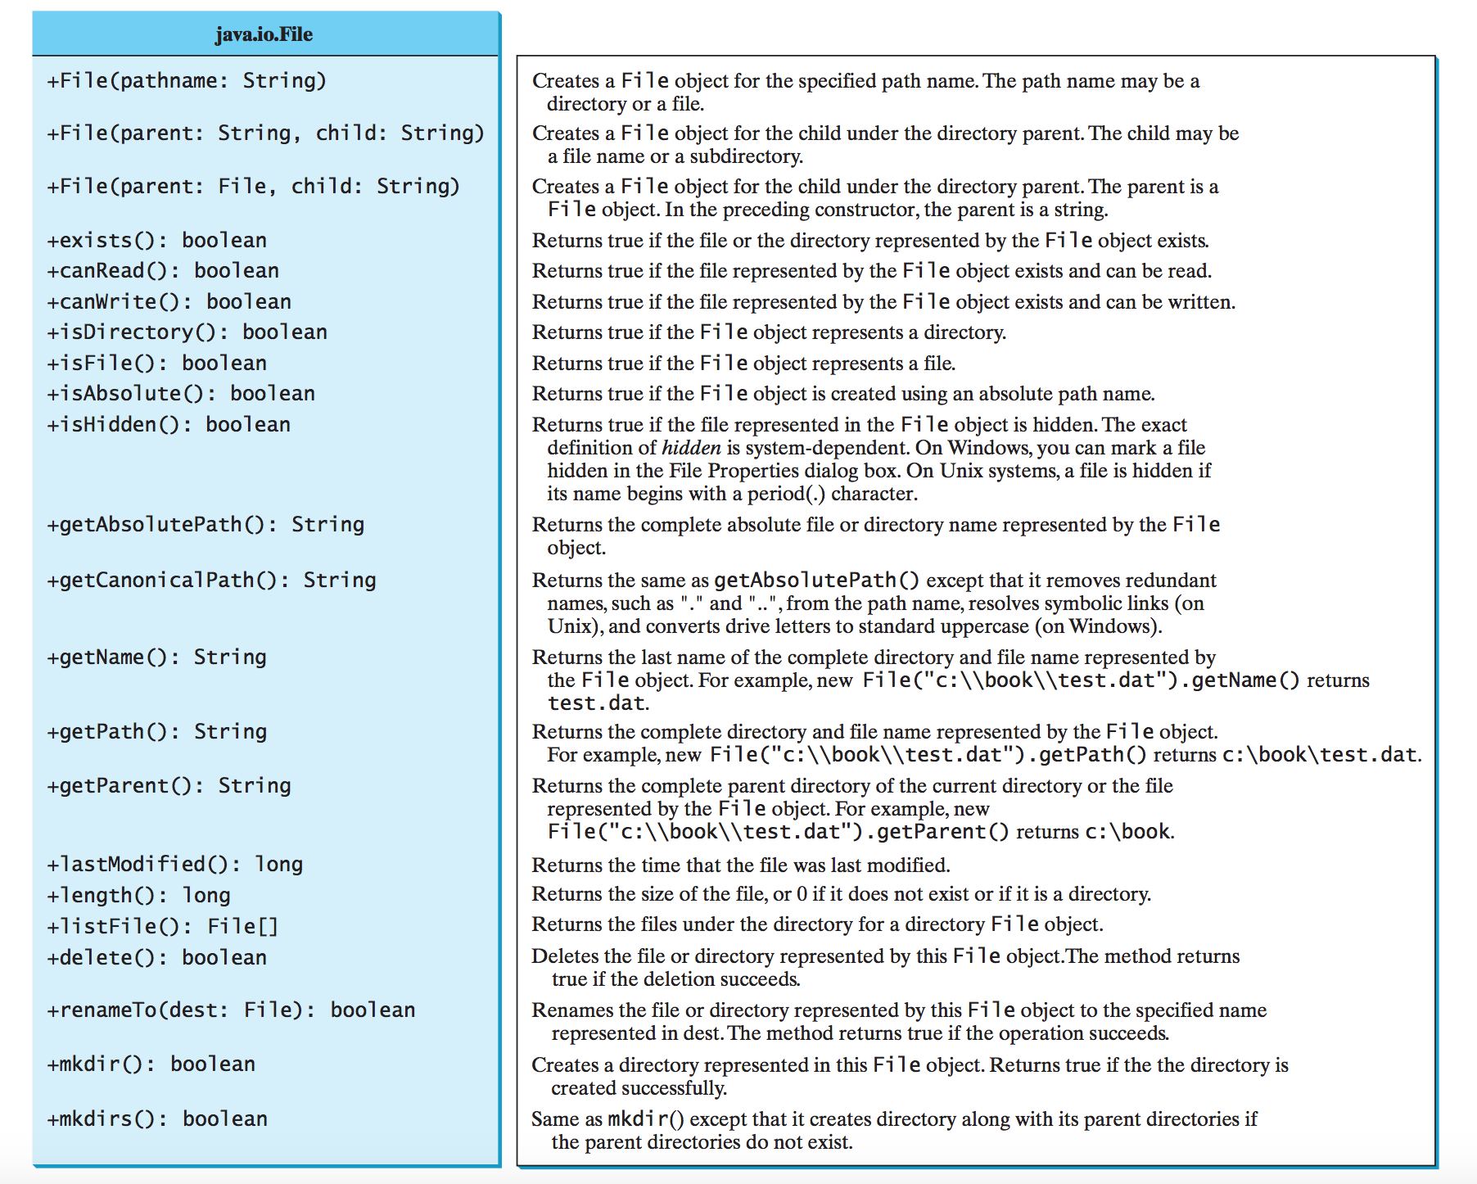
The File class UML diagram
This is all what you have to know from the File class.

Slide 6
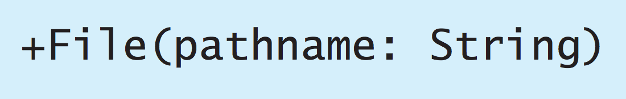
To access a file, we should specify the complete path the file resides in, or the file should reside in the current working directory .
An absolute file name (or full name) contains a file name with its complete path and drive letter.
On Windows: "c:\\Documents\\data.txt"
On Mac: "/Users/Username/data.txt"
A relative file name is in relation to the current working directory.
On Windows: "data.txt"
On Mac: "data.txt"

Slide 7
Using The Scanner class to Read a File
File f = new File("data.txt");
Scanner inputFile = new Scanner(f);
If the file doesn’t exist, a FileNotFoundException is thrown, this is a checked exception and must be handled.
So, the statement should go into a try-catch block.

Slide 8
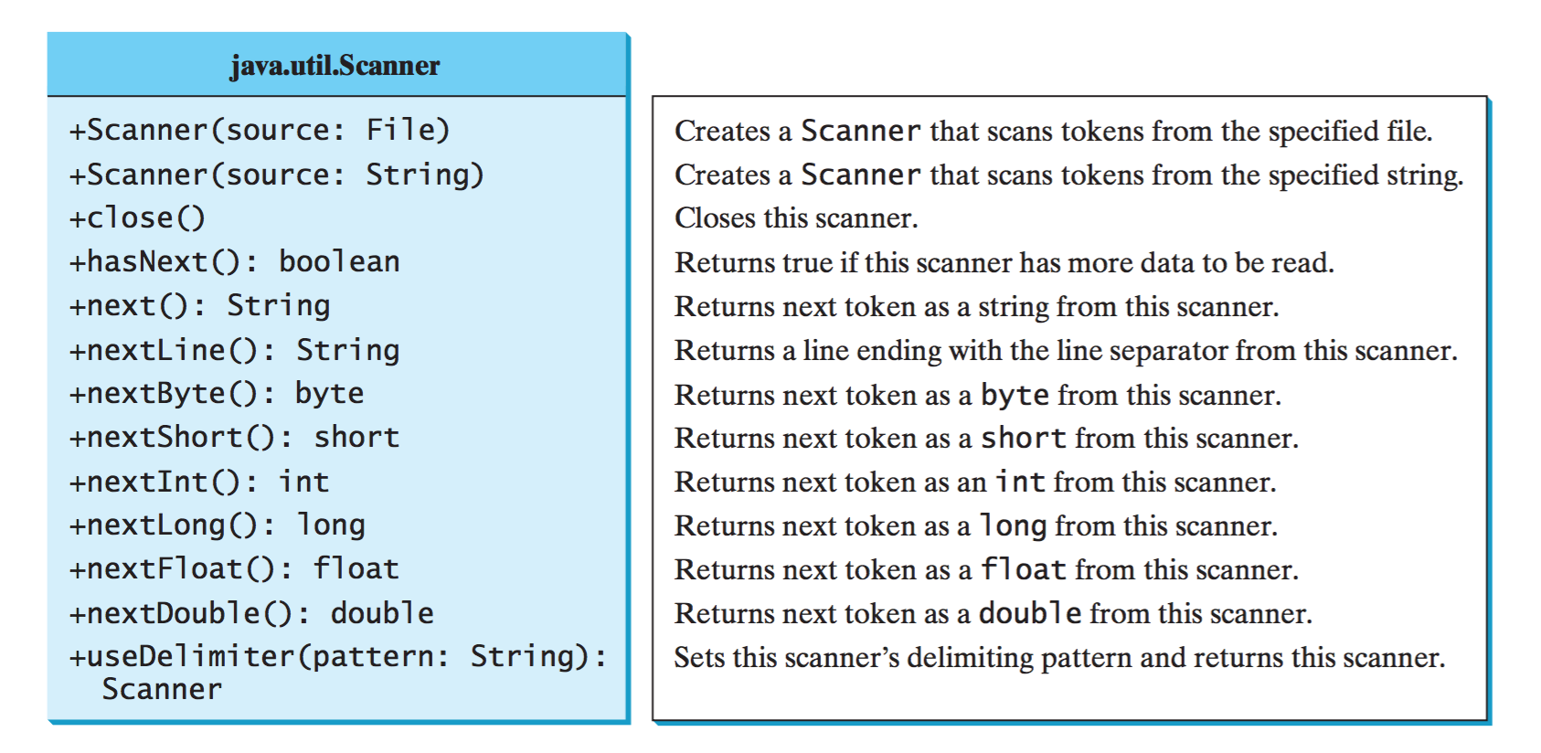
The Scanner class UML Diagram
The default delimiter is a white space.

Slide 9
import java.util.*;
import java.io.*;
public class FilesExamples
{
public static void main(String[] args)
{
File f = new File("data.txt");
try
{
Scanner inputFile = new Scanner(f);
while(inputFile.hasNext())
{
String s = inputFile.next();
int n = inputFile.nextInt();
System.out.println("Name: " + s + "\tID: " + n);
}
inputFile.close();
}
catch(FileNotFoundException ex)
{
System.out.print("File not found.");
}
}
}
data.txt
Samantha 4332
Micheal 9832
John 8938
Mary 3428
Output:
Name: Samantha ID: 4332
Name: Micheal ID: 9832
Name: John ID: 8938
Name: Mary ID: 3428

Slide 10
import java.util.*;
import java.io.*;
public class FilesExamples
{
public static void main(String[] args)
{
int sum = 0;
int count = 0;
double average = 0;
File f = new File("data.txt");
try
{
Scanner inputFile = new Scanner(f);
while(inputFile.hasNext())
{
String s = inputFile.next();
int n = inputFile.nextInt();
System.out.println("Course: " + s + "\tScore: " + n);
sum += n;
count++;
}
average = (double)sum / count;
System.out.println("Average: " + average);
inputFile.close();
}
catch(FileNotFoundException ex)
{
System.out.print("File not found.");
}
}
}
data.txt
Math 75
Reading 92
Writing 89
Science 91
Output:
Course: Math Score: 75
Course: Reading Score: 92
Course: Writing Score: 89
Course: Science Score: 91
Average: 86.75

Slide 11
import java.util.*;
import java.io.*;
public class FilesExamples
{
public static void main(String[] args)
{
File f = new File("data.txt");
double sum = 0;
try
{
Scanner inputFile = new Scanner(f);
while(inputFile.hasNext())
{
String s = inputFile.nextLine();
String[] str = s.split(" ");
for(int i = 0; i < str.length; i = i + 2)
{
System.out.print("Food: " + str[i]);
System.out.println("Price: " + str[i+1]);
sum = sum + Double.parseDouble(str[i+1]);
}
}
System.out.println("Total Calories: " + sum);
inputFile.close();
}
catch(FileNotFoundException ex)
{
System.out.print("File not found.");
}
}
}
data.txt
Banana 1.99
Broccoli 1.28
Egg 5.99
Cheeseburger 12.99
Output:
Food: Banana Price: 1.99
Food: Broccoli Price: 1.28
Food: Egg Price: 5.99
Food: Cheeseburger Price: 12.99
Total Price: 22.25

Slide 12
Declaring Exceptions
Every method must state the types of checked exceptions it might throw.
This is known as declaring exceptions.
Java does not require that you declare Error and RuntimeException (unchecked exceptions) explicitly in the method.
All other exceptions thrown by the method must be explicitly declared in the method header so that the caller of the method is informed of the exception.

Slide 13
import java.util.*;
import java.io.*;
public class FilesExamples
{
public static void main(String[] args)
{
try
{
readFile();
}
catch(FileNotFoundException ex)
{
System.out.print("File not found.");
}
}
public static void readFile() throws FileNotFoundException
{
File f = new File("data.txt");
Scanner inputFile = new Scanner(f);
while(inputFile.hasNext())
{
String s = inputFile.next();
int n = inputFile.nextInt();
System.out.println("Name: " + s + "\tID: " + n);
}
inputFile.close();
}
}
data.txt
Samantha 4332
Micheal 9832
John 8938
Mary 3428
Output:
Name: Samantha ID: 4332
Name: Micheal ID: 9832
Name: John ID: 8938
Name: Mary ID: 3428

Slide 14
try-with-resources
Programmers often forget to close the file.
JDK 7 provides the followings new try-with- resources syntax that automatically closes the files.
A resource is declared and created after the keyword try.
the resources are enclosed in the parentheses.
try (declare and create resources)
{
Use the resource to process the file;
}

Slide 15
import java.util.*;
import java.io.*;
public class FilesExamples2
{
public static void main(String[] args)
{
File f = new File("data.txt");
try(Scanner inputFile = new Scanner(f);)
{
while(inputFile.hasNext())
{
String s1 = inputFile.next();
String s2 = inputFile.next();
int n = inputFile.nextInt();
System.out.println("Name: " + s1 + " " + s2 + "\tID: " + n);
}
}
catch(FileNotFoundException ex)
{
System.out.print("File not found.");
}
}
}
data.txt
Samantha 4332
Micheal 9832
John 8938
Mary 3428
Output:
Name: Samantha ID: 4332
Name: Micheal ID: 9832
Name: John ID: 8938
Name: Mary ID: 3428

Slide 16
Practice: (Fall 2016 Final Exam)
Write the divisibleby10() method below so that it does the following:
  Reads the input from the numbers.txt file (sample provided below). You do not know how many lines are in the file. The sample provided is just an example of the file format.
  Determines whether the number on each line ends with a zero. If it does, print out the result of dividing the number by 10. Otherwise, print out "Not divisible by 10". Your code should work for integers of any size.
  Keep a count of the numbers that have been divided by 10 and display that value (matching the sample output format exactly) after processing the entire file. Note that the sample output displays this value as "xxx" since only a sample of the file has been provided.
  Handles a FileNotFoundException by printing out "File not found".
Sample of numbers.txt:
Sample output:
2300000010
125
57910298875933729478339273111382700
250
...
230000001
Not divisible by 10
5791029887593372947833927311138270
25
...
Count: xxx

Slide 17
public static void divisibleBy10()
{
try
{
File f = new File("numbers.txt");
Scanner in = new Scanner(f);
int count = 0;
while (in.hasNext())
{
String s = in.next();
BigInteger b = new BigInteger(s);
BigInteger r = b.mod(BigInteger.TEN);
if (r.equals(BigInteger.ZERO))
{
count++;
System.out.println(b.divide(BigInteger.TEN));
}
else
System.out.println("Not divisible by 10");
}
System.out.println("Count: " + count);
}
catch (FileNotFoundException e)
{
System.out.println("File not found");
}
}

Slide 18
That’s all for today

