Slide 1
Lecture: 2
Objects & Classes
Part I
Chapter 9, Sections 1-5, 13-14

Slide 2
Object Oriented Programming
Programming using objects.
  Enables to develop large-scale software's.
  Think about an object as an entity in the real world that can distinctly identified.
  For Example, a student, a desk, a circle, a button or even a loan can all viewed as an object.
  An object has a unique identity, state & behavior.

Slide 3
Object Oriented Programming
The state of an object (also known as properties or attributes) is represented by data fields and their current values.
  The behavior of an object (also known as its actions) is defined by methods.

Slide 4
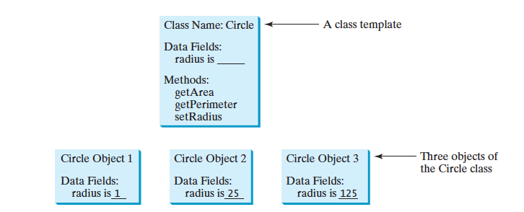
Object

Slide 5
What is a Class?
  A class is NOT an object.
It’s a blue print or template for an object.
It defines what an object’s data fields and methods will be.

Slide 6
Creating a class
  Each class is saved in a separate file which has .java extension.
Since you’ll be using jGrasp, every class should be compiled.
We only can run classes that have main() method, the others are just to be compiled.

Slide 7
Relationship
  An object is an instance of a class.
You can create many instances of a class.
Creating an instance is referred to as instantiation.
The terms object and instance are interchangeable.

Slide 8
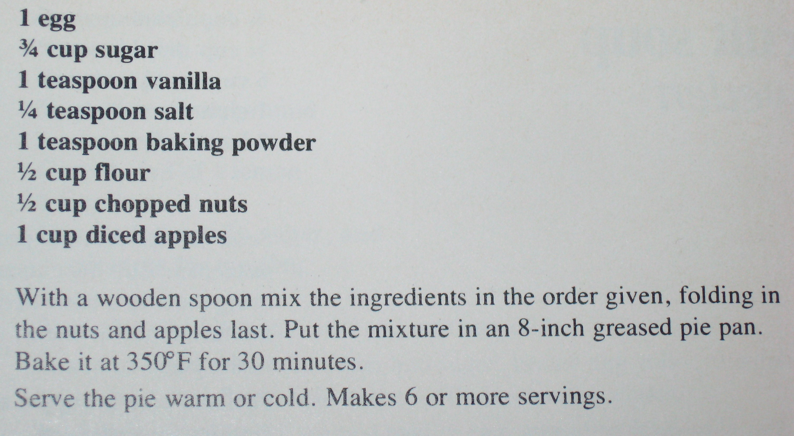
Relationship
  Think of a class as a apple-pie recipe and an object as an apple-pie.
  You can use the same recipe to make many apple-pies.

Slide 9
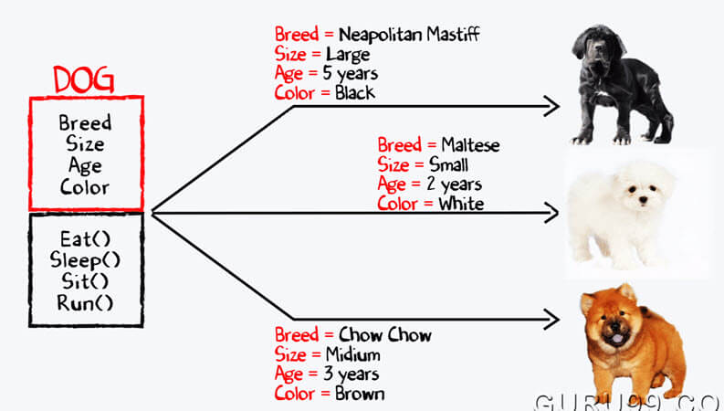
Relationship

Slide 10
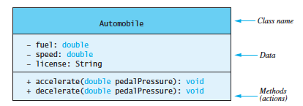
UML
  Universal Modeling Language.
A graphical representation of a class properties.
Class Name
Instance Variables
Constructors & Methods
+ sign means public variable/method
- sign means private variable/method

Slide 11
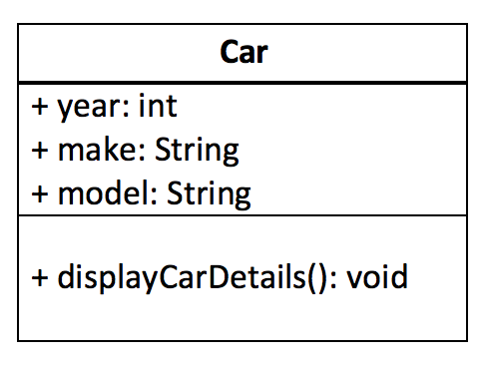
Creating a class
Instance Variables
public class Car
{
public int year;
public String make;
public String model;
public void displayCarDetails()
{
System.out.println("Beautiful Car!");
}
}
Method
UML Diagram

Slide 12
Instance Variables
  Things the object know about it self.
They hold the object’s data.
Every object of the class has it’s own version(values) of the instance variable.
In the Circle example, radius is an instance variable because each instance of Circle has it’s own value for radius.
Instance variables can be accessed from anywhere in the class.

Slide 13
Default Values of Instance Variables
  Unlike local variables, Java assigns a default value for instance variables.
    int: 0
    double: 0.0
    String: null
    char: \u0000
    boolean: false
    Reference variable: null

Slide 14
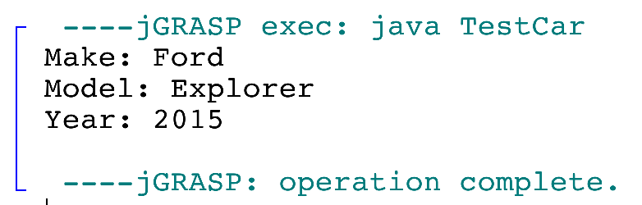
Let’s try all that!
public class Car
{
public int year;
public String make;
public String model;
public void displayCarDetails()
{
System.out.println("Make: " + this.make);
System.out.println("Model: " + this.model);
System.out.println("Year: " + this.year);
}
}
public class TestCar
{
public static void main(String[] args)
{
Car c = new Car();
c.year = 2015;
c.make = "Ford";
c.model = "Explorer";
c.displayCarDetails();
}
}

Slide 15
The new Operator
The new operator in java is responsible for the creation of a new object (aka an instance of a class).
It dynamically allocates memory in the heap with the variable/reference name we defined pointed from the stack.
Dynamic allocation means that the memory is allocated at run-time.
It is followed by a special method called a constructor (discussed later).
Because of that, variables for objects are called reference variables.

Slide 16
The dot (.) Operator
After an object is created, it’s data can be accessed and it’s methods can be invoked using the dot operator.
public class TestCar
{
public static void main(String[] args)
{
Car c = new Car();
c.year = 2015;
c.make = "Ford";
c.model = "Explorer";
c.displayCarDetails();
}
}
Calls year on the object c
Calls make on the object c
Calls model on the object c
Calls the method displayCarDetails() on the object c

Slide 17
The this keyword
The keyword this is used to refer to the calling object.
It can be used to reference the object’s instance variables or methods.
It can be used in a constructor to invoke another constructor of the same class.
It helps to explicitly differentiate the instance variables from the local variables.

Slide 18
The this keyword
public class Car
{
public int year;
public String make;
public String model;
public void displayCarDetails()
{
System.out.println("Make: " + this.make);
System.out.println("Model: " + this.model);
System.out.println("Year: " + this.year);
}
}
this keyword
You are required to use the keyword this for all your homework & exams for this class.

Slide 19
Constructors
Constructors have one & only one role, to instantiate an object.
Car c = new Car();

Slide 20
Constructors
Constructors have the same name as the class itself.
Have NO return type, not even void.
Constructors are invoked using the new operator when an object is created.
You can have multiple constructors for the same class, but the parameter list should be different.
Constructors can be overloaded(you can have more than one constructor), same rules for method overloading are applied for constructors.

Slide 21
Constructors
Constructors can be overloaded(you can have more than one constructor), same rules for method overloading are applied for constructors.
If you don’t define your own constructor, Java provides a default constructor which has no parameters, it’s called no-arg constructor.
Once you define a constructor, Java will no longer define one for you.

Slide 22
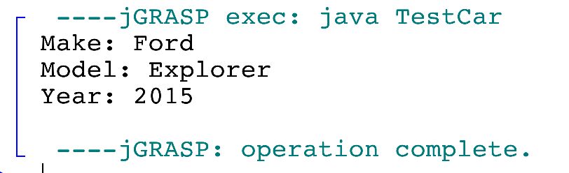
Constructors
Constructor
public class Car
{
public int year;
public String make;
public String model;
public Car(int year, String make, String model)
{
this.year = year;
this.make = make;
this.model = model;
}
public void displayCarDetails()
{
System.out.println("Make: " + this.make);
System.out.println("Model: " + this.model);
System.out.println("Year: " + this.year);
}
}
public class TestCar
{
public static void main(String[] args)
{
Car c = new Car(2015, "Ford", "Explorer");
c.displayCarDetails();
}
}

Slide 23
Constructors
public class Car
{
public int year;
public String make;
public String model;
public Car(int year, String make, String model)
{
this.year = year;
this.make = make;
this.model = model;
}
public void displayCarDetails()
{
System.out.println("Make: " + this.make);
System.out.println("Model: " + this.model);
System.out.println("Year: " + this.year);
}
}
public class TestCar
{
public static void main(String[] args)
{
Car c = new Car(2015, "Ford", "Explorer");
c.displayCarDetails();
}
}

Slide 24
See you on Thursday

