Slide 1
Lecture: 3
Objects & Classes
Part II
Chapter 9, Sections 7-12

Slide 2
Object Oriented Programming
Programming using objects.
  Enables to develop large-scale software's.
  Think about an object as an entity in the real world that can distinctly identified.
  For Example, a student, a desk, a circle, a button or even a loan can all viewed as an object.
  An object has a unique identity, state & behavior.

Slide 3
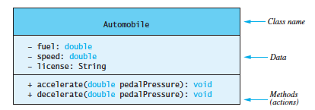
UML
  Universal Modeling Language.
A graphical representation of a class properties.
Class Name
Instance Variables
Constructors & Methods
+ sign means public variable/method
- sign means private variable/method

Slide 4
Method Overloading
Methods are overloaded one of three ways:
  Change the number of parameters.
    Change the type of parameters.
    Change the order of parameters, as long as not all parameters are of the same type.
  Changing the return type is not overloading.

Slide 5
Method Overloading
public class Overloading
{
public static void main(String[] args)
{
int x = sum(1, 2);
int y = sum(1, 2, 10);
int z = sum(30, 40, 8, 1);
System.out.println(x);
System.out.println(y);
System.out.println(z);
}
public static int sum(int a, int b)
{
return a + b;
}
public static int sum(int a, int b, int c)
{
return a + b + c;
}
public static int sum(int a, int b, int c, int d)
{
return a + b + c + d;
}
}
Original Method
Overloaded version
Overloaded version

Slide 6
Constructors
Constructors have the same name as the class itself.
Have NO return type, not even void.
Constructors are invoked using the new operator when an object is created.
You can have multiple constructors for the same class, but the parameter list should be different.
Constructors can be overloaded(you can have more than one constructor), same rules for method overloading are applied for constructors.

Slide 7
Constructors
Constructors can be overloaded(you can have more than one constructor), same rules for method overloading are applied for constructors.
If you don’t define your own constructor, Java provides a default constructor which has no parameters, it’s called no-arg constructor.
Once you define a constructor, Java will no longer define one for you.

Slide 8
Constructors
public class Item
{
public double price;
public int quantity;
public Item(double p, int q)
{
this.price = p;
this.quantity = q;
}
public Item(double p)
{
this.price = p;
this.quantity = 10;
}
public double totalPrice()
{
double total = this.price * this.quantity;
return total;
}
}
public class TestItem
{
public static void main(String[] args)
{
Item item1 = new Item(1.99, 5);
double total1 = item1.totalPrice();
System.out.println("Total price for item1: " + total1);
Item item2 = new Item(1.99);
double total2 = item2.totalPrice();
System.out.println("Total price for item1: " + total2);
}
}
Output:
Total price for item1: 9.95
Total price for item1: 19.9

Slide 9
Static Variables
Static variables are shared by all objects of the class.
Static variables store values for variables in a common memory location.
Because of the common location, if one object changes the value of a static variable, all objects of the same class are affected.
A static variable is initialized when a class is first loaded, NOT each time an instance of the class is created.
Static variables belong to the class, but NOT an object of the class.

Slide 10
When to use Static Variables or Instance Variables
When a variable is not dependent on an instance of a class, it should be declared as static variable.
When a variable is dependent on an instance of a class, it should be declared as instance variable.
Number of cars is not dependent on an instance of Car class, It should be static.
Radius of a circle should be an instance variable because each circle object has it’s own value for radius.

Slide 11
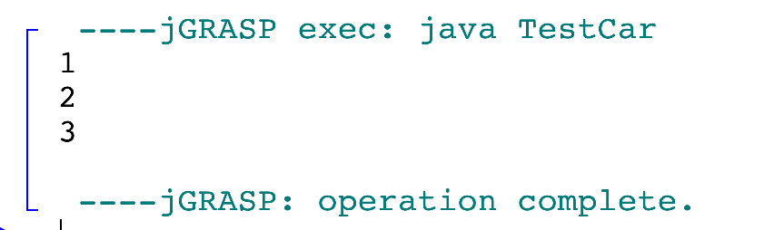
Static Variable
public class Car
{
public static int numberOfCars = 0;
public int year;
public String make;
public String model;
public Car(int year, String make, String model)
{
this.year = year;
this.make = make;
this.model = model;
numberOfCars++;
}
public void displayCarDetails()
{
System.out.println("Make: " + this.make);
System.out.println("Model: " + this.model);
System.out.println("Year: " + this.year);
}
}
public class TestCar
{
public static void main(String[] args)
{
Car c1 = new Car(2015, "Ford", "Explorer");
System.out.println(Car.numberOfCars);
Car c2 = new Car(2014, "Nissan", "Altima");
System.out.println(Car.numberOfCars);
Car c3 = new Car(2015, "Toyota", "Rav4");
System.out.println(Car.numberOfCars);
}
}

Slide 12
Static Methods
They follow almost the same rules as static variables.
A static method cannot access a non-static variable.
A static method cannot invoke a non-static method.
A static method can be invoked two ways, either by class name or by object/reference variable.

Slide 13
Static Methods
Why a static method cannot access a non-static variable or non-static method?
Because static methods are not dependent on a specific object, they don’t know which object’s instance variables/methods they should use.
They can return a value or nothing(void).

Slide 14
Constants
Constants are static, but declared as final
Example: the constant PI is declared as final in the Math class.
final static double PI = 3.14159265358979323846

Slide 15
Packages
A package is used to organize classes.
If a class is defined without package, it’s placed in the default package
Did we use packages before? Yes
  Java.util.Scanner
    Which uses the Scanner class for the java.util package.
  Java.lang.Math
    Which uses the Math class for the java.lang package.

Slide 16
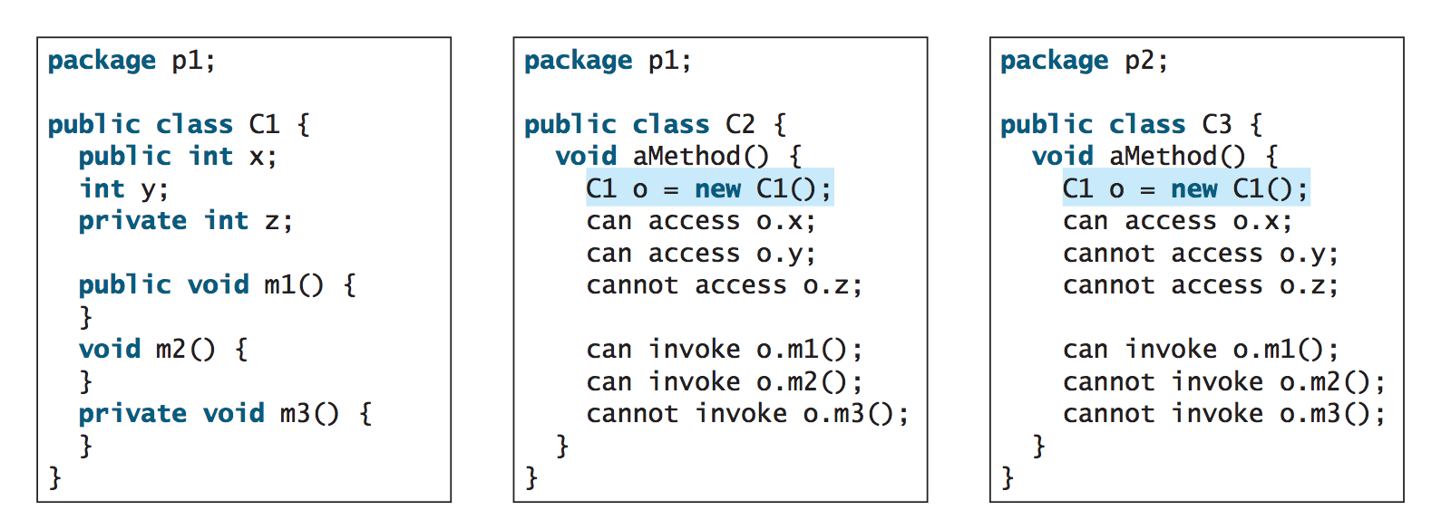

Slide 17
Visibility/Access Modifiers
Visibility Modifiers can be used to specify the visibility of a class and its members.
public: a class, method or a data field can be accessed from any other class.
private: methods and data fields can be accessed only from the class they belong to.
default or package-private: a class, method or data field can be accessed only from a class in the same package. This is the default access modifier if no other access modifier is used.
protected: to be discussed later on in the course.

Slide 18
See you on Thursday

