Slide 1
Lecture: 4
Objects & Classes
Part III
Chapter 9, Sections 6-12

Slide 2
Visibility/Access Modifiers
Visibility Modifiers can be used to specify the visibility of a class and its members.
public: a class, method or a data field can be accessed from any other class.
private: methods and data fields can be accessed only from the class they belong to.
default or package-private: a class, method or data field can be accessed only from a class in the same package. This is the default access modifier if no other access modifier is used.
protected: to be discussed later on in the course.

Slide 3
Encapsulation
Known as Information Hiding
So far, we have been leaving all our data as public, which means anyone can access/modify them.
Making data fields private protects data and makes the class easy to maintain.
A private data field cannot be accessed by any object from outside the class that defines the private data field.

Slide 4
How to Hide the Data?
Basically, we make all instance variables private.
Define getters and setters methods to access the data(getters are also know as accessors, and setters are known as mutators).
Make the getters and setters public.
If the return type of a getter method is boolean, the method defined as isPropertyName().

Slide 5
public class Car
{
private int year;
public Car(int year)
{
this.year = year;
}
public void setYear(int year)
{
this.year = year;
}
public int getYear()
{
return this.year;
}
}
Setter method, it has no return type(void)
Getter method, it has return type

Slide 6
public class Car
{
private int year;
public Car(int year)
{
this.year = year;
}
public void setYear(int year)
{
this.year = year;
}
public int getYear()
{
return this.year;
}
}
import java.util.Scanner;
public class TestCar
{
public static void main(String[] args)
{
Scanner kbd = new Scanner(System.in);
Car c1 = new Car(2015);
System.out.print("Enter an integer: ");
int in = kbd.nextInt();
c1.setYear(in);
int y = c1.getYear();
System.out.println("Year: " + y);
}
}
Output:
Enter an integer: 2050
Year: 2050

Slide 7
public class Car
{
private int year;
public Car(int year)
{
this.year = year;
}
public void setYear(int year)
{
if(year < 1885)
this.year = 1885;
else if(year > 2018)
this.year = 2018;
else
this.year = year;
}
public int getYear()
{
return this.year;
}
}
import java.util.Scanner;
public class TestCar
{
public static void main(String[] args)
{
Scanner kbd = new Scanner(System.in);
Car c1 = new Car(2015);
System.out.print("Enter an integer: ");
int in = kbd.nextInt();
c1.setYear(in);
int y = c1.getYear();
System.out.println("Year: " + y);
}
}
Sample outputs:
Enter an integer: 1800
Year: 1885
Enter an integer: 2000
Year: 2000
Enter an integer: 2019
Year: 2018

Slide 8
Objects Equality
public class Car
{
private int year;
private String make;
private String model;
public Car(int year, String make, String model)
{
this.year = year;
this.make = make;
this.model = model;
}
}

Slide 9
Objects Equality
You would expect the output to be ”Equal”
Though c1 & c2 have the same values for the data fields, the objects c1 & c2 are not equal.
The == operator checks if the objects have the same memory location.
public class TestCar
{
public static void main(String[] args)
{
Car c1 = new Car(2015, "Ford", "Explorer");
Car c2 = new Car(2015, "Ford", "Explorer");
if(c1 == c2)
System.out.println("Equal");
else
System.out.println("Not Equal");
}
}

Slide 10
Objects Equality
Yes, You can create methods that have class type parameters.
public class Car
{
private int year;
private String make;
private String model;
public Car(int year, String make, String model)
{
this.year = year;
this.make = make;
this.model = model;
}
public boolean isEqual(Car c)
{
boolean equal = false;
if((this.year == c.year) && (this.make.equals(c.make)) && (this.model.equals(c.model)))
equal = true;
return equal;
}
}

Slide 11
Passing Objects to Methods
Objects are passed by reference to the methods.
What do we mean by reference?
The reference of the object is passed to the method, which means, any changes you make on the argument, reflects the original value of the object.

Slide 12
Arrays of Objects
Arrays can hold objects as well as primitive type values.
When an array of objects is created using the new operator, each element in the array is a reference variable with a default value of null.

Slide 13
public class Car
{
private int year;
private String make;
private String model;
public Car(int year, String make, String model)
{
this.year = year;
this.make = make;
this.model = model;
}
public void displayCarDetails()
{
System.out.println("Year: " + this.year);
System.out.println("Make: " + this.make);
System.out.println("Model: " + this.model);
}
}

Slide 14
public class TestCar
{
public static void main(String[] args)
{
Car[] carsArray = new Car[3];
Car c1 = new Car(2015, "Ford", "Explorer");
Car c2 = new Car(2014, "Nissan", "Altima");
Car c3 = new Car(2010, "Toyota", "Rav4");
carsArray[0] = c1;
carsArray[1] = c2;
carsArray[2] = c3;
for(int i = 0; i < carsArray.length; i++)
{
System.out.println("Car " + (i + 1) + ":");
carsArray[i].displayCarDetails();
System.out.println();
}
}
}
Output:
Car 1:
Year: 2015
Make: Ford
Model: Explorer
Car 2:
Year: 2014
Make: Nissan
Model: Altima
Car 3:
Year: 2010
Make: Toyota
Model: Rav4

Slide 15
Using Classes from the Java Library
The Java API contains a rich set of classes for developing Java programs.
Random Class:
https://docs.oracle.com/javase/8/docs/api/java/util/Random.html
Math Class:
https://docs.oracle.com/javase/8/docs/api/java/lang/Math.html
LocalDateTime Class:
https://docs.oracle.com/javase/8/docs/api/java/time/LocalDateTime.html

Slide 16
The Random Class
Previously, we have used Math.random() to obtain random double number between 0.0 and 1.0 (excluding 1.0)
Another way to generate random numbers is the Random class.
  java.util.Random
Using Random Class, you can generate a random int, double, long, float or boolean.
In order to use the Random Class, you have to create an object of it.

Slide 17
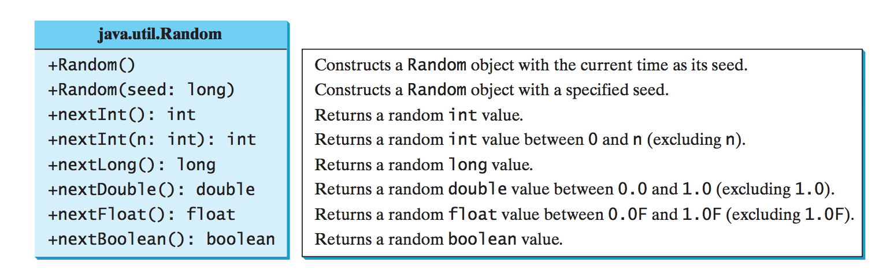
Random Class
This UML shows the constructors and the methods of the Random class.
It has two constructors, a default constructors which uses a default seed (current time elapsed), and second constructor which uses a specified seed.
A seed is used for consistency, if two objects of the Random class has the same seed, they generate the same sequence of random numbers.

Slide 18
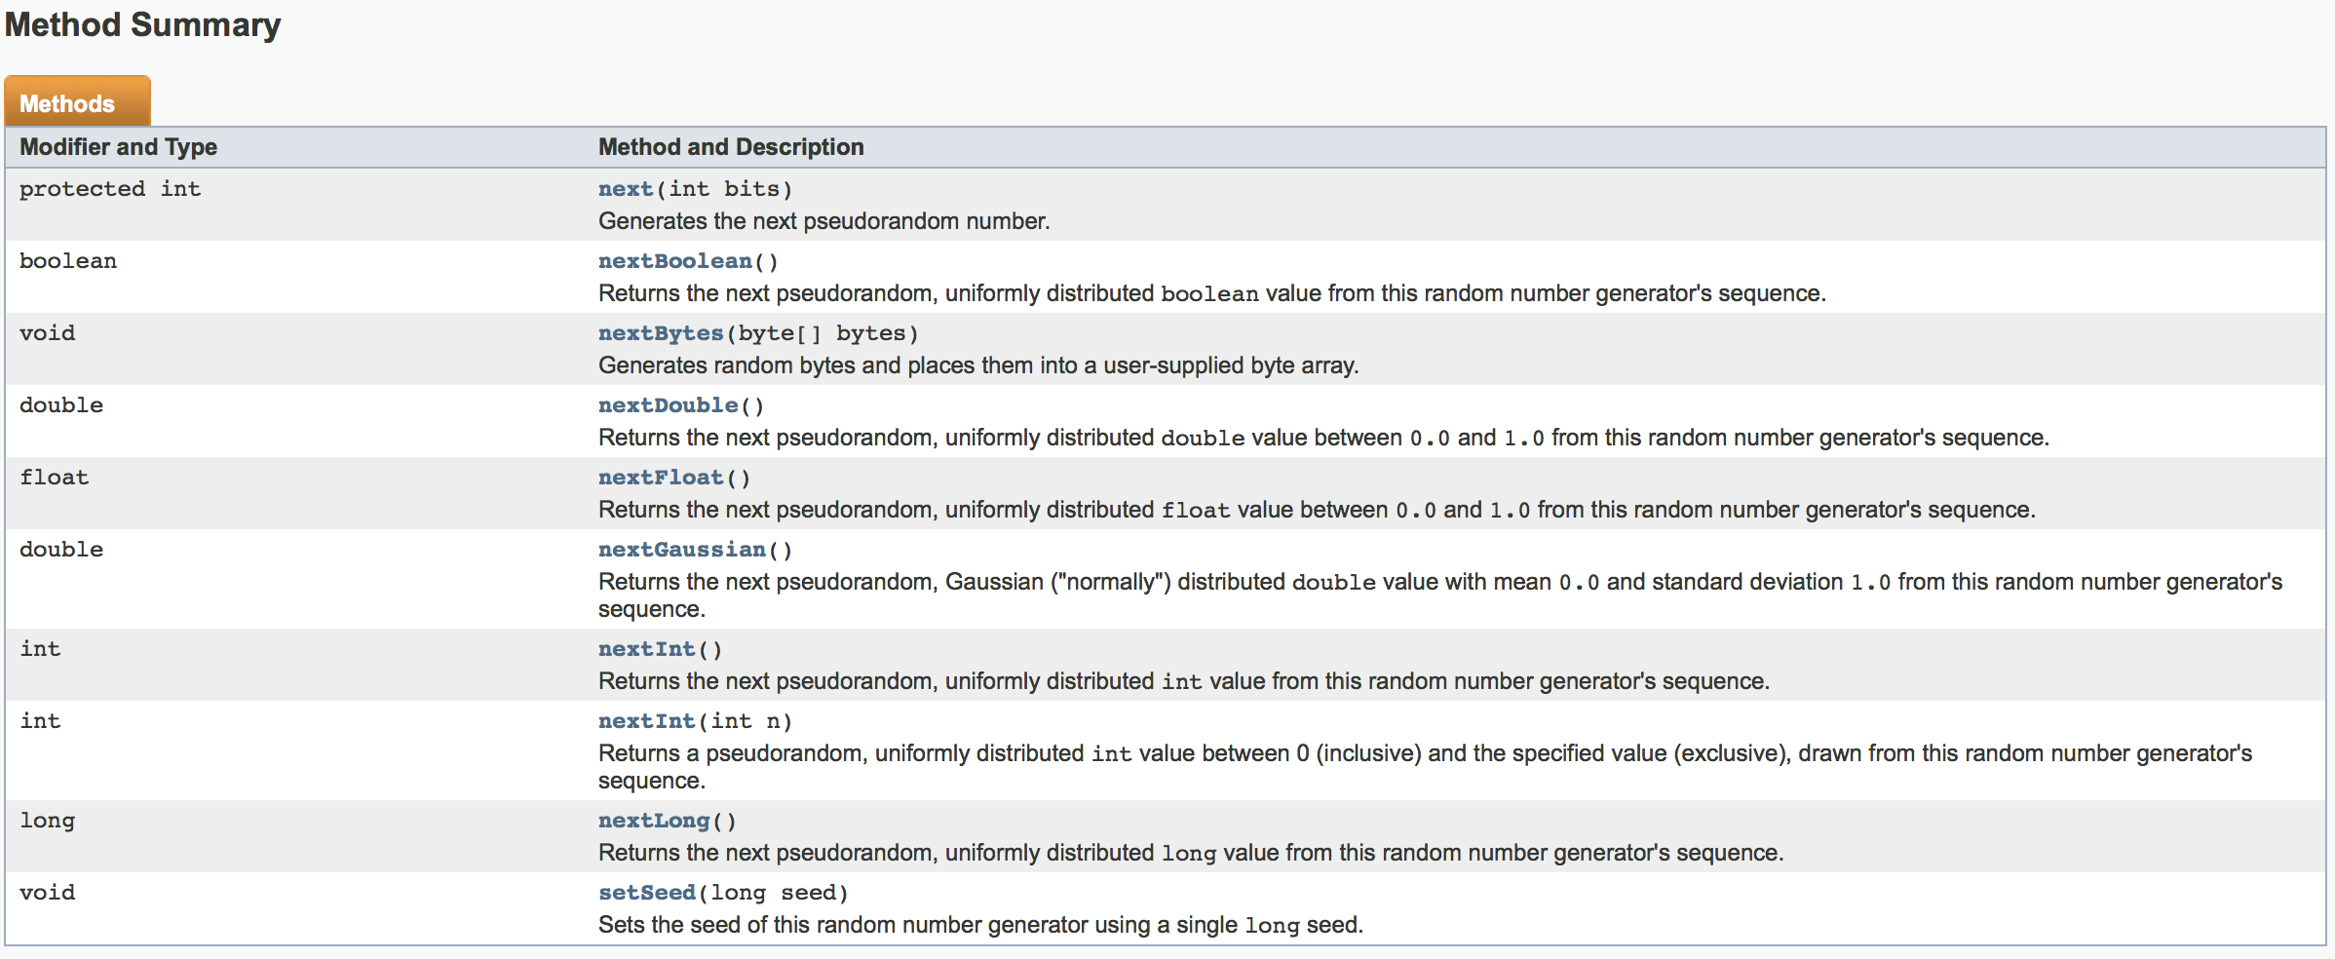

Slide 19
Random Class
Default Seed
import java.util.Random;
public class Rands
{
public static void main(String[] args)
{
Random rand1 = new Random();
System.out.println("Using rand1: ");
for(int i = 1; i < 7; i++)
{
int r = rand1.nextInt(1000);
System.out.println(r);
}
System.out.println();
Random rand2 = new Random();
System.out.println("Using rand2: ");
for(int i = 1; i < 7; i++)
{
int r = rand2.nextInt(1000);
System.out.println(r);
}
}
}
Output:
Using rand1:
542
321
973
351
281
151
Using rand2:
351
690
245
858
913
709

Slide 20
Random Class
Specified Seed
import java.util.Random;
public class Rands
{
public static void main(String[] args)
{
Random rand1 = new Random(3);
System.out.println("Using rand1: ");
for(int i = 1; i < 7; i++)
{
int r = rand1.nextInt(1000);
System.out.println(r);
}
System.out.println();
Random rand2 = new Random(3);
System.out.println("Using rand2: ");
for(int i = 1; i < 7; i++)
{
int r = rand2.nextInt(1000);
System.out.println(r);
}
}
}
Output:
Using rand1:
734
660
210
581
128
202
Using rand2:
734
660
210
581
128
202

Slide 21
The Math Class
Java provides many useful methods in the Math class for performing common mathematical functions.
  java.lang.Math
See Java docs for list of methods in the Math class.
It has private constructor, which means it can’t be used outside of the class.
Then how can we use it? They are Static

Slide 22
The LocalDateTime Class
The book introduces the Date class as a way to get the date and the time, however, most of the constructors and methods of the Date class are now deprecated.
Another way to get the date and the time is to use the LocalDateTime class.
  java.time.LocalDateTime
The LocalDateTime class has many useful methods to work with such as: getYear(), getMonthValue(), getDayOfMonth(), getHour(), getMinute(), getSecond()
The LocalDateTime has private constructors, which means you can’t create an object of this class, so we have to use a static method that returns an object of the class. now()

Slide 23
LocalDateTime Class
import java.time.LocalDateTime;
public class DateTimeExamples
{
public static void main(String[] args)
{
LocalDateTime date = LocalDateTime.now();
int year = date.getYear();
int month = date.getMonthValue();
int day = date.getDayOfMonth();
int hour = date.getHour();
int minute = date.getMinute();
int second = date.getSecond();
System.out.print("Date: ");
System.out.println(month + "/" + day + "/" + year);
System.out.print("Time: ");
System.out.println(hour + ":" + minute + ":" + second);
}
}
Output:
Date: 9/12/2017
Time: 8:15:29

Slide 24



Slide 25
Practice Problem:
What is the exact output of this program?
public class Tracing
{
private int x;
private int y;
public static int zz = 0;
public Tracing(int x, int y)
{
this.x = x;
this.y = y;
zz += this.x + this.y;
}
public int getX()
{
return this.x;
}
public int getY()
{
return this.y;
}
public void setX(int x)
{
this.x = x;
}
public void setY(int y)
{
this.y = y;
}
}
public class TestTracing
{
public static void main(String[] args)
{
Tracing t1 = new Tracing(2, 5);
Tracing t2 = new Tracing(-1, -7);
Tracing[] tArray = {t1, t2, new Tracing(0, 12)};
for (int i = 0; i < tArray.length; i++)
{
System.out.print("Index " + i + ": ");
System.out.println();
System.out.print("x: " + tArray[i].getX());
System.out.println();
System.out.println("y: " + tArray[i].getY());
System.out.println();
}
System.out.println("z: " + Tracing.zz);
}
}

Slide 26
Tracing work:
public class TestTracing
{
public static void main(String[] args)
{
Tracing t1 = new Tracing(2, 5);
Tracing t2 = new Tracing(-1, -7);
Tracing[] tArray = {t1, t2, new Tracing(0, 12)};
for (int i = 0; i < tArray.length; i++)
{
System.out.print("Index " + i + ": ");
System.out.println();
System.out.print("x: " + tArray[i].getX());
System.out.println();
System.out.println("y: " + tArray[i].getY());
System.out.println();
}
System.out.println("z: " + Tracing.zz);
}
}
stack: main
Heap:
x: 2
y: 5
t1
x: -1
y: -7
t2
x: 0
y: 12
Output:
Index 0:
x: 2
y: 5
tArray
{ , , }
Index 1:
x: -1
y: -7
zz:
0
7
-1
11
Index 2:
x: 0
y: 12
i:
0
1
2
3
z: 11

Slide 27
That’s all for today

