Slide 1
Lecture: 6
Thinking in Objects
The String Class (10.10)

Slide 2
The char data type
A char data type represents a single character. It can be a upper/lower case letter, digit, space, punctuation mark or anything similar.
To declare and initialize a char:
char firstLetter = 'a';
char firstDigit = '9';
Note that we use a single quotation marks.

Slide 3
How to use the char variables
To declare a variable:
char firstLetter = 'A';
char secondLetter = 'B';
To display a character.
public class CharExamples
{
public static void main(String[] ags)
{
char firstLetter = 'A';
char secondLetter = 'B';
System.out.println(firstLetter);
System.out.println(secondLetter);
}
}
Output
A
B

Slide 4
The String class
A string is a sequence of characters.
To represent a string of characters, we use the data type called String.
How to declare a String?
String s = "Welcome To Java";
Note that the first index is 0 and the last index is the length of the String - 1
0 | 1 | 2 | 3 | 4 | 5 | 6 | 7 | 8 | 9 | 10 | 11 | 12 | 13 | 14
s
W | e | l | c | o | m | e |  | T | o |  | J | a | v | a

Slide 5
The String class
The String class has 13 (+2 deprecated) constructors and more than 60 methods for manipulating strings.
A string object is immutable, It’s content cannot be changed once the string is created.
String s = "Java";
s = "HTML";
Java
s
HTML

Slide 6
How to create a String
Java is fun
s1
String s1 = "Java is fun";
String s2 = new String("Java is fun");
String s3 = "Java is fun";
s1 and s3 are called interned strings, JVM does that to improve efficiency and save memory.
char[] c = {'J', 'A', 'V', 'A'};
String s4 = new String(c);
s3
Java is fun
s2
JAVA
s4

Slide 7
How to create a String
Java is fun
s1
String s1 = "Java is fun";
String s2 = new String("Java is fun");
String s3 = "Java is fun";
System.out.println(s1 == s3);
System.out.println(s1 == s2);
System.out.println(s1.equals(s3));
System.out.println(s1.equals(s2));
s3
Java is fun
s2
true
false
true
true

Slide 8
How to display a String
public class StringExamples
{
public static void main(String[] args)
{
String s = "Java is fun";
System.out.println(s);
}
}
Output
Java is fun

Slide 9
How to concatenate Strings
public class StringExamples
{
public static void main(String[] args)
{
String s1 = "Java ";
String s2 = "is ";
String s3 = "fun";
String s = s1 + s2 + s3;
System.out.println(s);
}
}
Output
Java is fun

Slide 10
How to concatenate Strings
public class StringExamples
{
public static void main(String[] args)
{
String s1 = "Java ";
String s3 = "fun";
System.out.println(s1 + "is " + s3);
}
}
Output
Java is fun

Slide 11
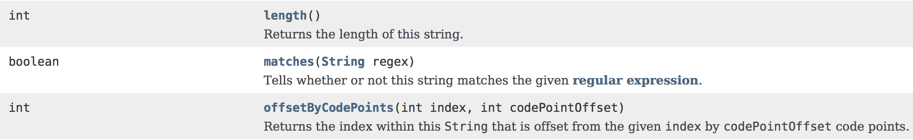
The length of a String
To process a String, most of the times we need to know the length of that String.
The String class has a method that returns the length of a String.
The method takes no parameters and returns an int.

Slide 12
The length of a String
public class StringExamples
{
public static void main(String[] args)
{
String s1 = "Java is fun";
System.out.println(s1.length());
}
}
Output
11

Slide 13
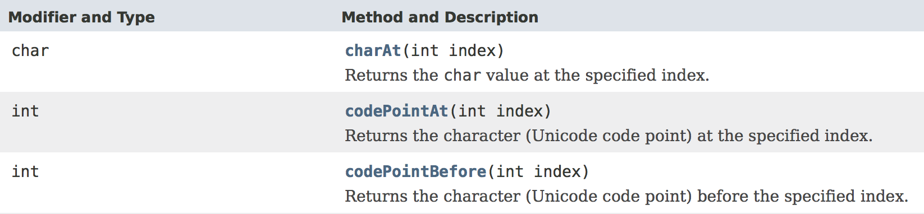
The charAt()Method
The method takes one integer parameter, and returns a single character char, the returned character is the character at the specified index.

Slide 14
The charAt()Method
Output
public class StringExamples
{
public static void main(String[] args)
{
String s1 = "Java is fun";
char c1 = s1.charAt(9);
char c2 = s1.charAt(2);
System.out.println(c1);
System.out.println(c2);
}
}
u
v

Slide 15
The charAt()Method
Output
public class StringExamples
{
public static void main(String[] args)
{
String s1 = "Java is fun";
for(int i = 0; i < s1.length(); i++)
{
System.out.println(s1.charAt(i));
}
}
}
J
a
v
a
i
s
f
u
n

Slide 16
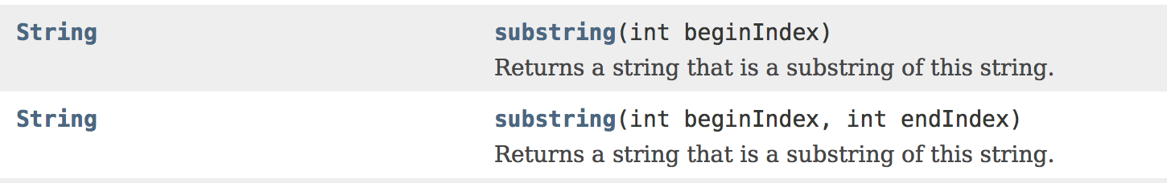
The substring()Method
The method takes one integer parameter, and returns a new string that is a sub string of the original string, starting at the specified index, and all the way to the end.

Slide 17
The substring()Method
Output
public class StringExamples
{
public static void main(String[] args)
{
String s1 = "Java is fun";
String s2 = s1.substring(5);
System.out.println(s2);
}
}
is fun

Slide 18
The substring()Method
The overloaded version of substring() method takes two integer parameters n and m, and returns a new string that is a sub string of the original string, starting at index n , and all the way up to (BUT NOT INCLUDING) m.

Slide 19
The substring()Method
Output
public class StringExamples
{
public static void main(String[] args)
{
String s1 = "Java is fun";
String s2 = s1.substring(1, 3);
System.out.println(s2);
}
}
av

Slide 20
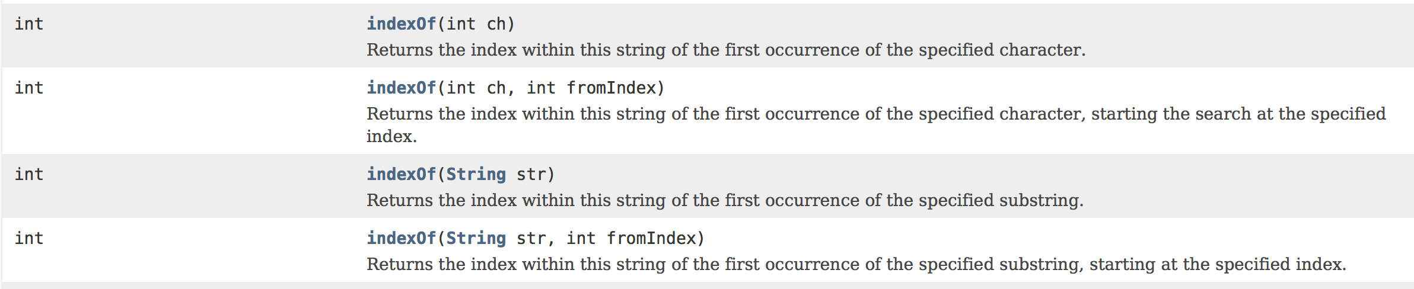
The indexOf()Method
The method takes a character or String and returns an integer, which is the index of the first occurrence of the specified character or String.
If that character o String doesn’t exist, the method returns -1.

Slide 21
The indexOf()Method
public class StringExamples
{
public static void main(String[] args)
{
String s1 = "Banana";
int n1 = s1.indexOf('a');
int n2 = s1.indexOf("na");
int n3 = s1.indexOf('x');
int n4 = s1.indexOf("re");
System.out.println(n1);
System.out.println(n2);
System.out.println(n3);
System.out.println(n4);
}
}
Output
1
2
-1
-1

Slide 22
The indexOf()Method
The other version of this method takes a character or String AND an integer n and returns an integer, which is the index of the first occurrence of the specified character or String starting at the index n.
If that character o String doesn’t exist after the starting, the method returns -1.

Slide 23
The indexOf()Method
public class StringExamples
{
public static void main(String[] args)
{
String s1 = "Banana";
int n1 = s1.indexOf('a', 2);
int n2 = s1.indexOf("na", 3);
int n3 = s1.indexOf('B', 2);
int n4 = s1.indexOf("Ba", 1);
System.out.println(n1);
System.out.println(n2);
System.out.println(n3);
System.out.println(n4);
}
}
Output
3
4
-1
-1

Slide 24
Converting characters and numbers to String
A number or character can be converted to a String by concatenating it with the empty String “”.
public class StringExamples
{
public static void main(String[] args)
{
int n = 5;
String s1 = "" + n;
double m = 9.5;
String s2 = m + "";
}
}
5
s1
9.5
s2

Slide 25
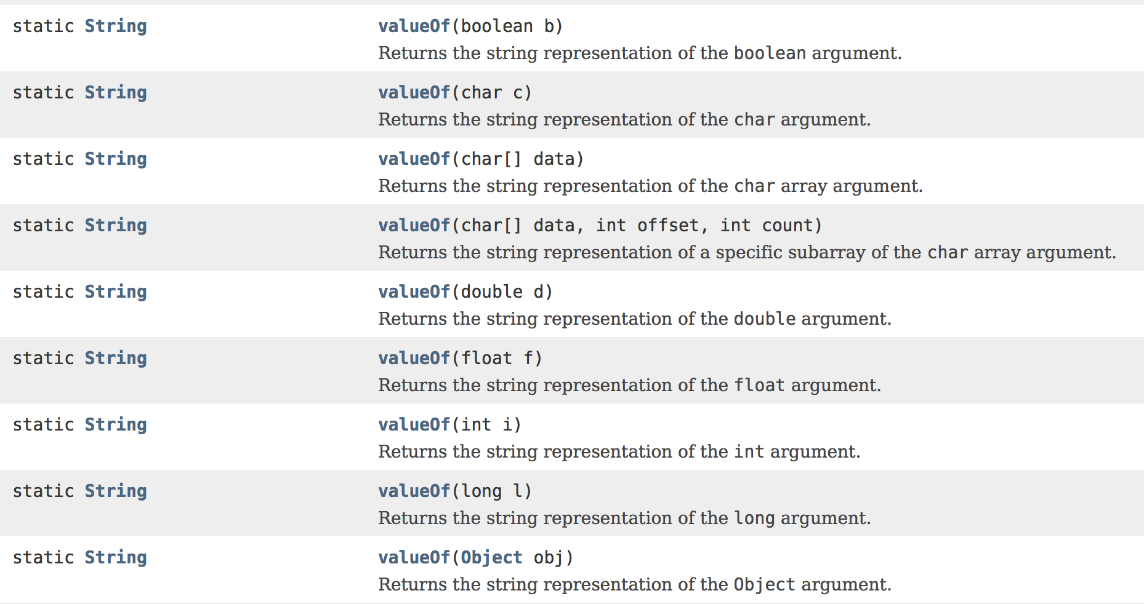
Converting characters and numbers to String
Or by using the valueOf()method and it’s overloads from the String class.

Slide 26
Converting characters and numbers to String
5
s1
public class StringExamples
{
public static void main(String[] args)
{
String s1 = String.valueOf(5);
String s2 = String.valueOf(9.3);
String s3 = String.valueOf('v');
String s4 = String.valueOf(false);
}
}
9.3
s2
v
s3
false
s4

Slide 27
See you on Thursday!

