Slide 1
Lecture: 7
Thinking in Objects
The String Class (10.10)

Slide 2
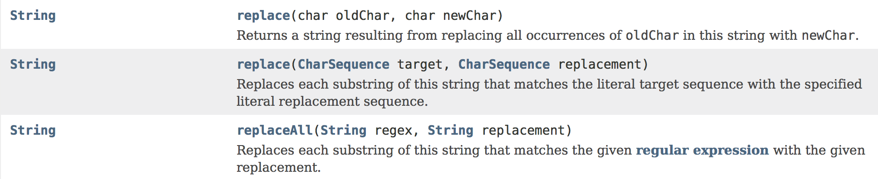
The replace()Method
The method returns a new String(object), derived from the original one with the specified character or String replaced by another character or String. (Without changing the original String).
The method can only replace:
- Character with character.
- String with a String

Slide 3
The replace()Method
Welcome
s
public class StringExamples
{
public static void main(String[] args)
{
String s = "Welcome";
String s1 = s.replace('e', 'D');
String s2 = s.replace("el", "NN");
String s3 = s.replace("e", "EEE");
s3 = s3.replace("E", "G");
}
}
WDlcomD
s1
WNNcome
s2
WEEElcomEEE
s3
WGGGlcomGGG

Slide 4
Regular Expressions
Often we need to write a code to validate user input.
We want to check if the user input matches a pattern or not.
To do so, we can use a regular expression (abbreviated regex).
A regular expression is a String that describes a pattern for matching a set of Strings.
We can match, replace or split a String based on a regular expression.

Slide 5
Regular Expressions
. (dot) Matches any single character.
* Matches zero or more occurrences of the preceding item.
+ Matches one or more occurrences of the preceding item.
{n} matches the preceding item exactly n times.
{n, m} matches the preceding item a minimum of n times and no more than m times.

Slide 6
Regular Expressions
[ ] : Character set. This pattern type matches any one of the characters in the brackets, including escape sequences. Special characters like the dot(.) and asterisk (*) are not special inside a character set, so they don't need to be escaped. You can specify a range of characters by using a hyphen.
^ : A negated or complemented character set. That is, it matches anything that is not enclosed in the brackets. You can specify a range of characters by using a hyphen. Everything that works in the normal character set also works here.
\d matches any digit from 0-9
\s matches a white space.

Slide 7
Examples
“.*” will match any String, for example: “Java”, “ANmksL93” or “KKKKKmxnx2Lp”
“[A-Z][a-z0-9]*” will match any Uppercase character followed by any number(0 or more) of Lowercase characters and digits.
“arj{5}2+m” will match any String that starts with an ‘a’ followed by an ‘r’ followed by 5 ‘j’s followed by at least one ‘2’ followed by an ‘m’
For example: “arjjjjj2m” or “arjjjjj222222m” or “arjjjjj22m”

Slide 8
Examples
“3T{2,4}GE” will match any String that starts with a ‘3’ followed by a 2 to 4 instances of ‘T’ followed by a ‘G’ followed by an ‘E’
For example: “3TTGE” or “3TTTGE” or “3TTTTGE”
“[^aeiou]+” will match any String has at least one character and doesn’t contain the characters a, e, i, o or u
“[^aeiou]*” will match any String that doesn’t contain the characters a, e, i, o or u including the empty String.

Slide 9
Example
Write a regex to validate a String that represents a social security number using regular expressions.
A valid social security number has the following pattern:
3 digits followed by a hyphen, then 2 digits followed by a hyphen, then 4 digits.
This is a valid SSN: 111-11-1111
This is an invalid SSN: 33-33-3333
"[0-9]{3}-[0-9]{2}-[0-9]{4}”
OR
"\\d{3}-\\d{2}-\\d{4}"

Slide 10
Example
Write a regex to validate a String has a dollar price format ( $dollars.cents )
A price format is a Dollar sign, followed by any number of digits, followed by a dot, followed by 2 digits.
"\\$\\d+\\.\\d{2}"
OR
"\\$[0-9]+\\.[0-9]{2}"

Slide 11
The replaceAll()Method
The method returns a new String(object), derived from the original one. The method replaces each substring of this string that matches the given regular expression.(Without changing the original String).

Slide 12
The replaceAll()Method
s
A#b@cd!
public class StringExamples
{
public static void main(String[] args)
{
String s = "A#b@cd!";
String s1 = s.replaceAll("[#@!]", "D");
String s2 = s.replaceAll("[abcd]", "MM");
String s3 = s.replaceAll("b@c", "EEE");
String s4 = s.replaceAll("[a-z]", "G");
String s5 = s.replaceAll("[a-zA-Z]", "G");
}
}
ADbDcdD
s1
s2
A#MM@MMMM!
s3
A#EEEd!
s4
A#G@GG!
s5
G#G@GG!

Slide 13
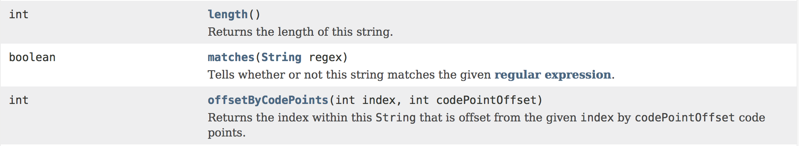
The matches()Method
The method takes a regular expression as a parameter.
The method returns a boolean value.
The method returns true if this String matches the regular expression passed in to the method, otherwise it returns false.

Slide 14
The matches()Method
s1
Java is fun
public class RegexExamples
{
public static void main(String[] args)
{
String s1 = "Java is fun";
boolean b1 = s1.matches("Java.*");
boolean b2 = s1.matches(".*Java.*");
boolean b3 = s1.matches(".*Java");
boolean b4 = s1.matches(".+Java");
String s2 = "Java2325";
boolean b5 = s2.matches("Java[0-9]*");
boolean b6 = s2.matches("Java[0-9]+");
boolean b7 = s2.matches("Java[0-9]{2}");
boolean b8 = s2.matches("Java[0-9]{5,6}");
boolean b9 = s2.matches("Java[0-9]{2,4}");
boolean b10 = s2.matches("[a-zA-Z]{4}[0-9]{2,4}");
}
}
Java2325
s2
b1: true
b2: true
b3: false
b4: false
b5: true
b6: true
b7: false
b8: false
b9: true
b10: true

Slide 15
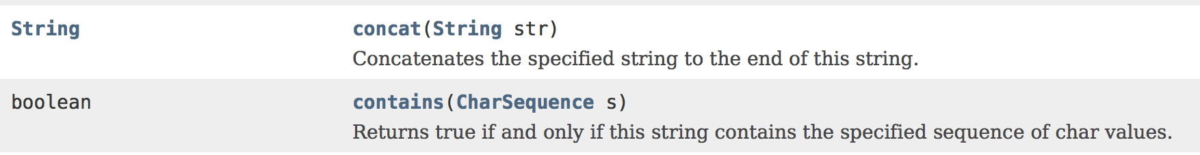
The contains()Method
The method takes a String as a parameter.
The method returns a boolean value.
The method returns true if this argument String exists in this String, otherwise it returns false.

Slide 16
The contains()Method
s1
Java is fun
public class StringExamples
{
public static void main(String[] args)
{
String s1 = "Java is fun";
boolean b1 = s1.contains("av");
boolean b2 = s1.contains("si");
boolean b3 = s1.contains(" Java");
boolean b4 = s1.contains("fun");
String s2 = "Java2325";
boolean b5 = s2.contains("232");
boolean b6 = s2.contains("a25");
boolean b7 = s2.contains("a2325");
boolean b8 = s2.contains("Java");
}
}
Java2325
s2
b1: true
b2: false
b3: false
b4: true
b5: true
b6: false
b7: true
b8: true

Slide 17
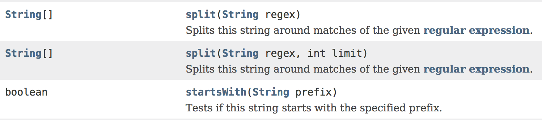
The split()Method
A very useful technique to split this string around a delimiter or matches of the given regular expression.
It returns a String array.

Slide 18
The split()Method
public class StringExamples
{
public static void main(String[] args)
{
String s1 = "ABC,DEF,NNN";
String[] sp1 = s1.split(",");
}
}
s1
ABC,DEF,NNN
sp1
ABC | DEF | NNN

Slide 19
The split()Method
public class StringExamples
{
public static void main(String[] args)
{
String s1 = "Javad2fisd5galwaysp4nfun";
String[] sp1 = s1.split("[a-zA-Z][0-9][a-zA-Z]");
}
}
s1
Javad2fisd5galwaysp4nfun
sp1
Java | is | always | fun

Slide 20
The split()Method
public class StringExamples
{
public static void main(String[] args)
{
String s1 = "12,43,3,6";
String[] sp1 = s1.split(",", 2);
}
}
s1
12,43,3,6
sp1
12 | 43,3,6

Slide 21
The split()Method
public class StringExamples
{
public static void main(String[] args)
{
String s1 = "12,43,3,6";
String[] sp1 = s1.split(",", 3);
}
}
s1
12,43,3,6
sp1
12 | 43 | 3,6

Slide 22
public class StringExamples
{
public static void main(String[] args)
{
String s = "CBBSBB2BB0BB7-BBSummerBB17";
String[] sp1 = s.split("BB");
for(int i = 0; i < sp1.length; i++)
{
System.out.print(sp1[i]);
}
}
}
Output
CS207-Summer17

Slide 23
Example
Write a program to check if a String has a dollar price format ( $dollars.cents ) using regular expressions.
Sample usage provided below:
Output
Output
Enter a price: $16.95
Valid price value
There was a dollar sign
Enter a price: 136.07
Valid price value
There was NO dollar sign
Output
Enter a price: $16.955
Not a valid price value

Slide 24
import java.util.Scanner;
public class PriceValue
{
public static void main(String[] args)
{
Scanner kbd = new Scanner(System.in);
double dollarsAndCents = 0;
System.out.print("Enter a price: ");
String s1 = kbd.nextLine();
if(s1.matches("\\$\\d+\\.\\d{2}"))
{
System.out.println("Valid price value");
System.out.println("There was a dollar sign");
}
else if(s1.matches("\\d+\\.\\d{2}"))
{
System.out.println("Valid price value");
System.out.println("There was NO dollar sign");
}
else
{
System.out.println("NOT a valid price value");
}
}
}

Slide 25
Example
Write a program to check if a String represents a social security number using regular expressions.
Sample usage provided below:
Output
Enter a Social Security Number: 444-55-9039
Valid!
Output
Enter a Social Security Number: 444-5-9039
Not Valid!

Slide 26
import java.util.Scanner;
public class SSN
{
public static void main(String[] args)
{
Scanner kbd = new Scanner(System.in);
System.out.print("Enter a Social Security Number: ");
String s1 = kbd.nextLine();
if(s1.matches("\\d{3}-\\d{2}-\\d{4}"))
{
System.out.println("Valid!");
}
else
{
System.out.println("Not Valid!");
}
}
}

Slide 27
That’s all for today!

