Slide 1
Lecture: 8
Inheritance
Chapter 11, Sections 1-2

Slide 2
Inheritance
Suppose we have to design a class that models a geometric shapes such as circles, rectangles triangle and a hexagon.
Those shapes have a lot in common.
They can be drawn in a certain color, they can be filled or unfilled.
Is there a way to do that without redundant data?
Yes, by using inheritance!

Slide 3
Inheritance
Object oriented programming allows you to define new classes from existing classes.
This is call inheritance.
Inheritance enables you to define a general class(superclass) and later extend it to more specific classes(subclasses).
By using inheritance, you will be able to share code between classes and provide services that can be used by multiple classes.

Slide 4
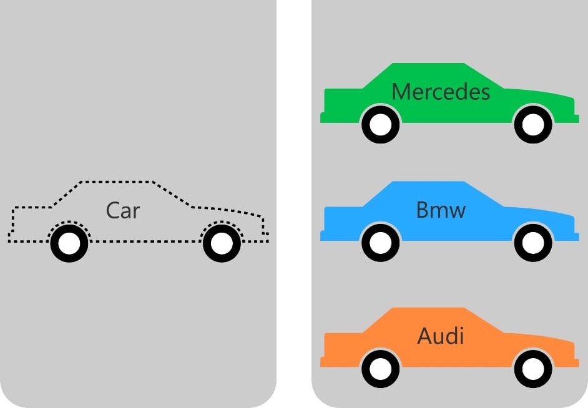
Inheritance

Slide 5



Inheritance

Slide 6
Inheritance
Shape
Super Class
Circle
Rectangle
Triangle
Sub Classes

Slide 7
Inheritance
Cat, Dog and Monkey are Animals.
They share some properties.
In order to reduce the redundant data, we can have all those classes to inherit from Animal.
Animal
Super Class
Cat
Dog
Monkey
Sub Classes

Slide 8
Superclass
Super Class
The most general class is called super class.
It’s created first.
Also known as base class or parent class.
Animal
Cat
Dog
Monkey

Slide 9
Subclass
Derived from the Super class
More specialized.
It inherits accessible data fields and methods from it’s superclass and may also add new data fields and methods.
Also known as a child class, a derived class or a extended class
Animal
Cat
Dog
Monkey
Sub Classes

Slide 10
Extends
If a class inherits from another class, we say that the subclass extends the superclass.
Cat extends Animal
Dog extends Animal
Monkey extends Animal
Animal
Cat
Dog
Monkey
Sub Classes

Slide 11
When to use inheritance
Super Class
IF we want to know if a class should extend another class, we have to use the “IS-A” test.
Triangle IS-A Shape
Rectangle IS-A Shape
Triangle IS-A Shape
Shape
Circle
Rectangle
Triangle

Slide 12
When to use inheritance
IF we want to know if a class should extend another class, we have to use the “IS-A” test
Cat IS-A(n) Animal
Dog IS-A(n) Animal
Monkey IS-A(n) Animal
Animal
Cat
Dog
Monkey
Sub Classes

Slide 13
super keyword
Consider the process of constructing a subclass object.
A subclass constructor can only initialize the instance variables of the subclass.
But the superclass instance variables also need to be initialized.
Unless you specify otherwise, the super class instance variables are initialized with the constructor of the superclass that has no arguments.
In order to specify another constructor, you use the super keyword.

Slide 14
super keyword
The statement super() calls the default constructor of the superclass.
The statement super(arguments) calls the constructor with the matching arguments in the superclass.
If the super() keyword is not present, the superclass no-arg constructor is invoked.

Slide 15

super keyword
Constructors are not inherited from the super class.
They are invoked by the subclass.
You can call the super class’s constructors only from the subclass constructors, methods can not call the super class constructors.
super keyword should be the first statement in the constructor.

Slide 16
super keyword
A constructor may invoke an overloaded constructor or its superclass constructor. If neither is invoked explicitly, the compiler automatically puts super() as the first statement in the constructor.
Public class B extends A
{
public B()
{
}
}
Public class B extends A
{
public B()
{
super();
}
}
Equivalent

Slide 17
Inheritance
If a class B inherits from another class A, we say that class B extends class A.
The keyword extends must be added to the class header.
A Java class may inherit from only one superclass, this is know as single inheritance.

Slide 18
Example
Let’s define a class named Animal, which has only one no-arg constructor.
The constructor will print the word “Animal”.
public class Animal
{
public Animal()
{
System.out.println("Animal");
}
}

Slide 19
Example
Let’s define another class named Cat, that extends Animal and has only one no-arg constructor.
The constructor should call the default no-arg constructor from the Animal class using the super keyword.
The constructor will print the word “Cat”.
public class Cat extends Animal
{
public Cat()
{
super();
System.out.println("Cat");
}
}

Slide 20
Example
Now, let’s create a test class named TestAnimal.
Since it’s a test class (we have to run it), we need a main method.
Inside the main method, create an object of Cat with a reference variable c1.
public class TestAnimal
{
public static void main(String[] args)
{
Cat c1 = new Cat();
}
}

Slide 21
Example
What’s is the output?
public class Animal
{
public Animal()
{
System.out.println("Animal");
}
}
public class TestAnimal
{
public static void main(String[] args)
{
Cat c1 = new Cat();
}
}
public class Cat extends Animal
{
public Cat()
{
super();
System.out.println("Cat");
}
}
Output
Animal
Cat

Slide 22
Example
What’s is the output?
public class Animal
{
public Animal()
{
System.out.println("Animal");
}
}
public class TestAnimal
{
public static void main(String[] args)
{
Cat c1 = new Cat();
}
}
public class Cat extends Animal
{
public Cat()
{
System.out.println("Cat");
}
}
Output
Animal
Cat

Slide 23
Example
Modify the Animal class as follows:
The class to have only one constructor that takes a String named s as a parameter.
The constructor will print the String s.
public class Animal
{
public Animal(String s)
{
System.out.println(s);
}
}

Slide 24
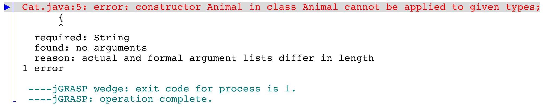
public class Animal
{
public Animal(String s)
{
System.out.println(s);
}
}
public class TestAnimal
{
public static void main(String[] args)
{
Cat c1 = new Cat();
}
}
public class Cat extends Animal
{
public Cat()
{
System.out.println("Cat");
}
}

Slide 25
Example
What’s is the output?
public class Animal
{
public Animal(String s)
{
System.out.println(s);
}
}
public class TestAnimal
{
public static void main(String[] args)
{
Cat c1 = new Cat();
}
}
public class Cat extends Animal
{
public Cat()
{
super("Animal");
System.out.println("Cat");
}
}
Output
Animal
Cat

Slide 26
Remember
Constructors are not inherited from the superclass
Private instance variables and methods are also not inherited from the superclass.
A class can inherit from ONLY one superclass, this is know as single inheritance.

Slide 27
superclass Methods
The subclass inherits all accessible methods of the superclass.
To call any method from the superclass, we use the super keyword, followed by .(dot), then the method name.
super.methodName(parameters);

Slide 28
Example
Create a class named Animal, which has a no- arg constructor, and the constructor prints the word “Animal”:
Add a public method named speak. The method takes no parameters and doesn’t return any value.
The method will print “Generic Sound”
Add a public method named walk. The method takes no parameters and doesn’t return any value.
The method will print “Walking Animal”
public class Animal
{
public Animal()
{
System.out.println("Animal");
}
public void speak()
{
System.out.println("Generic Sound");
}
public void walk()
{
System.out.println("Walking Animal");
}
}

Slide 29
Example
Let’s create another class Cat that inherits from Animal. Cat has no-arg constructor and prints the word “Cat”
Add a public method named displayInfo. The method takes no parameters and doesn’t return any value.
The method should call the speak method of the superclass, then prints “Meow”.
public class Cat extends Animal
{
public Cat()
{
super();
System.out.println("Cat");
}
public void displayInfo()
{
super.speak();
System.out.println("Meow");
}
}

Slide 30
Example
Create TestAnimal class.
Create a new object of Cat with reference variable named c1.
The object c1 should call the speak method.
public class TestAnimal
{
public static void main(String[] args)
{
Cat c1 = new Cat();
System.out.println();
c1.displayInfo();
c1.walk();
}
}

Slide 31
public class Animal
{
public Animal()
{
System.out.println("Animal");
}
public void speak()
{
System.out.println("Generic Sound");
}
public void walk()
{
System.out.println("Walking Animal");
}
}
public class Cat extends Animal
{
public Cat()
{
super();
System.out.println("Cat");
}
public void displayInfo()
{
super.speak();
System.out.println("Meow");
}
}
public class TestAnimal
{
public static void main(String[] args)
{
Cat c1 = new Cat();
System.out.println();
c1.displayInfo();
c1.walk();
}
}
Output
Animal
Cat
Generic Sound
Meow
Walking Animal

Slide 32
public class Animal
{
public Animal()
{
System.out.println("Animal");
}
public void speak()
{
System.out.println("Generic Sound");
}
public void walk()
{
System.out.println("Walking Animal");
}
}
public class Cat extends Animal
{
public Cat()
{
super();
System.out.println("Cat");
}
public void displayInfo()
{
speak();
System.out.println("Meow");
}
}
public class TestAnimal
{
public static void main(String[] args)
{
Cat c1 = new Cat();
System.out.println();
c1.displayInfo();
c1.walk();
}
}
Output
Animal
Cat
Generic Sound
Meow
Walking Animal

Slide 33


That’s all for today!

