Slide 1
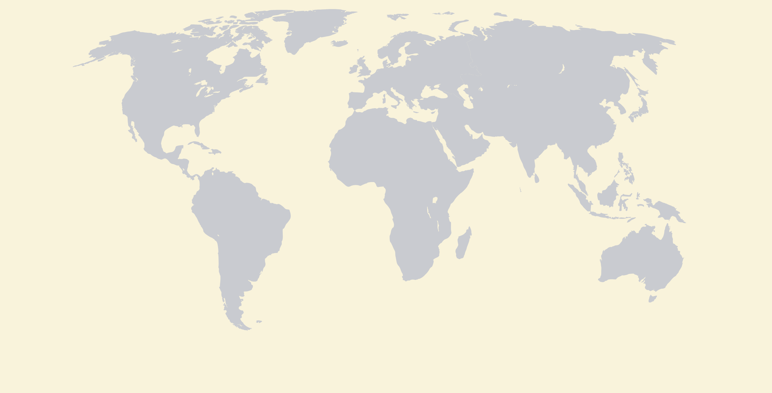
Our big, beautiful world!
There are 7 continents. Let's explore them all!

Slide 2
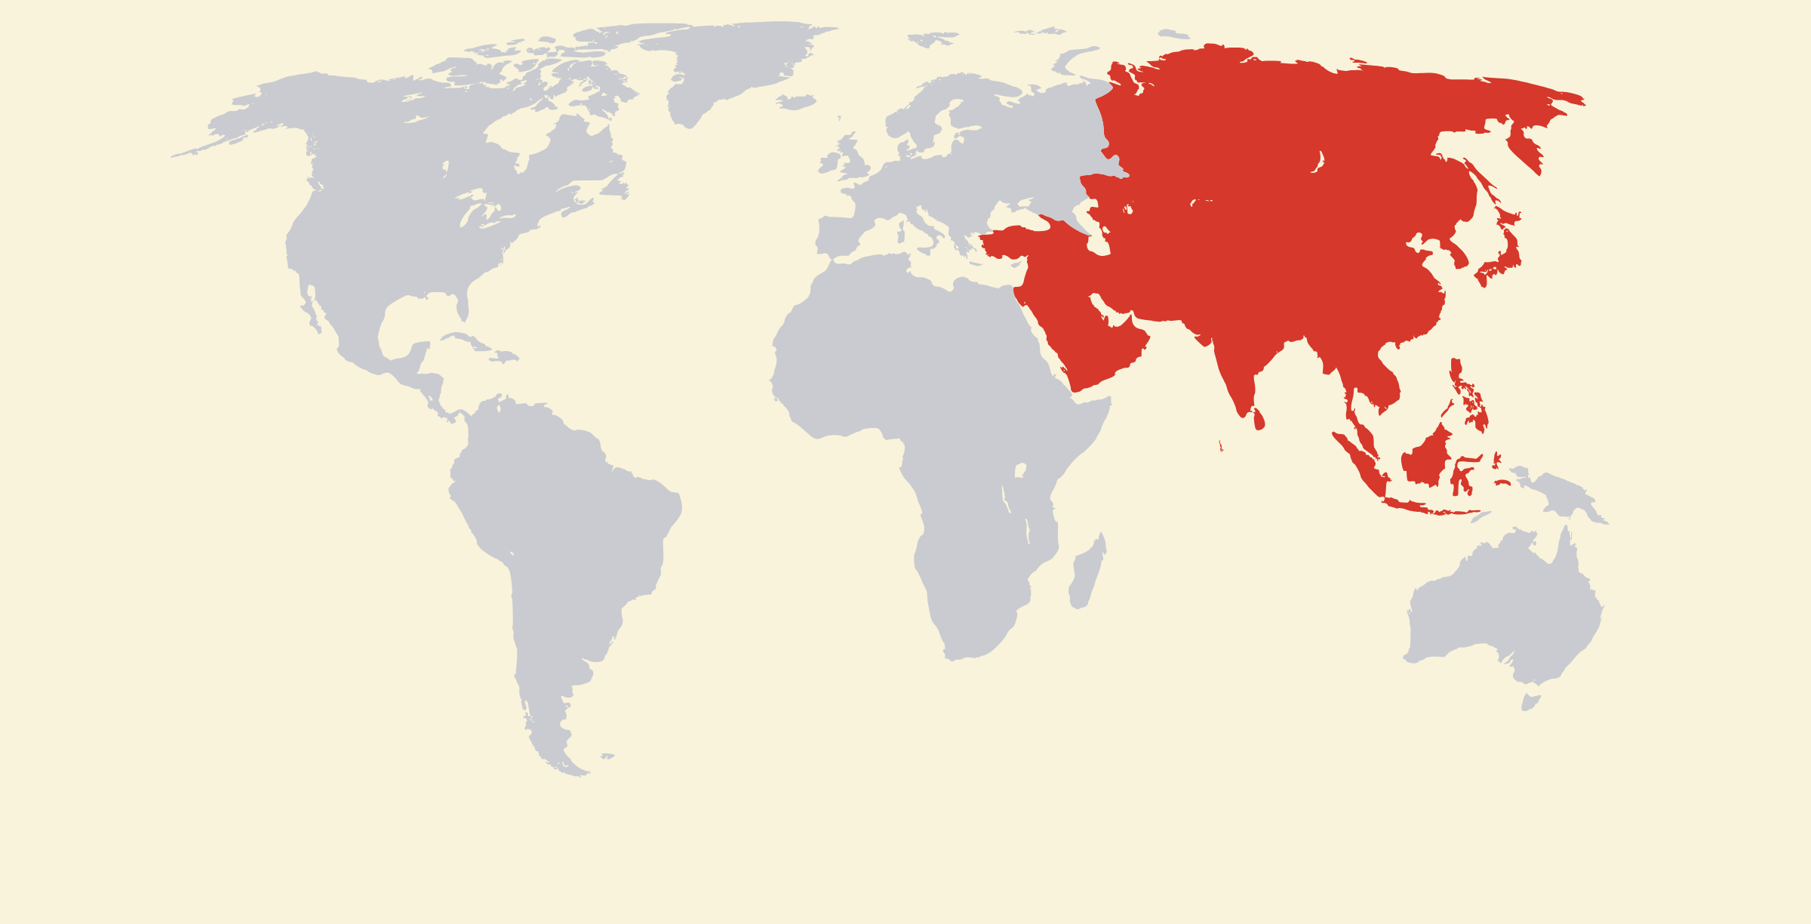
Asia
The biggest continent - home to Vietnam!

Slide 3
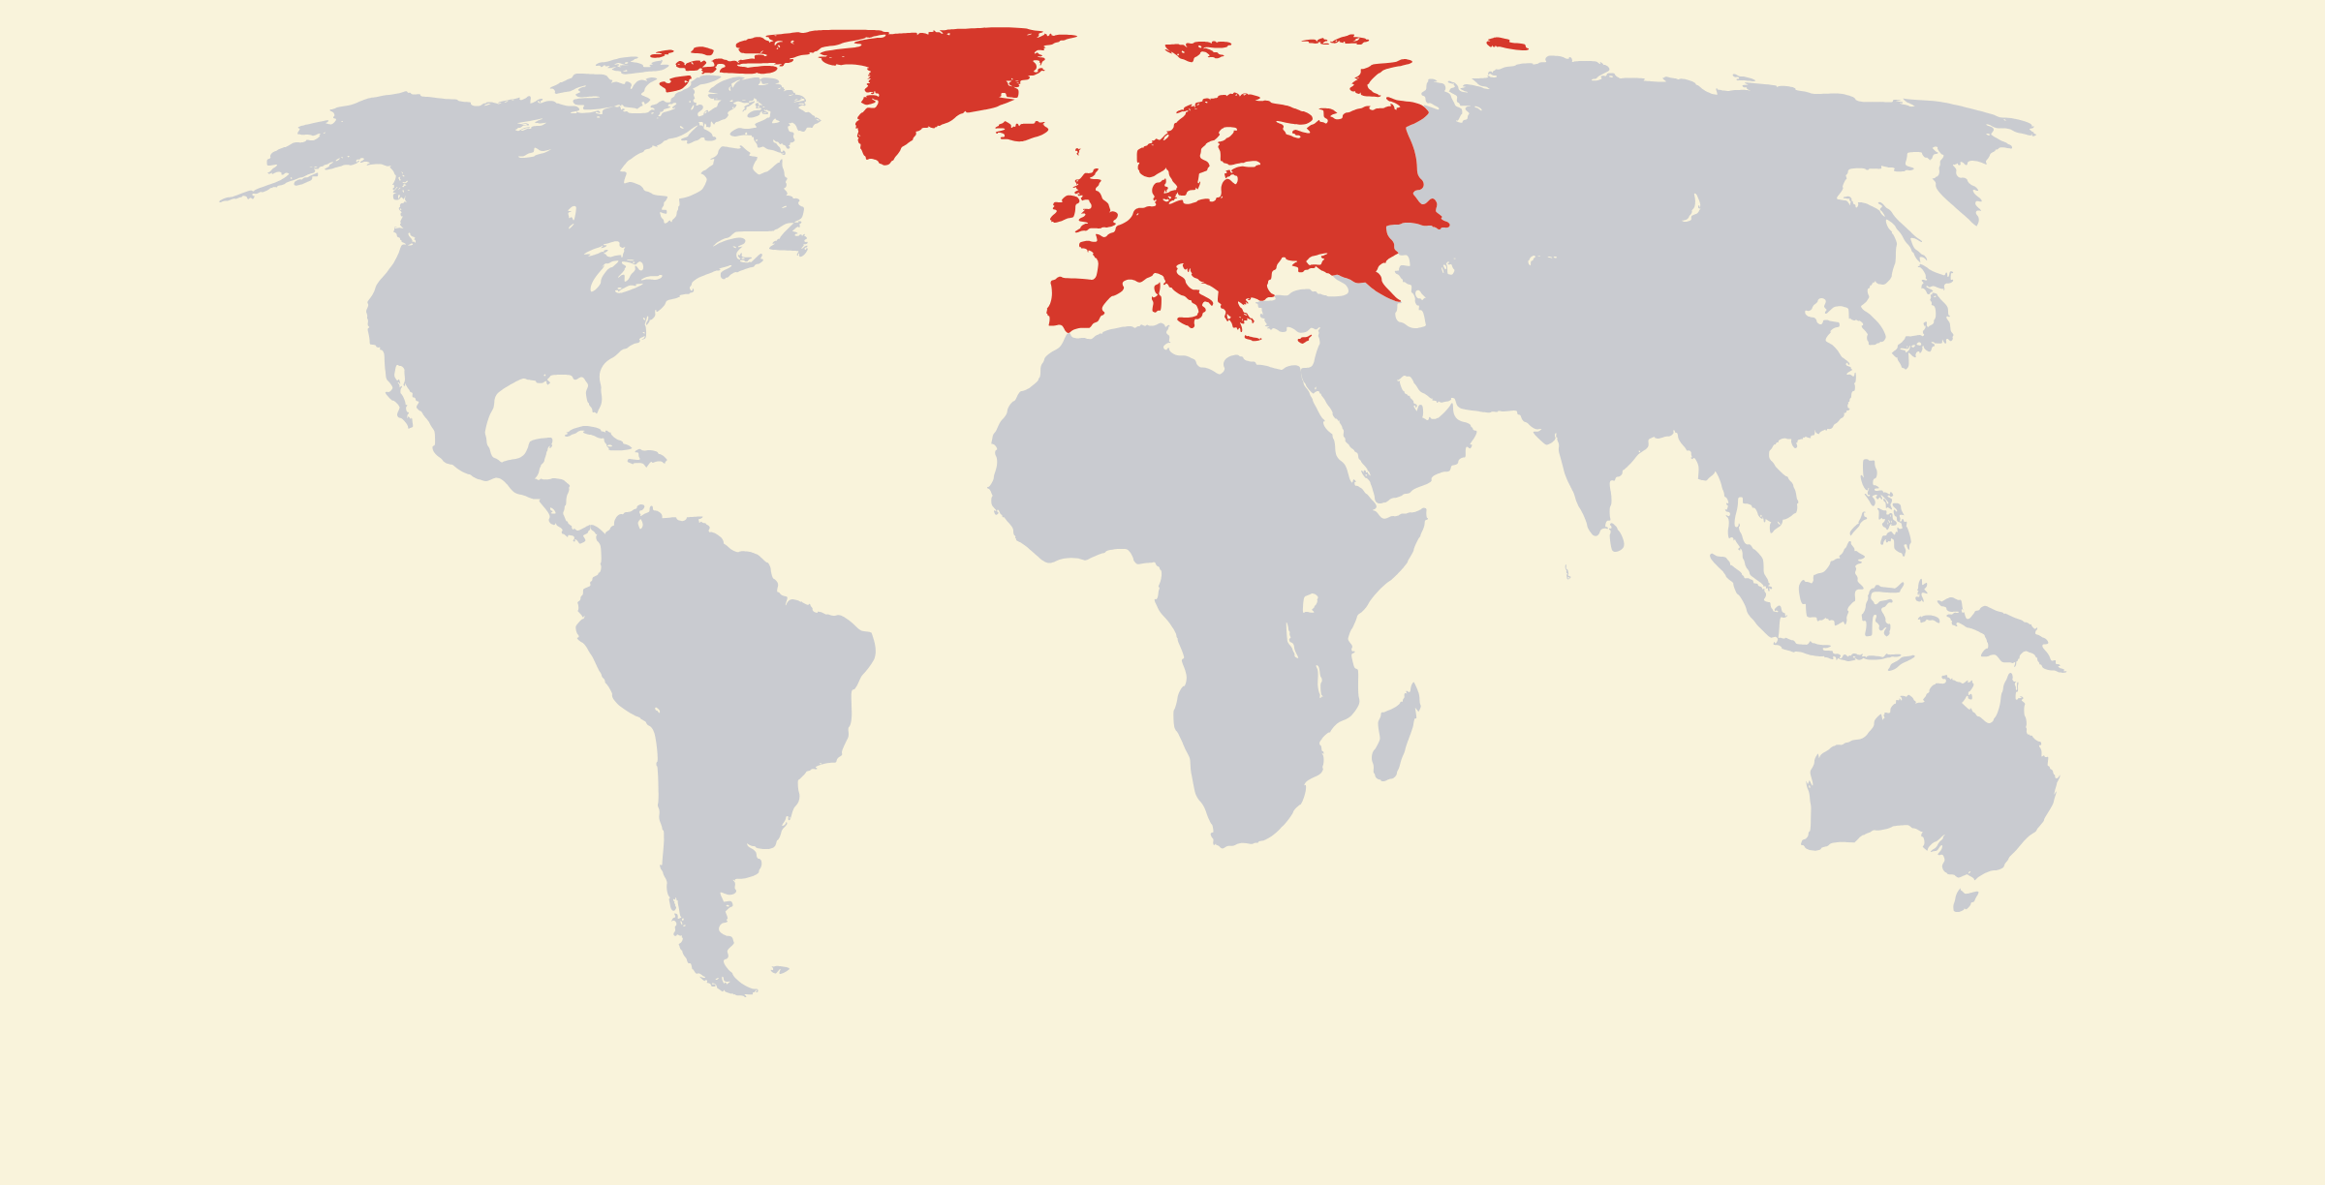
Europe
Castles, football and the Eiffel Tower!

Slide 4
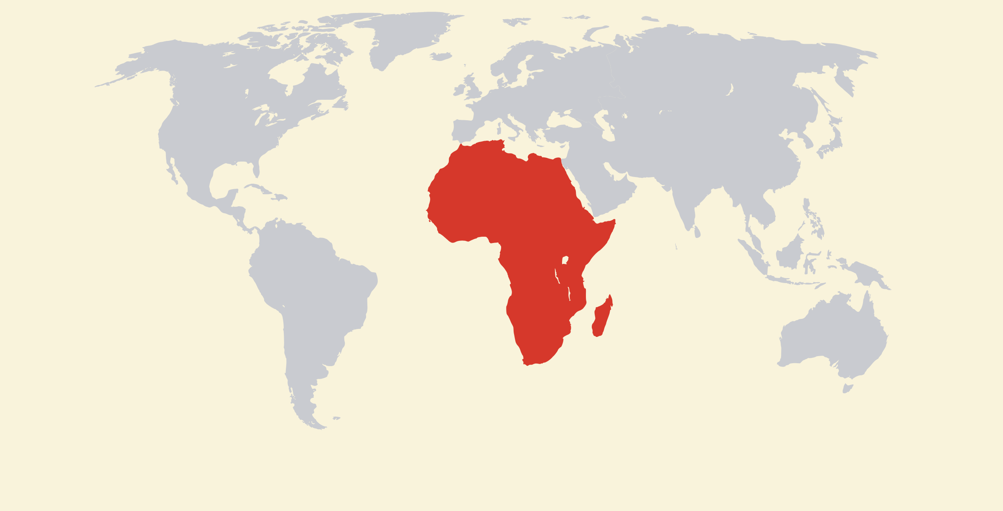
Africa
Lions, elephants and giant deserts!

Slide 5
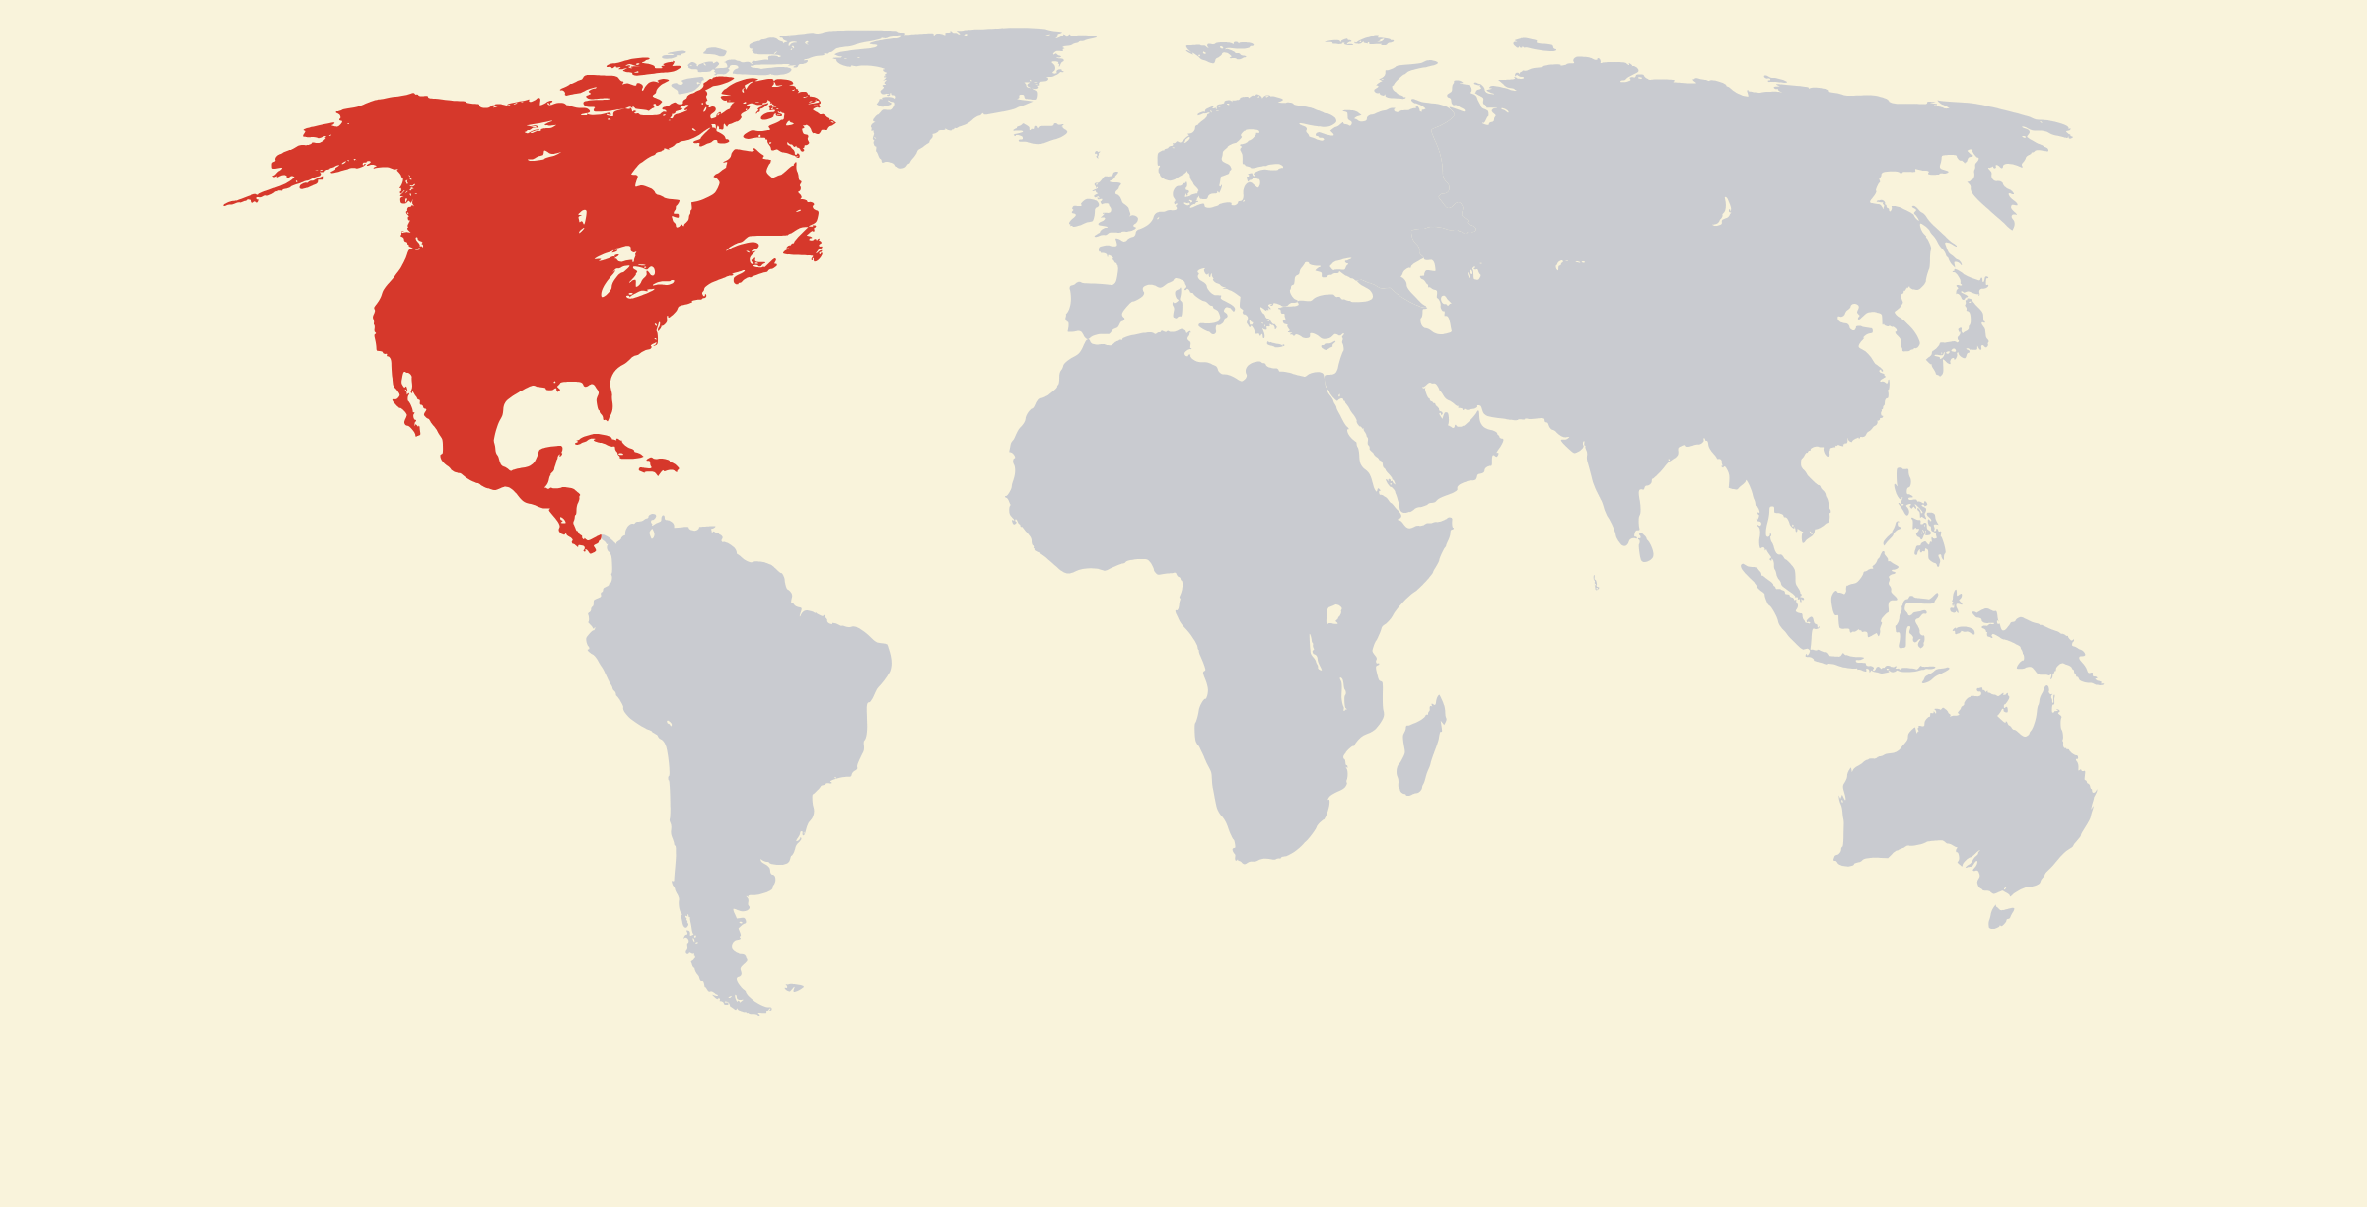
North America
Home to the USA and Canada!

Slide 6
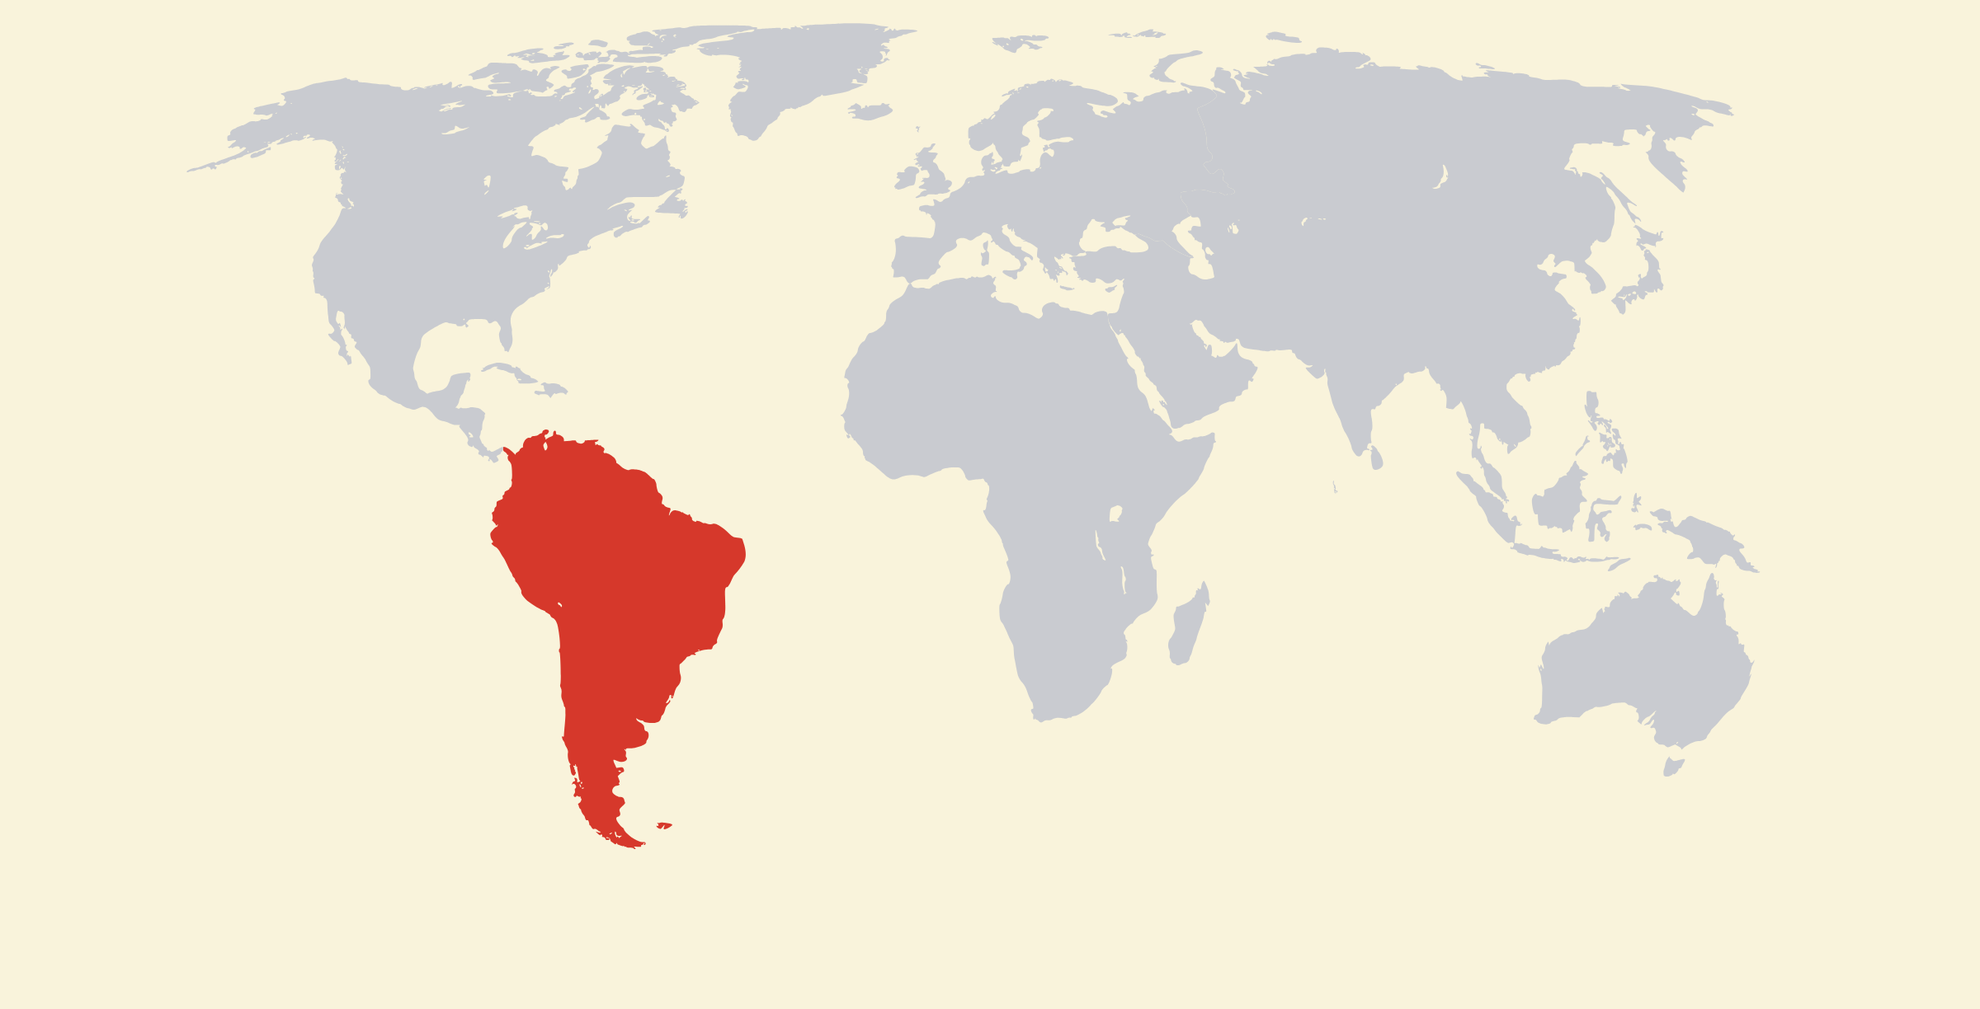
South America
Rainforests and the mighty Amazon river!

Slide 7
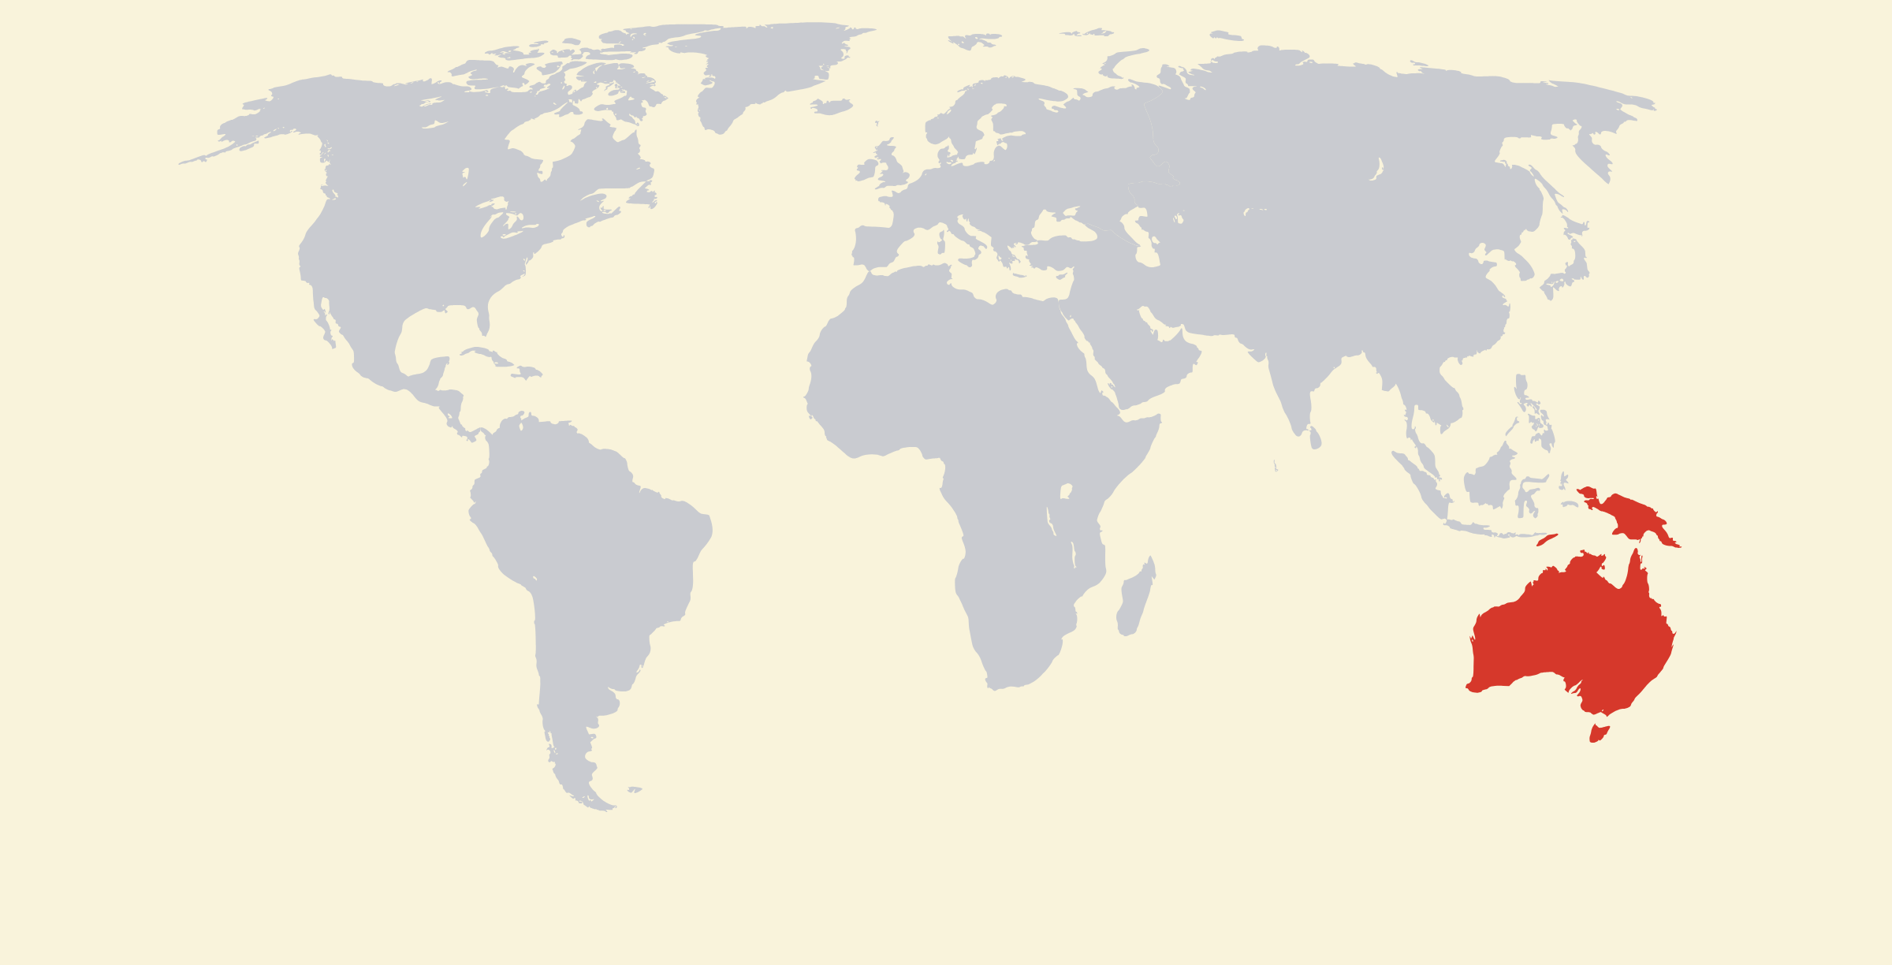
Oceania
Australia, kangaroos and sunny beaches!

Slide 8



Antarctica
The coldest, iciest continent! Brrr!
No countries here - just penguins and scientists!

Slide 9
Which continent do WE live in?
Point to the map... ready?
?

Slide 10
We live in Asia!
The biggest continent of them all.

Slide 11
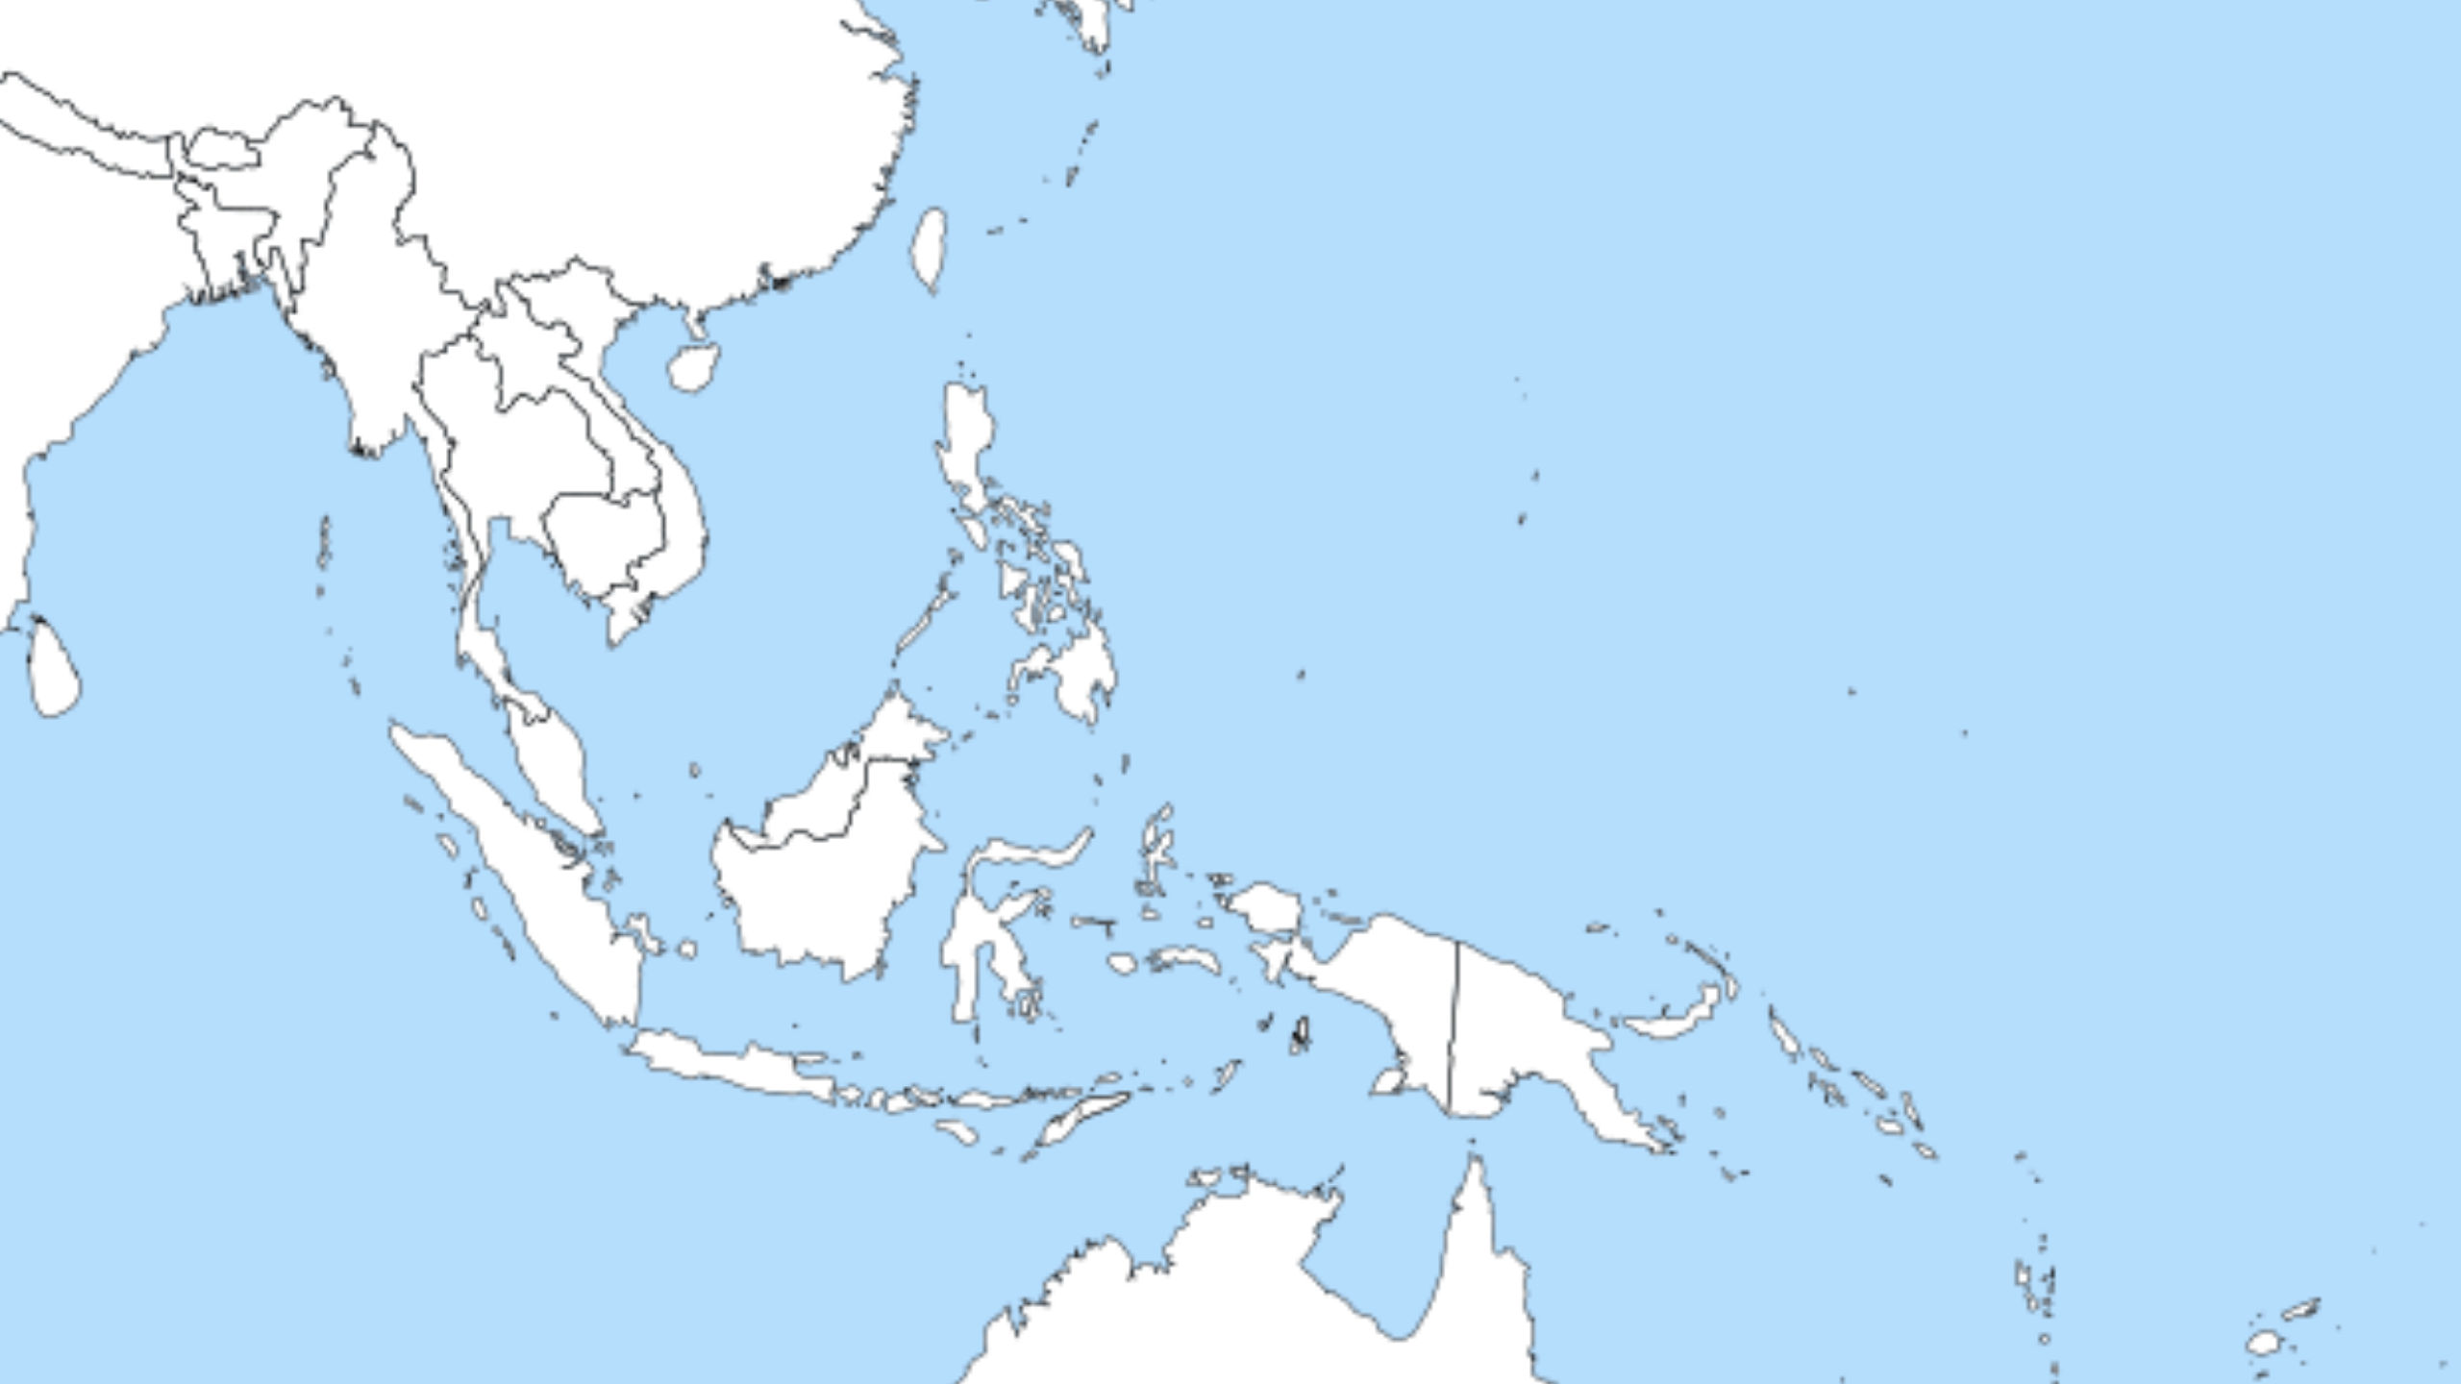
Can you find Vietnam?

Slide 12
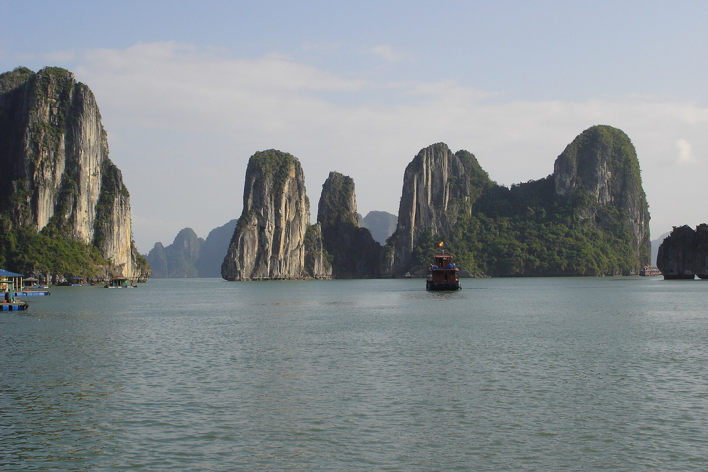


Follow Sam's journey!
This is Sam.
He is from Vietnam.
He is Vietnamese.

Slide 13


Meet Sam's friend
My first friend!
This is Lily.
She is from Singapore.
She is Singaporean.

Slide 14
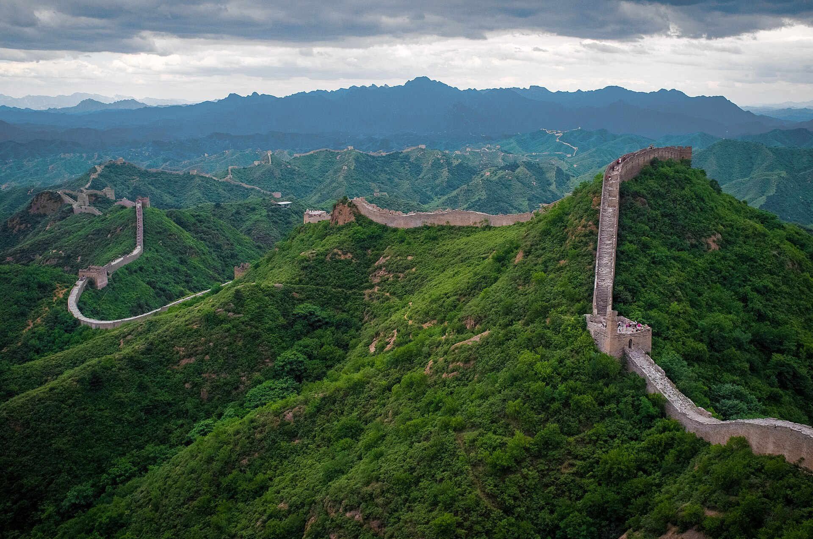
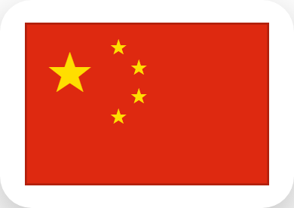
Meet Sam's friend
This is Mei.
She is from China.
She is Chinese.

Slide 15
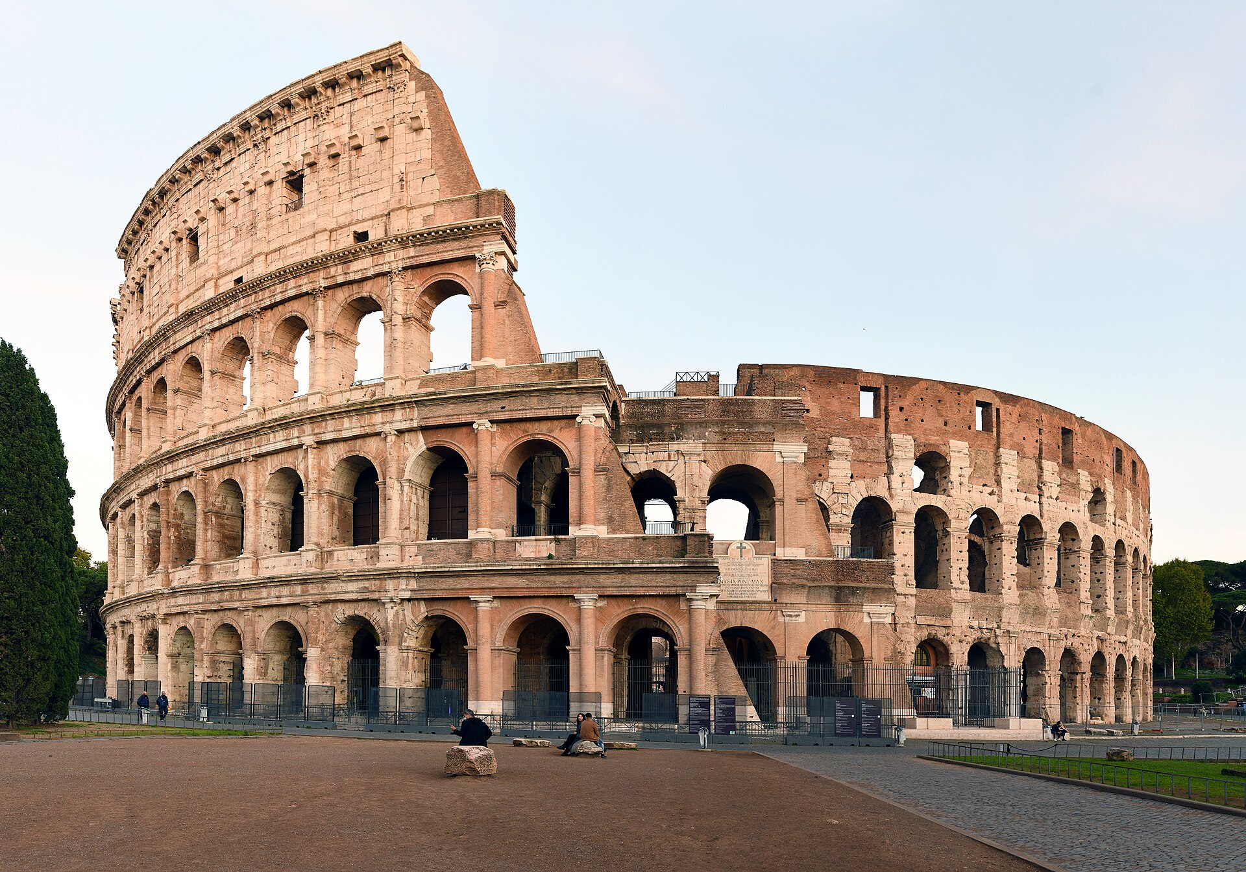

Meet Sam's friend
This is Marco.
He is from Italy.
He is Italian.

Slide 16
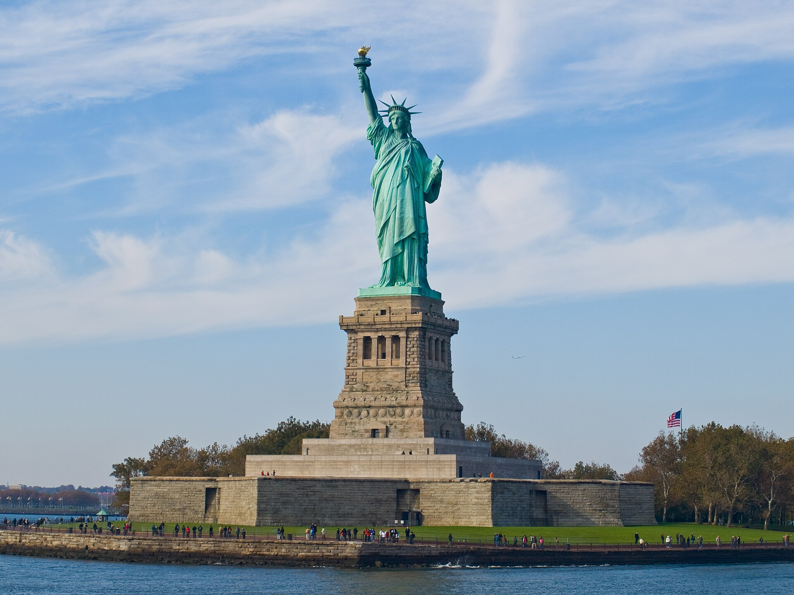

Meet Sam's friend
This is Alex.
He is from USA.
He is American.

Slide 17







Yummy food around the world!
Let's sort food into groups.

Slide 18



Fruits
(trái cây)
Apple
Banana
Orange
Watermelon

Slide 19



Vegetables
(rau củ)
Carrot
Broccoli
Tomato
Corn

Slide 20



Dairy
(bơ sữa)
Milk
Cheese
Butter
Ice cream

Slide 21



Meat & protein
(thịt)
Chicken
Beef
Egg
Bacon

Slide 22



Grains & carbs
(tinh bột)
Rice
Noodles
Bread
Potato

Slide 23


Drinks
(đồ uống)
Water
Juice
Tea
Milk

Slide 24



Seafood
(hải sản)
Fish
Prawn
Crab
Squid

Slide 25
Sam's friends share their food
Lily from Singapore
"Try our chicken rice & laksa!"

Slide 26

Sam's friends share their food
Mei from China
"Try our glass noodles & dumplings!"

Slide 27


Sam's friends share their food
Marco from Italy
"Try our pizza & pasta!"

Slide 28


Sam's friends share their food
Alex from USA
"Try our burgers & fries!"

