Slide 1
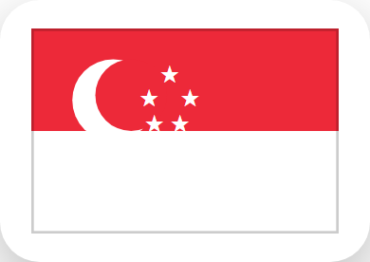
Fun Facts: Singapore!
Singapore is a tiny country that is also one big city!
Its national symbol is the Merlion - half lion, half fish!
People there speak English, Malay, Chinese and Tamil.
It's famous for yummy street food called hawker food!

Slide 2
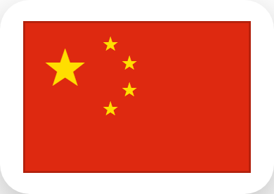
Fun Facts: China!
China is one of the oldest countries in the world!
The Great Wall of China is thousands of years old!
Giant pandas live wild in China's forests.
Chinese New Year is one of the biggest festivals on Earth!

Slide 3
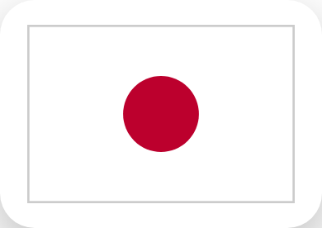
Fun Facts: Japan!
Japan is made up of thousands of islands!
Mount Fuji is Japan's tallest and most famous mountain.
Bullet trains in Japan can zoom over 300 km/h!
Sushi and ramen both come from Japan.

Slide 4
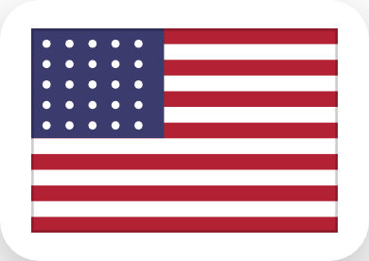
Fun Facts: USA!
The USA has 50 states from coast to coast!
The Statue of Liberty welcomes ships into New York.
Baseball and American football are super popular there.
The Grand Canyon is one of the biggest canyons on Earth!

