Slide 1


AI-Based Traffic Management Solution
Leveraging Artificial Intelligence to Optimize Traffic Flow

Slide 2
Cities experience major traffic delays, leading to
Increased fuel consumption.
Higher levels of pollution.
Significant travel time delays.
The Problem of Traffic Congestion
Traditional traffic light systems are fixed and unresponsive to real-time conditions, worsening congestion.

Slide 3
Limitations of Current Traffic Light Systems
Traditional traffic lights operate on pre-set cycles that:
Don’t adjust to real-time traffic.
Cause unnecessary delays during peak hours.
Lead to inefficient fuel usage and increased emissions.

Slide 4
Introducing Our AI-Based Solution
We propose an AI system that:
Analyzes real-time traffic data.
Dynamically adjusts traffic light timing based on vehicle flow.
Aims to reduce delays, fuel usage, and emissions.
Powered by SUMO (Simulation of Urban Mobility) to simulate and optimize traffic flow.

Slide 5
How It Works
Data Collection: Traffic sensors collect real-time data on vehicle count.
Prediction Model: AI predicts optimal traffic light phases to minimize congestion.
Dynamic Adjustment: Traffic lights are adjusted instantly based on AI decisions.
Simulation: SUMO helps simulate and refine the AI model’s impact.

Slide 6
Adaptive Data Processing:
As traffic increases, the system can process larger data volumes from additional sensors.
The AI model can be trained on more diverse data sources, improving prediction accuracy even with high traffic loads.
Distributed AI Architecture:
The system can use a distributed architecture where AI processing is handled across multiple nodes, ensuring real-time performance during peak traffic hours.
Cloud Integration:
Cloud integration enables scalable storage and processing, allowing for continuous expansion of traffic data without hardware limitations.

Slide 7
Reduced Traffic Delays: Faster travel times.
Lower Fuel Consumption: Optimized traffic flow reduces fuel use.
Environmental Impact: Lower emissions from reduced idling and traffic.
Enhanced Commuter Experience: Less stress and more predictability in travel.
Benefits of AI Traffic Control

Slide 8
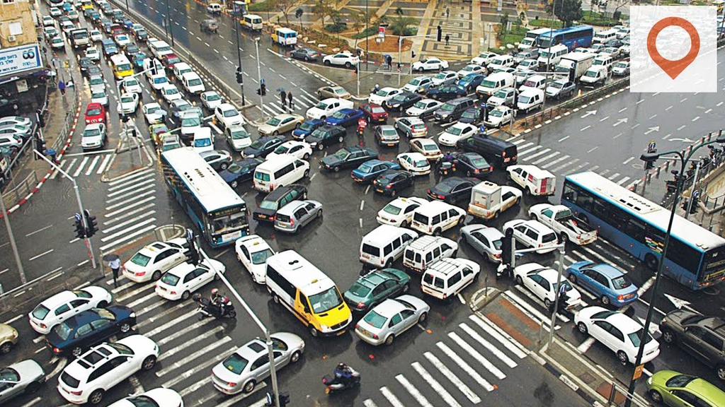
Conclusion
Our AI-driven traffic control solution offers a scalable, data-driven approach to reduce urban traffic congestion.
By integrating SUMO and AI, we can create more responsive, environmentally friendly traffic systems.
Embracing this technology is a step toward smarter cities with smoother and safer roads

Slide 9
Thank You!
-team NIL
For inquiries or further information, contact us at:
suhaebn.shaik@gmail.com
mouryas2005@gmail.com

